Slide 1
Contemporary Themes in the Hotel &Hospitality Sector (M6X01931 BIRM)
Session 4

Slide 2
Define the Goal of your event
What is your event about?
What is the purpose?
What do you want your end result to be?
How do you going to achieve it?
Is it realistic?
Be specific

Slide 3
Get Organized
Utilize worksheets
Label sections
Create folders
Create contact list

Slide 4
Timeline
Put together a timeline of your event
Set your goals
Gantts chart
Project management plan
To list
Calender

Slide 5
Communications
Meet regularly with your event planning team
Ensure that everyone that is involved know about the events goals/mission/objectives
Clear defined roles/responsibilities
Contact details of everyone in the team
Create a check list/to do
Social media accounts for your event (free marketing)

Slide 6
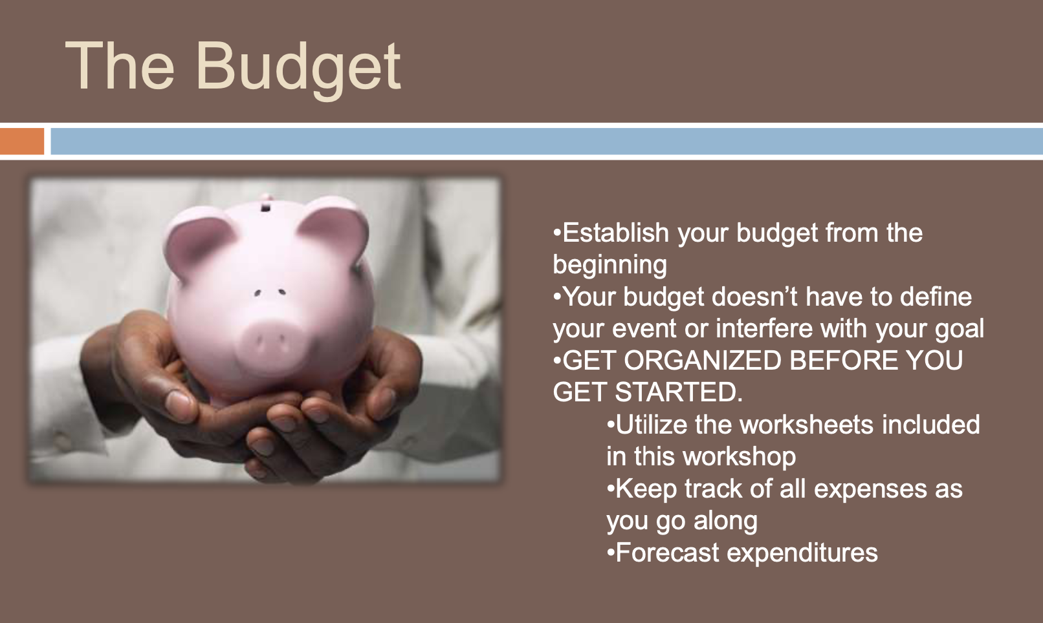
Budget
Create a budget from the start
Get organized before your start
Excel sheet
Keep track of your expenses
Forecast expenditures

Slide 7
Raising Funds
Sponsorships
Donations
Admission fees
Vendor booths
Grant
Partnerships

Slide 8
Sponsorships
Develop a valuable sponsorship plan
Make a list of potential sponsors
Explain your event’s goal to your potential sponsors
Show your sponsors ‘what’s in it for them’

Slide 9
Break
See you in 10 minutes

Slide 10
Sponsorship plan
Levels of sponsorships based on donations
Benefits
Advertising inclusion
On site promotions
PR opportunities
Space at event venue
Admission tickets

Slide 11
To avoid
Too many sponsors
Too little difference in sponsorship levels
Not delivering promise to sponsors

Slide 12
Selecting your venue
Does the venue fit the event goal?
Is accessible?
Is available?
Are the dates flexible?
Correct venue size?
What are the fees?
Parking on site?

Slide 13
Selecting your venue
Cancelation fees?
Prices negotiable?
Discounts available?
Deposit required?
What extra charges included?

Slide 14
Selecting your venue
Wi-Fi services?
Does the venue offer catering?
Can you bring your own catering?

Slide 15
Stalls/vendor booths
Does your venue allow stalls/vendors booths?
Treat your vendors as you would like your sponsors
Provide them info about the event
Rules/regulations of venue
Items needed (table, chairs, signage, extension cords etc)
Set up/tear down times

Slide 16
Advertising
Budget for advertising
Who is your target audience?
Where are they (that is where you will focus)
Social media (Facebook/LinkedIn/Twitter)
Posters (flyers)
Press release
Word of mouth

Slide 17
Catering
Is catering necessary?
What is the budget per person?
Do your attendees have special dietary requirements?

Slide 18
Arrive early
Arrive 2/3 hours before to set everything up
Bring your check list
Brief your team/volunteers
Double check that everything
Set up a registration desk or info desk

Slide 19
After the event
Send thank you notes to participants, volunteers and sponsors
Hold a meeting with your team and review the event

Slide 20
References
Office of Statistics, A report on the 2008 Living costs and food survey
Mules, T and Dwyera, L (2005) Public Sector Support for Sport Tourism Events: The Role of Cost-benefit Analysis in Sport and Society, Volume, 8 Issue 2, pp338-355
People 1st (2006) The hospitality, Leisure and Tourism Sector in the North East Region.
Stynes, J. D. (Undated) “Economic impacts of tourism” [online] accessed 19 September 2010 <https://www.msu.edu/course/prr/840/econimpact/pdf/ecimpvol1.pdf>
Tribe, J. (2001) The economics of Leisure and Tourism. London: Butterworth Heinemann.
Unnamed (2010) The economy . Guardian, 26th October, p.6

