Slide 1
Student name: Ciprian Chiparca
Student ID number:2111411
Module code: BMSW4004
Lecturer: Chijioke Uba
Problem Solving and Decision Making

Slide 2

Absenteeism can be defined as the tendency of the workers of staying out of duty and work without any good reason.

Slide 3
PESTEL ANALYSIS
POLITICAL:
STRESS
ECONOMIC CONDITION
TECHNOLOGICAL ADVANCEMENT
ENVIRONMENTAL:
POLLUATION
LEGAL FACTORS
SOCIAL PRESSURE

Slide 4
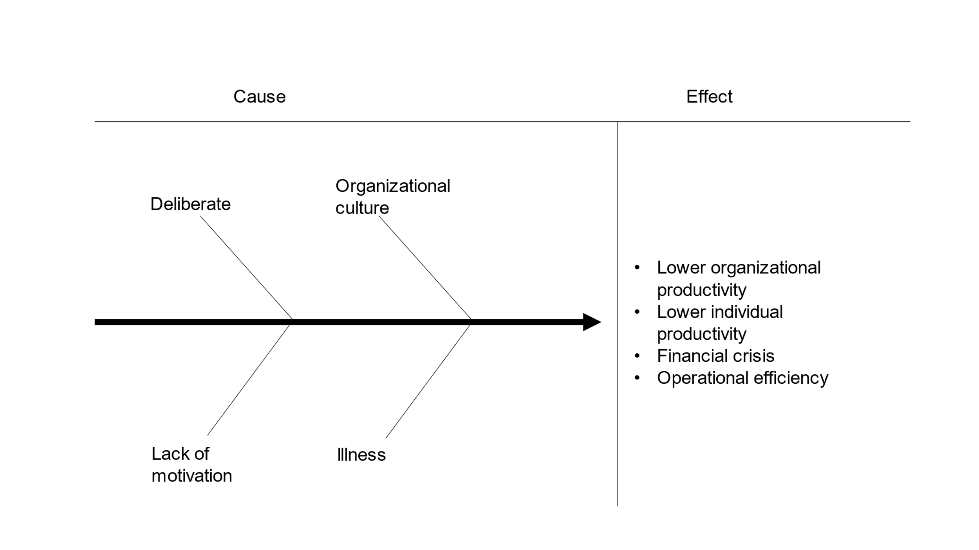

Cause and Effect analysis

Slide 5
SOLUTIONS:
Change the attendance policy
Motivate the employees
Low attendance = FINANCIAL PENALTY
Higher attendance
= REWARD

Slide 6
PLANING
MONITORING
REVIEW
CHECK THE ATTENDANCE
MOTIVATE THE EMPLOYEES=FINANCIAL COMPENSATION
ORGANISATIONAL CULTURE MUST BE RICH

Slide 7

Job absenteeism is a crucial problem.
Organisations need to motivate and engage employees with the organisation more.
Organisations to change the cultures and practices.

Slide 8

References
Aniyan, A., 2018. Absenteeism and Factors Affecting Absenteeism. International Journal of Nursing & Midwifery Research, 05(01), pp.27-31.
Bihunova, S., Vorobiova, I. and Fridrikh, A., 2019. DEVELOPING PROBLEM-SOLVING SKILLS. Naukovì zapiski Nacìonalʹnogo unìversitetu «Ostrozʹka akademìâ». Serìâ «Fìlologìâ», 1(5(73), pp.110-113.
Chu, Y. and MacGregor, J., 2015. Human Performance on Insight Problem Solving: A Review. The Journal of Problem Solving, 3(2).
G, S., S, J. and R, V., 2019. Employee Absenteeism. Journal of Advanced Research in Dynamical and Control Systems, 11(0009-SPECIAL ISSUE), pp.1426-1430.
Hoxsey, D., 2015. Are happy employees healthy employees? Researching the effects of employee engagement on absenteeism. Canadian Public Administration, 53(4), pp.551-571.
Hoxsey, D., 2015. Are happy employees healthy employees? Researching the effects of employee engagement on absenteeism. Canadian Public Administration, 53(4), pp.551-571.
Jäkel, F. and Schreiber, C., 2013. Introspection in Problem Solving. The Journal of Problem Solving, 6(1).
Katić, I. and Nešić, A., 2020. Socio-psychological effects of stress in organizations’ absenteeism problems. Work, 66(3), pp.689-697.
Pouliakas, K. and Theodoropoulos, N., 2015. The Effect of Variable Pay Schemes on Workplace Absenteeism. SSRN Electronic Journal.
Rhodes, S. and Steers, R., 2016. A Systematic Approach to Diagnosing Employee Absenteeism. Employee Relations, 3(2), pp.17-22.

