Slide 1
Business Plan

Slide 2
Content
Introduction
Overview of Business Plan
Ideas of marketing and PR strategies
SWOT Analysis
Conclusion
References

Slide 3

Introduction
A Business plan is a blueprint of the activities to be done by a company, its vision , mission and directions to achieve goals. It is made in detailed written form prior to the execution of plan. It includes matters related to various resources such as finance, marketing, production, etc. which will function accordingly.
Notes:
In the present report a business plan is being made for a Construction Recruiting Business organisation which is planning to establish its firm in order to provide construction services to its potential clients in market. The plan includes an overview of business proposal followed by marketing and public relation strategies. For a better understanding of a plan SWOT is being done further in report. The name of a business is Ovione Recruitment which is going to establish its business in the markets of Swansea.

Slide 4
Overview of Business Plan
A Business Plan is a detailed description of companies activities, vision, mission and objectives. It is helpful for investors, employees, management team in order to have clear understanding about the purpose of business. A construction recruiting Business named Ovione which is going to start its operations for the people of Swansea. The main reason behind establishment of this business is the Owner having a great experience of many years in construction domain so he can utilise his skills in this business. Business needs some contractors who will work for them and bring success in coming years.
Notes:
Scope of Business:
There is a scope of growth under this industry as construction is booming in areas of Swansea.
Mission:
The company carries a mission of utilizing their best skills for providing finest services to their clients.
Objective:
The objective of firm is to have a well established competition with similar firms and prove themselves in terms of quality offered for price.

Slide 5
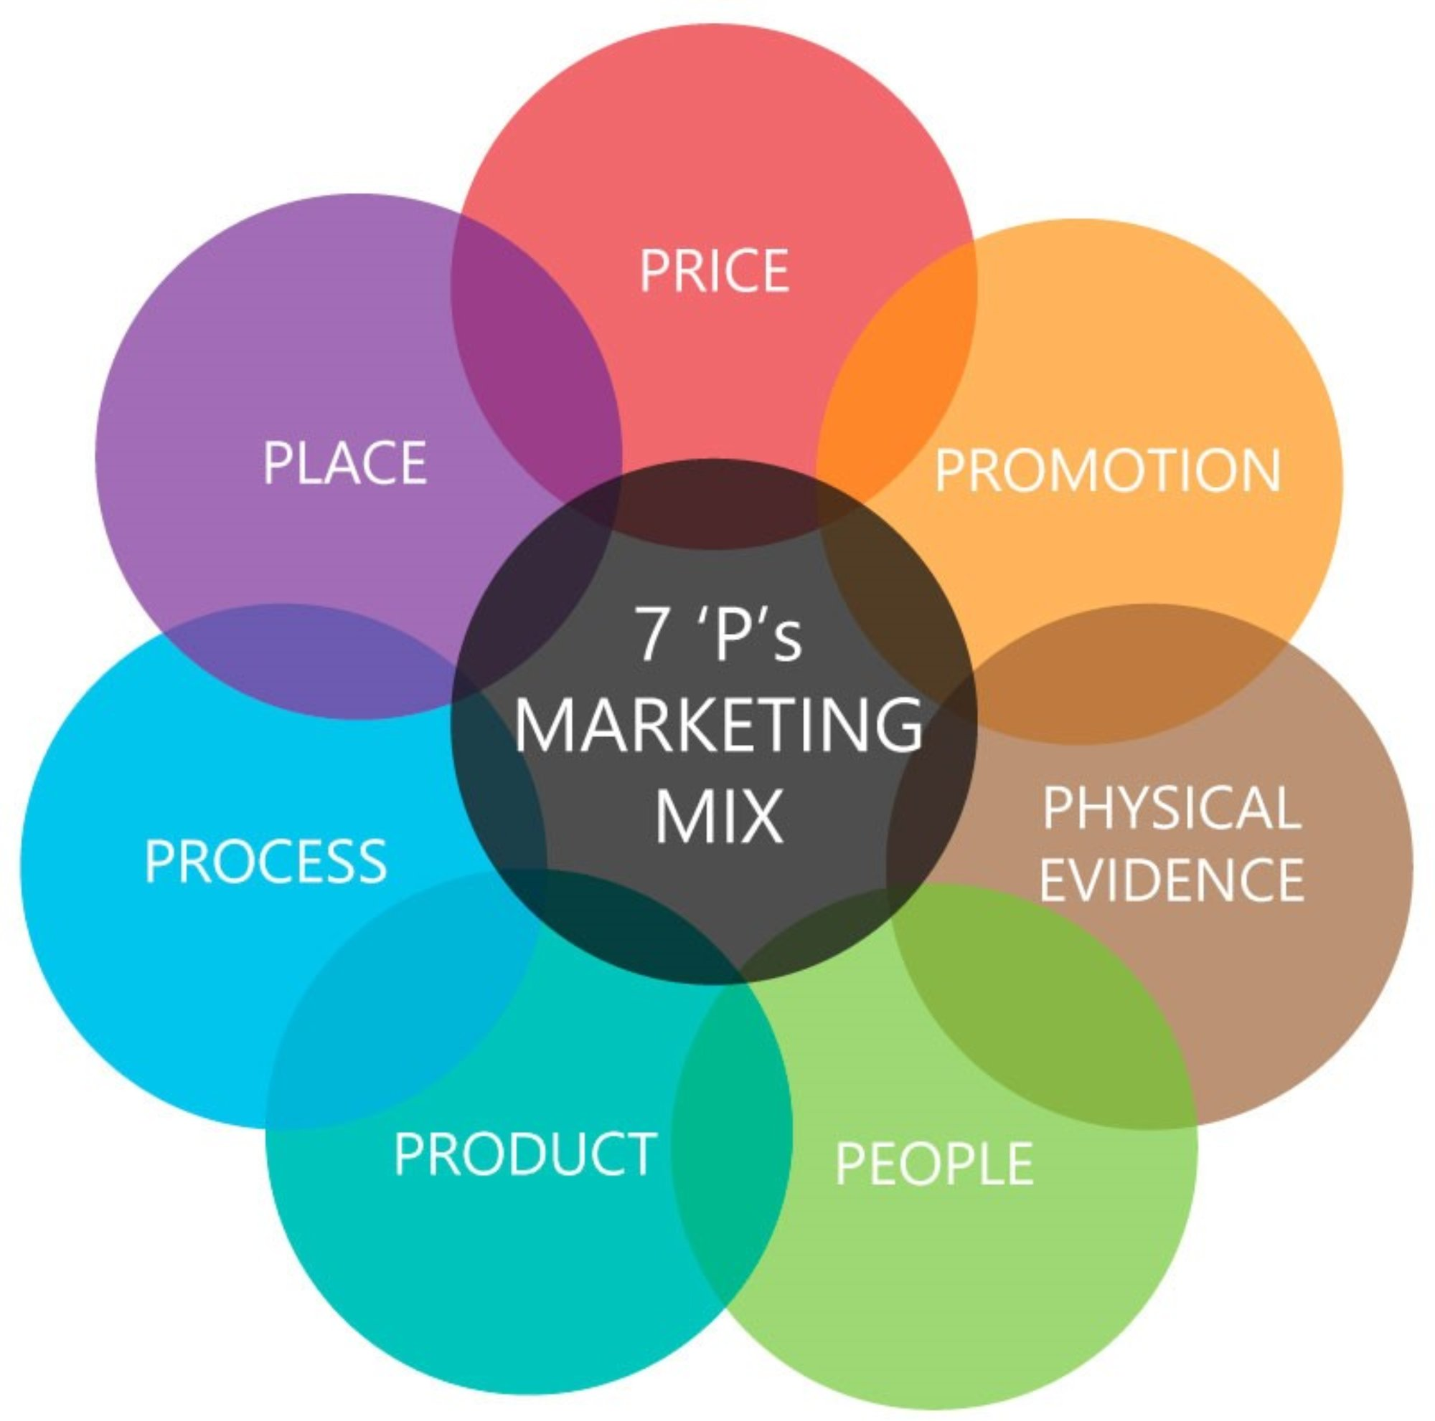
Ideas of Marketing and PR strategies
Marketing strategies refers to a selection of marketing channel which a company will adopt in order to have public awareness about their services. The marketing strategies available for Ovione Construction Recruiting agency is under:
This Photo by Unknown Author is licensed under CC BY
Notes:
Product: It refers to kind of product or services which is to be offered by a company in market (Hakobyan, 2020). In the present scenario Ovione is offering construction services.
Price: It refers to a cost for consideration of which company will provide its products and services to their customers. Ovione is going to keep prices similar to its competitors.
Promotion: it refers to making public aware about companies products and services (Jukova and et,al., 2019). Ovione in this case is going to have online advertising as well as flyers which will be for people of Swansea.
Place: This refers to a location where business will going to sale its products and services in order to generate revenue. Ovione is going to provide its services in markets of Swansea.
The Public relation strategy refers to adoption of such plans and ideas which generates a professional relation between company and its clients (Khatri and Singh, 2021). It is very necessary to have a good relation with clients because they are one who is going to use company's service and will provide revenue for firm. The PR strategies which Ovione can adopt in his business are mentioned under:
Native Advertising: It is a type of paid media which is placed on social websites, or on famous web pages (Rachid, Alameddine and El-Fadel, 2021).
Word of Mouth: This involves promoting company's products and services by speaking or via verbal communication.
People: If these employees are not given training in how to go about face-to-face customer contact, the entire marketing effort may not prove to be effective (Salloum and Ajaka, 2013, Anca and Daniel, 2012). Berry and Parasuraman (1991) suggested that a service firm can be only as good as its people.
Physical Evidence: Service environments, also called servicescape or physical evidence, relate to the style and appearance of the physical surroundings and other experiential elements encountered by customers at service delivery sites (Lovelock et al., 2007; Klaus and Maklan, 2012).
Promotion: It represents the communications that marketers use in marketplace including advertising, public relations, personal selling and sales promotion (McCarthy, 1960, Gronroos, 1994).

Slide 6
SWOT Analysis
Strengths Owner's experience of 16 years which he can utilise in bringing deep knowledge and great quality in their services. Familiar relation of firm with suppliers of raw material in market who will provide good quality of material at suitable prices. | Weaknesses Non availability of skilled workers which will not bring efficiency in constructing buildings or may not work properly. Lack of Coordination among contractors in terms of availability of raw material, proper number of workers, budget allocation, etc.

Slide 7
SWOT Analysis
Opportunities Investments from big giants such as from crowd funding, angel investors, bank loans due to scope of construction agency growth in future. To be a No.1 recruiting agency in markets of Swansea and Wales via scope of market boom in construction field. | Threats Chances of physical injury at construction place during work which can be hazardous or can create problem in company's existence. Large intensity of Ground water at construction area. Other competing Agencies who are already on the market.

Slide 8
Conclusion
From the present business plan it can be concluded that making proposal is beneficial for company which lists down all necessary activities and detailed structure of actual workings of firm. Ovione Construction Recruiting Agency has a large scope of growth in market of Swansea as there will be a huge demand. Application of proper marketing and public relation strategy is very essential in a business to make public aware of their products and services. Construction agency has strengths as well as some weaknesses. The industry brings opportunity for firms but also welcomes threats along with this. Business proposal presents a true and fair picture of future business.

Slide 9
Genadinik, A., 2019. Business plan template and example: how to write a business plan: Business planning made simple. Alex Genadinik.
Hakobyan, T., Prototype Designs and Engineering Services: a Business Plan.
Jukova and et,al., 2019. Planning a new business: typical mistakes of a business plan in the service sector. Journal of Environmental Management & Tourism. 10(3 (34)). pp.441-447.
Cruceru Anca and Moise Daniel / Procedia - Social and Behavioral Sciences 62 ( 2012 ) 198 – 202
L.L. Berry, A. Parasuraman
Marketing Services: Competing Through Quality, The Free Press, New York, NY (1991), p. 152
C. Lovelock, P. Patterson, R. Walker
Services Marketing: An Asia-Pacific Perspective (second ed.), Prentice-Hall, Englewood Cliffs, NJ (2001)
P.P. Klaus, S. MaklanEXQ: A multiple-item scale for assessing service experience
J. Serv. Manag., 23 (1) (2012), pp. 5-33
E.J. McCarthy
Basic Marketing: A Managerial Approach, Irwin, Homewood (1960)
C. Gronroos, P. ViomaCritical service logic: making sense of value creation and co-creation
Acad. Mark. Sci., 41 (2) (2013), pp. 133-150
References
Notes:
b

Slide 10
Thank You

