Slide 2
ECEY5006C: Arweinyddiaeth a gwaith tîm yn y blynyddoedd cynnar
ECEY5006: Leadership and Teamwork in the Early Years

Slide 3

Gofynion Statudol, Polisi ac arfer
Statutory Requirements, Policy and Practice
Notes:
Statutory Requirements and Employment Law

Slide 4
Gofynion statudol a goblygiadol
Statutory obligations and requirements
Y Gyfraith
Gofynion statudol gan cyrff llywodraethol sef:
AGC
ESTYN
IECHYD A DIOGELWCH
TÂN
IECHYD GYHOEDDUS CYMRU
YR ASIANTAETH AMGYLCHEDD
CYFLOGAETH – Y GYFRAITH
The law
Statutory requirements by governing bodies such as:
CIW
ESTYN
HEALTH AND SAFETY
FIRE
PUBLIC HEALTH WALES
ENVIRONMENTAL AGENCY
EMPLOYMENT LAW
Notes:
Consider ALL policies and procedures/legislative framework that fall under each of these.
Consider the need to carry out further and independent research once you have decided on the topics/matters on your group agenda.
Support one another and collaborate if you come across anything that may support any of the points on your agenda.
Remember – whilst you may just be researching ONE point, that teamwork involves supporting others.

Slide 5

AGC / CIW
Arolygiaeth Gofal Cymru
Cofrestru
Arolygu
Cwynion
Pwerau statudol
Care Inspectorate Wales
Registration
Inspection
Complaints
Statutory powers
Notes:
CIW support compliance with the regulations and can take enforcement action to ensure compliance: the website has information for people who provide services: they will support settings if they feel challenged in meeting the NMS (settings need to be proactive – can phone for advice). Settings can complain to the Govt if they feel badly treated by CIW.
They also provide info on the website for people who use the service
Students must be aware of the differences between school and childcare regulations/frameworks eg Care Standards Act 2000 for care settings.

Slide 6
AGC
CIW
Arolwg: Un neu ddau arolygydd (dibynnu ar maint y lleoliad)
1 diwrnod (yn gallu gwneud yr ail ymweliad)
Gofal
Safonau glendid a chydymffurfio
Arweinyddiaeth
Y barnau (rhagorol/da/digonol/ methu cydymffurfio)
Adroddiad yr Arolwg ar gael i bawb
Inspection: One/two inspectors (depending on size of setting)
1 day (may make a second visit)
Care
Standards of cleanliness and compliance
Leadership
Judgements (excellent/good/adequate/non-compliance)
The Inspection Report is available to all
Notes:
This is the Inspection Process under the Care Inspectorate Wales (CIW)
When inspectors visit a care service, they will consider four core themes:
Well-being
Care and Development
Environment
Leadership and Management

Slide 7
NMS – National Minimum Standards (CIW)
SGC - Safonau Gofynnol Cenedlaethol (AGC)
24 o bolisïau:
Meithrinfeydd ddydd
Crèches
Gofal sesiynol
Ar ôl Ysgol
Mynediad Agored
Gwarchodwyr
24 policies:
  Full Day Care (day nurseries)
  Crèches
  Sessional
  Out of School
  Open Access
  Childminders
Notes:
Show document- they must become familiar with this, especially the stated Standards for this assessment: what have they learnt about these so far? Before finishing today, please draw up the assignment and take queries from students. Have they all seen the Panopto by now?
Full day care – day nurseries. The two new day nurseries in Carmarthen open 6.30am – 6.30pm – therefore offer a 12 hour service. Most Day Nurseries within Wales operate 7.30am – 6pm Monday – Friday.
Parents who register at these settings sign contracts over 52 wks and pay by direct debit. Children registered at these settings must attend at least 2 x sessions every week.
Creches – a childcare service where children can be left for short period of times. For example, a crèche at a leisure centre would allow childcare whilst parent is following a class – therefore this is unlikely to be long term arrangement with the setting.
Sessional – means 2.5hours of hour – these would be Cylchoedd Meithrin, Playgroups and Flying Start settings.
Out of School – After School Clubs operate within school settings by now mostly or within day nurseries, where children are collected from school and transported back to the day setting. These usually run between 3.10pm and 6pm. However, there are also a high number of 1.59 clubs which operate – these mean that they offer care for 1 minute less than two hours which means that they do not have to register or be inspected by CIW.
Open Access – these are not as popular – these are open air holiday clubs that set up during school holidays to offer care in outdoor environments such as parks.
Childminders – must operate form the domestic home of the registered childminder (all adults living at the address of the childminder must also be DBS checked). Childminders operate long hours too and have a limited number of children. Some also offer wrap around care such as day nurseries with breakfast clubs, after school clubs and holiday clubs being part of their service. More and more childminders are now employing an additional practitioner within the home environment to allow for more children.

Slide 8
Ysgolion - Schools
Cymru - Wales – Estyn
Polisiau - Policies:
Managing schools | Sub-topic | GOV.WALES
Prosbectws Ysgol/School Prospectus:
School prospectuses: guidance for headteachers and governing bodies | GOV.WALES

Slide 9
Ysgolion - Schools
Categoriau polisiau:
Statudol
Cwricwlwm
Polisiau AD
Lles/iechyd a Diolgelwch/Adeilad
Amrywiol
Policy categories:
Statutory
Curriculum
HR Policies
Well-being/Health and Safety and Premises
Miscellaneous

Slide 10
Estyn: Her Majesty’s Inspectorate (HMI)
The inspection framework consists of inspection areas:
Standards
Wellbeing and attitudes to learning
Teaching and learning experiences
Care, support and guidance
Leadership and management
Mae’r fframwaith arolygu yn cynnwys meysydd arolygu:
Safonau
Lles ac agweddau at ddysgu
Addysgu a phrofiadau dysgu
Gofal, cymorth ac arweiniad
Arweinyddiaeth a rheolaeth

Slide 11
Estyn
Peth rhybudd…yr ‘amlen brown’ (3-4 wythnos)
Yn gallu cymryd lan hyd wythnos
Tîm o arolygwyr
Addysg a gofal
Arweinyddiaeth
Y barnau (rhagorol/da/digonol/ anfoddhaol)
Adroddiad yr Arolwg ar gael i bawb
Some notice provided…the ‘Brown envelope’ (3-4 weeks)
Can take up to a week
Team of inspectors
Education and care
Leadership
Judgements (excellent/good/ adequate/unsatisfactory)
The Inspection Report is available to all
Notes:
Highlight that in England they use Ofsted and in Wales schools are inspected by Estyn and non-maintained settings are inspected by CIW

Slide 12

Llywodraeth Cymru
Welsh Government
https://www.gov.wales/sites/default/files/publications/2018-12/theme-1-leadership-for-a-self-improving-system-resources-1-7.pdf
Arweinyddiaeth o fewn ysgolion yng Nghymru
Leadership within school settings in Wales
Notes:
The Welsh Government have produced supporting documents and resources in order to support the pathway for school teachers to become leaders (This could mean leaders within the classroom/curriculum/school). Therefore be mindful of all the literature that is available to support individuals to progress on a leadership pathway within education in Wales – later on we will also look at ERW.

Slide 13
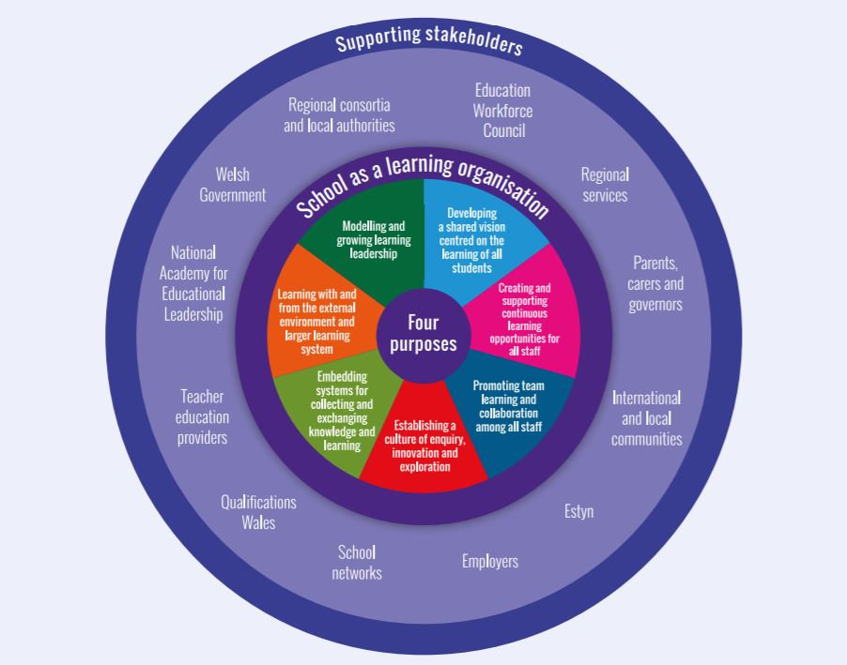
Ysgolion yng Nghymru
Schools in Wales
Notes:
Schools as learning organisations model: This diagram is linked to the Welsh Government’s requirements in terms of supporting LEADERS to fulfil these components in order to become successful schools.
Note the outer circle – the stakeholders – these are all considered to be important/crucial partners of every school – with the school working with/alongside these STAKEHOLDERS in order to achieve as a school setting.
Note the inner circle – the school itself – everyone within the school has a responsibility to achieve these parts but cannot be achieved without a LEADER and the Leader cannot achieve these without the TEAM.
https://hwb.gov.wales/professional-development/schools-as-learning-organisations – link to video outlining the SLO approach and the importance of working together – we’re all in it together and can all learn from each other.

Slide 14

Lleoliadau meithrin nas cynhelir
Non-maintained nursery settings
Arweinyddiaeth mewn lleoliadau meithrin nas cynhelir
Leadership in Non-maintained nurseries
Notes:
Refer back to them doing this

