Slide 1

Student name: Marinela Braganca
Student ID:2328116
Module name: Empowering the Older Person
Module code: BMHP6027
Lecturer’s name: Christopher Mafuva

Slide 2

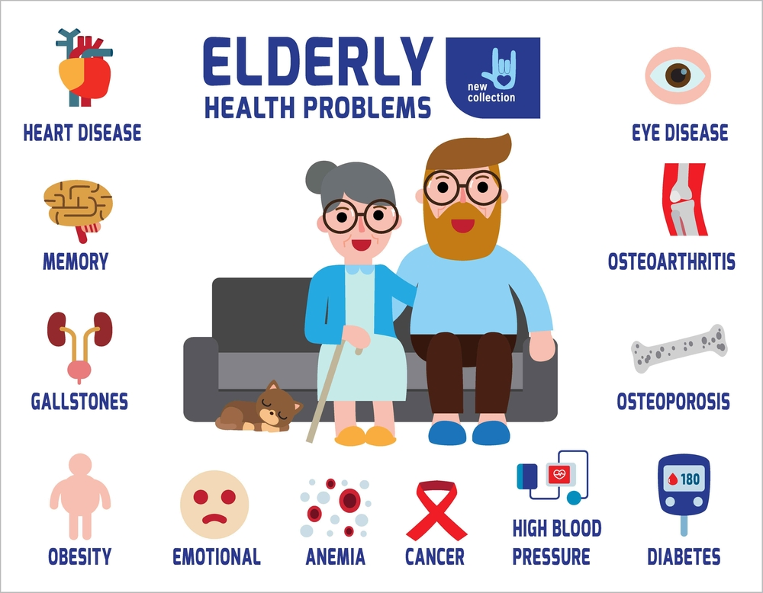
Empowering Older Adults
Care, Empowerment and Support of the Needs of Older People:
Older people should receive person-centred care that promotes dignity, independence and well-being. (NHS England, 2024; NICE, 2015).
Maintaining Functional Ability:
Supports safe daily activities.
Encourages mobility and rehabilitation.
Assistive technology promotes independence (Mishra et al., 2022).
Promoting Independence:
Builds confidence and improves well-being.
Encourages self-care and decision-making.
Rehabilitation helps older people regain skills (Clotworthy, Kusumastuti & Westendorp, 2021).
Freedom and Choice:
Respect individual preferences.
Involve older people in care decisions.
Shared decision-making improves outcomes (Wijngaarde et al., 2021).
Critical Evaluation:
Person-centred care, rehabilitation and shared decision-making can improve independence, confidence and quality of life. (NHS England, 2022) However, support should be tailored to each older person's needs(Social Care Institute for Excellence, n.d.). Too much support may reduce independence, while too little may increase the risk of falls and poor health outcomes.
(Stockcake.com, 2026)
I
(Fittr, 2022)
INTRODUCTION
In the UK, as life expectancy is increasing, older people are one of the fastest-growing population groups.
Healthy ageing is not about living longer; it's about maintaining healthy, physically, psychologically, socially and emotionally.
Empowerment means enabling older people to make informed choices and decisions and to be active participants in their own care (Hanlon et al., 2024). In 2024, around 625,000 people in the UK were aged 90 years and over.
53.7% increase since 2004.
There were 16,600 centenarians (100+) in the UK in 2024, double the number recorded in 2004. ( Office for National Statistics,2025).
Financial Challenges: Some older people are not able to afford basic needs. (Age, 2023).
Physical Challenges:
Frailty and reduced mobility affect daily activities.
Chronic conditions reduce independence (Hu et al., 2024).
Mental health problems and cognitive difficulties:
Dementia, depression and anxiety can affect memory, confidence and daily living (Hu et al., 2024).
Access to GP services:
Older people may struggle to access GP appointments(CQC.org.uk, 2024).
Social Challenges:
Limited social participation, reduced social interactions(Zhang and Wang, 2023).
I
Challenges Older People Face in Maintaining Independence and Functional Ability.

Slide 3


Effectiveness and Benefits of Approaches and Interventions for Older Adults:
BENEFITS: Person-centred care places older adults at the centre of all decision‑making.
It respects their values, preferences, and health goals (Liao et al., 2023).
It improves patient satisfaction.
Promotes dignity, independence, and autonomy.
Encourages older adults to take an active role in managing chronic conditions.
EFFECTIVENESS:
Care tailored to individual needs improves health outcomes (Social Care Institute for Excellence, n.d.).
Staff shortages and limited resources can reduce effectiveness (NHS England, 2024).
Short appointment times make personalised care harder.
Quality of care varies between services.
Older adults with cognitive impairment may need help from family or advocates.
Good results depend on enough staff, proper training and strong organisational support. ( NHS England).
Conclusion
Older adults need person‑centred, well‑coordinated care that supports independence and choice.
Maintaining functional ability protects dignity and improves quality of life.UK policies promote healthy ageing and integrated support.
Helping older adults regain their daily skills and independence.
Teamwork and assistive technology improve outcomes.
Strengthening community services, supporting carers and improving digital access help older people stay independent.
RECOMMENDATIONS:
Promote person-centred care and involve older people in decisions about their care (NICE, 2015).
Improve community health and social care services to help older people live safely and independently at home (NICE, 2015).
Improve teamwork between health and social care services to provide better coordinated care (Miller, Glasby & Dickinson, 2021).
Encourage social activities, volunteering and digital support to improve older people's wellbeing and independence (NICE, 2015).
UK Approaches and Current Provisions
Care Act 2014, the NHS Long Term Plan and the Health and Care Act 2022 (Department of Health and Social Care, 2019).
Disengagement Theory.
Activity Theory.
(Zaidi and Howse, 2017).
REFERENCES: Age. (2023). ‘A constant struggle’ – our report on household costs. Independent Age. Available at: https://www.independentage.org/policy-and-research/household-costs-report⁠ (Accessed 15 July 2026).
Care Quality Commission (CQC). (2024). Health and care for frail and older people. Available at: https://www.cqc.org.uk/publications/major-report/state-care/2024-2025/focus/older⁠ ([Accessed 15 July 2026).
Clotworthy, A., Kusumastuti, S. and Westendorp, R.G.J. (2021). ‘Reablement through time and space: a scoping review of how the concept of reablement for older people has been defined and operationalised’, BMC Geriatrics, 21(1). Available at: https://doi.org/10.1186/s12877-020-01958-1⁠
Department of Health and Social Care. (2019). NHS Long Term Plan. GOV.UK. Available at: https://www.gov.uk/government/news/nhs-long-term-plan-launched⁠ (Accessed 15 July 2026).
Hanlon, P., Wightman, H., Politis, M., Kirkpatrick, S., Jones, C., Andrew, M.K., Vetrano, D.L., Dent, E. and Hoogendijk, E.O. (2024). ‘The relationship between frailty and social vulnerability: a systematic review’, The Lancet Healthy Longevity, 5(3), pp. e214–e226. Available at: https://doi.org/10.1016/S2666-7568(23)00263-5⁠
Hu, H.-Y., Hu, M.-Y., Feng, H. and Cui, P.-P. (2024). ‘Association between chronic conditions, multimorbidity, and dependence levels in Chinese community-dwelling older adults with functional dependence’, Frontiers in Public Health, 12. Available at: https://doi.org/10.3389/fpubh.2024.1419480⁠
Liao, L., Feng, M., You, Y., Chen, Y., Guan, C. and Liu, Y. (2023). ‘Experiences of older people, healthcare providers and caregivers on implementing person-centred care for community-dwelling older people: a systematic review and qualitative meta-synthesis’, BMC Geriatrics, 23(1), p. 207. Available at: https://doi.org/10.1186/s12877-023-03915-0⁠
Miller, R., Glasby, J. and Dickinson, H. (2021). ‘Integrated Health and Social Care in England: Ten Years On’, International Journal of Integrated Care, 21(4). Available at: https://doi.org/10.5334/ijic.5666⁠
Mishra, S., Laplante-Lévesque, A., Barbareschi, G., Witte, L., Abdi, S., Spann, A., Khasnabis, C. and Allen, M. (2022). ‘Assistive technology needs, access and coverage, and related barriers and facilitators in the WHO European region: a scoping review’, Disability and Rehabilitation: Assistive Technology, 19(2), pp. 1–12. Available at: https://doi.org/10.1080/17483107.2022.2099021⁠.
NHS England (2024) NHS England – NHS Long Term Workforce Plan. NHS England. Available at: https://www.england.nhs.uk/long-read/nhs-long-term-workforce-plan-2/⁠ (Accessed: 17 July 2026).
NHS England (2022). Personalised Care and Support Planning. NHS England. Available at: https://www.england.nhs.uk/personalisedcare/pcsp/⁠(Accessed 17 July 2026).
NHS England. (2024). Person-centred care. Available at: https://www.england.nhs.uk/personalisedcare/⁠ (Accessed 15 July 2026).
NICE. (2015). Older people: independence and mental wellbeing (NG32). Available at: https://www.nice.org.uk/guidance/ng32⁠ (Accessed 15 July 2026).
Office for National Statistics. (2025). Estimates of the very old, including centenarians, UK: 2002 to 2024. (online) Available at: https://www.ons.gov.uk/peoplepopulationandcommunity/birthsdeathsandmarriages/ageing/bulletins/estimatesoftheveryoldincludingcentenarians/2002 to2024⁠ (Accessed 15 July 2026).
Social Care Institute for Excellence (n.d.) Meeting the needs of every individual in care homes. SCIE. Available at: https://www.scie.org.uk/providing-care/personalised-and-person-centred-care/meeting-the-needs-of-every-individual-in-care-homes/⁠(Accessed 17 July 2026).
Stockcake.com. (2026). Senior tech learning. Available at: https://stockcake.com/⁠(Accessed 15 July 2026).
Wingaarde, R.O., Hein, I., Daams, J., Van Goudoever, J.B. and Ubbink, D.T. (2021). ‘Shared decision-making and health outcomes: a scoping review’, European Journal of Pediatrics, 180(8), pp. 2345–2357. Available at: https://doi.org/10.1007/s00431-021-04055-6⁠
Zaidi, A. and Howse, K. (2017). ‘The Policy Discourse of Active Ageing: Some Reflections’, Journal of Population Ageing, 10(1), pp. 1–10. Available at: https://doi.org/10.1007/s12062-017-9174-6⁠
Zhang, W. and Wang, A. (2023). ‘Functional ability of older adults based on the World Health Organisation framework of healthy ageing: a scoping review’, Journal of Public Health. Available at: https://doi.org/10.1007/s10389-023-02121-

