Slide 1
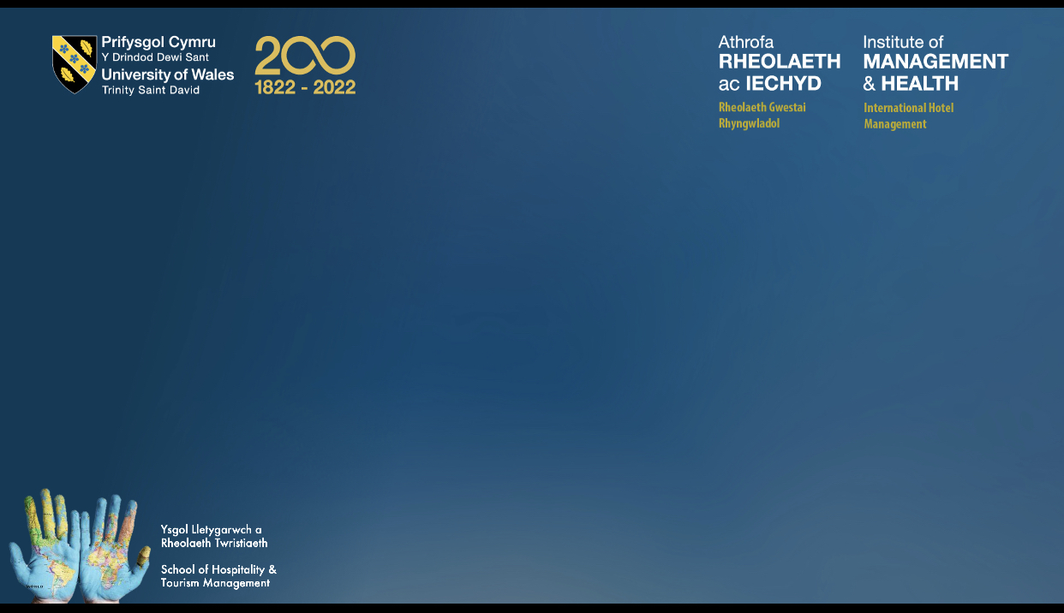
Module Name (BMIH4002)
Student Name Zhanita Bigdeloo
Student Number 2019352
Lecturers Name: Lola Villard

Slide 2
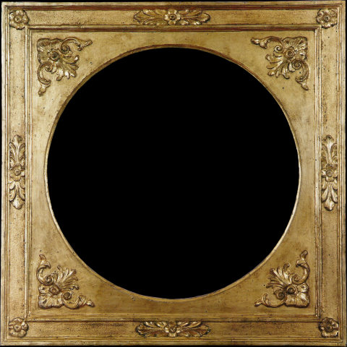
Raven Magic Restaurant f

Slide 3
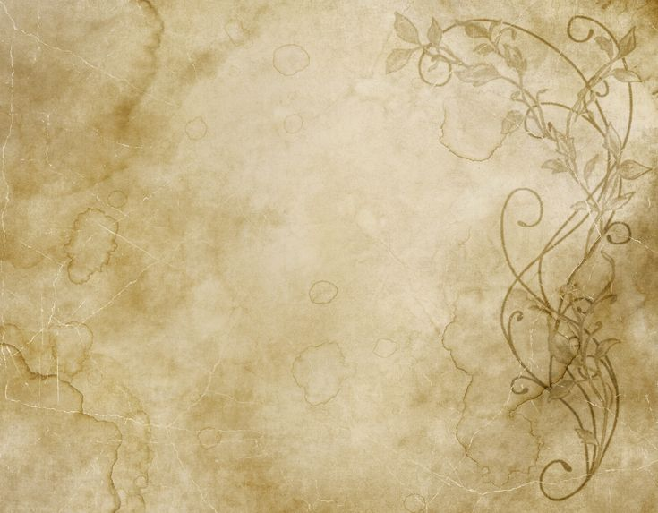
Welcome to our magic restaurant
Important Information
We have world-renowned certifications and world standards for food, drink, and hygiene.
We are glad that we can receive you in that best way here. We have more than fifty years of successful activity. We respect all our customers here in any situation and any age. We care about your health and that of your family as well. All or restaurant use extremely advanced facilities. We are connected to all the latest technologies in the world. You can touch the red button on your table so that you can enter the main menu and choose your orders. Our prices are our orders codes. You order your food and beverages by touching on prices. If you change your mind, you should cancel your old order immediately, then order new one. You can write your suggestion or criticism there to help us so that we can good hospitality you and our other guests better than before. Prices are order codes by selection prices you can choose your food and drink. Finally after ordering, you can pay on the option and top up the amount.
We have listed all our food and drink products on the last page our menu. We grow all our food and drink supplies on our farms. Our all products are organic and we guarantee you that. We will use global standards to grow up them. Tell us you are vegetarian or vegan.
Thank you

Slide 4
Our orders
Starters
Salad Shirazi = Chopped onion, Cucumber, Tomato, Dried Oregano, Lime juice and Olive Oil £4.00
Sup = Chicken, Parsley, Carrots, and Potatoes £5.55
Main Courses
Baghala Polo with Mahiche / Lamb Shank = cooked, served with green rice
Joje Kabab = Grilled chicken , Butter, With chips £22.22
Dessert
A variety of delicious and fresh cakes = Chocolate Cake , Strawberry Cake, Vanilla Cake, with delicious cocktails. £21.21

Slide 5
Coffee Drinks
Latte = Espresso + Steamed milk £3.33
Cappuccino= Espresso + Steamed milk + Foam £4.44
Espresso= 1oz Espresso £4.66
Mocha= Espresso + Chocolate + Steamed milk £4.88
Special Coffee Drink
Magic Coffee= Kopi Luwak + Chocolate + Milk + Gold powder
Kopi Luwak coffee is made from wild red coffee beans. £12.12

Slide 6
Magic Drinks & Cocktails
Mohitoo = Lime juice + Mint and soda water +Vodka + Ice £15.55
From The Beach = Filled to the brim with peach +orange +Cranberry + Ice Flavours+ Vodka Gin = This juicy drink is ideal for those with with a sweet tooth.
And garnish with cocktail cherries and a slice of orange. £16.66
Lovely Coconut= Coconut + Pineapple + Milk +Ice £17.77
Martini = Mix Gin or Vodka + Dry Vermouth + Garnish + A twist of lemon peel
Whether you like it with Gin or Vodka, a dirty version or a fruity variation. Whether you like it with gin or vodka, a dirty version or a fruity variation. £18.88

Slide 7
Our Magic Suggestion Food & Wine or Champagne
Roast ribs with Lamb + Mushrooms and Asparagus + Shiraz Wine.
Shiraz wine is made from the grapes of red vines, which have a cold nutritional property that should be used with food that are warm nutritional. This combination can be very enjoyable for you. £ 60.60
Spaghetti with special weather + France Champagne
Spaghetti with corn, mushroom, pieces of green bell pepper and carrots, pieces of shrimps + France Champagne = Cremant, Gaillac, Blanquette de, Limoux, Clairette de Die, Charmpagne. This combination is unique, and will be enjoyable for you. £33.33

Slide 8
Valentines Day & Birthday
Food and Beverages And Cakes
We have some greet suggestions for you on this day, we suggest you tell us on this day what food ingredients you use that, will be unique to you. And we will make a special one for you. Finally, tell us if you are vegetarian or vegan. Thank you

