Slide 1
Session 6
RECOVERY FROM SPORT AND PHYSICAL ACTIVITY

Slide 2
RECOVERY
IMPORTANT FACTORS
DIET
FLUID
SLEEP
TIME BETWEEN EVENTS – ESPECIALLY IN A COMPETION

Slide 3
DIET/FLUID - RECOVERY
A low GI diet post recovery
Aim to eat within 2 hours of finishing exercise when glycogen and protein up take is at its maximum. It can take up to 24 hours to re fuel
Also monitor fluid intake – aim to hydrate as soon as exercise stops
Eat between 50 – 100g CHO and 10 -20g Protein

Slide 4
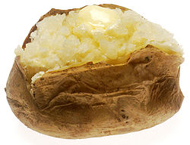
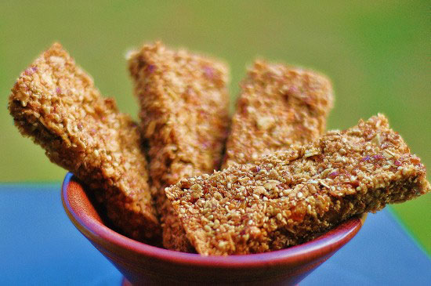
Ideas for Recovery Snacks
Sandwiches
Beans on Toast
Jacket potato with cheese
Recovery drink
Cereal with milk
Power bar or cereal bars
Followed by usual meal

Slide 5
SLEEP
Whilst we do not fully understand why we need sleep there is no doubt it is important to athletes
Partial loss of sleep can have effects on motor functions and Reilly and Edwards ( 2007) showed that sustained exercise can be effected.
Studies have also shown that sleep restores the immune and endocrine systems
Also decreases inflammation

Slide 6
Nutrition supplements and sleep
Valerian – flowering plant used to treat insomnia
A systemic review in 2006 showed that it did improve sleep
KAVA – a Polynesian plant that is not available everywhere – has been shown to aid sleep but has side effects – too many to mention.
Now banned in the EU

Slide 7
Tryptophan – essential amino acid that has been to show sleep improvement.
Tryptophan is found in milk, meat, poultry, eggs, beans, peanuts, cheese, green leafy vegetables
Melatonin – produced from tryptophan. Some studies have shown it increases sleep length

Slide 8
Factors that may decrease sleep
Caffeine – stimulates the central nervous system . Aim not have more than 100mg pre sleep. May be a negative effect for athletes that use high doses of caffeine
Hyper hydration – drinking too much gets you out of bed more often!

Slide 9
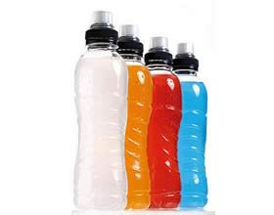
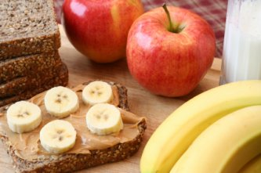
Planning
Athletes need to plan ahead
Take adequate snacks and fluids with them – keep a stock in the kit bag

