Slide 1
EFFECTIVE TEAMWORK AND COMMUNICATION

Slide 2
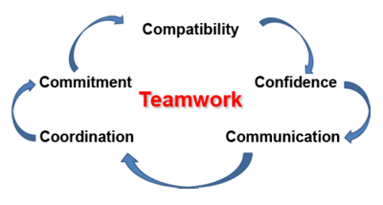
Benefits of Team Working
One is unlikely to be effective carrying out a variety of tasks by themselves due to their intricacy and difficulty. Teams are usually required to guarantee efficiency and effectiveness.
Working as a team may be useful since it establishes clear avenues for success by separating tasks and allocating jobs (nielsen et al. 2018).
Teamwork, which has been recognised as a critical component, is necessary to achieve objectives and aims.
Gstatic.com, 2022
Notes:
It can assist to achieve positive results by being trustworthy and effective in reaching objectives that would not have been possible with one person working alone. A team is made up of several individuals who are charged with executing a job or project. Teams that are effective often have goals that are very well stated. If the team's leader is successful, the group may focus on individual operational issues while still advancing a shared objective. Each member of a successful, disciplined team must be dedicated and determined while overcoming personal issues for the group to flourish.

Slide 3

Benefits of Team Working
Numerous benefits of teamwork ensure the achievement of overarching goals.
One can contend that productive collaboration improves participants' attitudes, convictions, and perspectives.
Group discussions provide for crystal-clear guidelines that can remove doubt from common aims and targets (koon-magnin et al. 2022).
Teamwork has a direct correlation to success and effectiveness.
Educba.com, 2022
Notes:
A successful cooperative will often have a highly decentralised management structure. The ability to work effectively and efficiently is a requirement for each participant in the process. Another benefit of a welcoming environment is that it may ensure that innovative solutions to difficult problems are used (Karla et al. 2022). The basis of effective collaboration is success in other areas and other considerations. The availability of the required information, resources, and people is the team's initial need for success. Because it motivates and directs people to do work swiftly and efficiently, the capacity to lead others is crucial for success. As additional competencies, high levels of team member devotion and commitment have been included.

Slide 4
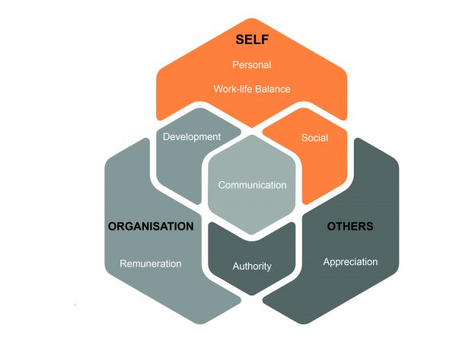
Benefits of Team Working
A team's members need to feel that they "own" the work at hand for it to be completed at its best (meckbach et al. 2022). Naturally, good delegation skills and avoiding micromanagement are essential for leaders.
Since each team member's job is crucial to the achievement of the overall objectives, everyone in the team will work diligently to fulfil their tasks, which can help the team become more disciplined and cohesive.
Increased communication and trust within the team may assure its potential to increase output and productivity.
Quadrant1.com, 2022
Notes:
Moreover, focus on perfection is achieved via the use of a range of techniques. They joined along on a mountain climbing excursion. Their staff encountered a lot of difficulties and difficulties. The team had to deal with several obstacles that may have changed the outcome had they been overcome; however, these problems kept the team from progressing (Waizenegger et al. 2020). The leadership was bad because it was fundamentally lacking in strategic thinking. Leadership must have a knack for "thinking beyond the box" to make future.

Slide 5
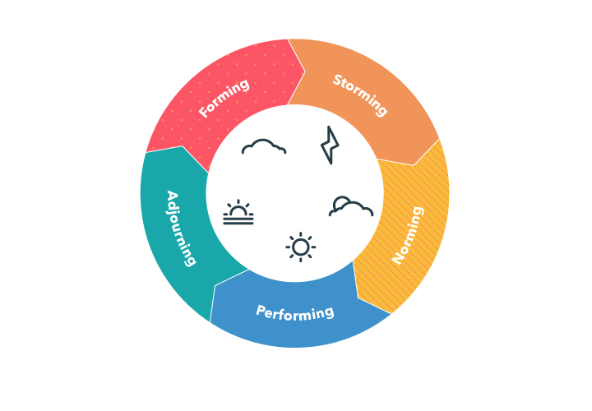
Stages of team development
Once people are in the group-forming stage of development, they frequently want to avoid conflict and need acceptance from others.
Although it might not appear as much is happening as everyone gets to know one another, a lot is happening during this phase of group formation (gonzález-cruz et al. 2020).
People are assessing one other's status, authority, and responsibilities.
Googleusercontent.com, 2022
Notes:
Apparently, there is not much of a haste to get to understand one another. This could have been the case because people were all just in their second week of classes and understanding about a project might have been too much for most of us to handle. The group unanimously decided to arrange a meeting instead of attending a presentation or seminar but since this initial consultation was merely an introduction through which almost everyone learned each other's names and created a WhatsApp group to interact through. While everyone came to the scheduled meeting to understand more concerning the project and establish a sense of direction, the first meeting was more of an introduction.

Slide 6
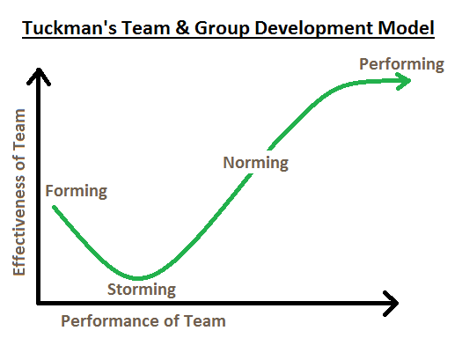
Stages of team development
Storming, the second stage, said that the gathering would eventually have to split up, vanish, or turn toward action (andersen et al. 2019).
People begin to fight for positions and align with other in-group members as soon as these things start to happen.
Conflict may also start to arise when people attempt to settle contentious issues relating to group outcomes and practices.
Thecoachingtoolscompany.com, 2020
Notes:
Before serious issues are brought up, group members can only behave pleasantly for so long. At this phase, there are a lot of group dynamics concerns that come up, yet members do try to be a unit on occasion to achieve goals. It is common for repressed issues to simmer before erupting into public hostility. The only time the group came close to having a disagreement was when two people couldn't agree on a date for the next weekend. The discussion was swiftly concluded and in no way disagreeable. Tuckman says that at this time of task engagement, there is an expression of feeling toward the activity, and the group may fall under this assertion (Taylor and Batty, 2022).

Slide 7
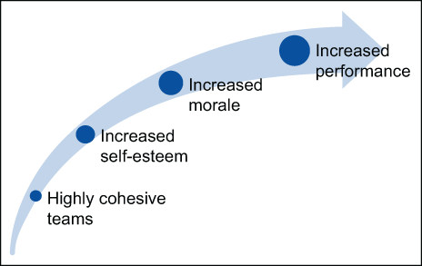
Stages of team development
According to the third stage, which is stated as follows, "people start to understand their responsibilities and duties, what they can and cannot accomplish, how they do it, and who does it" (hoogeboom and wilderom, 2020).
In order to avoid being avoided and kicked out the squad, new recruits must adhere to the established rules.
These customs are hard to change after they have been established because society accepts them as normal and ingrained.
Wp.com, 2022
Notes:
Because norms were established at this meeting, i.e., expectations were set that everyone would carry out their duties to the best of their ability, it was tied to the storming stage. Keeping with the features of this stage, it was also anticipated that everyone would have their jobs finished but there would have been a strong sense of duty and belonging within the group.

Slide 8
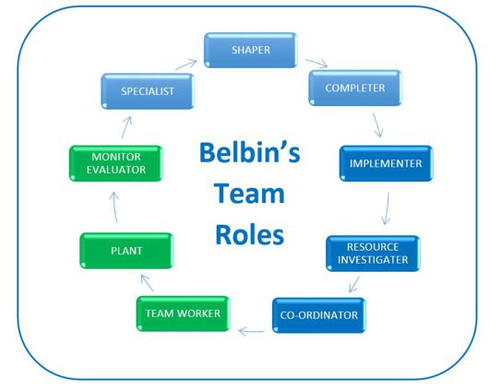
Team role (BELBIN) leadership roles
Teams are created inside organisations based on the qualifications, accomplishments, and successes of the participants, and on indicators of their mental acuity or the outcomes of psychometric testing.
However, the establishment of a successful team is greatly influenced by each team member's behavioural characteristics.
Belbin and his colleagues came up with nine jobs for the team, which are implementer, shaper, coordinator, complete-finisher, resource-investigator, team worker, monitor-evaluator, plant, and specialist (alharthi, 2020).
Educational-business-articles.com, 2019
Notes:
Typically, each team member participates in one of these tasks. The best teams consist of individuals that accept or adapt to each team position. It is likely that the team will have difficulty finishing its work if the team's responsibilities are not appropriately distributed. For example, a team of two resource detectives and two plants would not be effective since no one would pay attention or implement suggestions. Members of the team should be conscious of their own strengths and weaknesses to maximise their usage of their own skills and find colleagues who can cover for them where they fall short.

Slide 9
Team role (BELBIN) leadership roles
Most of the time, employers want candidates with a range of desired qualities; nonetheless, it may be quite challenging to discover the right fit.
Even if the organisation is successful in identifying the perfect candidate, there is no guarantee that they will remain employed by the company for a significant amount of time (kezar et al. 2020).
It would be more useful to locate a group of individuals who could combine all of their expertise.
Notes:
Tuckman's concept of group dynamics and Belbin's idea of team roles may both be used to build a productive team. During the early phase of Tuckman's theory of team building, known as forming, teams are unaware of one another's advantages and disadvantages (Robinson and Molthan-Hill, 2021). A coordinator might be helpful in outlining everyone's responsibilities. The monitor-evaluator would critique any novel ideas put forth by the plant during the second stage, known as storming. The growth of the team members' interpersonal relationships depends on a team member's assistance in addressing the myriad problems that are now in play.

Slide 10
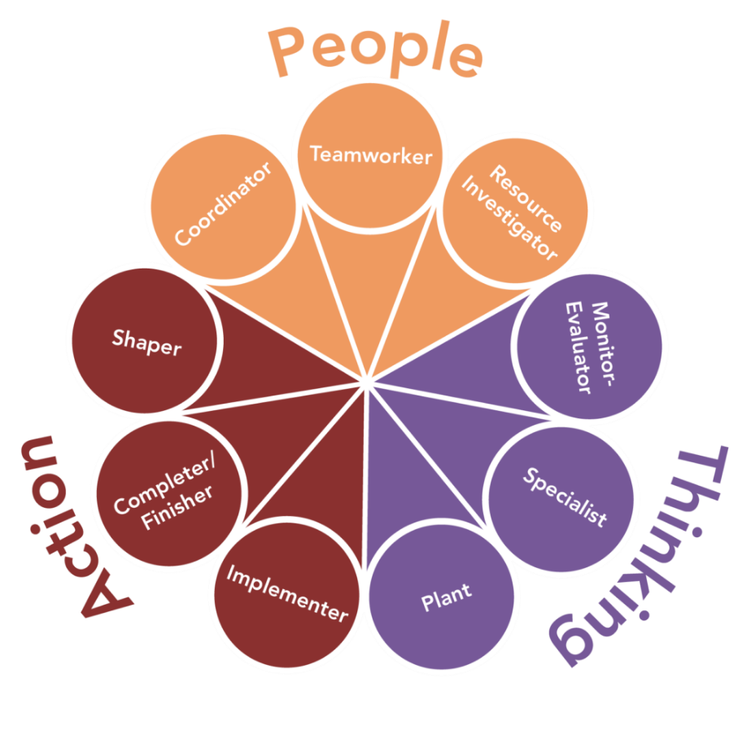
Team role (BELBIN) leadership roles
During the transition time, everyone is clear on each person's objectives, responsibilities, and obligations.
The resource detectives try to find out additional information about what the competitors are doing.
Each step of the performance is thoroughly understood by the team members in terms of their goals and duties (giudici and filimonau, 2019).
Amazonaws.com, 2022
Notes:
They can organise meetings, come to agreements, and resolve conflicts among themselves without a coordinator's help. As the meeting adjourns, each team member finishes the task they were given before leaving. Some people do not fit the job descriptions for any of the teams, hence they will not be assigned to any of the teams.

Slide 11
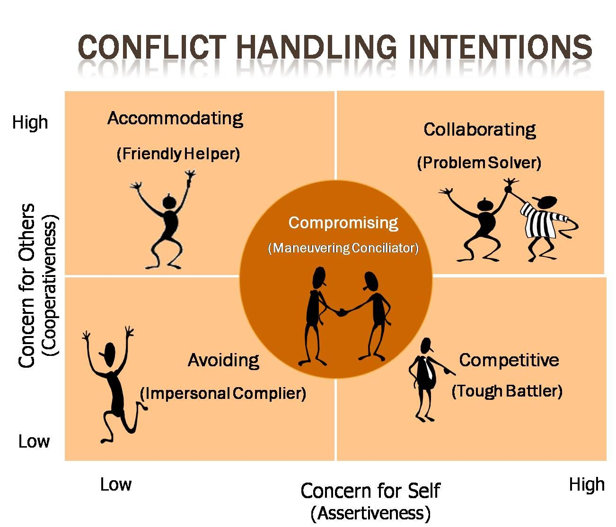
Managing conflict
There are several ways to manage. Inside each one, people can find a fresh method for tackling issues at work.
Certain aspects of another technique are included into some management philosophies.
They then alter it to meet their organisation's needs when that is finished. The objectives of this are to reduce conflict and resolve it.
Pinimg.com, 2022
Notes:
Once organisations attempt to address conflicts between employees and employers, adherence to human resource standards is essential. It is important for this to be done by a qualified authorised human resource representative (Yu and Zellmer-Bruhn, 2018). They must supervise all methods of resolving conflicts at work. Win-lose, lose-lose, or win-win scenarios might emerge from the outcome of a dispute. In order to effectively handle conflicts, all options should be discussed. It's critical to encourage compromise among the parties involved in order to arrive at a win-win solution. Most employment laws provide that mediation is the preferred technique of resolving conflicts.

Slide 12
Managing conflict
For those who are affected, this is a secure location (bundy et al. 2018). They may discuss their own viewpoints to find areas of agreement.
This requires effective communication. Communication problems are typically the foundation of office conflict.
In order to avoid misunderstandings or ambiguity, employees will communicate poorly with one another.
Notes:
This worsens already poor communication. In many corporate circumstances, having a place where miscommunications can be addressed, and mistakes can be admitted is enough to put an end to issues. It's typical for people to request praise from their supervisor. As an example, because of his unclear directions, the boss's project wasn't completed as he had expected. Instead of telling the employee they made a mistake when they didn't, he chose to let them figure it out on their own.

Slide 13
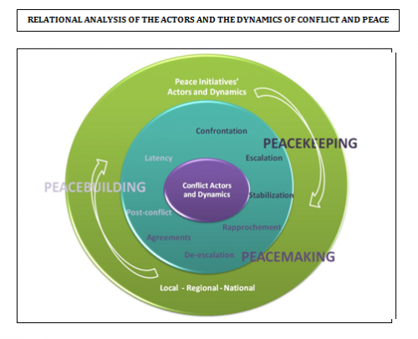
Managing conflict
In the modern workplace, males continue to earn, on average, 30% more than women (schroth, 2019).
In the beginning, women take more personal days off than do males.
Second, men tend to bargain more strongly when discussing wages.
Irenees.net, 2022
Notes:
Men also seem more forceful while discussing promotions. This raises conflict in organisations with diversity. Once giving directives to women at work, men frequently fail to take into account the sexism or misogyny in their tones or word choices. Because of this, women are left with little choice than to submit to the inappropriate behaviour or stand their ground (Molino et al. 2020). Once defending their rights at work, women are allegedly "emotional." In this situation, other acceptable explicative adjectives are also used to describe headstrong women.

Slide 14
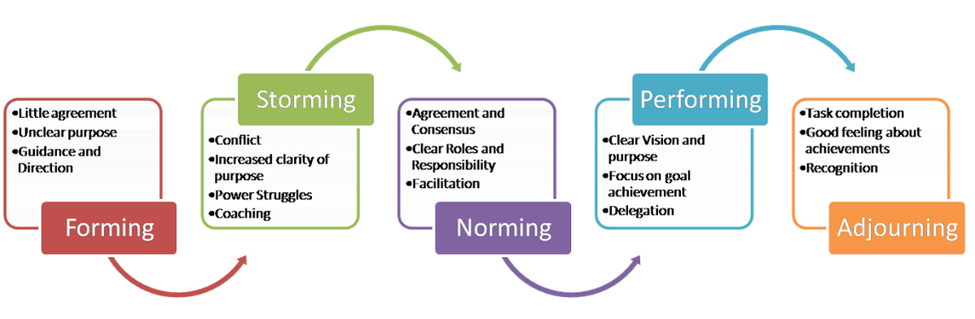
Successful team development
The term "team" refers to a group of two or more people who work together to accomplish common objectives (orsini et al. 2022).
In a variety of contexts, teams can be formed.
Since collaboration produces better results than solo effort does, teams will inevitably be formed in their daily activities.
Outlife.in, 2022
Notes:
Teams may be created in sports, educational settings, and even companies. The creation of efficient teams in enterprises has been cited by several thinkers as one of the key elements in achieving a firm's objectives. There have been many teams created throughout history. The effectiveness of each side, however, has differed significantly.

Slide 15
Successful team development
A team needs to be sufficiently effective for positive results to be realised in an organisation.
The most effective strategy to build a successful team is to start with meetings and seminars that address the team members (quigley et al. 2018).
During the initial team meetings, the team leader is reintroduced to the group's participants.
Notes:
The seminars will be essential for combining the numerous persons with various backgrounds. Thus, there will be beneficial ties among the group's members. A group's individuals need to be able to communicate effectively with one another in order to work together efficiently and accomplish the company's goals. Team-building activities should be added to motivate the team.

Slide 16
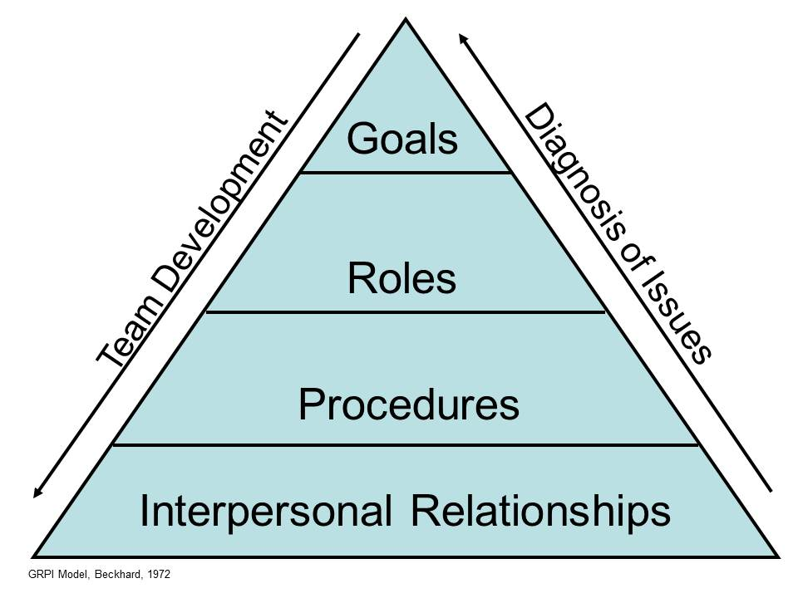
Successful team development
The members' remarkable cooperation is a key factor in the team's effectiveness.
By doing so, the company may further guarantee the effective coordination of operations within the operational organisation.
Teamwork is necessary for there to be a sense of belonging among the workers in an organisation.
Wrike.com, 2022
Notes:
These facts provide credence to Maslow's motivational theory (Morin, 2020). According to his theory of motivation, employees need to have a sense of belonging to the business to perform successfully. If there is effective collaboration, delegation will be completed successfully. A team's captain will frequently provide duties to the other team members when work is distributed inside the team. Communication is a key skill for a team. Information that is efficiently disseminated among team members will make it simpler for everyone to keep informed. Because of the quick flow among group members, conclusions may be taken fast. Communication will be key to the team's capacity to express all of its difficulties.

Slide 17


Reference list
Alharthi, N., 2020. Clinical reflection and leadership in efficient management of patients in the Intensive Care Unit. Journal of Nursing Research and Practice, 4(5), pp.1-4.
Andersen, M.H., Ottesen, L. and Thing, L.F., 2019. The social and psychological health outcomes of team sport participation in adults: An integrative review of research. Scandinavian journal of public health, 47(8), pp.832-850.
Bundy, J., Vogel, R.M. and Zachary, M.A., 2018. Organization–stakeholder fit: A dynamic theory of cooperation, compromise, and conflict between an organization and its stakeholders. Strategic Management Journal, 39(2), pp.476-501.
Giudici, M. and Filimonau, V., 2019. Exploring the linkages between managerial leadership, communication and teamwork in successful event delivery. Tourism management perspectives, 32, p.100558.
González-Cruz, T.F., Botella-Carrubi, D. and Martínez-Fuentes, C.M., 2020. The effect of firm complexity and founding team size on agile internal communication in startups. International Entrepreneurship and Management Journal, 16(3), pp.1101-1121.
Hoogeboom, M.A. and Wilderom, C.P., 2020. A complex adaptive systems approach to real-life team interaction patterns, task context, information sharing, and effectiveness. Group & Organization Management, 45(1), pp.3-42.
Karla, D., Alam, M.M., Jain, V. and Sharma, M., 2022. An Overview on Team Work Strategy in Medical Education. World Journal of English Language, 12(3), pp.110-110.
Kezar, A., Dizon, J.P.M. and Scott, D., 2020. Senior leadership teams in higher education: What we know and what we need to know. Innovative Higher Education, 45(2), pp.103-120.
Koon-Magnin, S., McGill, K.A. and Pusey, K.L., 2022. Benefits and shortcomings of an established sexual assault response team: a qualitative examination of stakeholder interviews. American journal of criminal justice, pp.1-18.
Meckbach, S., Wagstaff, C.R., Kenttä, G. and Thelwell, R., 2022. Building the “team behind the team”: A 21-month instrumental case study of the Swedish 2018 FIFA World Cup team. Journal of Applied Sport Psychology, pp.1-26.
Molino, M., Ingusci, E., Signore, F., Manuti, A., Giancaspro, M.L., Russo, V., Zito, M. and Cortese, C.G., 2020. Wellbeing costs of technology use during Covid-19 remote working: An investigation using the Italian translation of the technostress creators scale. Sustainability, 12(15), p.5911.
Morin, J., 2020. Scrum Iterative Development Practices for Team-Based Active Learning. Journal of Faculty Development, 34(3), pp.96-99.
Nielsen, M.W., Bloch, C.W. and Schiebinger, L., 2018. Making gender diversity work for scientific discovery and innovation. Nature human behaviour, 2(10), pp.726-734.
Orsini, J., Greenhaw, L.L., Coleman, B.M., Stone, W.A. and Bunch, J.C., 2022. Experiential Learning Style Grouping Impact on Student Outcomes in Team Leadership Coursework. Small Group Research, 53(3), pp.366-399.
Quigley, N.R., Collins, C.G., Gibson, C.B. and Parker, S.K., 2018. Team performance archetypes: Toward a new conceptualization of team performance over time. Group & Organization Management, 43(5), pp.787-824.
Robinson, Z. and Molthan-Hill, P., 2021. Assessing competencies for future-fit graduates and responsible leaders. Assessment and Feedback in a Post-Pandemic Era: A Time for Learning and Inclusion, pp.196-213.
Schroth, H., 2019. Are you ready for Gen Z in the workplace?. California Management Review, 61(3), pp.5-18.
Taylor, S. and Batty, C., 2022. One for the team: understanding individual and collaborative pursuits of script development across competing discourses. Creative Industries Journal, pp.1-12.
Waizenegger, L., McKenna, B., Cai, W. and Bendz, T., 2020. An affordance perspective of team collaboration and enforced working from home during COVID-19. European Journal of Information Systems, 29(4), pp.429-442.
Yu, L. and Zellmer-Bruhn, M., 2018. Introducing team mindfulness and considering its safeguard role against conflict transformation and social undermining. Academy of Management Journal, 61(1), pp.324-347.

Slide 18
Thank You

