Slide 1
Ibrar Ali- 2538206
DS1- My Digital life

Slide 2

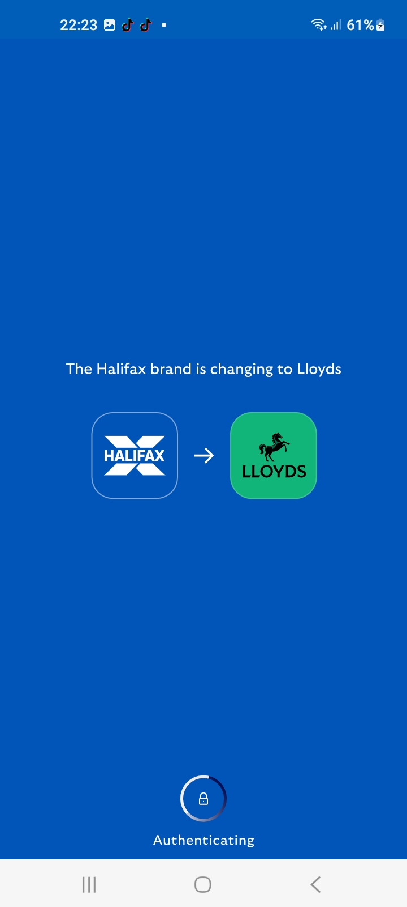
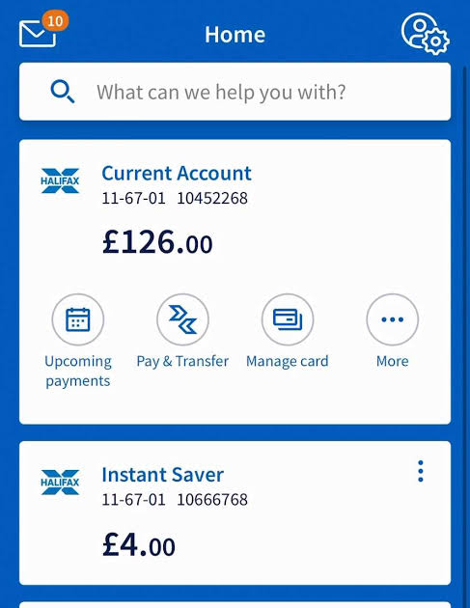
Halifax online banking app
This App is for me to handle my finances, having access to this helps me to see when I have been paid, see my outgoings helps me to handle my direct debits and make payments to suppliers for my business when making orders. Having online banking allows me to use apple pay making it easier to pay without having to carry a card.
Pressing the mail icon, I can view my bank statements as I have chosen to go paperless
When clicking this icon, you can view information like bank card number and pin number
Click this icon to pay into different saved accounts

Slide 3


Halifax online banking app
ADVANTAGES
DISADVANTAGES
App does not work without WIFI, cannot use outside unless you have data a or WIFI connection
Easy way to bank, transfer and pay

Slide 4
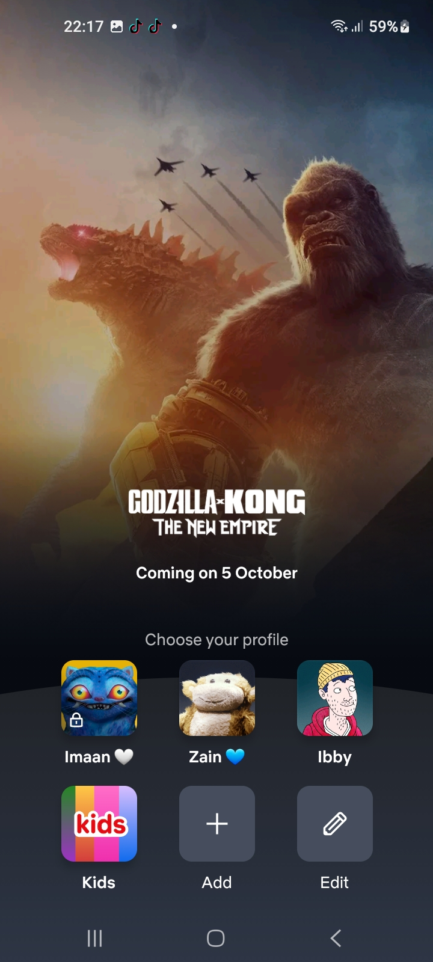

Netflix App
This app is my form of entertainment. Its easy to use app being able to watch my favourite movies and new movies when ever and wherever I want. It gives me a variety of shows and movies to choose from and there are always new ones to choose from.
Click account profile to view saved shows, recently watched shows and new movies and series

Slide 5
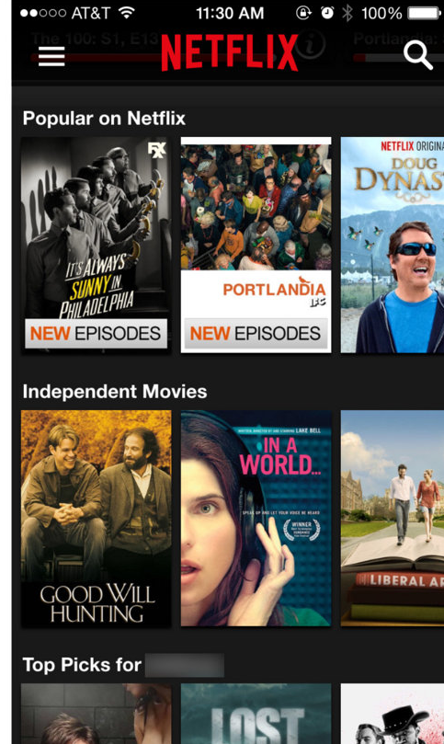
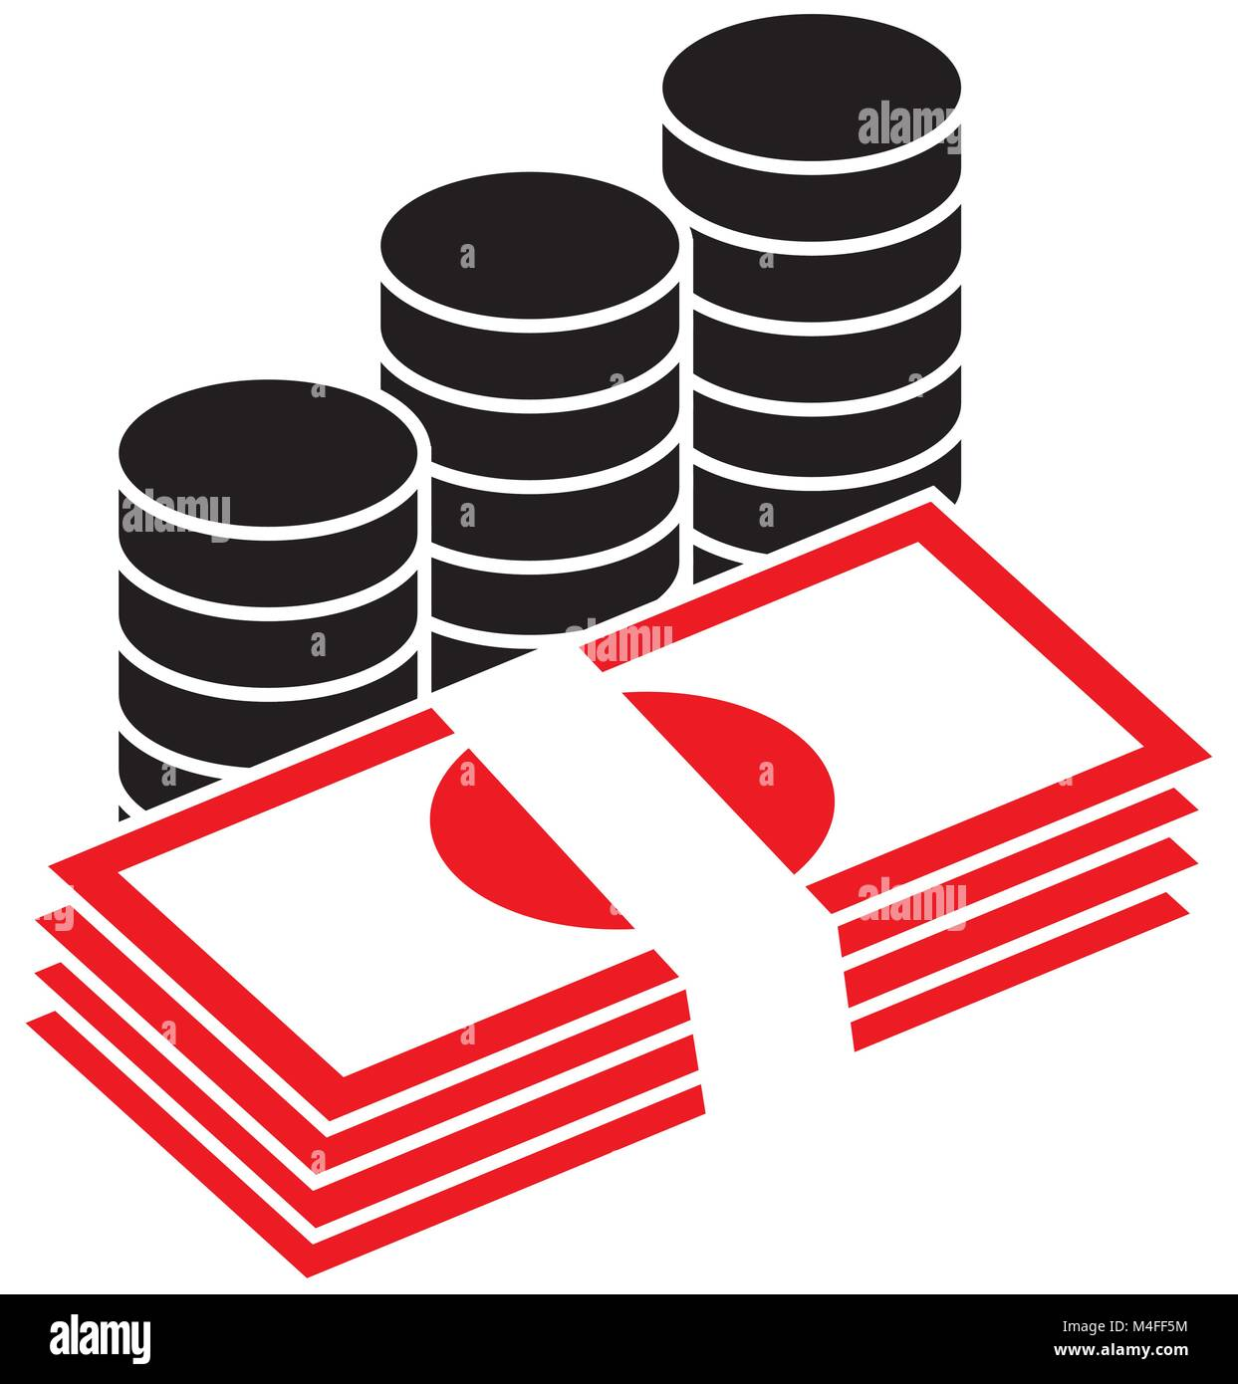
Netflix App
ADVANTAGES
DISADVANTAGES
Lots of option to choose from for entertainment
You have to have a subscription to watch on this app.

Slide 6
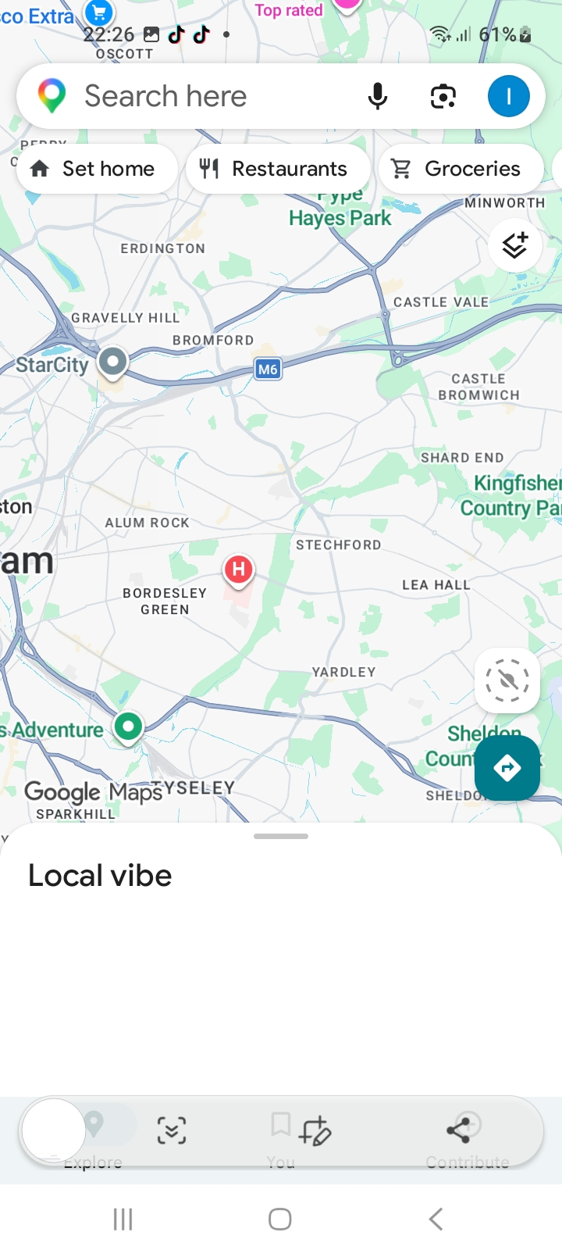

Google maps app
I use google maps nearly everyday in my life. For my business I have to travel to different locations everyday. Using google maps helps me find the places I need to travel to the locations using easy routes. It shows me traffic and obstacles on my routine helping me to avoid them.
Click and type address of destination for the drive to show up so you can start to travel.

Slide 7

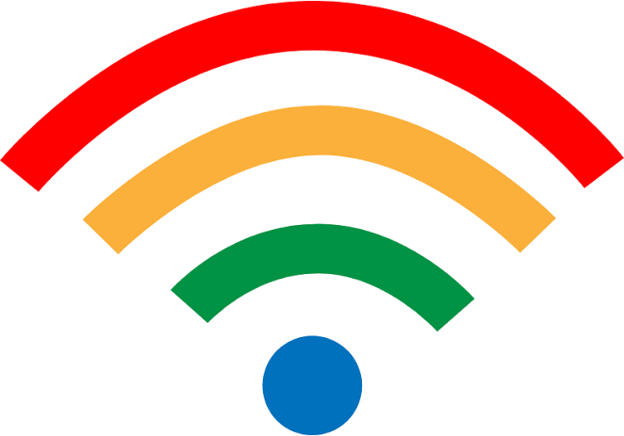
Google maps app
ADVANTAGES
DISADVANTAGES
Won’t work without internet
Easy to use

Slide 8
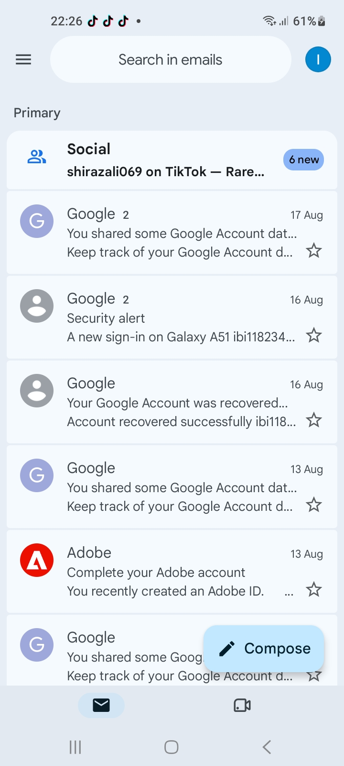

Google Mail app
I use google mail to send emails to suppliers to order my materials, track my orders , receive updates from them. Having this app on my phone makes it convenient to communicate and track information at any time. I can access my emails on my phone and my computer.
Press this icons and view multiple accounts
Click individual tab to view the full email and its contents

Slide 9
Google Mail app
ADVANTAGES
DISADVANTAGES
Doesn’t work without WIFI and easily loose emails in the junk folder
Able to keep secured and important emails safe

Slide 10
Reflection
I feel confident when I use the following apps, Netflix, Halifax banking, google maps and Gmail. This is because I use them regularly in my everyday life. I often use these tools to communicate, find directions and relax through these apps.
I would like to improve my knowledge of different tools and be able to use them more effectively. Having these skills are very important to me as they help me manage and get through my everyday tasks

