Slide 1
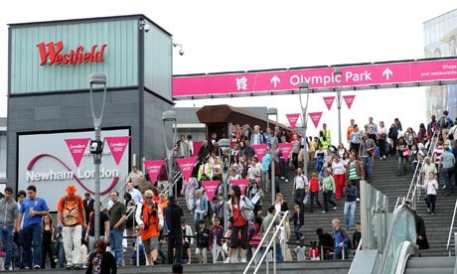
Strategic Sports Events Management
Research and Evaluation

Slide 2
Sports Event Evaluation

Slide 3


Slide 4
Discuss in Pairs
Why is it important to evaluate the impact of major sports events? List the reasons for doing so.
What outcomes/impacts is it important to evaluate? Make a list of the main ones.
What methods/tools are used to evaluate the impact?

Slide 5
Evaluation Overview
An essential part of sports event management – “a strategic necessity” (Masterman, 2014, p. 364).
Too often an after thought – ill conceived, ill prepared and executed.
Not just post event evaluation: pre, during and post event.

Slide 6
What would you use qualititave or quantitative?
Collecting feedback.
  Attendee, Sponsors, etc.
Analyzing data.
  Ticket sales, social media, sponsor and partner investment.
Financial performance
  Revenue and expenses, economic impact, sponsorship and funding evaluation.

Slide 7
Event Evaluation
Assists an event become more successful and helps to professionalise the industry (Getz, 2005; Hall, 1997; Allen et al, 2002).
Methods can be quantitative and qualitative.
Risk of bias, so vital that several types of research are conducted to provide a comprehensive outcome (Masterman, 2014).

Slide 8
Costs of Evaluation
Time and effort / quality and detail needed
Production of materials.
Wages or fees.
  All need to be included in the event feasibility process.
  Need to identify who needs the evaluation, when they need it and in what form they will accept it.
Masterman (2014).

Slide 9
Post Event Evaluation
Important for organisers, stakeholders, sponsors, participants, employees, suppliers, partners, investors, local communities and pressure groups.
Must be done against the original objectives – short and long term.
Timing: can be done at various points: 6 months, 1 year, 10 years.
Need to prioritise which stakeholders are key recipients of evaluation reports e.g. the state, sponsors.
Masterman (2014).

Slide 10
What gets evaluated?
For example:
Sports participation levels
Tourism impacts
Economic impacts
SIRC study, sample 7,500 questionnaires at ten major sports events between 2010-2012, found that 57% of spectators felt motivated to participate more than they normally did in sport.
Masterman (2014).

Slide 11
Evaluation Methods
Data collection e.g. sales data, participant data, budgets and cash flow.
Observation e.g. reports from staff, mystery shoppers, photographic and film records.
Debriefs - one meeting or series of meetings.
Surveys – questionnaires, interviews.
Economic Impact analysis.
Media coverage – press cuttings, broadcast coverage, internet activity.

Slide 12
Economic Impact Assessment
EIA is a technique for estimating the economic dimensions to a particular activity e.g. sports events.
Typically conducted for 3 reasons:
Advocacy – make case for staging an event.
Planning – so we can fully exploit the benefits from staging an event e.g. hotel space.
Finance - help attract funding and investment for events by illustrating the impact.

Slide 13
Economic Impact
Economic Impact is a measure of the additional expenditure, income and jobs created by an activity.
It is the extra activity created by an event.
There are 3 dimensions: direct impact, indirect impact and induced impact.

Slide 14
Economic Impact
Direct impact is the expenditure, income and jobs created at the site of the event and by the visitors to the event in the local economy.
Indirect impact is the exp, local income and local jobs created in the supplying industries for the event site and other places where the visitors spend money.
Induced impact is the exp., local income and local jobs created in the local economy in general, as a result of higher spending in 1 and 2.
Taken together 2 & 3 are known as the “multiplier.”
The size of the multiplier is dependent on the flow of “leakages” from the economy – money “lost” in savings, taxation and imports.

Slide 15
Economic Impact Examples
Evidence collected for Sydney, Athens and Beijing Olympic Games pointed to only a limited economic impact, possibly because some people would rather avoid the Games.
Short-term economic impact of London 2012 Games was also disappointing, with tourism revenues for 2012 down on previous years.
Economic legacies are likely to reach fruition only in the long term; some economists argue not until 15-20 years after the event.
Rose and Spiegel (2011) found that winning countries experience up to 20% growth in their national trade.
Notes:
Try and add citations here

Slide 16
Criticisms of EIA
Borrowed multipliers are inaccurate.
Ignores efficiency e.g. wasteful expenditure with little returns is seen as a benefit.
Ignores opportunity cost of resources used.
Little account taken of distribution of economic impact.
Too short run.
Deadweight expenditures – local residents expenditure not included.
Displacement effect – displaces activity that would have occurred elsewhere in the region.
Notes:
Deadweight expenditures – argument is if local residents expenditure is included it will lead to an overestimate. Contentious for some. The reasoning is that if event did not happen these local residents would simply spend the same amount on different opportunities locally. Therefore, following this reason, if local residents’ spending were included in the economic impact estimates it would lead to an overestimate. However, this could be seen as an extreme view. Some local residents spending at an event may be seen as additional if they would have otherwise spent their money on events and amenities in other localities (see Scotinform reference for a different, inclusive approach).
What do the students think?

Slide 17
Benefits
Enables diffuse or concealed benefits to be revealed.
Provides a clear lead for infrastructure investment and planning.
Justified public investment with evidence, not just rhetoric.
It is better than nothing!

Slide 18
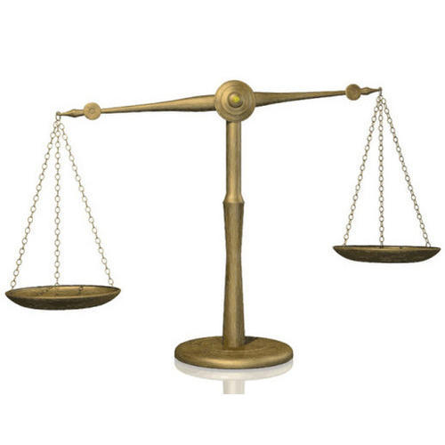
Therefore, on balance a useful tool but need to be aware of weaknesses.

Slide 19
Big spend but no return..
“The failure of London 2012 and Glasgow 2014 to create and inspire a nation to get active is not really surprising. For more than 40 years, community sports policy in Britain has been plagued by failings to meet physical activity performance indicators set by governments….. In the end, we have to face a difficult truth: governments continue to invest in costly elite sport and big extravagant sporting events that come at the expense of community sport” Challis (2018, no page).
Notes:
https://theconversation.com/fit-for-nothing-where-it-all-went-wrong-for-glasgows-commonwealth-games-legacy-94889
Big spend but no return
The failure of London 2012 and Glasgow 2014 to create and inspire a nation to get active is not really surprising. For more than 40 years, community sports policy in Britain has been plagued by failings to meet physical activity performance indicators set by governments.
This could be down to a variety of factors including: poor policy analysis to inform future policy-making decisions; overambitious or naïve participation targets; inadequate resources to deliver long-term programmes; and changes in direction leading to ambiguity regarding who is responsible for delivery.
Given these issues, it is understandable that grass-roots sport policies and major sporting events have failed to encourage more people to get active. Future government policy on community sport needs to have an all-party group commitment, that is evidence-based to ensure objectives are realistic. It needs to have a long-term plan and be adequately funded to ensure that there are real and lasting results.
In the end, we have to face a difficult truth: governments continue to invest in costly elite sport and big extravagant sporting events that come at the expense of community sport.

Slide 20

Student Task
Use research from websites and newspaper articles / interviews that evidence the impact of the Qatar World Cup
Has it been successful? Form an evidenced based opinion by utilising quantitative and qualitative data / opinion

Slide 21
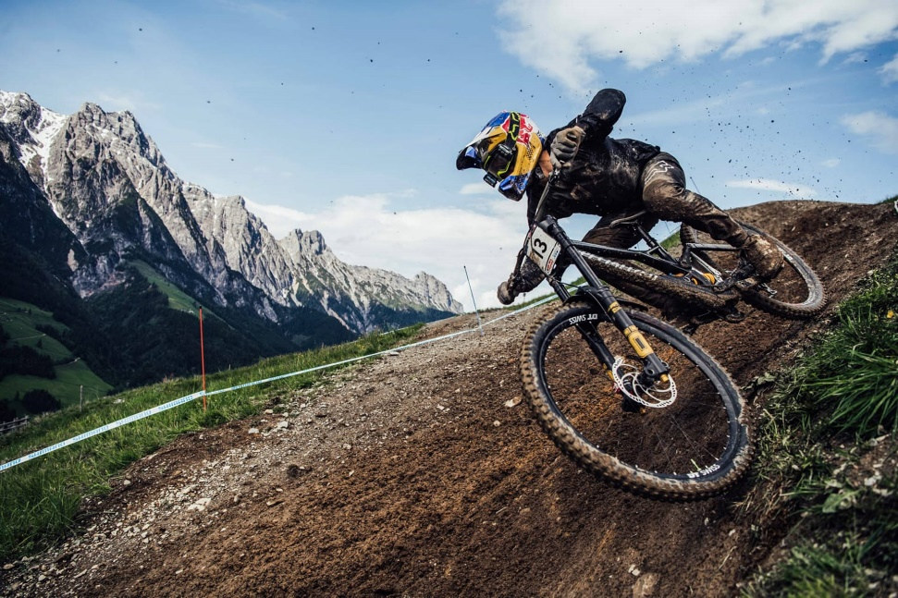
MTB Event Example
View feedback sheet
Post event Eval conducted after last race
Team meeting 2 weeks after
Further research to plan for the next

Slide 22
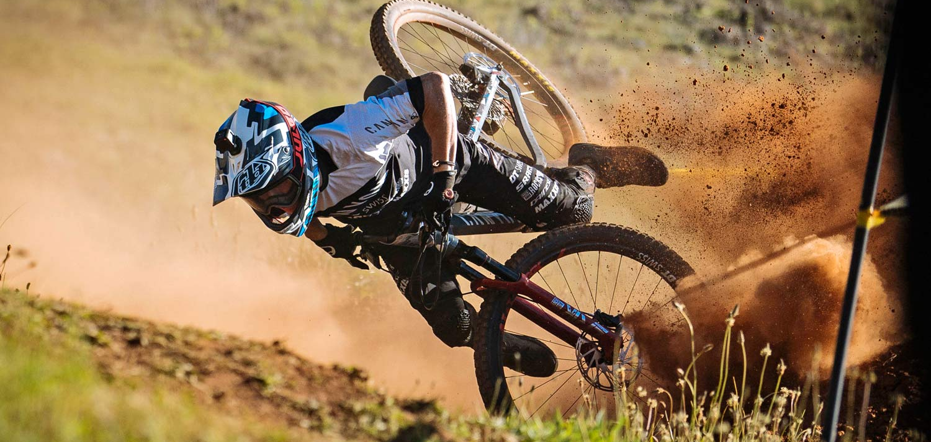
MTB Risk Assessment x2

Slide 23
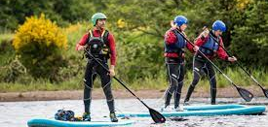
West Wales 2021 Paddle Boarding Excursion

Slide 24
Next week
Final in person lecture before XMAS
Information for the exam / revision
Assessment feedback
Drop in session 13th December
Exam 17th January

