Slide 1


Llwybr y Gymraeg
Welsh Pathway
BA3 2021-22
Grŵp B – Darlith/Lecture 3
Catrin Evans-Thomas/Julia James
c.evans-thomas@pcydds.ac.uk/j.james@uwtsd.ac.uk

Slide 2
Nod Ac Amcanion
Aims and Objectives
Llwybr y Gymraeg
Welsh Pathway
BA3 2021-22
Adolygu’r Gorffennol i gyd/Revision of all past tenses
Dysgu’r Gorffennol Rheolaidd/Learn about the regular past tense

Slide 3
YR AMSER GORFFENNOL: GWNEUD – Cysylltwch/Link
Gwnes i The children did
Gwnest ti I did
Gwnaeth e/hi He/She did
Gwnaeth Charlene Charlene did
Gwnaethon ni You did
Gwnaethoch chi We did
Gwnethon nhw They did
Gwnaeth y plant Charlene did

Slide 4
AMSER GORFFENNOL- CAEL- Cysylltwch/Link
Ces i The parents had
Cest ti They had
Cafodd e/hi He/she had
Cafodd Laura Laura had
Cawson ni We had
Cawsoch chi You had
Cawson nhw I had
Cafodd y rhieni

Slide 5
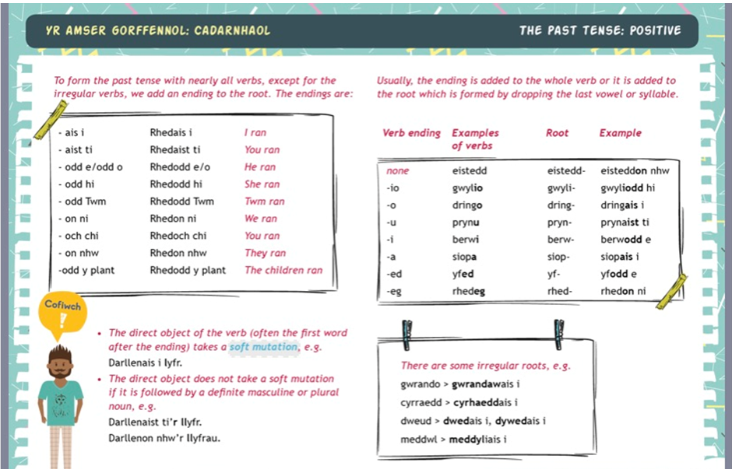

Slide 6
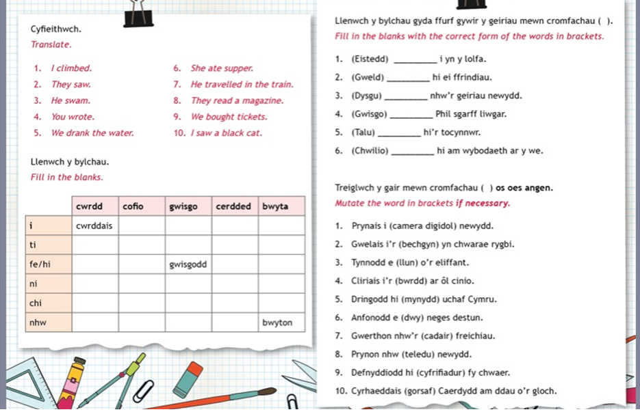

Slide 7
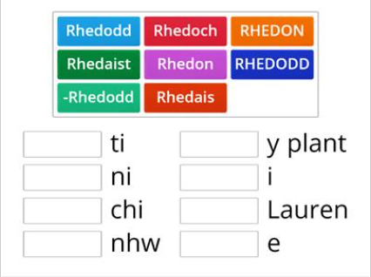
YR AMSER GORFFENNOL:CADARNHAOL

Slide 8
YR AMSER GORFFENNOL: CADARNHAOL
Wordwall-Yr amser gorffennol unjumble

Slide 9
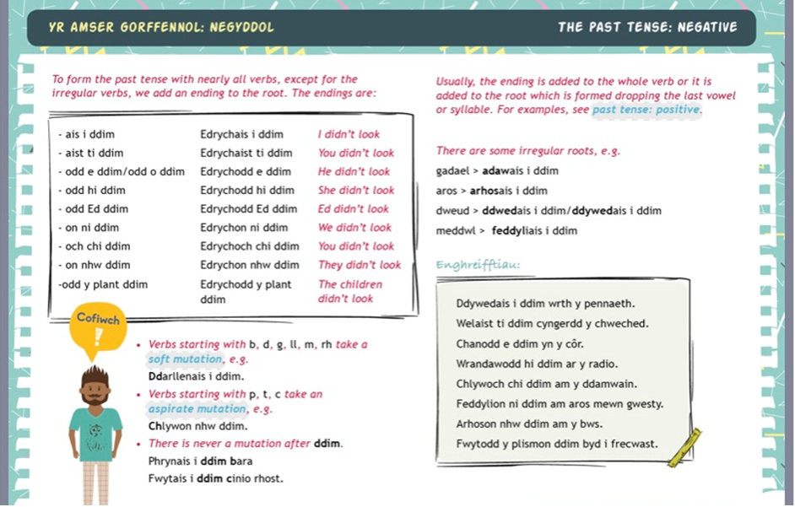

Slide 10
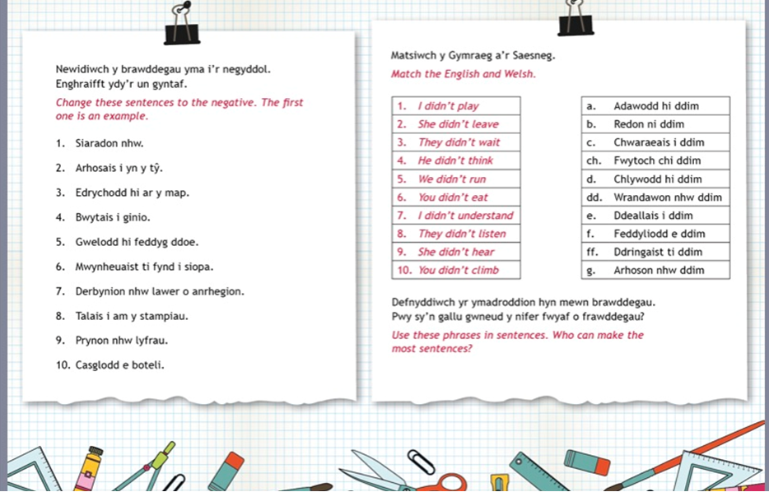

Slide 11
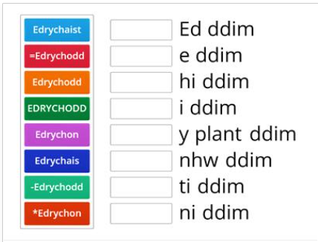
YR AMSER GORFFENNOL:NEGYDDOL

Slide 12
YR AMSER GORFFENNOL : NEGYDDOL
Wordwall – yr amser gorffennol –negyddol-match up!!!!!!
Yr amser gorffennol negyddol-match up-by Misseslocombe

Slide 13
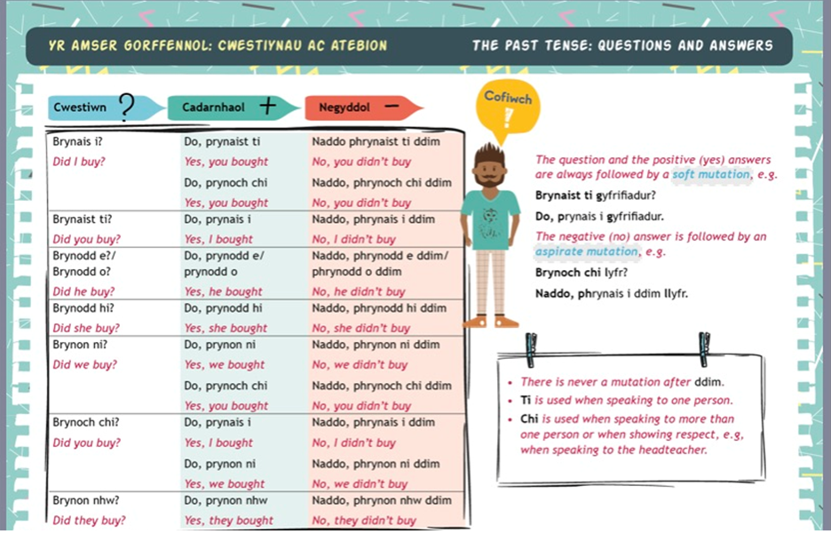

Slide 14
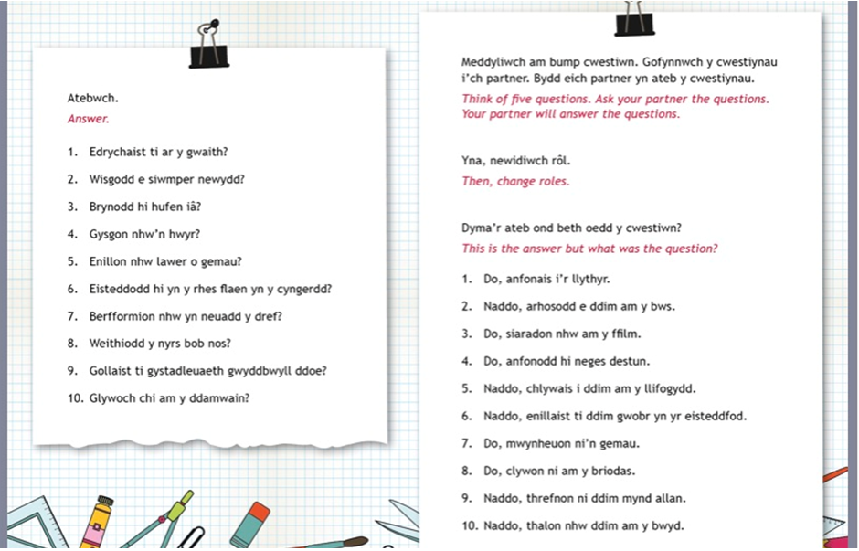

Slide 15
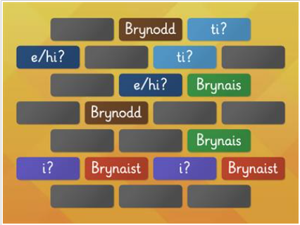
YR AMSER GORFFENNOL: CWESTIYNAU
Wordwall-yr amser gorffennol-cwestiynau!!!
Wordwall –yr amser gorffennol- cwestiynau
Wordwall – yr amser gorffennol airplane-airplane by Misseslocombe
Wordwall – yr amser gorffennol-cartref-match up-by Bailyess5

Slide 16
Adolygu
-YR AMSER GORFFENNOL: MYND
-YR AMSER GORFFENNOL: DOD
-YR AMSER GORFFENNOL: GWNEUD
-YR AMSER GORFFENNOL:CAEL

