Slide 1

ARCHES & OPENINGS
Green Bridge of Wales, Pembrokeshire

Slide 2

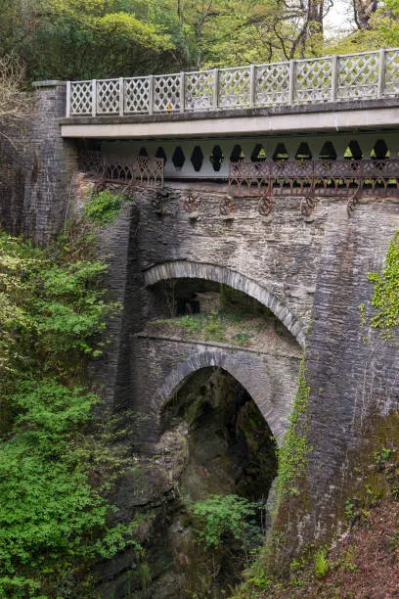
Arches
Arches are very strong load bearing shapes.
They can be difficult to build on a very large-scale hance the adoption of triangles for more modern bridges.

Slide 3
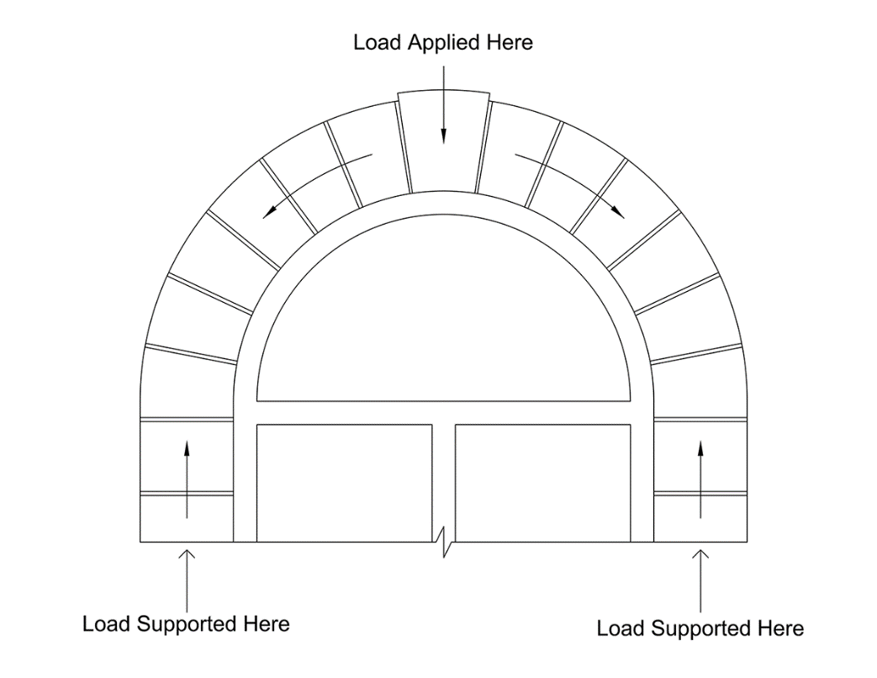
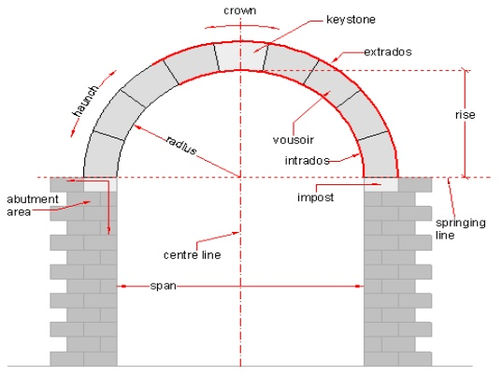
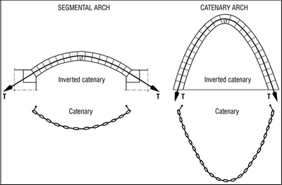
ARCH LOAD TRANSFER
https://www.youtube.com/watch?v=JlL6ZHChhQE

Slide 4
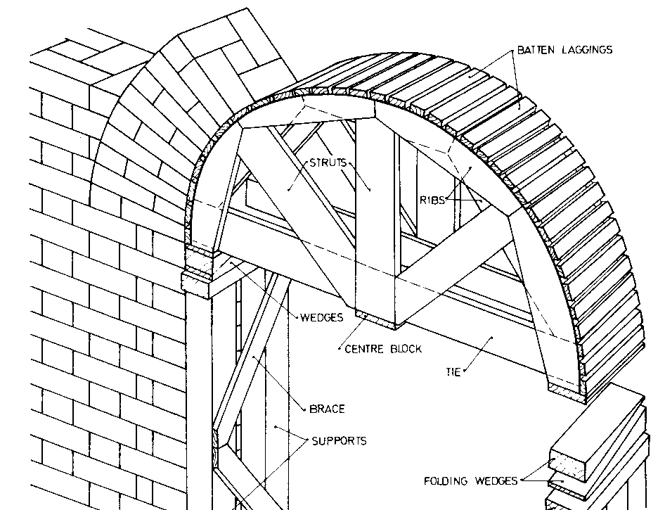
A centering form
Temporary wooden frame for creating brick or stone arches

Slide 5


Slide 6
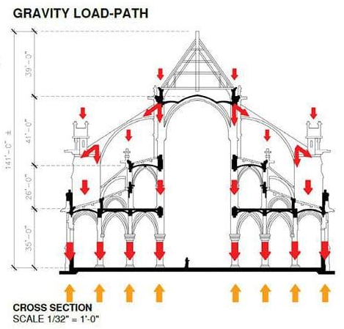
ARCH LOAD TRANSFER
Notre Damme, Paris

Slide 7
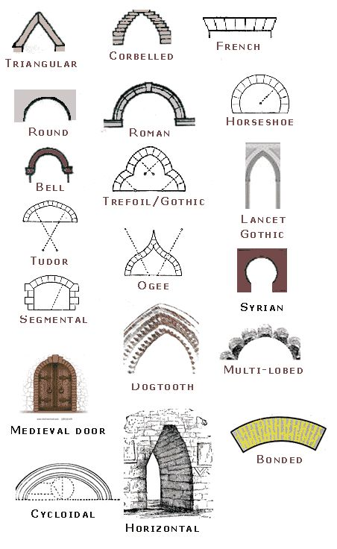
ARCH TYPES

Slide 8
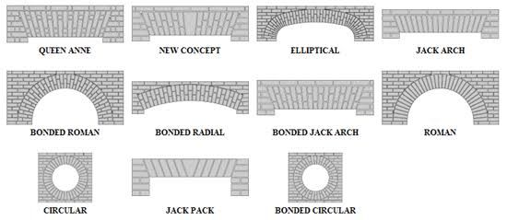
FACE BRICK ARCH TYPES

Slide 9
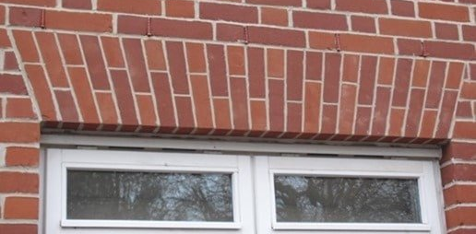
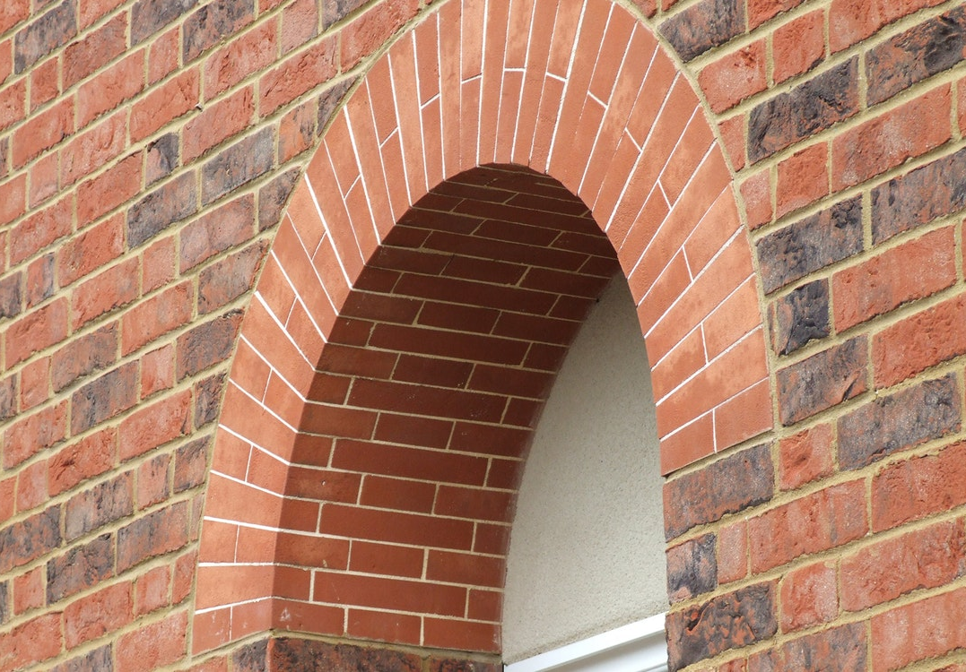
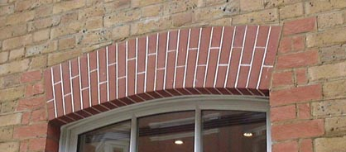
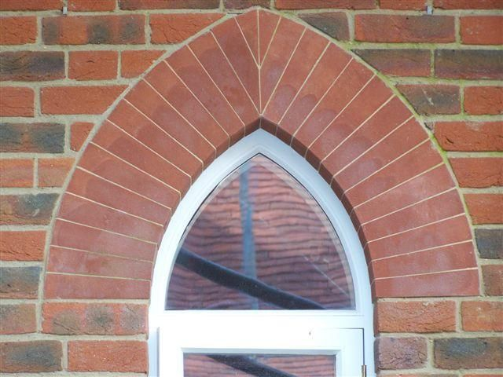
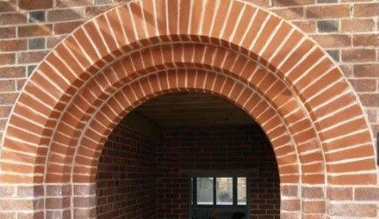
FACE BRICK ARCHES

Slide 10
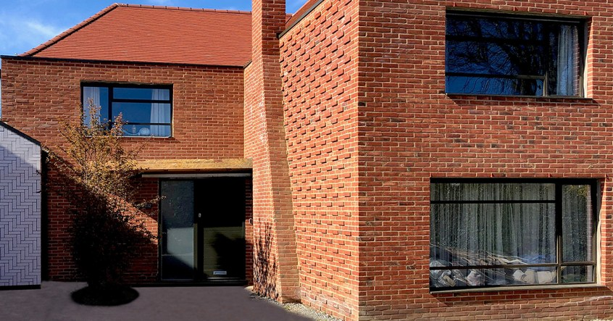
WHAT? NO ARCHES!

Slide 11
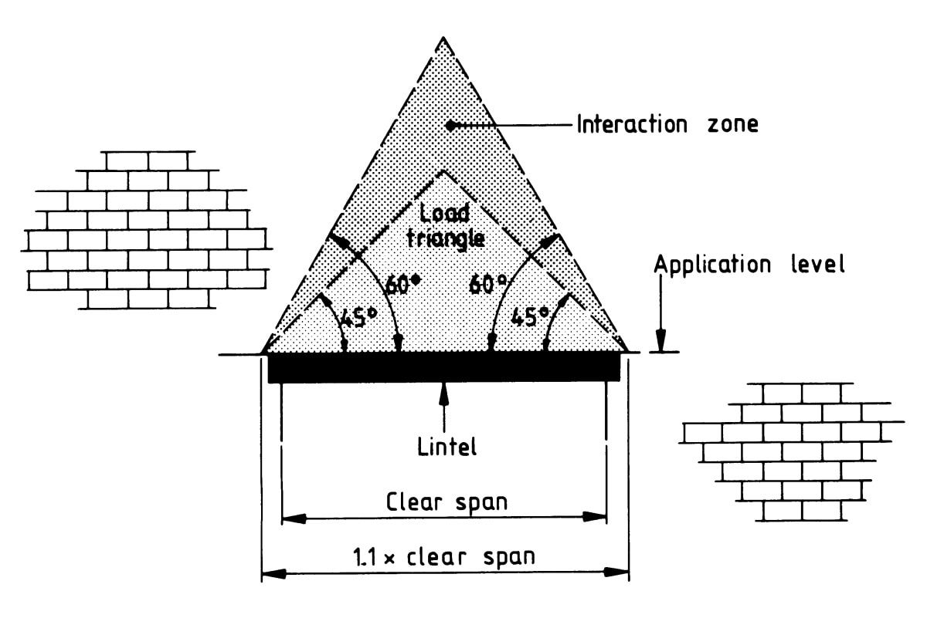
LINTELS
A horizontal load bearing beam
Flexural strength is the ability of the material to withstand bending forces applied perpendicular to its longitudinal axis.

Slide 12
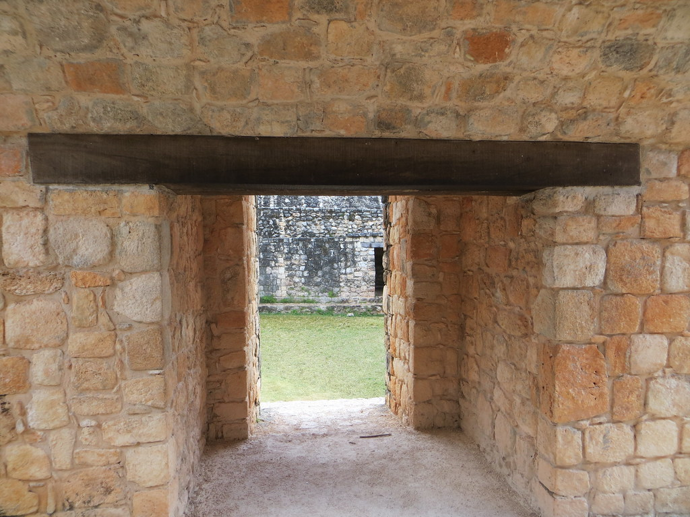
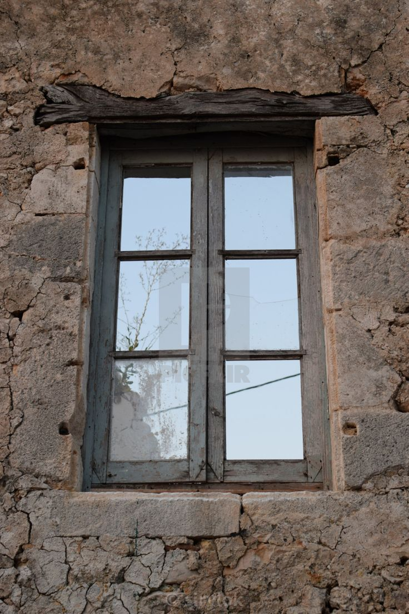
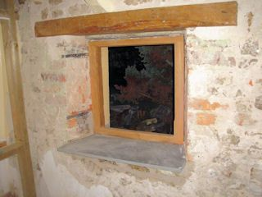
LINTELS
Timber elements
They will cover the whole span and will be supported at the jambs
Maintenance is essential
It is more flexible than masonry and can bend without breaking
Bending is an indicative of wrong performance but does not mean immediate failure
Potentially prone to rot / insect attack
Timber lintel being replaced

Slide 13
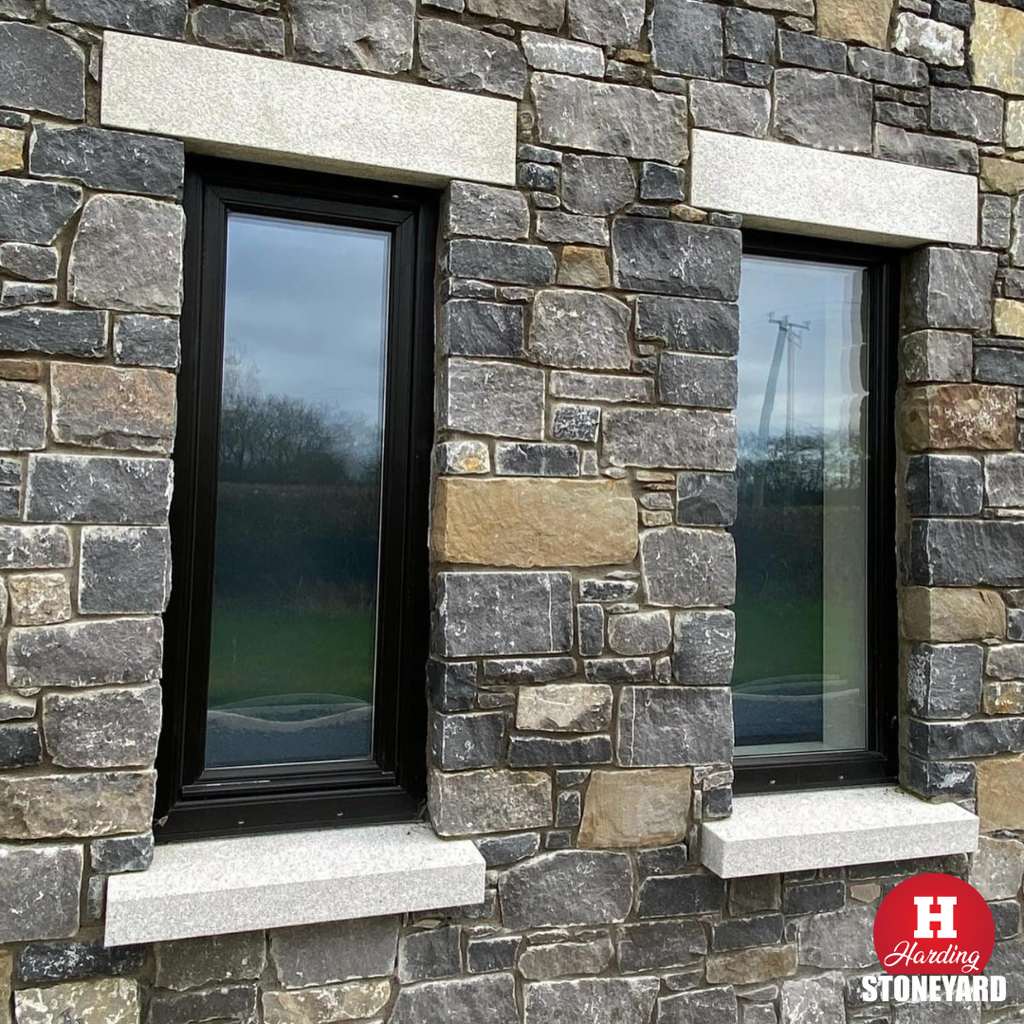
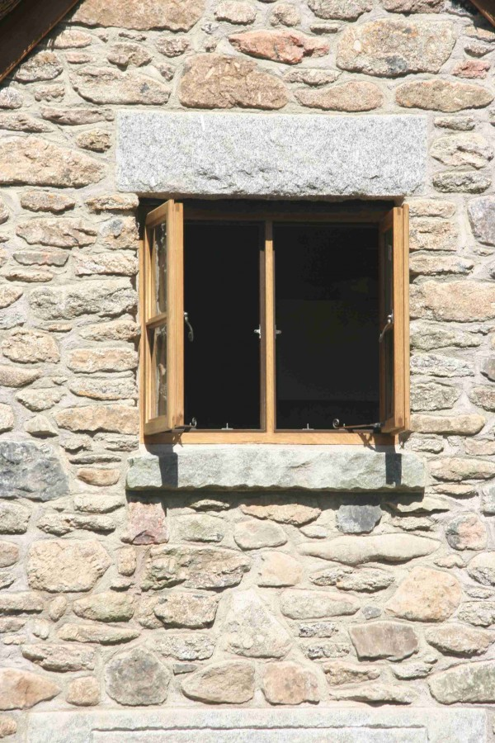

LINTELS
Stone elements
Similar construction
Much heavier
No special maintenance
Stone has little flexural strength, improved with thickness
Fragile. Easy to break
Ruined when broken

Slide 14
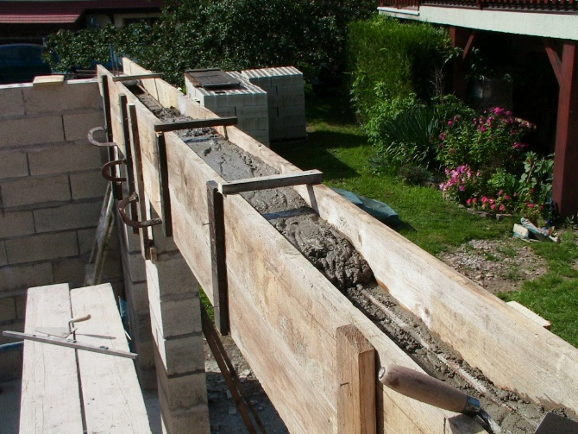
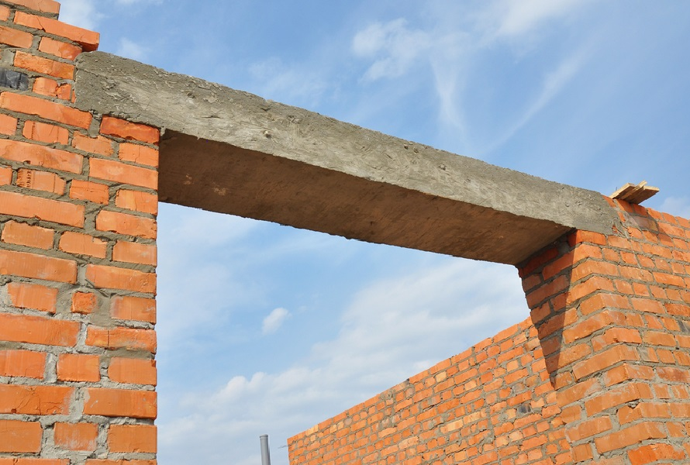
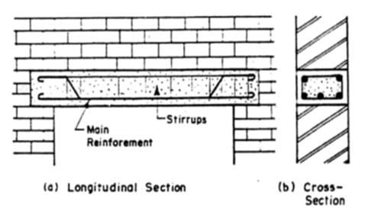
LINTELS
Cast in-situ elements
They are made at the same time of the wall construction and form part of it
Usually made of reinforced concrete to absorb flexural efforts properly
More difficulty in construction
  Framework/mould
  Reinforcement
  Pouring concrete
Replacement and repair are more difficult

Slide 15
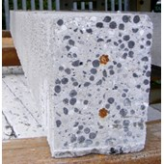
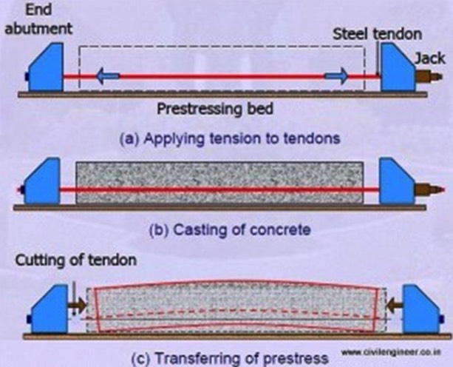
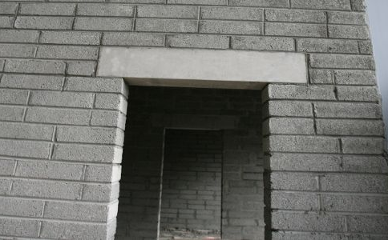
LINTELS
LINTELS
Precast/pre-stressed elements
Made off-site
Reinforcement can be pre-stressed to absorb flexural stress better
Health and Safety?

Slide 16
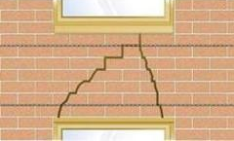
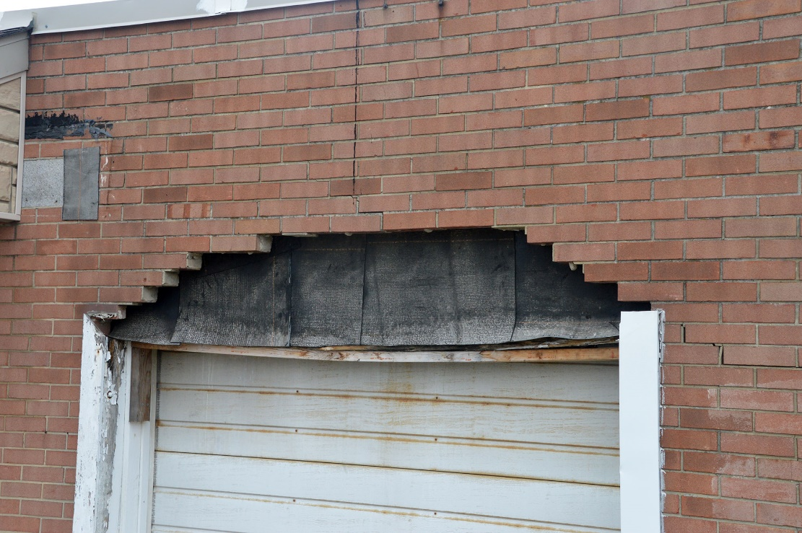
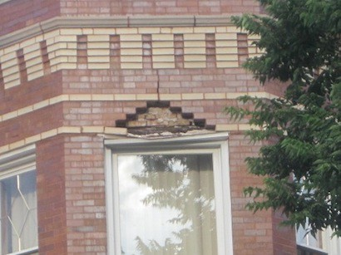
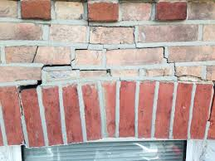
LINTEL FAILURE

Slide 17
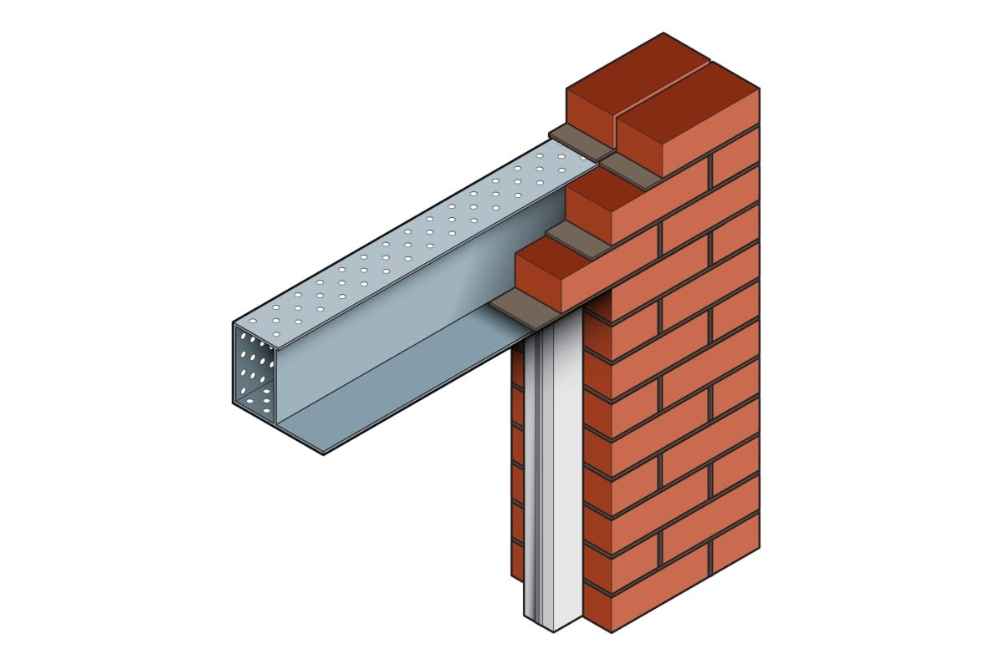
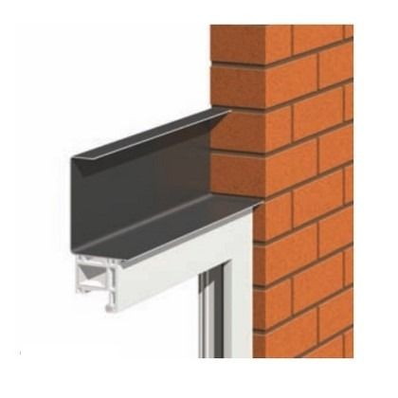
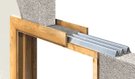
Evolution of LINTELS
Metal elements
Fast and cheap solution
Light weight
Problems with thermal bridging. It should be correctly installed and insulated

Slide 18
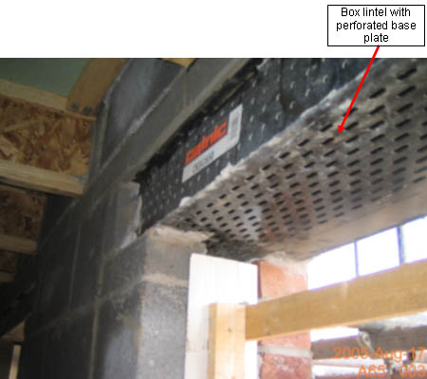
LINTELS
LINTELS
Metal elements
Be careful!!!
Thermal bridge

Slide 19
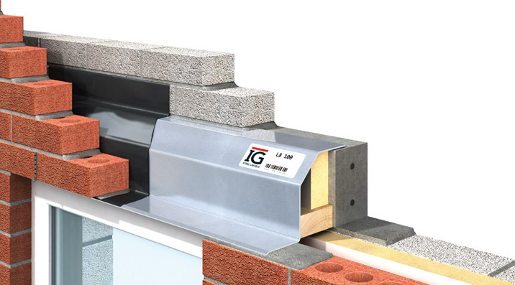
Modern LINTELS
Metal elements
Cavity walls
Concrete lintel to inner leaf
Steel stepped lintel to outer leaf
Cavity tray
Insulation

Slide 20
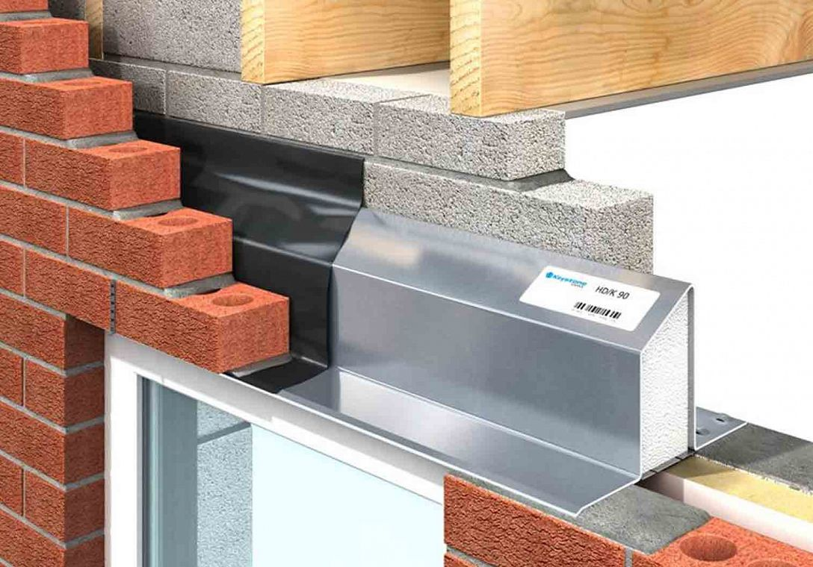
LINTELS
LINTELS
Metal elements
Standard steel cavity lintel
Cavity tray
Insulation
Size dependant upon masonry and cavity dimensions

Slide 21
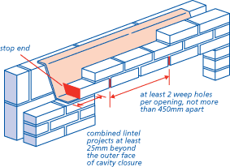
LINTELS
LINTELS
Metal elements

Slide 22
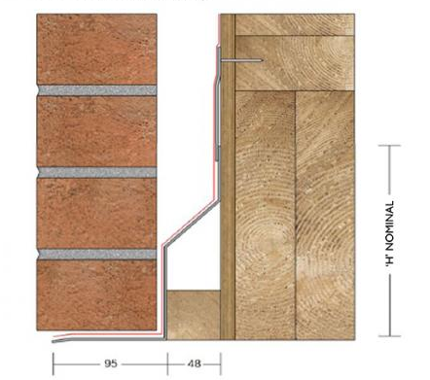
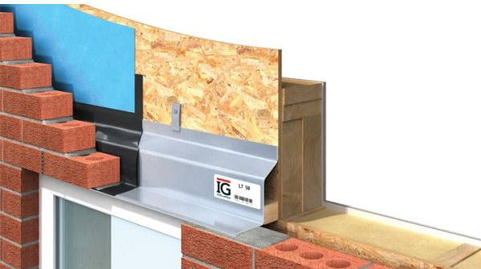
For timber frame?

Slide 23
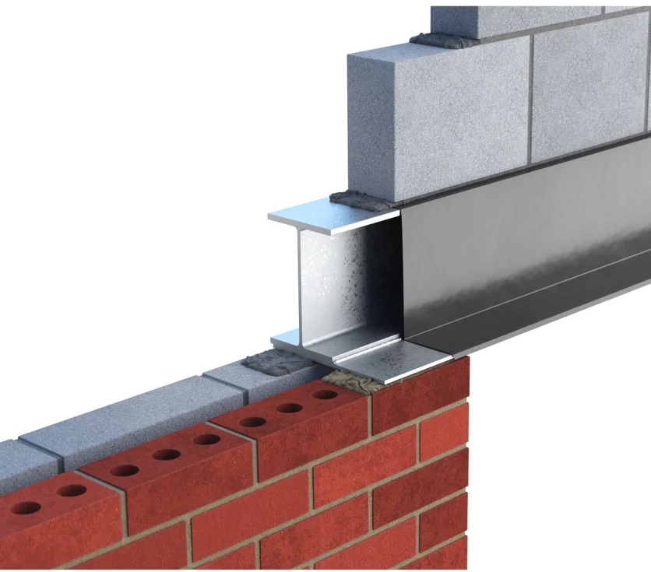
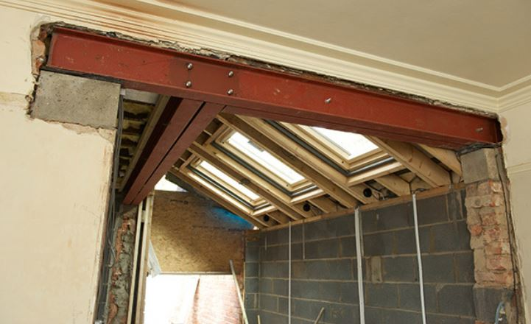
What about RSJ’s – Rolled Steel Joists?
Can be used as lintels, more common for internal walls where they support an entire solid wall.
It is possible to use them for the internal leaf in a cavity, though less common

Slide 24
LINTELS
LINTELS
Specifications
Lintels should be installed with a minimum end bearing of 150mm, bedded on mortar and levelled along its length and across its width.
The masonry above the lintel should be built in accordance with BS EN 1996-2:2006.
Raise the inner and outer leaves simultaneously to avoid excessive eccentricity of loading, with a maximum height difference of 225mm (Masonry should be laid on a mortar bed and all perpendicular joints should be filled.)
Allow the mortar to cure before applying floor or roof loads (Temporary propping beneath a steel lintel is practised to facilitate speed of construction).
A damp proof course (DPC) or cavity tray should be installed over all openings in external cavity walls.
When installing concrete floor units or other heavy components above a lintel care should be taken to avoid shock loading and floor units should not be dragged into position. Masonry immediately above the lintel should be allowed to cure.
Point loads should not be applied directly onto lintel flanges. Lintels should have a minimum of masonry 150mm high between the flange and the application level of any form of loading.

Slide 25
LINTELS
LINTELS
How about a window cill?
What about the jambs?

Slide 26
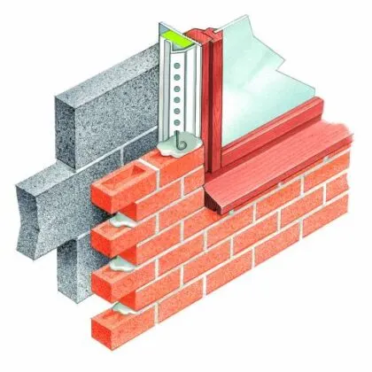
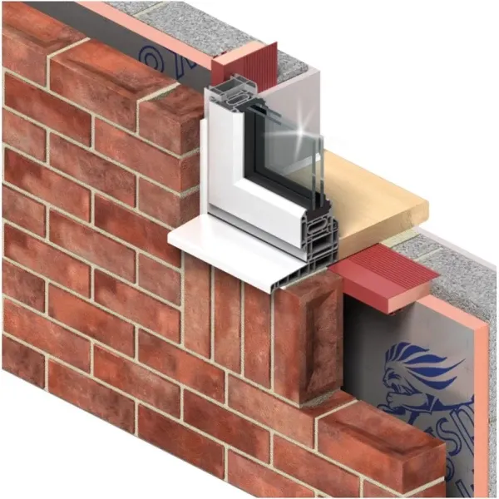
Cavity Closers
To overcome thermal bridging

Slide 27
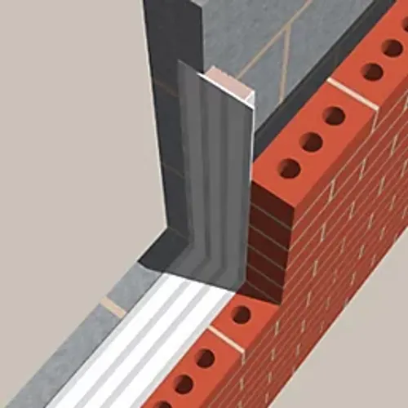
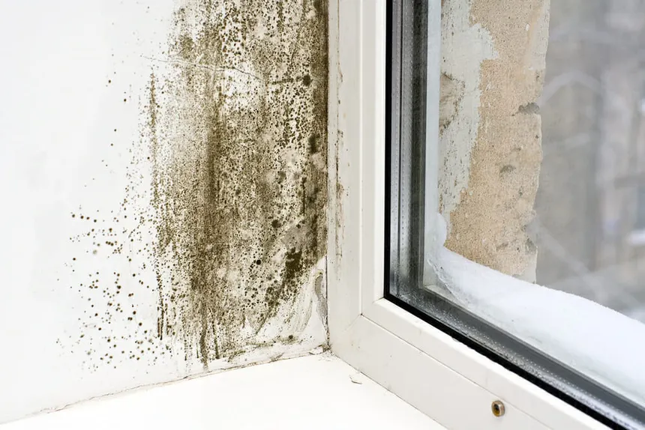
Cavity Closers
This is an image of a more modern cavity closer which incorporates insulation.
Prior to the inclusion of insulation in the early 90’s a piece of slate or other spare material could be nailed in place to form a surface to plaster. This created cold spots which is susceptible to damp and mould

