Slide 1
Group Presentation:
Fates Card
By
Anja, Hadie Issie, Jake & Lily

Slide 2
The fates have decreed that Athenodoros son of Timon of the deme of Thorikos will be tasked with the choregia for the tragedian Mikon in this years Great Dionysia.

Slide 3
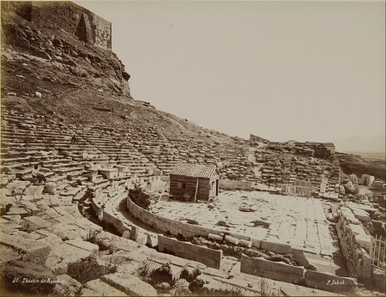
What does this mean?
We have been chosen to for the liturgy of acting the part of a sponsor for this year’s Tragic play at the Great Dionysia.
A liturgy is a “compulsory public service” that required a citizen to “not only bear the costs of essential state services, but also to supervise their execution” (Christ, 1990).
Whilst the Great Dionysia or ‘Festival Dionysia’ was a “city festival” (Goldhill, 1987) and occurred in the spring toward “the end of March, when the allies were accustomed to send their tribute to Athens and the city was crowded with visitors” (Flickinger, 1914).
During this time there would be a “performance phase” in which there would be all sorts of plays of varying natures such as comedic, tragic and satirical. (Rasmus Brandt and Iddeng, 1914)
Theatre of Dionysus – Sebah Pascal

Slide 4
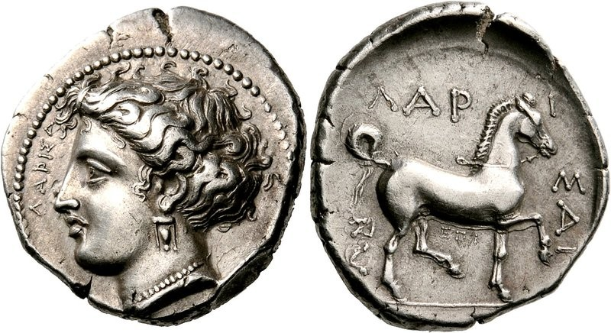
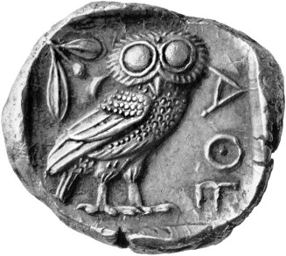
What would we need to pay for?
“the musicians and the chorus (and its training in singing and dancing), stage sets, costumes and so on” (Osborne, 1957).
How much would this cost? “appointed to produce tragic drama, I spent thirty minae” (Lys 21.1) this would suggest that the rough approximation in Athenian currency would be 3000 drachma or 0.5 Talent.
This is because “The Greek drachma was originally defined as 1/6000th of a Talent of silver” and 1 Athenian Talent = 60 minae (Trader, 2012) .

Slide 5
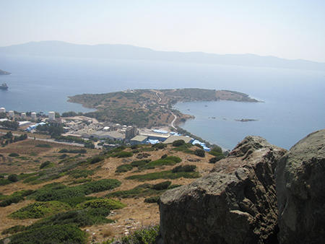
The Family’s Assets
Own: A workshop of shield-makers
Inherited: Land surrounding two working mines in Besa
Inherited: A Plyterion (an ore-washing facility)
Invested: in a potter’s workshop
Invested: in Maritime Loans
People: A freeman (oversear in the workshop) → Brings in money
People: A slave → Brings in money
Thorikos – Maria Kayafa

Slide 6
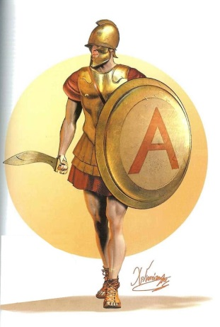
Workshop of Shield-makers
During the Mid-4th Century BC, Athens was involved in disputes and eventual outright war with Macedonia (Hornblower,2012). As a result, it would be necessary for Athens to be able to equip soldiers and an army with which to fight their battles. This of course in turn would garner a larger profit for a Workshop of shield-makers such as this one.
As an estimation of what such as workshop would profit we turn to Lysias who was a Metic who had “joint inheritance of the weapon manufacturing business of his father” (Weißenberger, 2018).
Lysias at one point offers a bribe of “three talents of silver, four hundred cyziecenes, a hundred darics and four silver cups” (Lys 12.11) which suggests that not only was the man well off but he was rich enough that he had this much cash in hand at his disposal.
Drawing by C. Giannopoulos for Periskopio Editions

Slide 7
Land in Besa
Besa is a small village approx. 5 miles south west of Thorikos and is considered to be the source of Athen’s wealth due to the silver mines there. Due to the wealth and opportunities the mines provided, people often chose to live near said mines to be able to profit from said opportunities.
Taking this into consideration we could rent out the land surrounding the mines. The land surrounding one mine would create an income of “one hundred and five drachma a month” (Demos 37.5).

Slide 8
Plynterion
Demosthenes states that he himself had bought a plynterion “for ninety minae” (Demos 37.22) meaning that should we have the need to we could afford to provide half of the 3 Talents required by simply selling this ore washing facility.

Slide 9


Conclusion
Considering the financial information provided it is apparent that not only could we afford to pay for what we have been tasked, but with the profit from the shield-maker’s workshop we could make back the loss from renting out the land which surrounds the mine for just over 14 months.

Slide 10
Bibliography
Bouvrie, S “Greek Festivals and the Ritual Process: An Inqiry into the Olympia-cum-Heraia and the Dionysia.” Greek and Roman Festivals: Content, Meaning and Practice. Oxford University Press, 2013. http://www.oxfordscholarship.com/view/10.1093/acprof:oso/9780199696093.001.0001/acprof-9780199696093-chapter-4 <Accessed 23rd September 2018>.
Christ, M (1990) “Liturgy Avoidance and Antidoes in Classical Athens” Transactions of the American Philological Association (1974-2014) Vol. 120. www.jstor.org/stable/283983 <Accessed 23rd September 2018>.
Demosthenes. Against Pantaenetus. A.T. Murray (trans.) 1939.(37.5–37.22) http://www.perseus.tufts.edu/hopper/text?doc=Dem.+37+5&fromdoc=Perseus%3Atext%3A1999.01.0076 <Accessed 22rd September 2018>.
Flickinger, R “The Influence of Festival Arrangements upon the Drama of the Greeks Part I.” The Classical Journal, Vol. 10, No. 3. 1914 (115-125) JSTOR https://www.jstor.org/stable/3287234 <Accessed 23rd September 2018>.
Goldhill, S “The Great Dionysia and Civic Ideology.” The Journal of Hellenic Studies Vol. 107. 1987 (58-76). JSTOR https://www.jstor.org/stable/630070 <Accessed 23rd September 2018>
Lysias Defence Against a Charge of Taking Bribes. W.R.M. Lamb (trans.) 1930. Camridge; Harvard University Press. p. 477. Leob Classics. https://www.loebclassics.com/view/lysias-21_defence_charge_taking_bribes/1930/pb_LCL244.477.xml <Accessed 23rd September 2018>
Osborn, R (1957) The World of Athens: an introduction to classical Athenian culture. Cambridge; New York; Cambridge University Press (8.59-8.65)
Trader2Trader Ancient Greek Drachma. 2012. https://trader2trader.co/2012/09/04/historic-currencies-ancient-greek-drachma/ <Accessed 23rd September 2018>.
Weißenberger, Michael, Beck, Hans, Mehl, Andreas, Karttunen, Klaus, Neudecker, Richard, Nutton, Vivian Lysias.2018 Brill’s New Pauly,. http://dx.doi.org.ezproxy.uwtsd.ac.uk/10.1163/1574-9347_bnp_e714620 <Accessed 2st September 2018>

