Slide 1
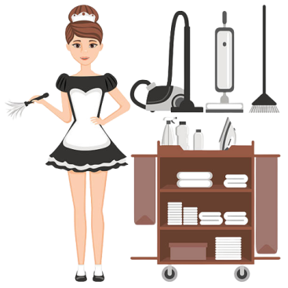
Housekeeping checklist
Student name- Ionela Lacramioara Balta
Student number-2208099
Source: (Christl, 2023)

Slide 2
Content
Introduction | Slide 3
Checklist of daily housekeeping tasks | Slide 4
Tasks | Slide 5
Tasks | Slide 6
Principle of employee engagement | Slide 7 and Slide 8
Conclusion | Slide 9
References | Slide 10

Slide 3
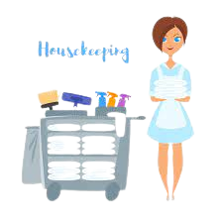
Introduction
To obtain the appropriate measure of cleaning there is the checklist to maintain in order to successfully implement the task (Christl, 2023). That checklist involves daily cleaning task such as changing shower curtains in every 1 or 2 days, change of pillow protector in 1 or 2 days and also before new guest arrival, clean bathroom extract along with Air conditioner filters daily, change mattress cover daily and also clean the dust and wipe the floor.
Source: (Christl, 2023)
Notes:
This presentation will highlight the principles of an employee engagement mode in order to maintain the proper standards of housekeeping and cleanliness measure to ensure the cleanliness of rooms in order to gain the satisfaction of the guests. To obtain the appropriate measure of cleaning there is the checklist to maintain in order to successfully implement the task. That checklist involves daily cleaning task such as changing shower curtains in every 1 or 2 days, change of pillow protector in 1 or 2 days and also before new guest arrival, clean bathroom extract along with Air conditione filters daily, change mattress cover daily and also clean the dust and wipe the floor.

Slide 4
Checklist of daily housekeeping tasks
Task | MON | TUE | WED | THU | FRI | SAT | SUN
Changing shower curtains (Sever, 2019) | ✓ |  | ✓ |  | ✓ |  | ✓
Change of pillow protector | ✓ | ✓ | ✓ | ✓ | ✓ | ✓ | ✓
Clean bathroom extract | ✓ | ✓ | ✓ | ✓ | ✓ | ✓ | ✓
Air conditione filters | ✓ |  | ✓ |  | ✓ |  | ✓
Change mattress cover | ✓ | ✓ | ✓ | ✓ | ✓ | ✓ | ✓
Notes:
That checklist involves daily cleaning task such as changing shower curtains in every 1 or 2 days, change of pillow protector in 1 or 2 days and also before new guest arrival, clean bathroom extract along with Air conditioner filters daily, change mattress cover daily and also clean the dust and wipe the floor (Sever, 2019).

Slide 5
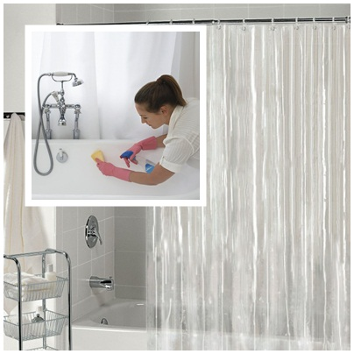
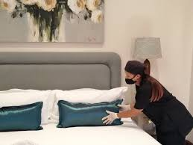
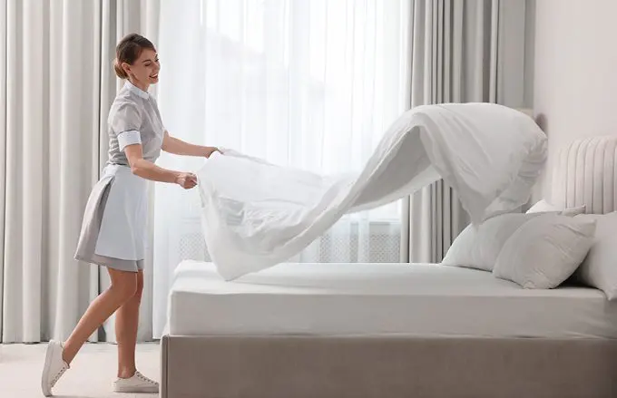
Tasks
Changing shower curtains
Change of pillow protector
Source: (Sianipar and Cicilia, 2023)
Change mattress cover
Source: (Sianipar and Cicilia, 2023)
Source: (Sianipar and Cicilia, 2023)
Notes:
Changing shower curtains – the shower curtain does not need to change daily, these can be change in every one or two days depending on the use and dirtiness of shower curtains. Before arriving the new guest in the same room at that condition the deep cleaning has to be done that includes the implantation of every task including dusting and wiping of the floor in order to the satisfaction of the guest and sense of feeling of new and cleaned room.
Change of pillow protector- changing the pillow cover can be performed daily in order to provide the cleaned pillow protector ensuring the satisfaction of guest. As some guest have some skin issues that should not be a cause any issue to the new arriving guests. The bed should be neat and cleaned in order to provide the best experience of stay to the guests (Sianipar and Cicilia, 2023).
Change mattress cover – In terms of sanitation, mattresses protectors serve as a defence towards leaks, staining, alongside allergies. Washing sheets frequently keeps the bedroom for visitors neat and sanitary. It allergy Controlling cleaning reduce the accumulation regarding pollen, skin cells that have died, and various other allergies that might gather on mattress by switching out the mattress's coverings. Visitors with allergy or nutritional to food should pay particular attention to this.
Mattresses coverings shield mattresses form accidents alongside staining, keeping their aesthetic appeal alongside extending their useful lives. In order to maintain Customer happiness a freshly cleaned bedding featuring an updated mattress covering helps visitors feel satisfied and have a good night's rest. In order to conformity a guidelines the existing rules and requirements for lodging cleaning alongside sanitation in different countries. Resorts can fulfil these demands by constantly altering the mattress's coverings.

Slide 6
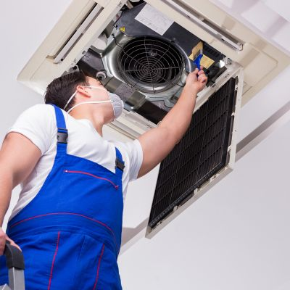
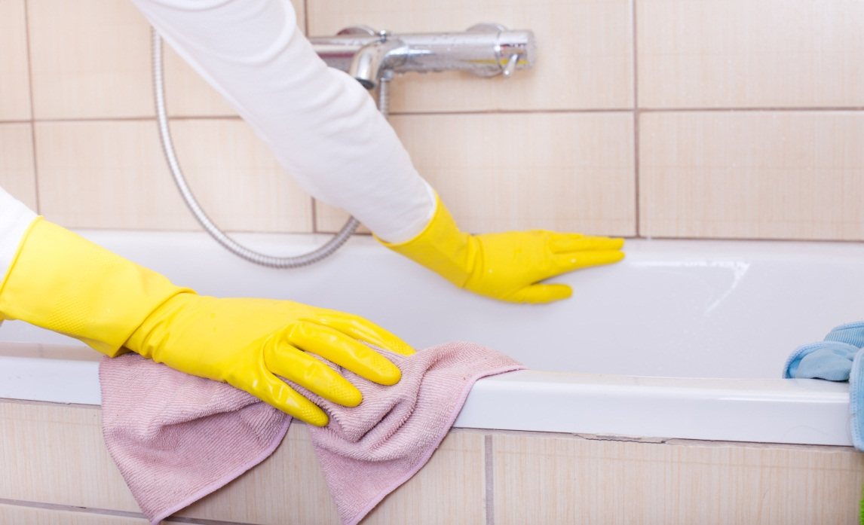
Tasks
Air conditioner filters
Clean bathroom extract
Source: (Chen et al., 2020)
Source: (Chen et al., 2020)
Notes:
Clean bathroom extract – the bathroom extract have to be cleaned daily in order to maintain the cleanliness across the room. As the leaving this as it is for 1 or 2 days it spread a bad smell across the room and that can impact the image of the hotel. The cleanliness is the main aspect of hotel that can improve the stay experience of the guest. Sanitation id significant as visitors utilise restrooms regularly, making them high-traffic locations. a substance smells, alongside other dangerous bacteria or diseases which can build up in the system for air circulation are all eliminated with each cleaning of each outflow. That encourages hygienic and fresh surroundings, lowering the possibility of disease along with inconvenience for visitors (Chen et al., 2020).
Air conditioner filters - the cleaning of air conditioner is done in two or three days in order to maintain the clear conditioning and energy shaving. To ensure optimum quality of air inside, air conditioner screens must be cleaned. The cartridges may become clogged with contaminants alongside allergies gradually, which could impair airflow and result in an adverse effect on visitors' health and well-being. To save the energy filters that are blocked have the air conditioner's conditioner operate more diligently, which raises energy expenditures. The process runs more effectively when it is regularly cleaned, which saves both money and electricity (Chen et al., 2020).
Having cleaned filtration keeps odours from spreading, giving visitors an appealing alongside free of smell experience. Periodic cleaning of Air conditioner filtration increases the machine's useful life and lowers the requirement over pricey fixes or upgrades.

Slide 7
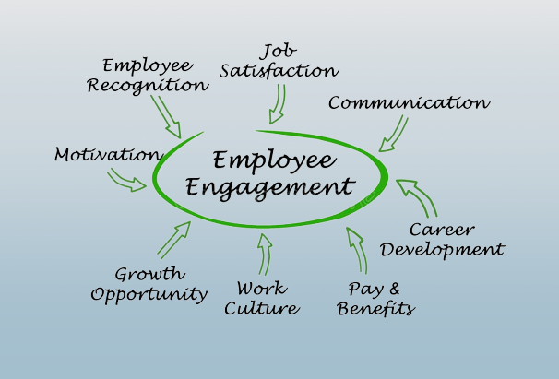
Principle of employee engagement
Comprehensive Standards (Gulyaeva, 2019)
Learning and Growth
Communication
Source: (Gulyaeva, 2019)
Notes:
Comprehensive Standards: the housekeeper staff have to possess a clear awareness of their duties and obligations. That means being familiar with the precise cleanliness responsibilities, requirements for quality, and anticipated expectations for services over every space along with the location in which they're accountable.
Learning and Growth: This is vital to provide continual education for growth possibilities. Workers who clean must be well trained not just in the cleaning process but also in interpersonal relationships, and safety standards, alongside the proper application for washing tools and supplies. This gives individuals the trust and knowledge needed to carry out their responsibilities (Gulyaeva, 2019).
Collaboration that is both honest and forthright is essential. Workers must feel free to express issues, and ideas, including comments. periodic conferences alongside avenues over raising difficulties asking for support can help to improve collaboration among teams.

Slide 8
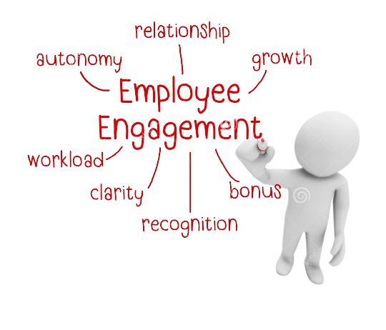
Principle of employee engagement
Acknowledge with rewards
Teamwork (Hasnat, 2021)
Empowerment
(Gulyaeva, 2019)
Source: (Hasnat, 2021)
Notes:
Recognise alongside Rewards Recognising and praising cleaning personnel for their diligence and commitment is a key tenet of worker involvement. This could involve spoken praise, incentives, prizes, or additional forms of recognition for outstanding achievement. That acknowledgement promotes optimism and drive.
Encourage cooperation and cooperation amongst cleaning personnel to establish a feeling of community alongside common accountability towards cleaning alongside the general customer experience. Whenever employees help one another, this boosts work happiness and also participation (Hasnat, 2021).
Freedom alongside Independence: Providing cleaners with a degree of independence in task-related choices may result in improved involvement. Encouraged workers have an impression of having control over what they do and express pleasure in the standard they provide in their allocated areas.

Slide 9

Conclusion
Analysing the needs of checklist and the housekeeping task and implementing by designing the checklist of tasks allowed the housekeeping team to ensure the effective implementation of the task. Further, analysing the principle of employees engagement can conclude that in order to carry out the successful implementation of the housekeeping task the employees need to well trained. And these engagement principles will help them to achieve the efficiency in their work in order to improve the satisfaction of the guest that will improve the brad image of the hotel.

Slide 10
References
Sever, M.M., (2019) Research in Business and Social Science.
Sianipar, R. and Cicilia, R.L. (2023) Procedure Housekeeping. Penerbit NEM.
Chen, X.A., Wang, R. and Zhang, J. (2022) Divide and conquer: A hygienic, efficient, and reliable assembly line for housekeeping. Manufacturing & Service Operations Management, 24(2), pp.938-955.
Christl, W. (2023) MONITORING WORK AND AUTOMATING TASK ALLOCATION IN RETAIL AND HOSPITALITY.
Hasnat, Q. (2021) An Exploration of Employee Engagement and Employee Commitment in the London Hotel Sector: The Perspectives of Migrant Housekeeping Workers and Their Managers (Doctoral dissertation, University of Brighton).
Gulyaeva, Y. (2019) Employee engagement factors in Corporate Social Responsibility.

