Slide 1
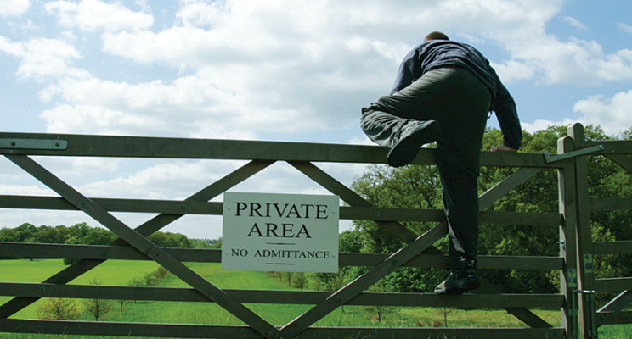
TRESPASS TO LAND

Slide 2

CONTENT
- Aims and Learning objectives.
- Trespass on Land and Nuisance.
- Activities.
- Quiz.
- Summary.

Slide 3

AIMS AND LEARNING OBJECTIVES
- The aim of today's session is to explain and apply the law in relation to trespass to land, private and public nuisance and explain the rule in Rylands v Fletcher.
- By the end of today's session students should be able to demonstrate that they understand trespass to land and nuisance in tort law.

Slide 4

TRESPASS
What prior knowledge do you have on the topic?
Notes:
Today we are going to consider land-based torts of trespass to land and nuisance.
We have focused on common law of negligence and its application to statutory regimes such as employers liability, occupiers liability, highway authorities statutory duties of care. Whilst these torts aim to protect both our personal and economic rights and our personal property.

Slide 5

TRESPASS ON LAND
- Concerns property/ land that you own.
- Nuisance – Ryland v Fletcher.
- Not the same- they are different.
- Trespass of land is different to nuisance.
Notes:
Trespass to land and nuisance focus on protecting the ‘real’ property we own and our enjoyment of it.
There is a further cause of action known as the rule in Rylands v Fletcher which seeks to protect land from specific damage which is caused by the escape of dangerous or mischievous things on a neighbouring landowner's property. This is regarded as a species of nuisance, though given its strict liability nature it has developed as a cause of action in its own right with its own rules.
Whist both trespass to land and nuisance, including the rule in Rylands v Fletcher, seek to protect the same or similar interests, they are distinct and separate torts so we shall deal with them in turn. We will also consider two separate case studies to illustrate the different torts

Slide 6

TRESPASS ON LAND
- If there is land someone owns it.
- You are trespassing on that land if you go on it without permission.
- Or if you have an easement.
- Trespass is dealt with tort law.
- 3 elements that need to be questioned;
Notes:
As you may recall from the introduction to tort at your very first lecture, we can use the concept of trespass to refer to not only interferences with one’s land and things, but also with one’s person (trespass to the person), although today we are only going to consider the tort in relation to land.
You have a case study on the story board so please do go back and consider this if you have not done so already.
In the UK, every piece of land belongs to somebody. If you go on land without the owner’s permission, you are trespassing unless there is some right of access for the public OR if you have acquired a personal right to pass over the land to reach some land of your own i.e. an easement.
Trespass to land is a civil wrong . However, certain forms of trespassing, generally those which involve squatters, raves and hunt saboteurs are covered by criminal law. There are offences under the Criminal Justice and Public Order Act 1994 of trespassing on land and trespassing with vehicles, which is outside the scope of this course book.
All forms of trespass, whether to person or land or goods, are said to share certain characteristics.
(1) A trespass is actionable per se (without proof of damage).
(2) A trespass is committed by a direct and immediate interference with the protected interest of the claimant in possession (bodily security, land or goods).
(3) The act that constitutes the trespass is committed intentionally.

Slide 7

ACTIONABLE PER SE
- ‘’Proof without damage- if you want to claim before damage has taken place- Entick v Carrington’’.
REFLECT:
Do you think a person should be liable in trespass even when they have not caused any damage to another person’s land?
What is the justification for the tort?
Notes:
This tort is completely different to the tort of negligence, which requires proof of damage before a claim can be successful.
Trespass is actionable without the need for the claimant to prove that they have suffered any damage (Entick v Carrington (1765)). This is particularly relevant in cases where a landowner wishes to prevent persistent trespassing, for example, in a boundary dispute with a neighbour or a dispute concerning a right of way; they can seek a remedy, whether or not any damage has been done to the land. Whilst only nominal damages will be awarded to a claimant who cannot prove any damage, the main aim of a claim for trespass is likely to be to obtain an injunction to prevent further occurrences.

Slide 8

DIRECT AND IMMEDIATE INTERFERENCE WITH THE LAND
Westripp v Baldock [1938
Notes:
The most obvious example of direct and immediate interference is simply walking across someone else’s land, though even the slightest of intrusions will suffice. For example, in Westripp v Baldock [1938] it was a trespass when the defendant placed his ladder against the claimant’s wall. We shall also see that placing objects on land will meet this requirement.
A trespass is actionable only by a person who is in possession of the land. Possession includes entitlement to immediate and exclusive possession. A landlord cannot therefore sue for trespass (as the tenant is the person in possession) unless they can prove that actual harm has been caused to the property which has damaged the value of their reversionary interest

Slide 9
COMMITTED INTENTIONALLY
‘Has to be done purposefully’
Conway v George Wimpey & Co Ltd [1951]
League Against Cruel Sports v Scott [1986
Notes:
Most trespasses to land are intentional in the sense that the defendant intended to be on the land in question, whether or not they knew to whom the land belonged. It is no defence that the defendant had lost their way or believed the land to be theirs. In Conway v George Wimpey & Co Ltd [1951] the claimant contractor working on an aerodrome injured his leg which had to be amputated after flagging a lift with the defendant’s employee on a works bus. The employee had been expressly forbidden to give lifts to anybody other than employees of the defendant. Whilst this was primarily a case about vicarious liability it was held that the claimant was a trespasser regardless of whether or not he knew he was trespassing / permission to be on the bus.
If a person’s presence on the land is involuntary, as in the situation where A and B pick up X bodily and throw them onto the claimant’s land, then A and B commit the tort of trespass and not X. In cases of cars unintentionally moving from the public highway onto adjacent land, it is questionable whether the action must be brought in negligence or can be brought in trespass, but in League Against Cruel Sports v Scott [1986] it was held at first instance that where a hunt entered land after permission had been refused, the master of the hunt was liable in trespass if the hounds had been intentionally or negligently allowed to enter the claimant’s land. If the decision is correct, it means that the tort may be committed negligently.
Identifying who is a trespasser is essential in other areas of tortious liability, for example, in order to decide whether a claim arises under OLA 1957 or 1984.

Slide 10
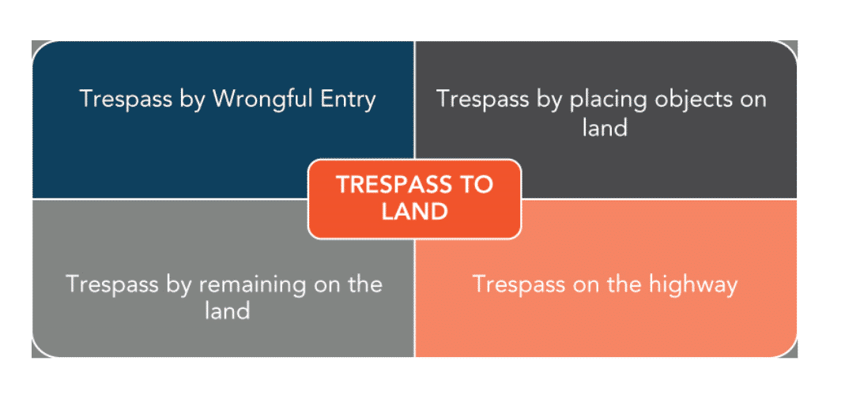
Notes:
This image shows how trespass to land may be committed in a number of situations.

Slide 11

What if you enter somewhere wrongfully?
- It is enough to even touch the soil with your hand to amount to trespass.
- The landowner owns the sky above and the soil beneath.
- Ancor Brewhouse Developments v Berkley house 1987- Research this case.
- Special laws regarding drones.
- 'Bocardo Ltd v Star Energy Ltd [2010]‘ Research the case and tell the class what the law says about how far down the landowner owns.
- Access to neighbouring Land Act 1992.
Notes:
The slightest crossing of the boundary will suffice – for example, putting a hand through an open window or by placing your body or an object on the claimant’s land.
As a general rule the person who owns the land also owns the sky above and the soil beneath. Trespass can therefore be committed by digging a tunnel under land or by interfering with the airspace.
Parliament recognised a particular problem which can arise when one landowner needs to enter neighbouring property in order to carry out necessary works to the buildings on their own land. The Access to Neighbouring Land Act 1992 makes provision for such a landowner to apply to the court for an access order which, if granted, will identify a fixed area of the adjoining land to which the rights of entry will apply and also the terms on which this defined access is to be made available. No charge is made for this access if the works are to residential land. In this manner the tort of trespass to land does not prevent the necessary work being undertaken

Slide 12

TRESPASS BY REMAINING ON LAND
A person commits trespass if they remain on land when their right of entry has ceased. Even if the licence (permission) to enter is gratuitous and revocable at the will of the licensor, a reasonable time must be granted to the licensee to remove themselves and their property from the land.
If the licence is contractual – for example, to enter a cinema and watch the showing of a film – then it is irrevocable until the purpose for which it was granted and paid for is achieved, unless the licensee breaks the terms of the contract

Slide 13

TRESPASS BY PLACING OBJECTS ON LAND
It is a trespass to place any chattel on the claimant’s land. Trespass continues for as long as the offending article remains on the land. Successive actions will lie from day to day until the article is removed.
In British Waterways Board v Severn Trent Ltd [2001] it was held that discharging water into the flowing watercourse owned by another amounted to a trespass

Slide 14

TRESPASS ON THE HIGHWAY
We saw last week when we considered the law relating to highways that everyone has a right to “pass and repass” along the highway when travelling from one place to another.
Notes:
Traditionally, it was the owner of the subsoil who had a right to claim in trespass on the highway for acts that went beyond ordinary passage, and this was held to be the owner of the land which abuts the highway (Tithe Redemption Commission v Runcorn UDC [1954]).
It had been held previously that using a public highway to obstruct shooting on the adjacent private land is a trespass, as in Harrison v Duke of Rutland [1893] or using it in order to gain inside information on racehorse trials as was held in Hickman v Maisey [1900].
However, this must be considered in light of the decision in DPP v Jones [1999], which was a case regarding criminal trespassory assembly under the Public Order Act 1986. The case involved a civil law issue regarding the meaning of the trespass and the House of Lords held that it was not a trespass to participate in a peaceful assembly on a highway so long as it was reasonable and caused no obstruction. It was suggested that any reasonable use of the highway not involving nuisance or obstruction was lawful

Slide 15

WHAT ABOUT ANY DEFENCES?
- A license.
- Justification by law.
- Necessity.
Notes:
License - Trespass is not committed if the defendant enters the claimant’s land with the claimant’s express or implied permission, so any member of the public has an implied licence to approach premises with a legitimate enquiry, even if that enquiry has nothing to do with the occupier’s business or interests.
The licence exists unless the defendant has exceeded the terms of the licence or the claimant has legally revoked the licence. Certain notices (e.g. “Keep Out”) or clear words used by the occupier will indicate that the implied licence has been revoked. A licensee must be given a reasonable time to leave the land on revocation of the licence (Robson v Hallett [1967]).
Justification by Law - Acts which would otherwise be trespass are not so when justification is provided by law. For example, the police have powers under Police and Criminal Evidence Act 1984 (PACE 1984) to enter premises and search them, or to carry out an arrest. In such cases, it is important that the police act in accordance with the requirements of PACE 1984 if the defence is to be successful.
Necessity - It is a defence to show that it was necessary for the defendant to enter the claimant’s land. In Rigby v Chief Constable of Northamptonshire [1985] police fired a gas canister into the claimant’s shop to flush out a dangerous suspect. The canister started a fire and caused extensive damage to the shop. The claimant sued the police for trespass. The police raised the defence of necessity. It was held that necessity could be a defence to trespass, but only provided that there was no negligence on the part of the defendant in contributing to the state of necessity. In this case the police were found to have been negligent by firing the canister into the premises without having any firefighting equipment on hand, so the defence did not apply on the facts, and the police were liable.
When campaigners, protesting against crop tests for genetically modified foods, entered land and pulled up growing crops, they were not entitled to plead necessity or public interest when sued for trespass. On the facts, the Court of Appeal considered that the main purpose of the trespass was publicity for the cause of the trespassers (Monsanto v Tilly [1999]).

Slide 16
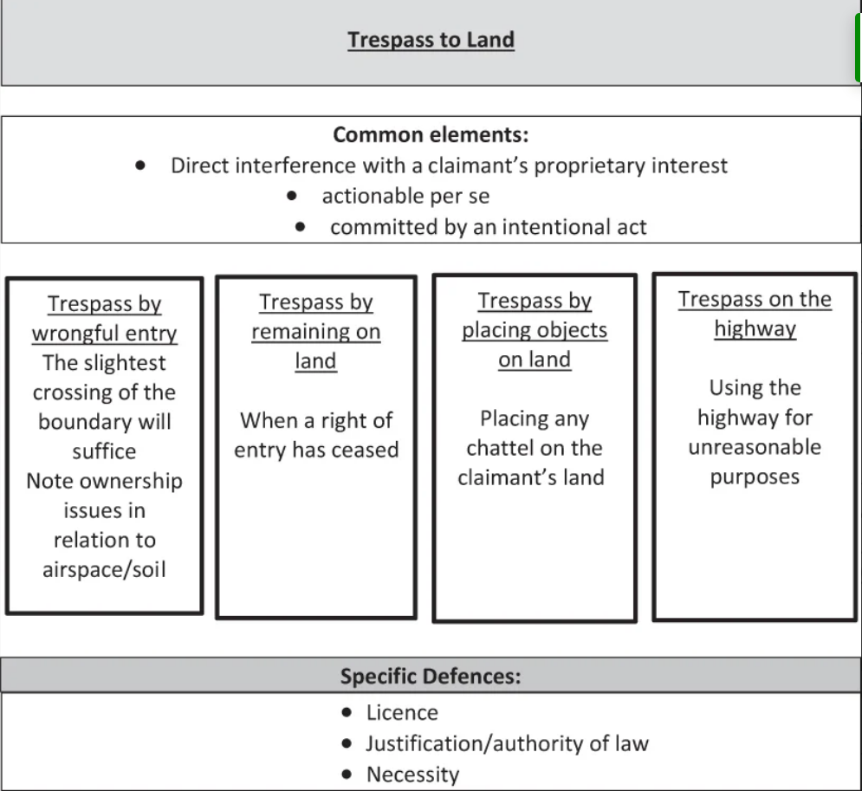
Notes:
The table provides a useful summary of the elements of a claim in trespass to land.

Slide 17

NUISANCE
- Two types;
- Public nuisance.
- Private nuisance.
- We will consider each on in turn.
Notes:
The tort of private nuisance protects a person’s use and enjoyment of land, and the tort therefore operates mainly between neighbouring landowners. A public nuisance is principally a criminal offence but may also be actionable as a tort. A statutory nuisance is usually concerned with public health, and enforcement is charged to public bodies. The same conduct by the defendant may give rise to actions in any of the three varieties of nuisance. In this section, we shall consider only public and private nuisance.

Slide 18
PRIVATE NUISANCE
- Meaning; ‘’ The defendant interferes unlawfully with the individual rights to use or enjoy their land’’.
- In order for this to be proven a number of elements need to be proven;
- Proprietary interest, damage and sensory discomfort, damage, locality, sensitivity malice, public utility
- In order for there to be a claim – the individual who is claiming must have an interest in the land.
Notes:
The tort places a double emphasis on:
unreasonable interference with the claimant’s protected interest; and
a condition for which the defendant is responsible (i.e. the source of the nuisance).
This should arise in some place over which the claimant does not have control, but the defendant need not be the occupier of the premises from which the nuisance comes. Sometimes the defendant is the creator of the nuisance or a landlord out of possession of the land.
The court must decide whether the defendant has caused, adopted or continued an unreasonable interference with the claimant’s use and enjoyment of their land. Ultimately a balance must be struck between the conflicting interests of neighbours – some degree of give and take is necessary.
Here are the requirements and elements of a claim in private nuisance:
the need for a proprietary interest;
damage and sensory discomfort;
The concept of reasonableness and the factors the court will consider including: the extent of the damage, the locality, sensitivity of the claimant, malice and the usefulness or utility of the defendant’s conduct; and

Slide 19

CONTINUED
- Are there any defences available for private nuisance;
- Yes.
ACTIVITY
- Research what each one is and what they mean.
- Do this in groups.
Notes:
The defences potentially available in a claim for nuisance including sensitivity of the claimant, prescription, statutory authority and coming to nuisance is no defence

Slide 20
PUBLIC NUISANCE
- Meaning; Damages that are special.
- Rylands V Fletchers.
- The case deals with issues concerning the damage done to someone else’s land by the defendant.
- ‘’The person who is in control of the land is the individual who is liable for the damage.’’
- Non- Natural – outside of original doings – more risk of damage.
- Certain elements will lead to dangerous damages.
Notes:
Every public nuisance is a crime but a person who suffers special damage as a result may bring a civil action for damages in tort.
Public nuisance was defined in Attorney-General v PYA Quarries Ltd [1957] as one “which materially affects the reasonable comfort and convenience of life of a class of Her Majesty’s subjects”. Whether the number of persons affected constitutes a class is a question of fact in each case. It was also noted in the same case that “a public nuisance is a nuisance which is so widespread in its range or so indiscriminate in its effect that it would not be reasonable to expect one person to take proceedings on his own responsibility to put a stop to it but that it should be taken as the responsibility of the community at large.”
It is impossible to define with any precision the acts capable of amounting to a public nuisance. Two major groups are identifiable, consisting of abuses of the highway and the carrying on of noxious trades. There is also a third group which consists of assorted wrongs such as holding a badly organised pop festival, keeping a brothel or making a hoax bomb call.
Special damage is damage over and above that suffered by the class of persons affected, that is, different in nature or extent. Special damage was held to occur when a golf ball driven over a highway caused injuries to the claimant motorist. The siting of the tee amounted to a nuisance. The class affected were highway users. The claimant suffered damage over and above that suffered by other members of the class (Castle v St Augustine’s Links [1922]). Special damage has also been held to occur where a business suffers economic loss because of obstruction of the highway. In Benjamin v Storr [1874] the claimant complained of damage to his trade caused by horses and vehicles waiting (on the highway) outside his shop.
Many public nuisances are caused by obstruction of the public highway or the creation of a danger which threatens those who use the public highway. Even the fouling of the public highway caused by roosting pigeons has been the subject of a claim by the owners of a footpath which ran underneath a railway bridge.

Slide 21
ACTIVITY
- Research two cases relating to public nuisance.
01
- What are the facts of the case?
02
- Feedback to the rest of the group.
03
Notes:
There are cases identified in your pre-reading.

Slide 22

Notes:
Just Stop Oil protesters told to 'Just F--k off' by angry drivers and pedestrians

Slide 23
THE RULE IN RYLANDS V FLETCHER
The rule in Rylands v Fletcher [1868] creates an area of strict liability where one person by the use of their land inflicts damage on another person. In the original case, the defendant employed independent contractors to build a reservoir. The contractors omitted to seal up underground passages and when the reservoir was filled with water the claimant’s mine was flooded. Blackburn J, in the High Court, stated:
“A person who for his own purposes brings on his land and collects and keep there anything likely to do mischief if it escapes, must keep it in at his peril and if he does not do so, he is prima facie answerable for all the damage which is the natural consequence of its escape.”
The judgment also required that the thing the defendant brought onto his land was something “which was not naturally there”. In this way the emphasis shifted from the introduction of something which was within the power of man to control, rather than the forces of nature, to the concept of unacceptable use of the land, as the essential basis of the defendant’s liability.
Notes:
The tort is generally considered to be one of strict liability, as there is no need for proof of fault in the part of the defendant, but the interpretation of what amounts to a non-natural use of land and the requirement that the type of damage suffered by the claimant must not be too remote has gone some way to “relax” the strict liability nature of the tort.

Slide 24

PERSONS LIABLE
The parties to an action are usually neighbouring landowners. The defendant will normally have control over the premises from which the thing escapes or at least control over the accumulated Rylands v Fletcher things.
As with private nuisance, the claimant must have a proprietary interest in the land affected (Transco plc v Stockport Metropolitan Borough Council [2003]).

Slide 25
THE USE OF LAND MUST BE NON-NATURAL
Rickards v Lothian [1913] “It must be some special use bringing with it increased danger to others and must not merely be the ordinary use of the land or such as is proper for the general benefit of the community.”
The test depends on the circumstances of the time and place. Read v Lyons [1947]
Notes:
The sting of strict liability has been largely removed by this interpretation of “non-natural use”. There has been a tendency for it to be looked at as almost equivalent to a negligence test. For example, in Mason v Levy Auto Parts of England Ltd [1967] a quantity of combustible materials which was stored on the defendant’s land ignited and burnt the claimant’s ornamental hedge. It was held that regard should be had to the quantity of the materials, the way in which they were stored and the neighbourhood. Students will appreciate that these considerations would also be relevant to an examination of negligence liability.
This passage should now be considered in the light of the words of Lord Goff in Cambridge Water Co Ltd v Eastern Counties Leather plc [1994]:
“It may well be that, now that it is recognised that foreseeability of harm of the relevant type is a prerequisite of liability in damages under the rule, the courts may feel less pressure to extend the concept of natural use…and in due course it may become easier to control this exception, and to ensure that it has a more recognisable basis of principle.”
In Cambridge Water Co Ltd Eastern Counties Leather (ECL) carried on the business of tanning leather and from 1973 onwards stored large quantities of a chemical used in the tanning process on their premises. Cambridge Water Company (CWC) bought a borehole in the area in 1976, to supply drinking water to Cambridge. Unknown to either the claimant or defendant, the chemical had seeped into the ground. It was not until 1983 that a test was available to detect microscopic levels of the chemical in question and the water from the borehole in question was found to contain the chemical far in excess of permitted levels. CWC was forced to close down the borehole and start up another, thus incurring substantial costs. The company sought to recover damages from the ECL based on the Rylands v Fletcher tort. The appeal to the House of Lords focused on the question whether foreseeability of harm of the relevant type was an essential element of liability either in nuisance or Rylands v Fletcher. Lord Goff referred to The “Wagon Mound” (No. 1) as having settled the issue regarding nuisance. He then considered the very close historical link between nuisance and Rylands v Fletcher. It appeared to him logical that the test for remoteness of damage in Rylands v Fletcher should be the same as that in nuisance (and, in fact, in negligence). On the facts of Cambridge Water Co Ltd, the original seepages occurred in circumstances where a reasonably prudent person would not foresee contamination of ground water resulting. ECL was therefore not liable for CWC’s losses.
The tort is not often invoked, and there was academic discussion as to whether the tort continued to exist as a tort in its own right, or whether it was just a type of private nuisance. The House of Lords had the opportunity to consider the status of the Rylands v Fletcher tort in Transco plc v Stockport Metropolitan Borough Council [2003].
The defendant was sued when water from a service pipe, which brought water to a block of flats owned by the council, seeped out into the soil of a railway embankment and undermined the support for a Transco gas main. The House of Lords confirmed that the tort of Rylands v Fletcher should not be discarded, however, it was necessary, to restate the rule with certainty and clarity. To succeed in Rylands v Fletcher it had to be shown that the defendant had done something that they recognised or, judged by the standards appropriate at the relevant place and time, they ought reasonably to have recognised as giving rise to an exceptionally high risk of danger or mischief if there was an escape, however unlikely an escape might be. The rule applied only when the use of the defendant’s land was extraordinary and unusual, judged by contemporary standards. On the facts, the water service pipe was held to be an ordinary use of land, a routine function with no particular hazard and so there was no liability under Rylands v Fletcher.
An example of a high risk of danger can be seen in LMS International Ltd v Styrene Packaging and Insulation Ltd [2005]. The defendant occupied a factory in which polystyrene blocks were cut with a hot-wire machine. A fire broke out which destroyed the factory and caused extensive damage to the claimant’s property and contents. The court found that the defendant had brought things onto its premises which were a known fire risk and stored them in such a way that they were likely to cause a fire and spread to the claimant’s premises. Thus, the defendant’s use of land was a non-natural use.

Slide 26

DANGEROUS AND MISCHIEVIOUS ESCAPE
Many things, including water, are capable of causing harm if not properly controlled. Perhaps the emphasis is better placed on the idea that the defendant has increased the risk of damage to others by the use to which they have put their land. This covers not only intrinsically dangerous things such as chemicals and explosives, but also accumulations of things such as water, fire, gas and slag heaps which will cause harm if they escape.
In Read v Lyons [1947] there was an explosion in the defendant’s munitions factory. The claimant, an employee, was injured on the premises. It was held that she had no action in the tort of Rylands v Fletcher as there had been no escape from the defendant’s property to land over which the defendant had the control.

Slide 27

REMOTENESS
Defendant is only liable if they could reasonably foresee that this harm would take place’. Cambridge Water Co Ltd v Eastern Counties Leather plc [1994]
Notes:
It was decided in Cambridge Water Co Ltd v Eastern Counties Leather plc [1994] that the defendant will be liable only for such damage as they knew or ought reasonably to have foreseen as the type of damage which the escaped things might cause. Thus, the test for remoteness of damage is the same as that for private nuisance, that is, reasonable foreseeability (The “Wagon Mound” (No. 2) [1967]).
It is important to note that the test for remoteness is to be applied only after the defendant’s strict liability has been determined and Cambridge Water Co Ltd does not introduce reasonable foreseeability into the test to determine prima facie liability. Liability under the rule is strict. This means that the claimant is not required to prove either intention or negligence on the part of the defendant. The test for remoteness is applied only to determine for which damage the defendant will be held liable.

Slide 28

QUIZ

Slide 29

Notes:
https://forms.office.com/Pages/ResponsePage.aspx?id=-REPTm4EBUWcuNshUjEeIYWhUfuKn1hLnoaStuLBGF1UN0s5TzJIS05CTElEMFlJRkRNN1lWN1NRVS4u

Slide 30

SUMMARY
- Trespass to the person
- Nuisance (Private and Public)
Notes:
1) The common features of trespasses are:
(a) trespass is committed by a direct and immediate interference with the protected interest of the claimant (which may be the claimant’s bodily security, land or goods);
(b) a trespass is actionable per se (without proof of damage); and
(c) the act that constitutes the trespass must be committed intentionally.
(2) Trespass to land is an unjustifiable interference with possession of land.
(3) A trespass to land can be committed by:
(a) wrongful entry;
(b) remaining on land; or
(c) placing objects on land.
(4) Defences to trespass to land include:
(a) an express or implied licence to be there;
(b) statutory justification; and
(c) necessity.
(5) A private nuisance is an interference with the beneficial use of land.
(6) A claimant in private nuisance must have a legal interest in the land interfered with to have status to sue. A defendant will be a person who created the nuisance, a person who has adopted and continued the nuisance, or in some circumstances the landlord of a tenant who causes a nuisance.
(7) The interference may cause property damage or interference with comfort and convenience.
(8) Any interference must be both substantial and unreasonable to be actionable. For an interference with comfort and convenience, the interference must be significant to satisfy the “substantial” requirement.
(9) To determine reasonableness for an interference with comfort and convenience, the courts will look at factors such as:
(a) nature of the location;
(b) time of the interference;
(c) duration of the interference;
(d) motive.
NB Public utility is not a factor in determining reasonableness but is relevant when considering which remedy the court will grant if the claim is successful.
(10) The defences to nuisance are:
(a) sensitivity of the claimant;
(b) prescription;
(c) statutory authorisation.
NB Coming to the nuisance is no defence.
(11) A public nuisance might occur when the nuisance is so widespread that it would be unreasonable to expect an individual to bring a private action and the nuisance occurs in a public place.
(12) An individual claimant in public nuisance need not have an interest in land but must have suffered special and particular damage.
(13) The rule in Rylands v Fletcher provides strict liability for land or property damage resulting from an escape of something dangerous from the defendant’s land.
(14) The claimant should have a legal interest in land to have status to sue. The defendant may be an occupier of the land from which the dangerous things escaped, or they must have control over the accumulation of the things.
(15) The requirements of the rule are:
(a) the defendant brought something onto the land;
(b) they collected and kept the thing there;
(c) it was something which was likely to give rise to an exceptionally high risk of danger or mischief if it escaped;
(d) there was an escape; and
(e) the defendant’s use of their land was extraordinary and unusual, judged by contemporary standards (otherwise referred to as non-natural use of land)

Slide 31

THANK YOU

