Slide 1

Strategies for Effective Communication in a Business Setting.
By Blue Group

Slide 2
Module Code: BMSW4002 Effective Team Working and Communication
Student Name: Ralitsa Kircheva (2025993)
Assignment Title: Task 2 Strategies for Effective Communication in a Business Setting.
Lecture Name: Azora Hurd
Blue Group

Slide 3
1. Introduction:
-Communication problems in Rainbow Children’s Hospital
2.Theories relating to models of communication.
3.The channels of communication used by the organization and channels that can be used to improve communication.
4.The types of barriers that can prevent effective communication between the organization and their external stakeholders.
5.The impact of effective communication on the staff and patients.
6.Conclusions
7.References

Slide 4
2.Theories relating to models of communication.
1. After Blue group got acquainted with the case of poor communication in Rainbow Hospital, together we tried to find a solution to the problem, so let start with theories relating to models of communication:
-Linear Models​
-Interactional Models​
-Transactional Models​

Slide 5
Linear model ​
Linear model is a very straightforward method. It has one way communication, wherein the sender transmits the message and receiver absorb the message (Andre I. Khuri 2009).
Aristotle Model of Communication
Shannon-Weaver Model of Communication
Lasswell Model of Communication
Berlo’s SMCR Model of Communication

Slide 6
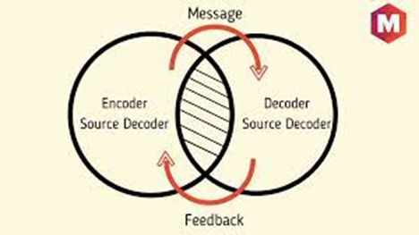
Interactional Models by (Schramm, 1997)
The SENDER is the person who sends the message
The ENCODER is the person who is responsible for turning the message into codes
The DECODER is the person who then convert the message into untestable language
The INTERPRETER is the same person who interprets the language message
The RECEIVER is the revving party of the message
The MESSAGE Is the coded message sent by the sender
The FEEDBACK is the process of understanding the message
The CHANNEL is the medium for the message being passing for and back
The NOISE is just like the previous model an intervening factor.
Notes:
The interaction model of communication describes communication as a process in which participants alternate positions as sender and receiver and generate meaning by sending messages and receiving feedback within physical and psychological contexts (Schramm, 1997). By the book this is definition we know

Slide 7
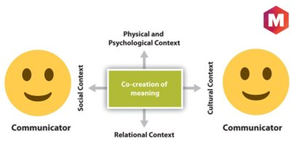
Transactional Models
The Transaction Model of communication differs from the Transmission and Interaction Models in important ways, including the conceptualization of communication, the role of sender and receiver, and the role of context (Barnlund, 1970).

Slide 8
3.The channels of communication used by the organization and channels that can be used to improve communication.​
1.Communication channels are a means of communicating between people in an organization. The channels can be Richness and Media Richness, Low and High, depending on what type of communication looking for, this includes: Video Conferencing, Documents(email, letters) Telephone, Radio.
2.Channels improve communication:
-communication is process of sending and receiving messages through verbal and non-verbal means, including speech or oral communication, written or graphic representations, signals and behavior.
The channels which can improve the communications can be visual
(pictures, graphics or videos), social media (facebook, instagram), way of communication (calm voice and respect for others).
Sharing with the other people is the heart of communication (McCabe and Timmins, 2013, p.3).

Slide 9
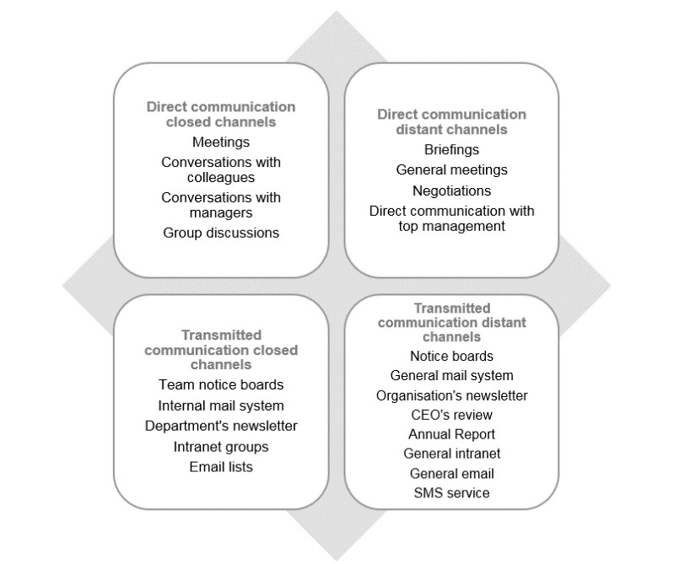
Sources: cool marketing

Slide 10
4.The types of barriers that can prevent effective communication between the organization and their external stakeholders.
The barrier is something that can prevent or stop an event completely (Hollnagel 2016, p.2)
In this case the barriers can be the reasons for poor communication.
1.According to Jijo's Skill Factory(2017) we can see some of the barriers in communication:
Language( different country or generation or specific accent )
National culture (different understanding and moral norms)
Attitudes( sadness or anger)
Physical( bad signal of the devices or noise)
Information overload( to many details or information)
Physiological( bad healt, poop hearing or weak eyes)

Slide 11
5.The impact of effective communication on staff and patients.
The right communication is obligatory for any organization, business or life situation. Through it all the desired goals such as good profit, creating the right product and personal satisfaction.
1.Basic rules for positive impact:
-Ethical communication
-Use only the information and date you need without violating privacy rights
-Always use the questions: What? Why? Who? When and where(Seely, 2013).
-Body language 'every smile, gesture or move tells others your own story(Lowndes, 2014p.12).

Slide 12
6.Conclusion:
Quality and effective communication is the basis of any success. The good communication is the key to everything we do, but when do we realize that communication is really good. There is many different categories and methods for communication and channels:
-Channel Richness/Media Richness, Low-High Richness,
verbal, formal-informal, internal-external communication, body language, eye contact, written, face to face or with any device, but perhaps the best communication method we can find is 'Try to understand how the other person feels, what is his point of view and why, put yourself in other people shoes (Bento,2017 p.24). Because without human attitude and respect for each other, every technique or method becomes empty terms and words.

Slide 13
7.References:
1.Bento, C.L.(2017) 4 Essential Keys to Effective Communication in Love, Life, Work--Anywhere!: Including the "12-Day.
2.Berger, C.R., 1991. Communication theories and other curios. Communications Monographs, 58(1), pp.101-113.
3 .Cool Marketing(2020)Internal communications. Available at: https://adelabiancahan.blogspot.com/2018/05/internal-communications.html?m=1 (Accessed:22.November2021).
4.Deutsch, K.W., 1966. On theories, taxonomies, and models as communication codes for organizing information. Behavioral Science, 11(1), pp.1-17.
5. Hollnagel, E.(2016)Barriers and Accident Prevention. New York: Ashgate Publishing
6.Lowndes, L.(2014) How to Talk to Anyone: 92 Little Tricks For Big Success In Relationships. London. Harper Collins Publisher.
7.McCabe, Cand Timmins, F.(2013)Communication Skills for Nursing Practice. Hampshire: Macmillan Publisher
8.Summerlin, R.D., 1991. An evaluation of the use of sermonic illustrations by Frank William Boreham, Harry Emerson Fosdick, and Joel Cliff Gregory by utilizing Wilbur Schramm's models of communication (Doctoral dissertation, New Orleans Baptist Theological Seminary).
9. Seely, J.(2013)Oxford Guide to Effective Writing and Speaking: How to Communicate Clearly. Hampshire. Ashford Colour Press.
10.Jijo's Skill Factory(2017) 10 Barriers to Effective Communication. Available at: 10 Barriers to Effective Communication - YouTube (Accessed: 22.November.2021).

Slide 14


