Slide 1







DJA Bakehouse
Business Plan Presentation
Program of Study: Business for the Workplace
Module Code and Name: LCML4006 Enterprise and Entrepreneurship
Assessment Title: Component 2 Presentation
Lecture Name: Fouziya Farheen
Student Name: Eriselda Rama
Student number: 2505618

Slide 2

Presentation Outline
Overview of the Business Idea
Unique Selling Proposition (USP)
Legal Format and Management Structure
PESTEL Analysis – Three Important External Factors
Marketing Plan.
Target market.
Two Marketing Strategies-Digital and Offline Strategies
Founding Requirements and Allocation
Cash Flow Summary ( First Month)

Slide 3
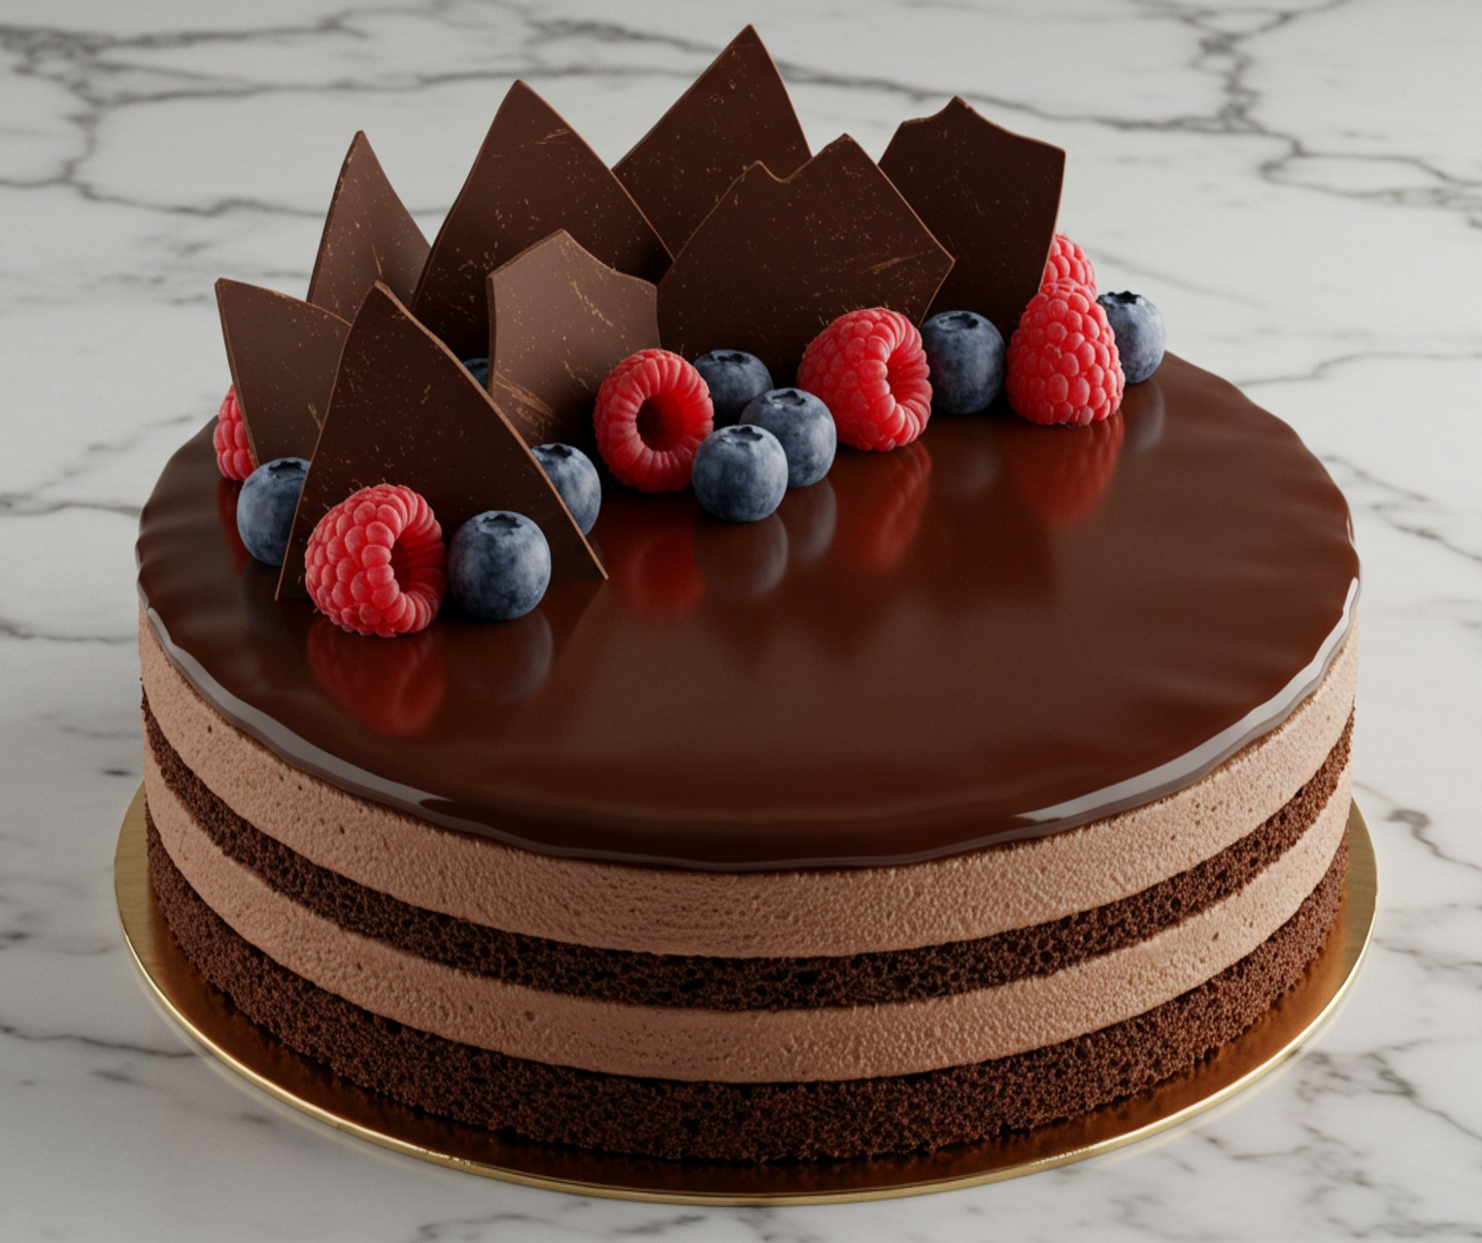
Overview of the Business Idea
DJA Bakehouse will be a small, independent and artisan bakery located in Coventry.
Will be a Private Limited Company( LTD).
Daily freshly baked pastries, cakes and artisan breads made on-site.
Allergen friendly, gluten free and vegan menu.
Events cake and take away cakes.
To marked seasonal products to win year-round customers.
Online pre-orders for quick and easy customer access.
High footfall location serving families, students and local workers.
Sustainability focus: Eco-friendly packaging and local ingredients.
Community- focused: giving away unsold products.

Slide 4

DJA Bakehouse USP
Gluten free, vegan and allergen friendly menu.
Artisan products freshly made and baked every day.
Sustainable practices: eco-friendly packaging and local ingredients.
Community focus: Donating unsold goods to minimise waste.
Sustainability Elements
Eco-friendly packaging.
Secured locally ingredients.
Bakes every day to reduce waste.
Donating unsold products.

Slide 5

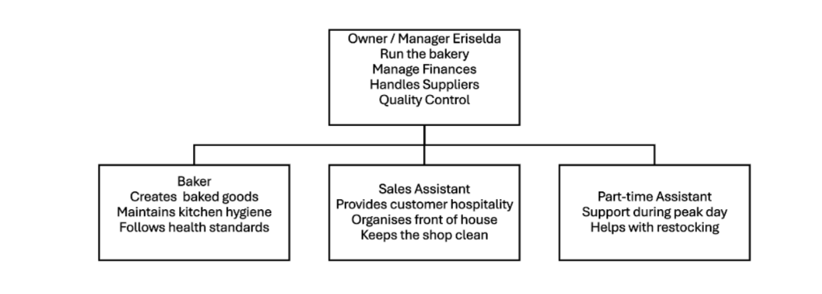
Legal Format & Management Structure
DJA Bakehouse will be a Private Limited Company (LTD).
Limited Liability
Professional Image.
Assist in ensuring founding form bank and Investors
Management Structure
Owner/ Manager (Eriselda) will run the bakery.
Baker: Production and Kitchen standards.
Sales Assistant: costumer service
Part- time assistant: Peak time support and restocking
A simple structure is ideal for a small start-up bakery.

Slide 6

PESTEL Factors
Economic Factor
Bakery costs are increasing due to higher ingredients costs.
Even in economic downturn, baked goods are still in demand.
Coventry's size and diversity of community ensures sales remain steady.
Social
Customers prefer the fresh arisanal, vegan and allergen friendly products.
The diverse population of Coventry are giving a good customer potential.
Technological
Social Media is a great tool for marketing products and reaching consumers.
Online and digital payments enhance convenience and help business grow.

Slide 7
Marketing Plan
Social Media marketing Instagram, TikTok and Facebook.
A simple Website with menu, opening hours and online ordering.
Printed materials like flyers, in store singuage and loyalty cards.
Events and partnership with community.
Sustainability messaging like eco-friendly and local ingredients.
Areas of segmentation Geographic( local area) Demographic (students/families) Behavioural (homemade goods) Psychographic ( sustainability/artisan food)

Slide 8
Target Market
Families, students, workers to the local community.
A crowd of those interested in fresh, inexpensive and homemade baked goods.
People who want vegan, gluten free and allergen friendly food.
Customers who prefer to buy locally and from small businesses.
Coventry's large and multicultural population provide a strong customer base.

Slide 9

Marketing Strategy: Digital and Offline Strategy
Digital Marketing
Instagram, TikTok and Facebook
The fresh produced have been photographed and video-recorded.
Special opportunities and participation in the community.
A website is providing a menu, opening hours and online ordering.
Offline Marketing
Eye catching signage.
Flyers in school and offices.
Loyalty cards.
Cooperation with others and community activities.

Slide 10

Founding Requirements
Start-up cost: £18,000-£25,000
Service: Equipment, Rent, Cooking Supplies, Licensing, Insurance, Marketing, Utilities, Labor.
Founding Sources
Personal Savings: £5,000
Government-Backed Loan: £10,000-£15,000
Bank Loan: £5,000

Slide 11
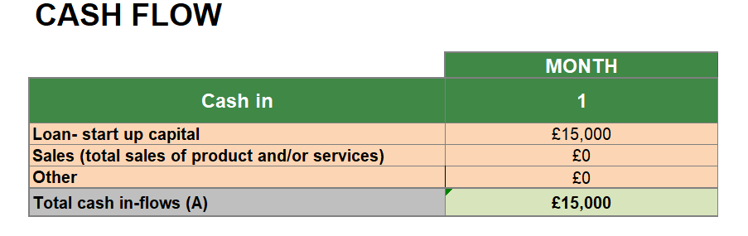
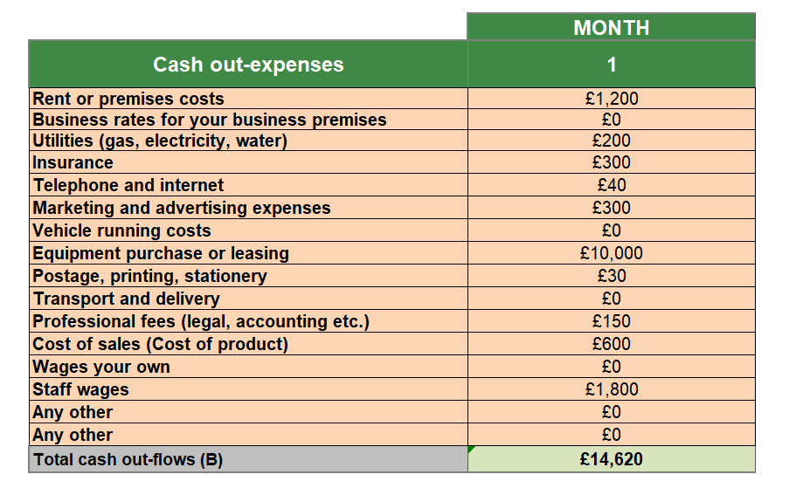
Cash Flow First Month

