Slide 1
Further Reflective Models – Level 6 - 7

Slide 2
Nod
Trafod y cysyniad o adfyfyrio fel dull dysgu
Amcanion:
Trafod:
  cysyniad a phwpas adfyfyrio;
  modelau adfyfyrio;
  lefelau adfyfyrio.
Dadansoddi egwyddorion adfyfyrio.
Aim
Discuss the concept of reflection as a learning strategy
Objectives
Discuss:
  the concept and purposes of reflection;
  models of reflection;
  levels of reflection.
Analyse the principles of reflective practice

Slide 3
Critical incidents journal
- record a critical incident ... The critical incident refers to events in which a decision was made, a conflict occurred, a problem resolved. The critical incident journal provides a systematic way to communicate problems and challenges involved in working with and can thus help in dealing with the affective dimensions of the service experience.

Slide 4
Addasrwydd?
Dysgu drwy ddatrys problemau
Unrhyw ddisgyblaeth
Dull dysgu/asesu amgen
Ysgrifennu dros gyfnod o amser
Canolbwyntio ar faterion cyfredol
Appropriateness?
Problem based learning
Any discipline
Alternative assessment / learning method
Written over a period of time
Focus on ongoing issues

Slide 5
Dysgu oddi wrth neu fel canlyniad i’r broses
Yn ystod y broses neu wedi’r broses
Nid cofnod / dyddiadur o ddigwyddiadau
Learning from, or from the result of, a process
Learning during or after the process
Not an events diary or record

Slide 6
Pwysigrwydd deall y cysyniad:
Deall beth a olygir wrth adfyfyrio.
Pam mae adfyfyrio yn cael ei ddefnyddio ar gyfer datblygiad proffesiynol parhaus
Y ffordd y defnyddir adfyfyriad mewn asesiad dysgu
The importance of understanding the concept:
Understand what is meant by reflection.
Why is reflection used for continuous professional development
How reflection is used in the assessment of learning

Slide 7
Sut mae e’n gwahaniaethu oddi wrth ddulliau mwy traddodiadol o ddysgu ac addysgu.
Materion yn ymwneud a’r person cyntaf
Beth yw adfyfyrio da / gwael?
Ymarfer ysgrifennu adfyfyrgar a chyfleon adborth
How does it differ from more traditional teaching and learning methods
The issues around the first person
What is good / poor reflection?
Practice on reflective writing and provide opportunities for feedback

Slide 8
Gall gynnwys adfyfyrio fydd wedi cael ei ddylanwadu gan ymateb emosiynol i ddigwyddiadau.
Dulliau cydweithredol o ddyfnhau’r adfyfyrio e.e. ffrindiau beirniadol, grŵp, gweithgareddau ayyb
Adfyfyrio ar adfyfyriad.
Reflection can be influenced by emotional reactions to events
Collaborative methods of deepening reflection e.g. critical friends and group, activities etc
Second-order reflection

Slide 9
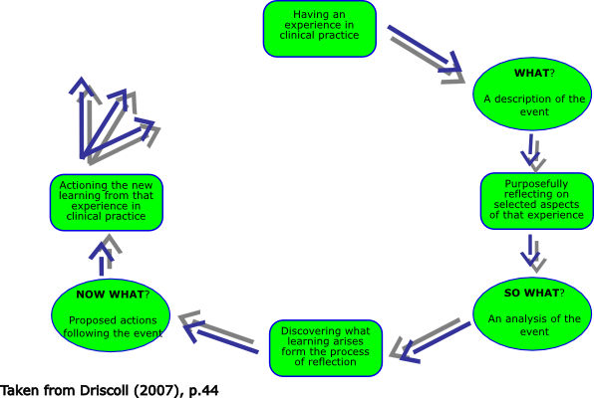
Driscoll, J., Practising Clinical Supervision – a reflective approach, Royal College of Nursing, 2007.

Slide 10
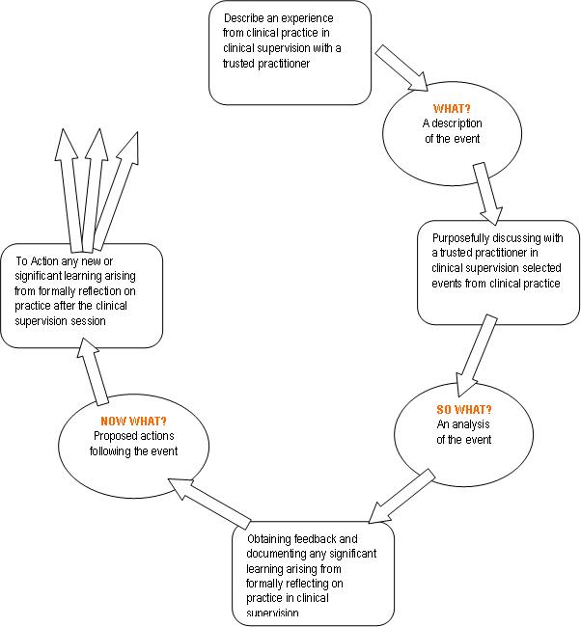
http://www.hampshirepartnership.nhs.uk/online-tools/cbt/3/

Slide 11
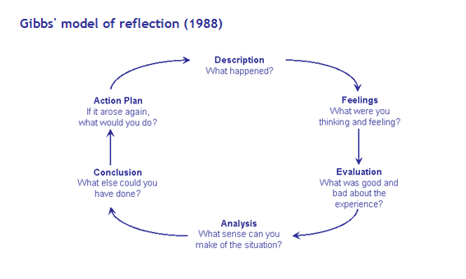
Gibbs, G., Learning by Doing: A guide to Teaching and Learning Methods. Oxford: Further Education Unit, 1988.

Slide 12
CYD-DESTUN:
Maes proffesiynol / sector
Profiadau dysgu sy’n seiliedig ar waith
Lefelau dysgu (Fframwaith Credydau a Chymwysterau Cymru (FfCChC ))
CONTEXT:
Professional area / sector
Work-based learning experiences
Levels of Learning (Credit and Qualifications Framework for Wales (CQFW) )

Slide 13
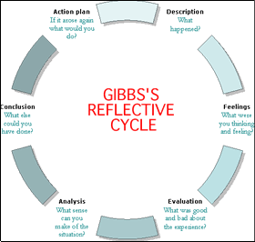

Slide 14
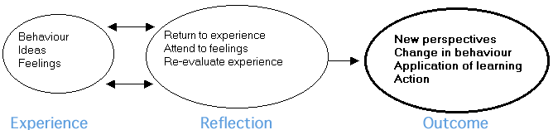

Slide 15
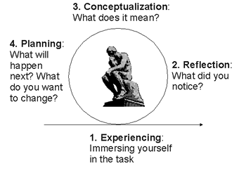

Slide 16
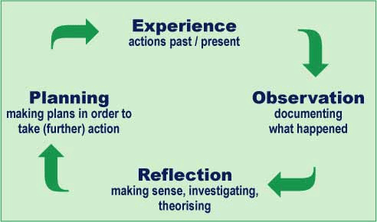

Slide 17
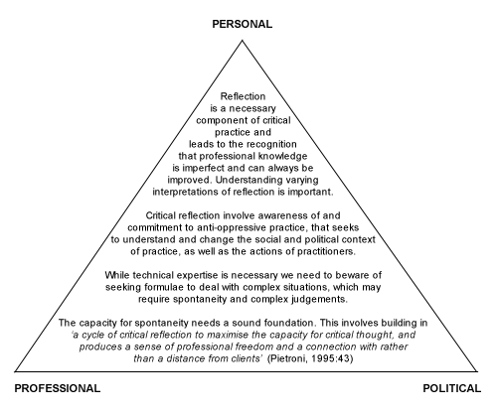
http://www.celt.mmu.ac.uk/ltia/issue8/issitt.shtml

Slide 18
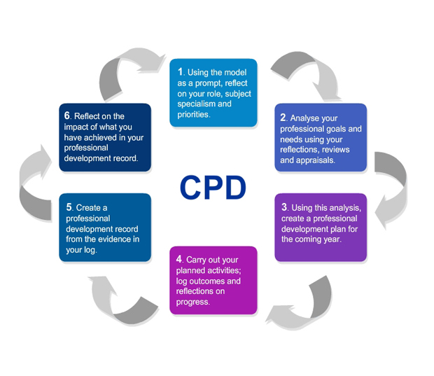
http://tlp.excellencegateway.org.uk/tlp/stem/resource2/gettingstarted.html

Slide 19
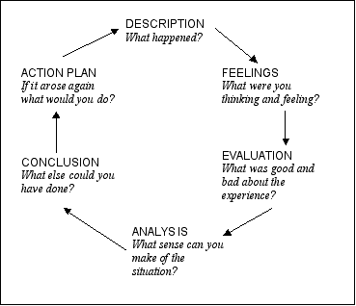
http://newton.ex.ac.uk/handbook/Rad-TutReflective.html

Slide 20
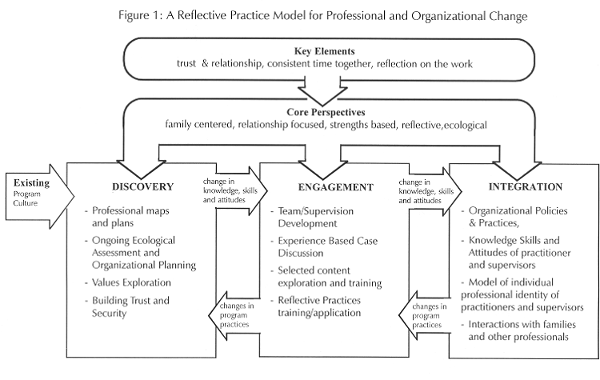
http://www.portageproject.org/newslett/rp_model.htm

Slide 21
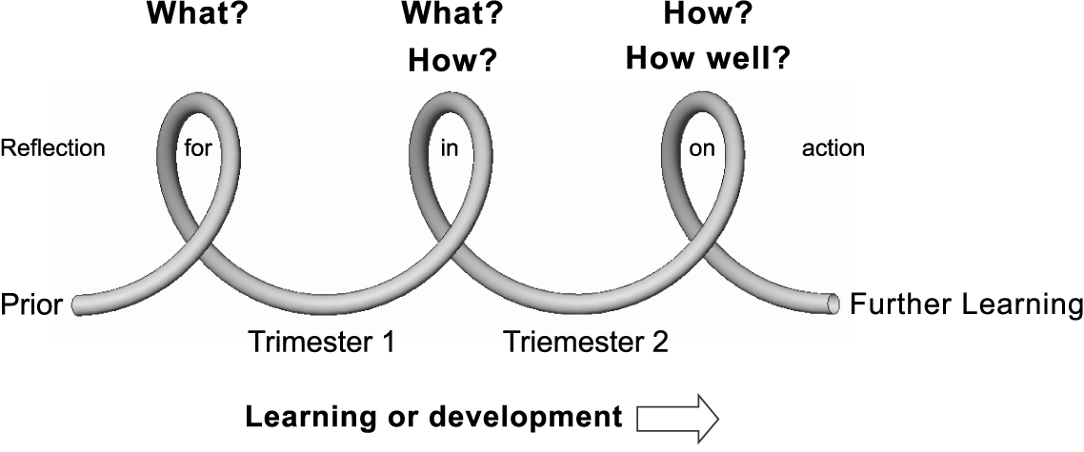
http://www.emeraldinsight.com/journals.htm?articleid=1728460&show=html

Slide 22
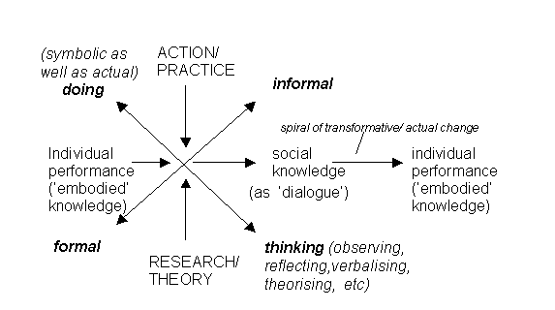
http://www.aare.edu.au/01pap/ric01318.htm

Slide 23
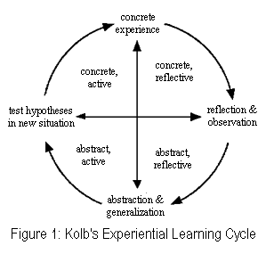

Slide 24
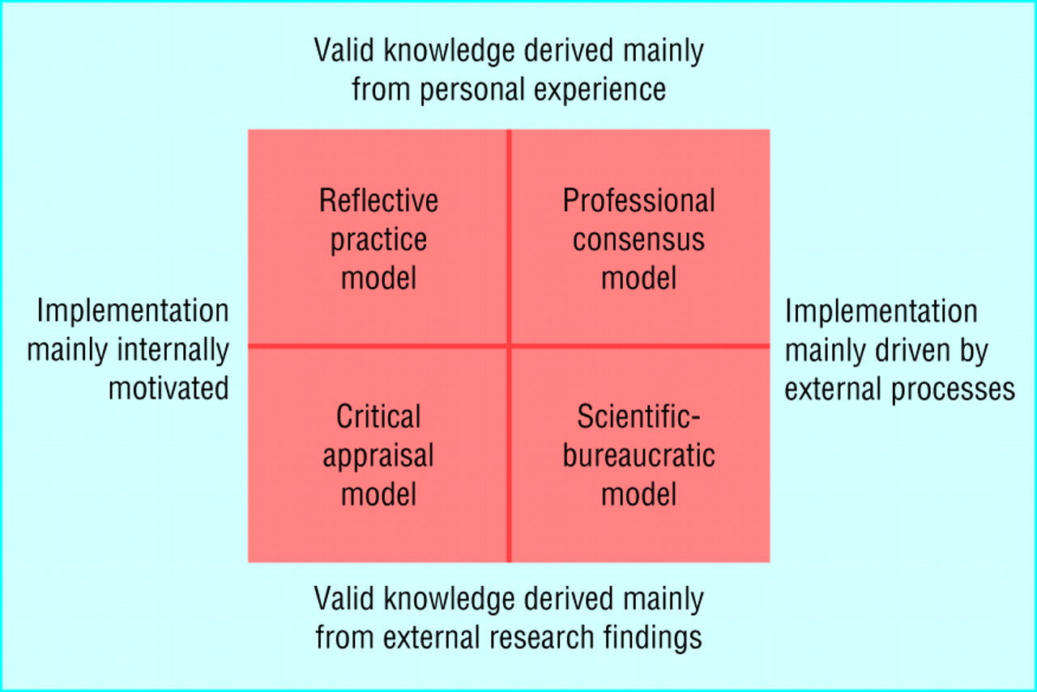
http://www.bmj.com/content/326/7390/646.extract

Slide 25
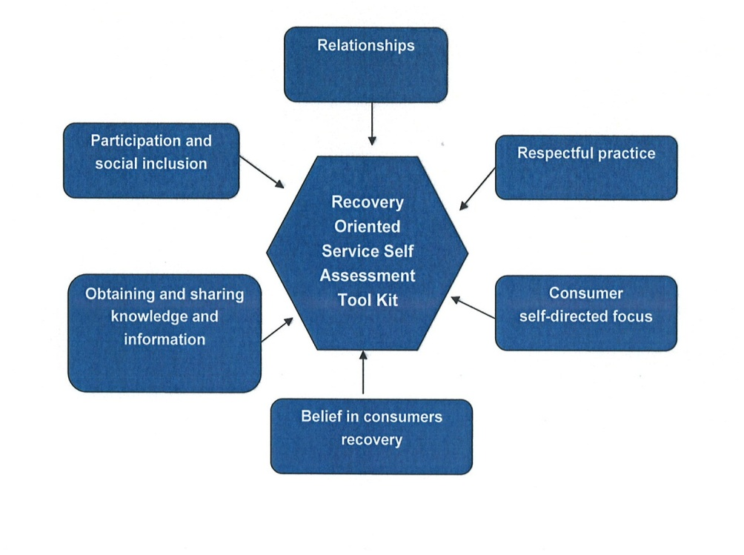
http://www.nswcag.org.au/page/nsw_cag__mhcc_recovery_project.html

Slide 26
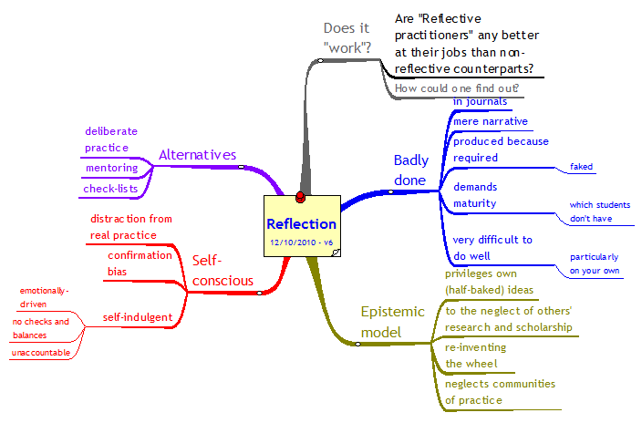
ATHERTON J S (2010) Doceo; Reflection; an idea whose time is past [On-line] UK: Available: http://www.doceo.co.uk/heterodoxy/reflection.htm Accessed: 16 January 2011
http://www.doceo.co.uk/heterodoxy/reflection.htm

Slide 27
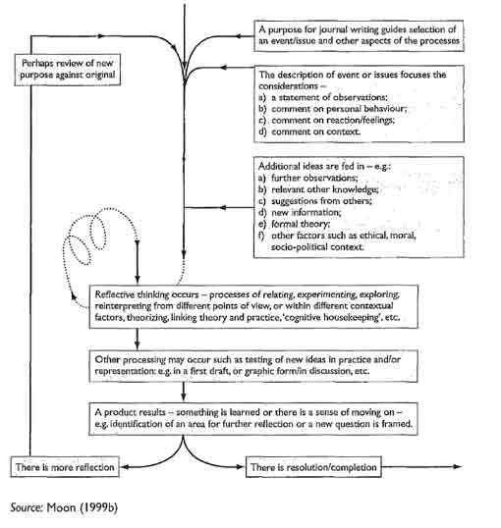

Slide 28
http://reflectivepractice-cpd.wikispaces.com/
Reflective Practice on;-ine resource
Article by Jenny Moon, http://www2.unca.edu/et/br022102.html
Wrkiting and keeping journals, http://www.infed.org/research/keeping_a_journal.htm
Reflection for Learning, http://sites.google.com/site/reflection4learning/why-reflect
http://www.york.ac.uk/admin/hr/researcher-development/students/resources/pgwt/reflectivepractice.pdf
http://journals.cambridge.org/action/displayAbstract?fromPage=online&aid=1465656
http://www-new1.heacademy.ac.uk/assets/York/documents/ourwork/research/literature_reviews/reflective_practice_full_report.pdf

Slide 29

PWYSIG I ADNABOD
Y gwahaniaeth rhwng cofio / disgrifio ac adfyfyrio.
IMPORTANT TO IDENTIFY
The difference between recollection / describing and reflection

