Slide 1

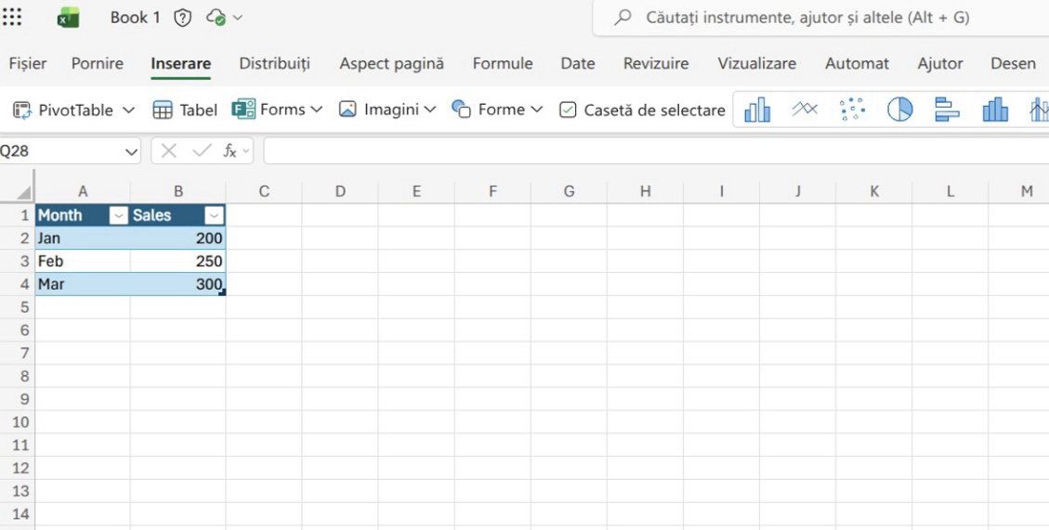

LCLM4002- Digital Skills Task 2- Poster Title- How to create a chart in excel
MS Excel is one of the 365 Apps that facilitates efficient use of numbers and large data sets.
2
3
4
After Excel opens, you can either create a new workbook by selecting “Blank Workbook” or open an existing file that contains the data you want to use.
Once your spreadsheet is open, take a moment to make sure your data is well organized in rows and columns.
Each column should have a clear heading, such as “Month” or “Sales,” and each row should contain the corresponding values.
Next, use your mouse to click and drag to highlight all the data you want to include in your chart.
Then go to the top menu bar and click on the Insert tab. You will see a section called Charts with different chart icons such as Column, Line, Pie, and Bar. Click on one of them — for example, “Column Chart.''
1
Excel will automatically create a chart using your selected data. You can then move the chart by clicking and dragging it, or resize it by pulling its corners.
To customize it, click on the chart and go to Chart Design or Format tabs. You can also add titles, labels, or change colors to make it look professional.
Finally, remember to save your work by clicking “File” → “Save As,” choose a location, and give your file a name.
To open or create a chart in Microsoft Excel, you first need to prepare your environment.
Start by turning on your laptop and waiting for the system to load completely
. Once it’s on, log into your account using your password or fingerprint if necessary.
Then, locate the Excel icon on your desktop or in the Start menu. Double-click it to open Microsoft Excel.
Created by : Mario Alberto Gheorghe ​
Student id: 2510294​
23.Oct.2025​
For more information you can wach this video: HOW TO USE EXCEL

