Slide 1

Mattel: Earth day Barbie
By Jordan Forbis

Slide 2
SWOT Recap
Strengths | Mattel and Barbie rand recognition and loyalty (Hivelr Business Review, 2023). Top competitor in the toy market (Statista). High demand for Barbie (Horizon Databook).
Weaknesses | Competition from competitors such as Hasbro, Lego, Bratz Dolls, Sindy, etc. (Statista) and (Hassan, 2023). Reliance on China for around 50% of their production Stroh (2024).
Opportunities | Expansion into ‘green toys’ or video games (Horizon Databook). Increase production outside of China for diversification of production (Stroh, 2025).
Threats | Competition from Sindy, Queens of Africa, Lottie Dolls, and Bratz Dolls (Hassan, 2023). American tariffs placed on China that can result in increased prices for consumers (Samp, 2025). Generally uncertain political and economic climate (Samp, 2025) and (Sherman 2025).
Notes:
From Assignment 1

Slide 3
Situation
New direction is product development.
Mattel creates Earth Day Barbie, which is a doll made of fully recyclable plastic. This means she can be made of recycled material, and be recycled at end of lifetime.
Concept of using recycled plastic is already being used by certain companies, such as Green Toys (Green Toys).
high-density polyethylene (HDPE)
polypropylene (PP)
low-density polyethylene (LDPE)
Polyethylene Terephthalate (PET) is also very recyclable
Component: | Material Currently Used (Brunning, 2023) | Recyclable Alternative (PlasticExpert)
Head and Hair | PVC or PVDC | PP and Nylon, respectively
Torso | ABS or LDPE* | Already recyclable!
Arms | PVC* or EVA | PP
Legs | PVC or PP | Switch to recyclable PP

Slide 4
Objectives
Goal | Enter the market for sustainable toys by launching fully recyclable Barbie doll, “Earth Day Barbie” by 2030.
Specific | Release “Earth Day Barbie” which is composed of easily recyclable plastics
Measurable | Have check in points leading up to launch, such as testing different prototypes, measuring customer interest/input, gauging cost of using fully recyclable materials, and so on
Achievable | I have conducted the research that there are viable recyclable substitutes to the materials currently used in Barbie
Relevant | It is possible to launch the “Earth Day Barbie” to enter the eco-toy market. It needs to be done with the acknowledgment that she is different from the more familiar/traditional doll, due to the different composition of her parts
Time-Bound | Having the goal of 2030 gives the company, and its customers, a time that they can expect to have the product finished.
Goal | Launch online advertising campaign to promote Earth Day Barbie before, during, and after product launch.
Specific | Focus ads to social media and TV to promote Earth Day Barbie and her focus on sustainability. Incorporate the blue, green, and pink colour palate to differentiate from other Barbie dolls.
Measurable | Use data from ad campaign to assess customer interest in product, particularly in terms of entering the Eco-Friendly toys market.
Achievable | I have found alternative Recyclable plastics that Barbie can be made of, which I will discuss shortly.
Relevant | The market for Eco-Friendly toys is growing (Global Market Insights, 2024) so advertising Matel’s entry into the market may help it participate and benefit from that growth.
Time-Bound | Having the ad campaign span the duration of the product launch will allow greater product awareness.

Slide 5
Strategy
Product | Earth Day Barbie
Price | Begin with a competitive pricing strategy, eventually slightly elevate cost to compensate for higher costs associated with recycled plastic (Plunkett Corporate Benchmarking Reports 2023 and Cole 2025).
Place | Global via Mattel retailers
Promotion | Online Marketing, Public Relations
People | Environmentally aware employees and customers
Process | Utilize Mattel’s established processes
Physical Evidence | Focus on the blue, green, and pink colour palate to differentiate Earth Day Barbie
Target market: Eco-Friendly toys market (Global Market Insights, 2024)
  Valued at USD 1.2 billion in 2024
  Estimated growth of 12.5% CAGR from 2025 to 2034
This is an adjacent market to what Matel already occupies. (Harvard Business Review)
Positioning: an Eco-Friendly alternative to the classic Barbie Doll.
Notes:
Business Queensland defines marketing as being, “about planning and executing the development, pricing, distribution and promotion of products and services to satisfy the needs of your customers.”. It is delivered through a combination of elements, called the marketing mix or 7 P’s. They are product, price, place, promotion, people, process, and physical evidence.

Slide 6
Tactics
Product Design & features: recycled/recyclable (Global Market Insights, 2024)
Quality & Branding: The different plastics are substitutes, not direct replacements.
Positioning: Continue with how this Barbie is different, but that is because she is made from recycled/recyclable plastics.
Can also focus on how this diverts plastics from landfills (Plastic Pollution Coalition 2023). Pricing:
Pricing: start with competitive pricing, then raise price after establishing product.
(Mattel and Plunkett Corporate Benchmarking Reports 2023).
Notes:
Product Design & features: recycled/recyclable (Global Market Insights, 2024) “The global eco-friendly toys market size was valued at USD 1.2 billion in 2024 and is estimated to grow at a CAGR of over 12.5% from 2025 to 2034. The market for eco-friendly toys is continually expanding due to greater consumer cooperativeness in the use of eco-friendly products, eco-useful parenting, policies put in place by governments, and advances in materials .”
Quality & Branding: The different plastics are substitutes, not direct replacements. For example, some of the plastics have additives that make the plastic softer or more flexible, but this makes them harder to recycle (Plastic Pollution Coalition 2023). This will likely result in a different looking/feeling doll, changing the typical quality. That is why the messaging of Earth Day Barbie will be focused on her environmentally friendly features, and how they result in the differences between her and the conventional Barbie doll
Positioning: Continue with how this Barbie is different, but that is because she is made from recycled/recyclable plastics. Can also focus on how this diverts plastics from landfills (Plastic Pollution Coalition 2023). Pricing:
Due to Mattel’s size and reputation (it has been around since 1945), it may be financially stable enough to use a competitive pricing strategy without losing too much money. After seeing how the product does in the market, they may be able to increase the price to compensate for the increased costs associated with using recycled plastics in the product (Mattel and Plunkett Corporate Benchmarking Reports 2023).

Slide 7
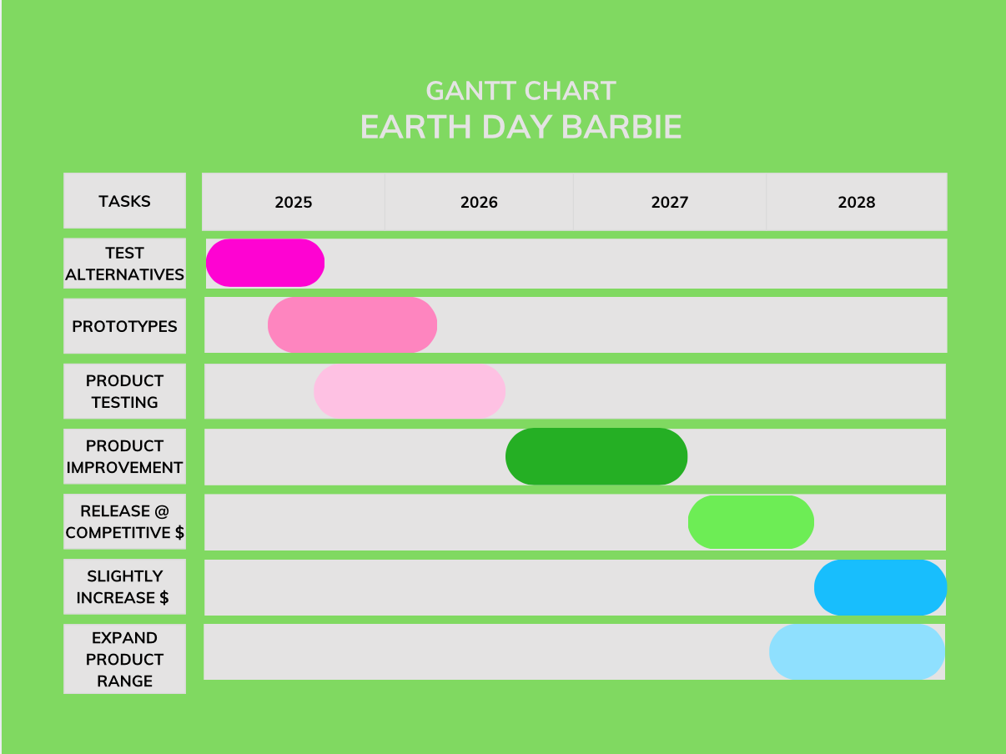
Action

Slide 8
Control
Metrics used:
  What?: Customer satisfaction, revenue, and social media engagement
  When?: Test customer satisfaction after product testing, revenue after launch, and social media engagement from the start.
  Why?: Satisfaction and revenue to gauge product success, media engagement for interest.
  How will this support the implementation of the plan?: They will help indicate how interested customers are in the product, and if it will do well in the market.
Notes:
“Marketing metrics are the key performance indicators (KPIs) that help businesses measure the effectiveness of their marketing campaigns and make data-driven decisions to drive growth” (Györke-Szász, 2024).

Slide 9
References
Business Queensland. Marketing basics for business and the 7 Ps. Available at: https://www.business.qld.gov.au/running-business/marketing-sales/marketing/strategy-planning/marketing-basics#the-7ps-of-marketing (Accessed: 9 May 2025).
Brunning, A (August 2023) Life in plastic(s): The chemistry of a Barbie doll. Available at: https://www.compoundchem.com/2023/08/18/barbie/. (Accessed April 2025).
Cole, S. (2025) Why are Sustainable Products More Expensive? Available at: https://theroundup.org/why-are-sustainable-products-more-expensive/#:~:text=In%20conclusion%2C%20eco%2Dfriendly%20products,don't%20know%20what%20is.. (Accessed: 9 May 2025).
Green Toys. About Us. Available at: https://www.greentoys.co.uk/pages/our-story. (Accessed: 21 April 2025).
Global Market Insights (December 2024). Eco-Friendly Toys Market - By Product Type, By Material, By Age Group, By Price, By End User, By Distribution Channel Analysis, Share, Growth Forecast, 2025 – 2034. Available at: https://www.gminsights.com/industry-analysis/eco-friendly-toys-market. (Accessed: 23 April 2025).
Györke-Szász, K. (2024). The Importance of Marketing Metrics: Why They Matter for Business Success. Available at: https://www.linkedin.com/pulse/importance-marketing-metrics-why-matter-business-kata-györke-szász-f2l4f/. (Accessed: 9 May 2025).
Harvard Business Review (2021). 5 Things to Consider Before Entering a New Market. Available at: https://hbr.org/sponsored/2021/01/5-things-to-consider-before-entering-a-new-market. (Accessed: 23 April 2025).
Mattel, Inc. History. Available at: https://corporate.mattel.com/history. (Accessed: 18 March 2025).
Mattel. Mattel PlayBack and Sustainability. Available at: https://shop.mattel.com/pages/playback. (Accessed: 23 April 2025).

Slide 10
References
Plastic Expert. Is Abs Plastic Recyclable? Available at: https://www.plasticexpert.co.uk/plastic-recycling/abs-plastic-recycling/#:~:text=is%20abs%20plastic%20recyclable?,times%20without%20losing%20its%20properties. (Accessed: 21 April 2025).
Plastic Expert. Nylon Recycling For Your Business. Available at: https://www.plasticexpert.co.uk/nylon-recycling/. (Accessed 21 April 2025).
Plastic Pollution Coalition (July 2023) In Our Real World, Barbie’s Plastic Is Not So Fantastic. Available at: https://www.plasticpollutioncoalition.org/blog/2023/7/21/in-our-real-world-barbies-plastic-is-not-so-fantastic#:~:text=Barbie%20(and%20all%20of%20her,hard%20vinyl—plus%20additive%20chemicals (Accessed: 18 April 2025).
Plunkett Corporate Benchmarking Reports (2023) ‘Mattel Inc’, Proquest, (May). Available at: https://www.proquest.com/reports/mattelinc/docview/2825202452/se 2?accountid=130472 (Accessed 18 March 2025).
RotaJet Recycling. PET Plastic Recycling. Available at: https://plasticwashing.co.uk/pet-polyethylene-terephthalate-recycling/#:~:text=PET%20Recycling%20Solutions,UK%20collecting%20PET%20for%20recycling.&text=With%20the%20coming%20introduction%20of,into%20its%20constituent%20process%20stages. (Accessed: 21 April 2025).

