Slide 1
論語-顏淵

Slide 2
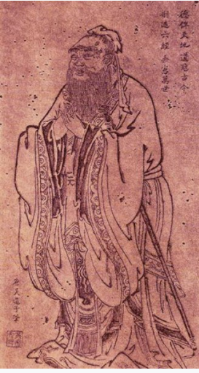
論語 Analects of Confucius
Is a book composed a large collection of ideas from Chinese philosopher- Confucius.
Confucius- 孔夫子 Master Kong
Educator
Main core: Wisdom(智),benevolence(仁), courage(勇)
Education basically base on: filial piety (孝),courtesy (禮), harmony (和)
Education goal

Slide 3
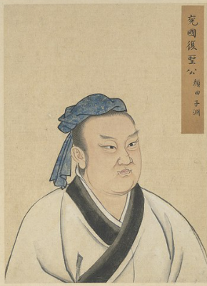
Yan Yuan 顏淵
Student of Confucius
Head of Confucius’ 72 disciples
Most proud disciple
Wont repeat same mistake

Slide 4
1.顏淵問仁。子曰：“克己復禮為仁。一日克己復禮，天下歸仁焉。為政由己，而由人乎哉？” 顏淵曰：“請問其目。” 子曰：“非禮勿視，非禮勿聽，非禮勿言，非禮勿動。” 顏淵曰：“回雖不敏，請事斯語矣。”

Slide 5
顏淵問仁
Yan Yuan asked about perfect virtue – James Legge

Slide 6
子曰：克己復禮為仁
The Master said, "To subdue one's self and return to propriety, is perfect virtue.
Restrict self – one’s own desires, bad habits
Classic of rights - do not blame others, have to change ourselves

Slide 7
一日克己復禮，天下歸仁焉
If a man can for one day subdue himself and return to propriety, all under heaven will ascribe perfect virtue to him.
Example: King Wen （文王）use perfect virtue to transformed the two kingdoms of Rui Yu.
The Kings of Rui and Yu have argument in land
At Country Zhou, they saw people in Zhou are letting each others, the two king returned home astonishment.
The rest of the world know about this, there are 40 countries join the Zhou.
Restrict ourselves and follow the rights rules will influence others

Slide 8
為政由己，而由人乎哉
Is the practice of perfect virtue from a man himself, or is it from others
Person of noble still behave as perfect virtue even though they are alone.

Slide 9
顏淵曰：“請問其目。”
Yan Yuan said, "I beg to ask the steps of that process."

Slide 10
子曰：“非禮勿視，非禮勿聽，非禮勿言，非禮勿動。”
The Master replied, "Look not at what is contrary to propriety; listen not to what is contrary to propriety; speak not what is contrary to propriety; make no movement which is contrary to propriety."
Do not look- movie, news- which do not conduct the classic of rights
Do not listen – nonsence, gossip
Do no speak – words lets unhappy
Wont not affect our mindset
Notes:
要運用在生活當中
清淨心
不最求，不好奇不符合理
看大標題

Slide 11
顏淵曰：“回雖不敏，請事斯語矣。”
Yan Yuan then said, "Though I am deficient in intelligence and vigor, I will make it my business to practice this lesson."

Slide 12
2.仲弓問仁。子曰：「出門如見大賓，使民如承大祭。己所不欲，勿施於人。在邦無怨，在家無怨。」仲弓曰：「雍雖不敏，請事斯語矣。」”

Slide 13
仲弓問仁
Zhong Gong asked about perfect virtue.

Slide 14
子曰：「出門如見大賓，使民如承大祭。
he Master said, "It is, when you go abroad, to behave to every one as if you were receiving a great guest; to employ the people as if you were assisting at a great sacrifice;
Need to respect (敬) for great guest
Behave sincere (誠) when attend great sacrifice
Perfect virtue must have respect and sincere

Slide 15
己所不欲，勿施於人。
not to do to others as you would not wish done to yourself;
This is the matter of forgive (恕)
Give forgiveness = perfect virtue

Slide 16
在邦無怨，在家無怨。
to have no murmuring against you in the country, and none in the family."
Will not lets others blame where ever we at

Slide 17
仲弓曰：「雍雖不敏，請事斯語矣。」”
Zhong Gong said, "Though I am deficient in intelligence and vigor, I will make it my business to practice this lesson."

Slide 18
Conclusion
Yan Yuan –to cultivate one’s moral character – self-denial- sincere and respect
Zhong Gong- not to do to others as you would not wish done to yourself- forgiveness
仁

Slide 19
Refences
李炳南：《論語講要》
孔子解構「仁」字的意義。中國文字文化院。檢自https://chiculture.org.hk/tc/china-five-thousand-years/373(2021年1月1日)
論語名句。國學夢。檢自http://www.guoxuemeng.com/guoxue/15119.html (2021年1月1日)
James Legge。中國哲學書電子化計劃。檢自https://ctext.org/analects/yan-yuan/zh?en=on (2021年1月1日)

