Slide 1

Writing an introduction, ethical approval and using supervision wisely
Workshop 4 Dr Beverly Cole

Slide 2

OPENING ROUND:

Slide 3
How might your research impact upon:
You as a person
You as a counsellor
You as a researcher

Slide 4

Writing a dissertation : A short video clip [7 mins] …
Here’s one view on how to write a dissertation,
Writing a dissertation

Slide 5

More on the structure of a dissertation [19 mins] …
The Format and Structure of a Dissertation

Slide 6
Discussion on the recordings on writing a dissertation:
Let’s make a plan of our dissertation
Where might we start?
Free writing
Supervision
►

Slide 7
Making a research plan … … …
Consider the links between the advice on the recordings/Moodle, the template for a dissertation and the following view of research design, then consider the relevance of each heading for your own research:
►

Slide 8
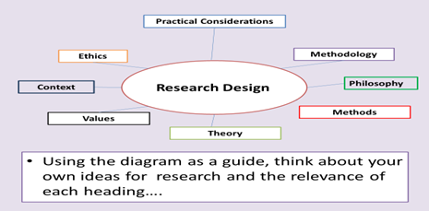

Slide 9
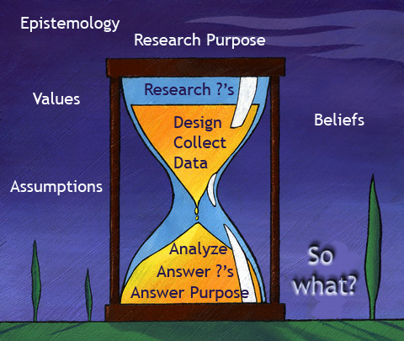

Slide 10

Discussion : Structure of a dissertation
Questions regarding:
The PowerPoint and YouTube on the Structure of a dissertation
The draft structure on Moodle
►

Slide 11
The Abstract …
Writing an abstract [BC]
Writing an abstract [YouTube]
Writing an Abstract [5 Mins]
Writing an Abstract [9 mins]
10

Slide 12
Discussion: Writing an abstract [Free writing]
1. What is an Abstract?
2. What is its role in research?
3. List five essentials to be included in an abstract

Slide 13

Writing an abstract : Let’s make a start…
The focus of this research is in the area of … … …
Such a study is important in order to … … …
The research approach adopted in this research includes … … …
The findings from this research evidence how … … …
The main conclusions from this research are … … …
Recommendations are made for practice in that …. …. …
Key words: a,b,c,d,e
10

Slide 14

Any questions:
Questions on the writing of an abstract or the structure of the dissertation … …

Slide 15

Writing workshop
MA IN PSYCHOTHERAPEUTIC PRACTICE

Slide 16
Aims of this lesson:
Writing your Introduction
Applying for ethical approval
Using Supervision Wisely

Slide 17
The first part of your dissertation
Writing an Introduction to a Dissertation

Slide 18


QUESTIONS AND Discussion on the INFORMATION on Writing an Introduction and ethics
►

Slide 19
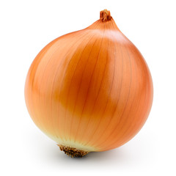
The research onion

Slide 20

Discussion on Writing an Introduction [Con’t]
Write down five words to describe your area of research.
Come up with synonyms for each word.

Slide 21
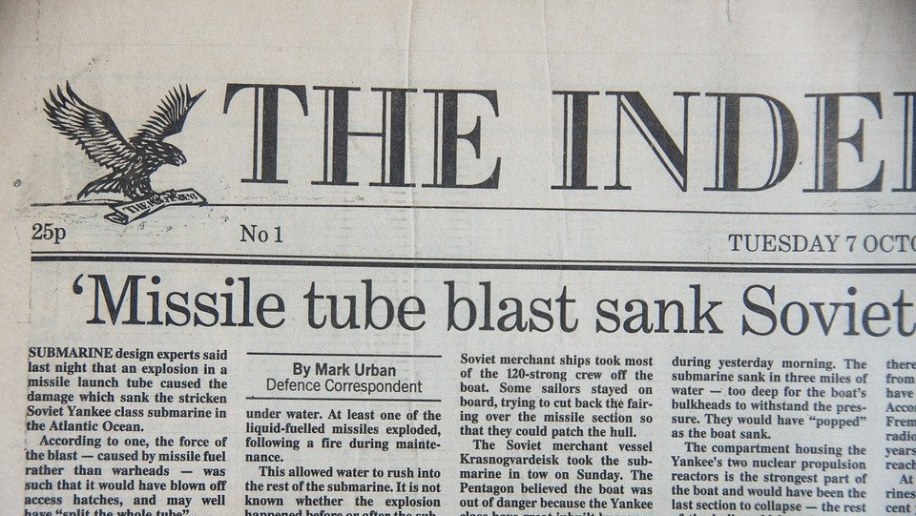
Making an impression with your first few pages

Slide 22

Discussion on: Writing an Introduction
Start to write your Introduction … … ….
t.

Slide 23

DRAFT INTRODUCTION [Free writing exercise}
TITLE
REEARCH QUESTION
BACKGROUND
AIMS
OBJECTIVES
10

Slide 24

Developing research eyes
Spot the issues … … …

Slide 25
Spot the issues…
This research aims to find out what people think about television.

Slide 26
This research aims to find out what people think about television.
  This is broad and obscure. I would want to know what ‘people’ and what ‘television’?
  What would be the purpose of this research? Who would want to know the results? No point in repeating research.
  What is the educational value of children’s programming according to teachers?

Slide 27
Spot the issues
I want to find out how many local residents are interested in a play scheme for children during the summer holiday.

Slide 28
How many local residents are interested in a play scheme for children during the summer holiday?
All local residents?
  Only if they’re ‘interested’… or whether they would want to actually use it?
  Would residents be happy to use the scheme if it was run? What is your interest in this?

Slide 29
Spot the issues
My project is to do some research into autism, find out what people do when their relatives have it and what support they can get and how doctors deal with it.

Slide 30
Research into autism, find out what people do when their relatives have it and what support they can get and how doctors deal with it.
- What do you think about the way this question has been written?
- What questions would you ask if you were supervising this student?

Slide 31
Now consider your research…
What?
What is your research?
Why?
Why do you want to do the research?
(Consider the reason you’re conducting this research!)
Firstly: Explain the 4 W’s of your research … you have 2 minutes!
Secondly: What questions do you have about the research ideas you have heard?
When?
When are you going to complete each stage?
Where?
Where are you going to conduct your research?

Slide 32

Questionnaire on the expectations of supervision:
Mutual expectations - agreeing what can be expected within, and the process of, research supervision and considering a contractual arrangement.
Supervisees need to … (3)
Supervisors need to … (3)
Both need to … (3) 10 G​

Slide 33
HAVE WE MET THE Aims of this lesson:
Writing your Introduction
Applying for ethical approval
Using Supervision Wisely

Slide 34

FEEDBACK AND SUGGESTIONS

Slide 35

Critique of research paper
Select a key research paper within your area of research
Be sure that you are fairly well acquainted in your knowledge and understanding of the content
Have this available for discussion at our next lesson.

Slide 36
Next Lesson … Becoming a master researcher …
Writing
Writing a Literature Review
Reading and understanding research papers
Writing

Slide 37
closing ROUND:

