Slide 1
MSc Cybersecurity and Digital Forensics
Module: Digital Forensics Analysis
Submitted by: Md Ahasanul Kobir Opy
Student ID: 2522648
Lecture: Dr. Mohamed Ghanem

Slide 2
Incident Response and Digital Forensics Investigation Record: Case QT-AI-2025

Slide 3
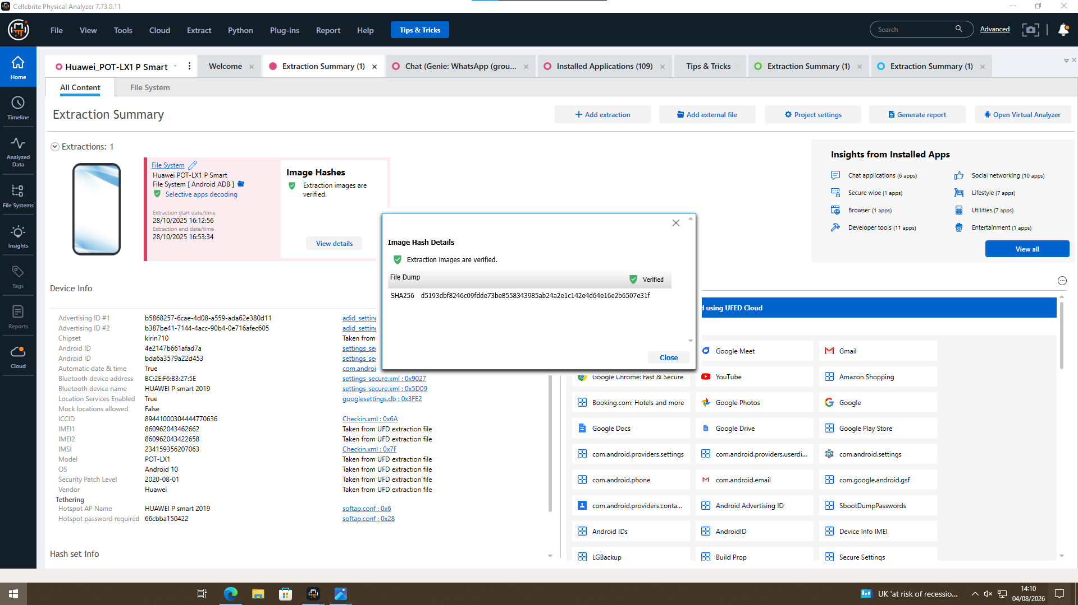
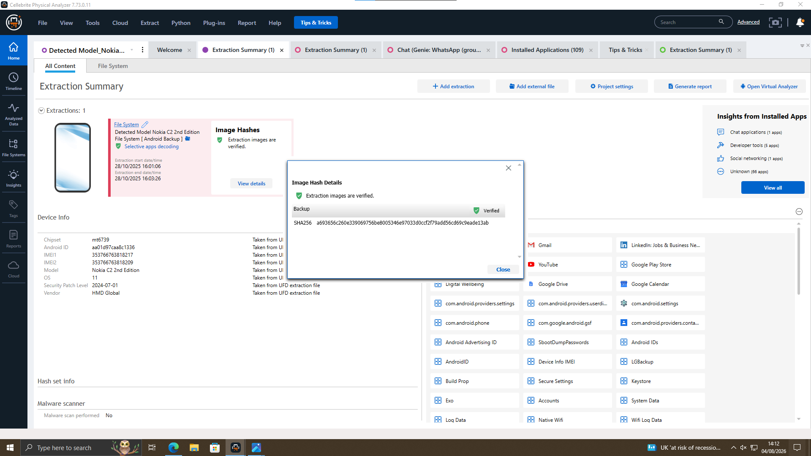
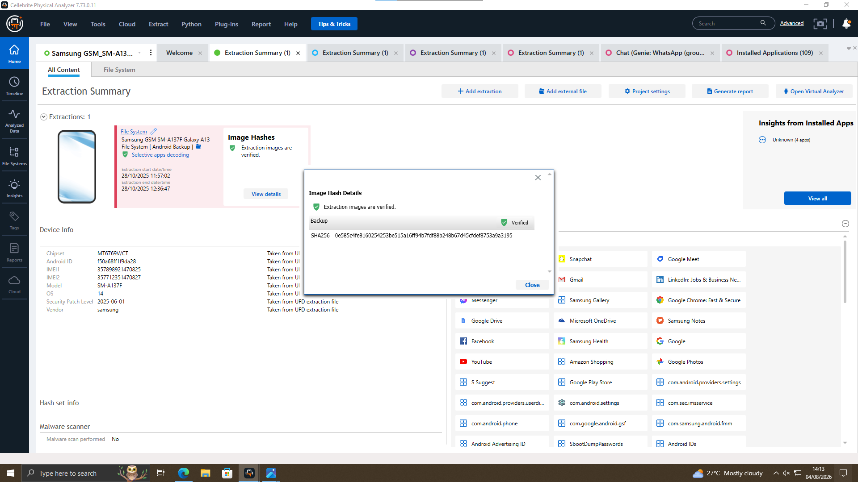
Digital Evidence Inventory and Chain of Custody
QT-01 Nokia C2
QT-02 Huawei P Smart
QT-03 Samsung Galaxy A13 SHA-256 verified

Slide 4
Forensic Framework and Analysis Tools
Cryptographic Assurance & Hashing Procedures
Analysis Tools
Cellebrite UFED
Cellebrite Physical Analyzer V7
Evidence Collection
Secure Preservation
Forensic Extraction & Hash Verification
Artifact Analysis & Event Correlation

Slide 5
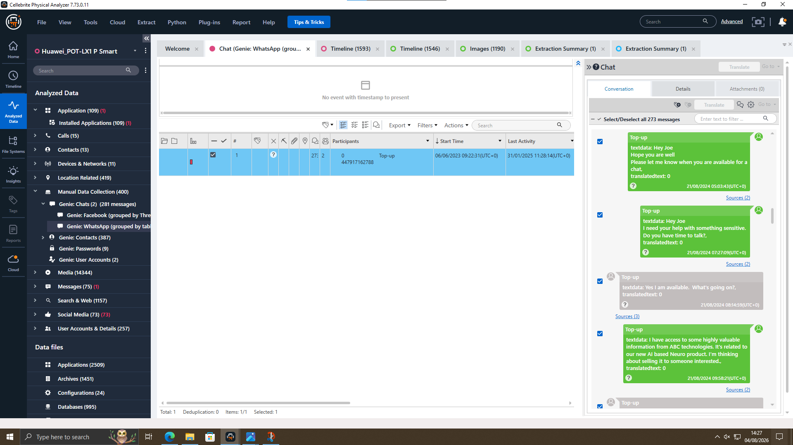
Analysis of Digital Communications
Emma used Genie Chats to communicate covertly with external parties
Joe functioned as the intermediary, coordinating the illicit transaction

Slide 6
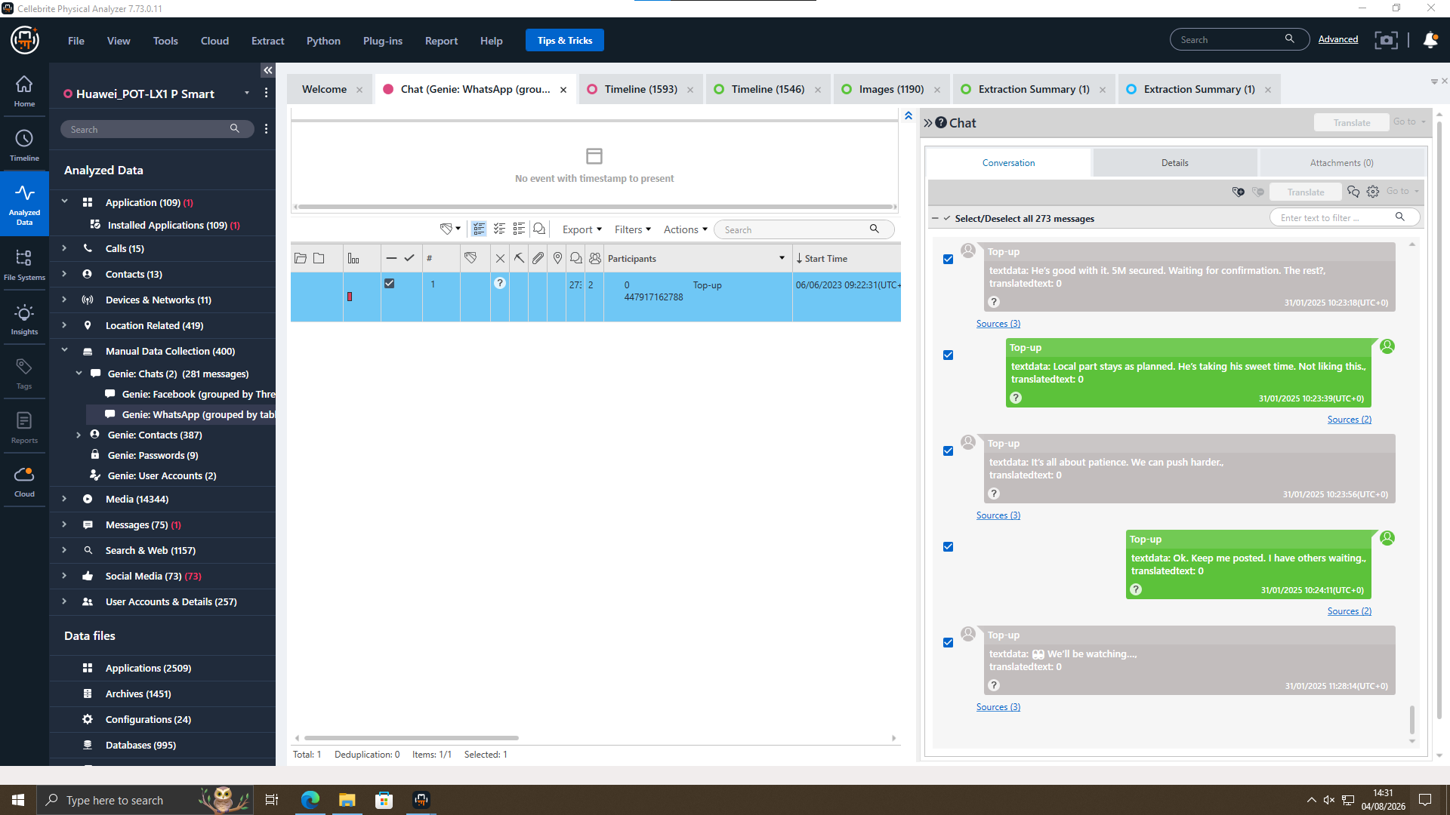
Analysis of Digital Communications
Emma talked with Joe about the money.
Emma is confused about the deal.

Slide 7
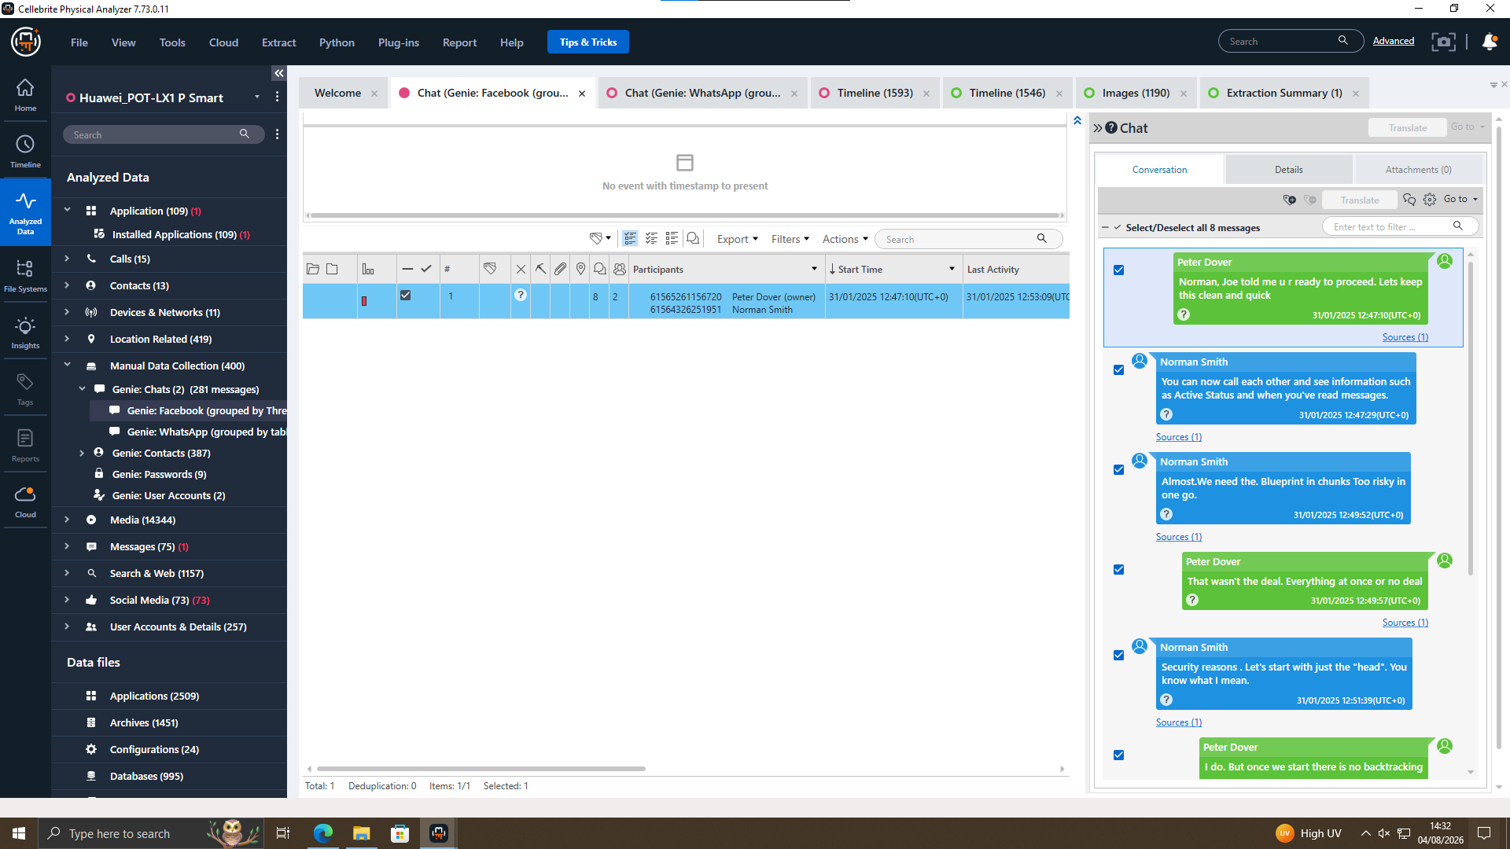
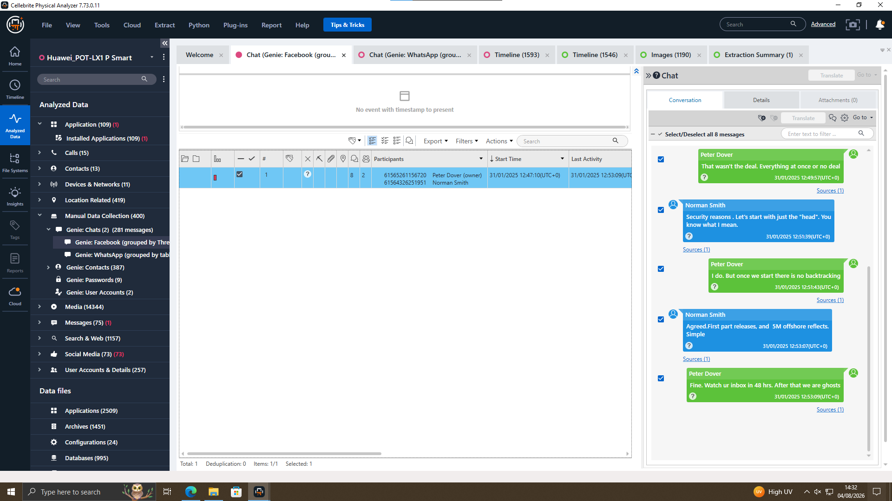
Analysis of Digital Communications
Norman agreed to illegally acquire the proprietary AI patent
Recovered communications indicated planned evidence concealment following the transaction.

Slide 8
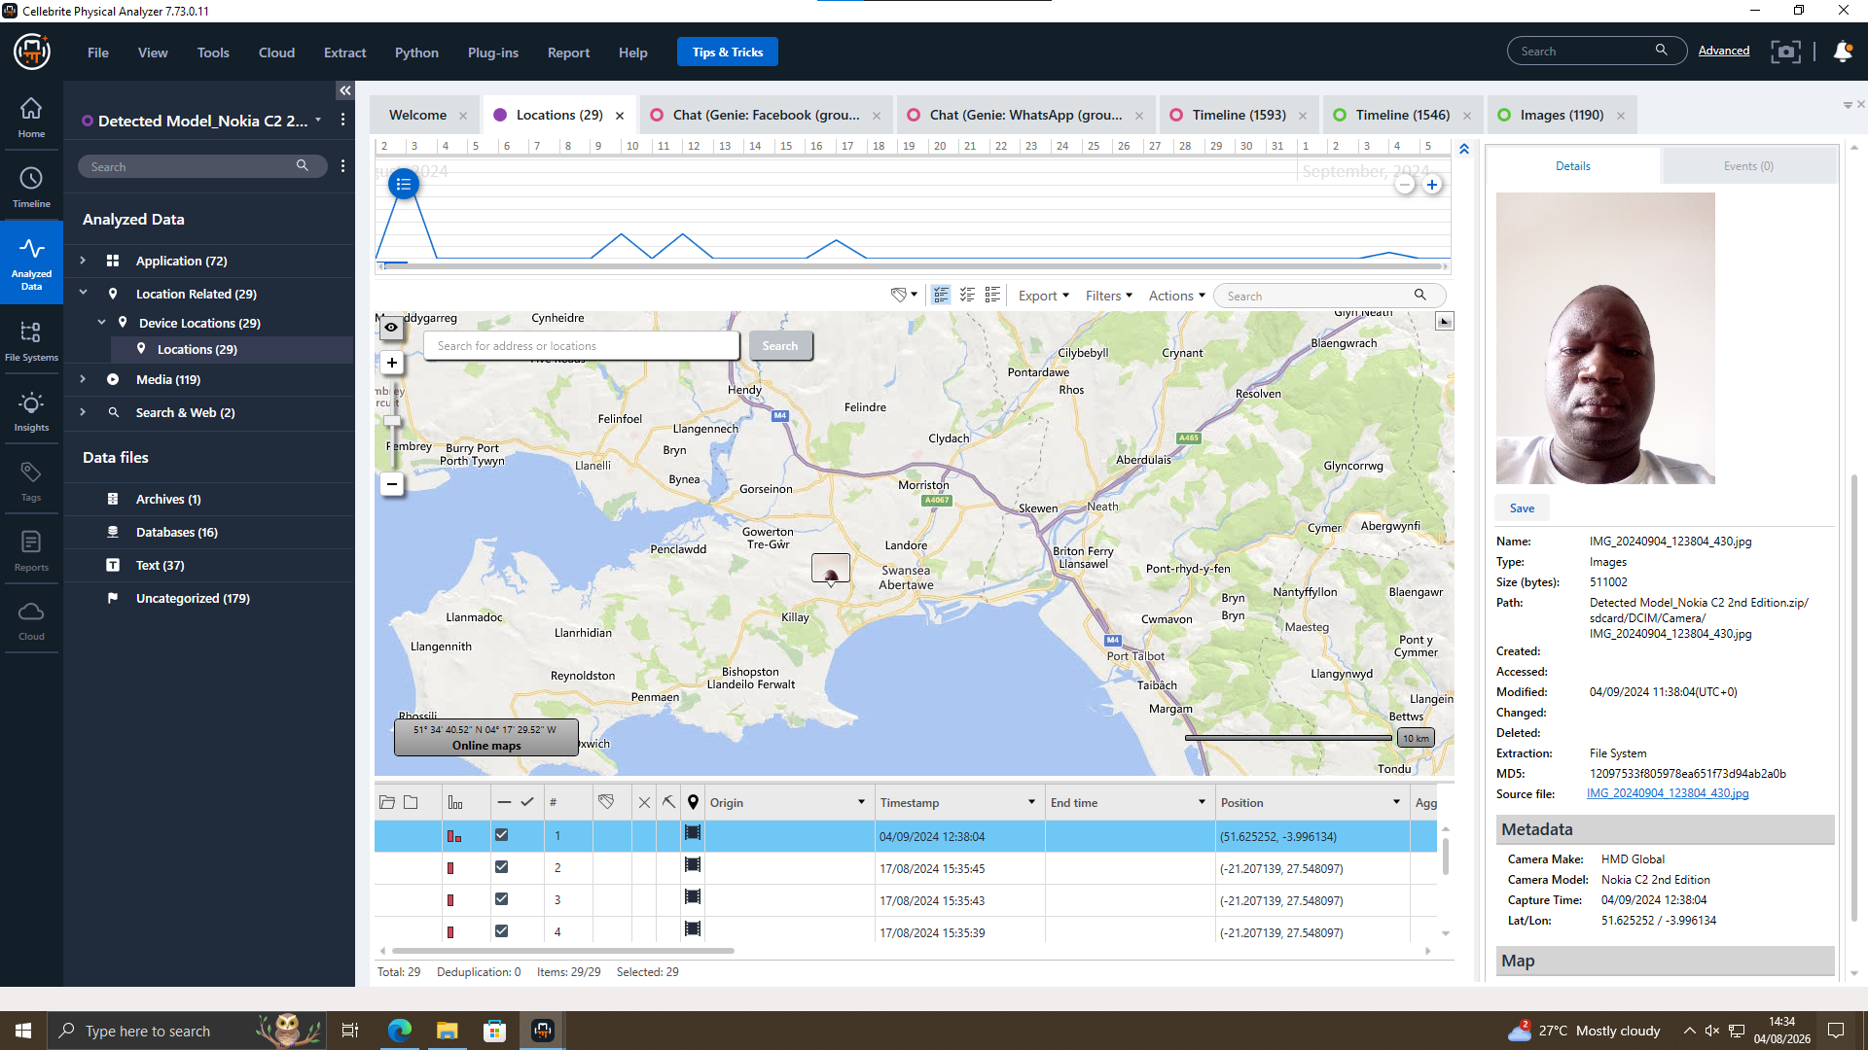
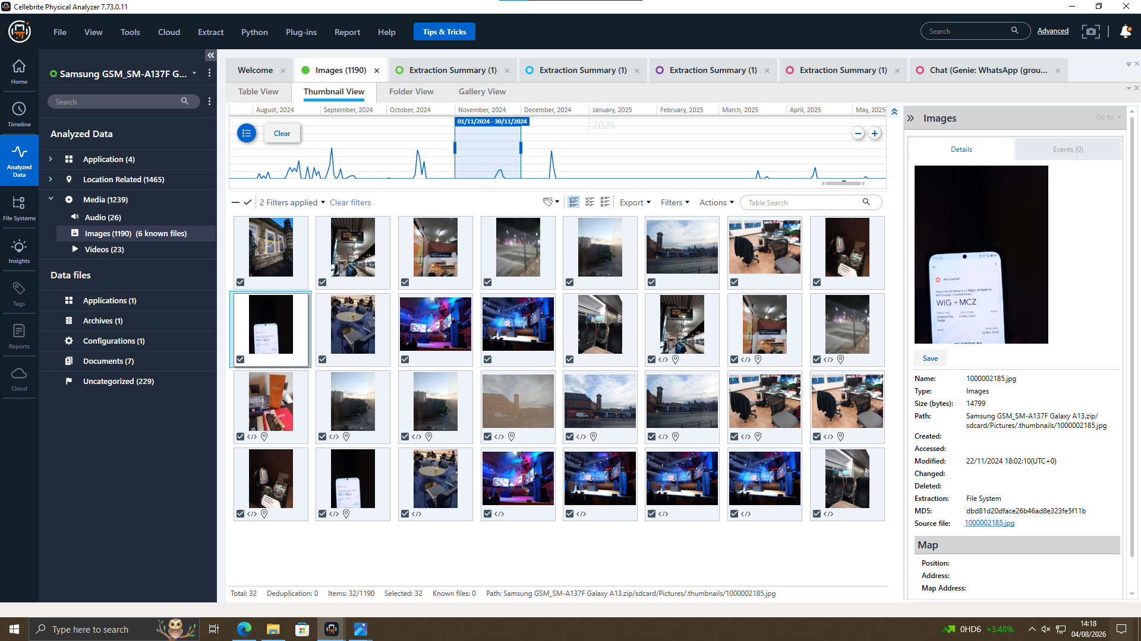
Interaction Mapping & Spatial Data Analysis
GPS metadata validated the suspects' presence at the meeting location.
Electronic travel tickets reconstructed the route through Glasgow and Manchester.

Slide 9
Suspect Profiling & Behavioral Analysis
Emma (The Perpetrator): Utilized legitimate access credentials to target intellectual property (QT-AI-2025 patent) for financial gain.
Joe (The Intermediary): Handled operational logistics to prevent direct contact tracing between source and buyer.
Norman (The Buyer): Displayed conscious guilt (mens rea) through post-incident anti-forensic practices and SIM card destruction/removal on Exhibit QT-01.

Slide 10
Case Progression & Activity Log
Timestamp | Suspect Involved | Evidence Source | Event Description
21/08/2024 07:27:09 | Emma and Joe | Huawei System Logs / Genie Chats | Initial setup of covert communication
31/01/2025 10:23:18 | Emma and Joe | Huawei System Logs / Whatsapp Chats | Disclosing intent to sell the AI-based Neuro product
31/01/2025 12:49:57 | Emma and Norman | Huawei System Logs / Facebook Chats | Emma initiates direct contact with the corporate buyer.
31/10/2025 12:51:49 | Emma and Norman | Huawei System Logs / Facebook Chats | Norman agreed with the deal
04/09/2024 12:08:04 | Norman | Nokia C2 Device Location | Geolocation mapping records
22/11/2024 11:21:58 | Joe | Samsung Galaxy A13 | Joe traveled manchester to meet clients.

Slide 11
Final Assessment & Corrective Measures
Espionage Confirmation
Law Enforcement Handover
DLP Enforcement
Carrier Data Request

Slide 12
Any questions?

