Slide 1

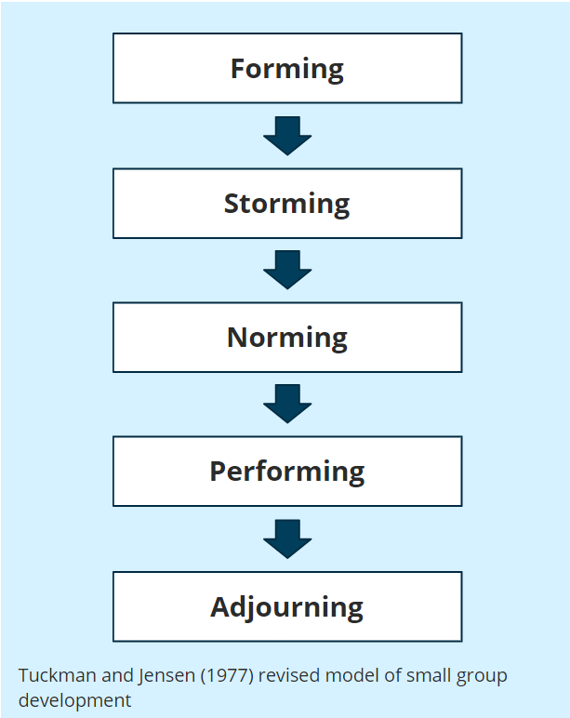
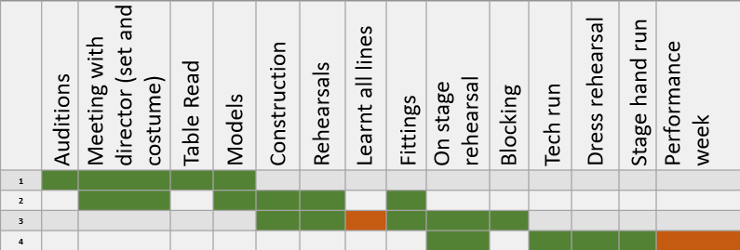
Unit 3 – Task 3
ATHROS Theatre Company
Storming
The way we dealt with conflict was, honestly effectively . We discoursed and debated, the pros and cons, in order to efficiently, EXTERMINATE any unwanted mishaps. We voted, for we are a democratic group. And there are no leaders, who infiltrate our equality as we identified this was essential for forming trust. An example of conflict resolving, we as a group dealt was The Grinch, the second choice to our production.
Performing
We planned our Company’s, performance, following a strict schedule, based on necessity and time efficiency. Once we had obtained the script, We started with the audition process which was led by our Director, Rosie and Tommi the Choreographer. Our Treasurer Alex discussed with Obaid, the Constuction Manager and Harry our Stage Manager what sort of set we wanted for our production. Sam, who is Head of Costume was responsible for fitting our chosen actors, once all of that was completed, we began our rehearsal process ASAP so that we are prepared for our opening night.
Tuckman’s theory
Spotlights the generalised way a team will develop over the course of a project which we used alongside a smart goal system.
Swot strengths
As we began assigning roles to our team, we discussed everyone’s individual strengths. This brought a level of trust to the group which allowed us to get to know each other better. This is an example of our group applying the ‘forming’ step of Tuckman’s Theory.
Planned timeline:
Alex’s Reflection
We worked well as a group, everyone contributed ideas and gave their opinions on the direction we took. Naturally, the more outgoing members were the driving force during discussions but when the more reserved members of the group made contributions they were incredibly valuable. We worked through any conflict we had well as everyone knew that we all wanted the same thing, and therefore comments made were always constructive. However, if we were to do the task again, during our discussions, I would encourage the group to defer to people’s areas of strength on a more regular basis to ensure we made use of everyone’s expertise.
SWOT weaknesses
We discussed openly our weaknesses as a group, creating a judgement-free zone for each other. Together we looked at the 5 dysfunctions of a team by Patrick Lencioni, to overcome these before they became an issue within our group. Enabling us to effectively assign roles for everyone that they were best suited for and most comfortable performing.
Arts Emergency
We unanimously chose this charity as we felt it aligned with our beliefs and values due to their efforts helping young people enter higher education and creative industries. They offer gateways into industries like TV,
Performing arts, and publishing and we plan to donate a large portion of our profit to their cause.

