Slide 1

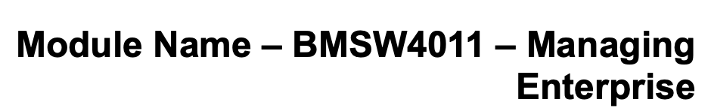
BlueSky Cafe Business Plan
Student Name: Liljana Reci
Student Id: 2309831

Slide 2
BlueSky Cafe Business Plan
BlueSky Cafe is a pioneering coffee shop designed to blend premium coffee with cutting-edge technology services. Situated in a bustling urban area, BlueSky Cafe targets tech enthusiasts, remote workers, and coffee aficionados. Our inviting environment features modern amenities such as high-speed internet, ample charging stations, and private workspaces, making it the ideal spot for productivity and relaxation. (Cusson & Bottorff, 2024).

Slide 3
Business Idea and Mission
BlueSky Cafe is a pioneering coffee shop designed to blend premium coffee with cutting-edge technology services. Situated in a bustling urban area, BlueSky Cafe targets tech enthusiasts, remote workers, and coffee aficionados. Our inviting environment features modern amenities such as high-speed internet, ample charging stations, and private workspaces, making it the ideal spot for productivity and relaxation. (Coffee Shop & Cafe Business Plan examples 2024)
By offering a unique blend of premium coffee and a tech-friendly environment, BlueSky Cafe appeals to customers who appreciate quality beverages and require a conducive space for work and social interaction. Our mission is to create a community hub where technology and coffee culture merge, providing an exceptional customer experience through innovative offerings and excellent service. (Pendrill, 2023)

Slide 4
Legal Status
Chosen Legal Status: Limited Liability Company (LLC) (Maule, 2024)
  Pros:
Limited Liability: Owners are not personally liable for business debts and liabilities.
Tax Flexibility: An LLC can choose between being taxed as a sole proprietor, partnership, S corporation, or C corporation.
Credibility: An LLC structure can enhance the business’s credibility and professionalism.
Management Flexibility: Owners can manage the business or appoint managers without affecting their liability protection.
  Cons:
Formation and Ongoing Costs: Higher initial setup and ongoing compliance costs compared to a sole proprietorship.
Complexity: More paperwork and formalities in setting up and maintaining the business.
Limited Life: In some jurisdictions, if an owner leaves or passes away, the LLC may need to be dissolved. (Hayes, 2024)

Slide 5
Market Research
To understand our target market and validate our business idea, we conducted comprehensive market research including surveys, focus groups, and an analysis of industry trends. (Pecánek, 2023)
  Survey Findings
    Demographics: Predominantly young professionals aged 25-40.
    Preferences: High demand for quality coffee and a work-friendly environment with tech amenities.
    Pricing Sensitivity: Willingness to pay premium prices for exceptional quality and convenience.
  Industry Trends
    Growth in Specialty Coffee: Increasing consumer preference for artisanal and specialty coffee.
    Remote Working: Rising number of remote workers seeking comfortable and productive workspaces. (Graves, 2024)

Slide 6
Competitor Analysis
Competitors
  Local Coffee Shops: Independent coffee shops offering quality beverages but lacking tech amenities.
  National Chains (e.g., Starbucks): Established brands with a broad customer base but less focus on a tech-friendly environment.
  Co-working Spaces: Provide workspaces but lack the ambiance and quality coffee offerings.
Competitive Advantage
  Unique Selling Proposition (USP): BlueSky Cafe’s blend of high-quality coffee and tech amenities sets us apart.
  Location: Strategically located in a high-traffic urban area.
  Customer Experience: Focus on creating a welcoming and productive environment for tech enthusiasts and remote workers. (Lavinsky, 2024)

Slide 7
Marketing Plan
Marketing Objectives
  1. Brand Awareness: Establish BlueSky Cafe as the go-to spot for coffee and tech-friendly amenities.
  2. Customer Acquisition: Attract a loyal customer base through targeted marketing efforts.
Marketing Strategies
  1. Social Media Marketing: Utilize platforms like Instagram and Facebook to showcase our unique offerings.
  2. Partnerships: Collaborate with local tech meetups and events to promote the cafe.
  3. Promotions: Offer introductory discounts and loyalty programs to attract and retain customers.
Marketing Examples
  Instagram Campaigns: Photos and stories highlighting our premium coffee and tech-friendly environment.
  Event Sponsorships: Hosting local tech meetups and offering discounts to participants.
  Flyers and Brochures: Distributing at nearby office buildings and tech hubs.
(Graves, 2024)

Slide 8
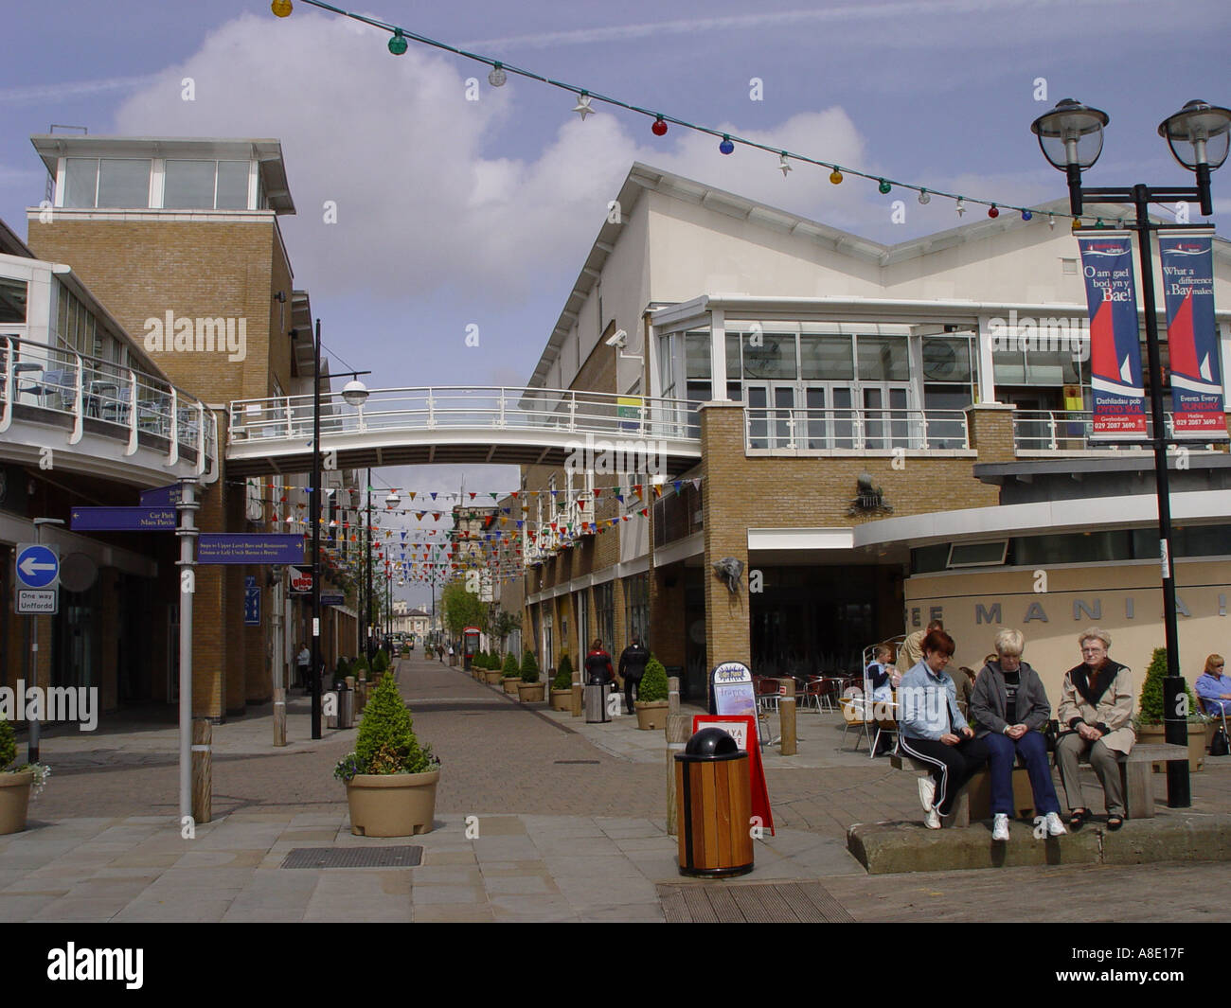
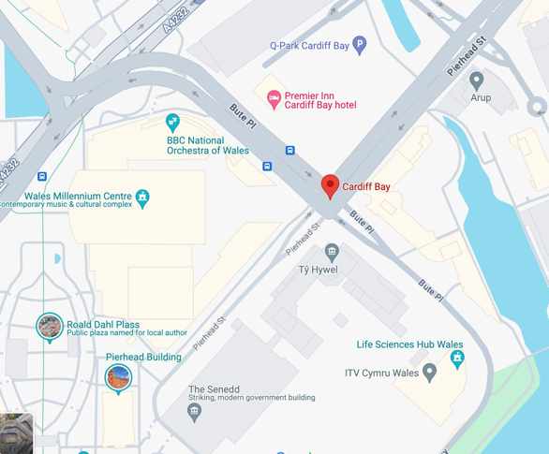
Operations Plan
Location and Facilities
Location: High-traffic urban area with ample footfall.
Caspian point pierhead Street, Cardiff, CF10 4DQ
Facilities: High-speed internet, charging stations, private workspaces, and a cozy seating area.
Staffing
Baristas: Trained in specialty coffee preparation.
Tech Support: Available to assist with any technical issues.
Management: Experienced team to oversee daily operations and ensure customer satisfaction.

Slide 9
Financial Plan
The financial plan for BlueSky Cafe outlines a clear path to achieving profitability and sustainable growth. Our initial investment is estimated at £190,000, which covers essential startup costs such as equipment, rent, marketing, and initial inventory.
We anticipate a monthly revenue target of £30,000 within the first year, derived primarily from coffee and beverage sales, supplemented by income from tech support services and venue rentals for events.
Monthly expenses will include rent, wages, ingredients, utilities, marketing campaigns, and maintenance costs. Based on our financial projections, we expect to reach the break-even point within eight months of operation.
By the end of the first year, we aim to achieve profitability through increasing customer traffic, repeat business, and effective cost management strategies. This financial approach ensures that BlueSky Cafe will not only establish a strong market presence but also pave the way for future expansion and success. (Doyle, 2024)

Slide 10
Risk Analysis
Potential Risks
  Market Competition: High competition from established brands and new entrants.
  Economic Downturn: Potential decrease in disposable income affecting sales.
  Operational Risks: Challenges in maintaining consistent quality and customer service.
Mitigation Strategies
  Differentiation: Continuously innovate and improve our offerings.
  Financial Management: Maintain a reserve fund to manage cash flow during tough times.
  Quality Control: Regular training and quality checks to ensure high standards.
  (What is business risk? 2023)

Slide 11
Conclusion
BlueSky Cafe aims to revolutionize the coffee shop experience by seamlessly blending high-quality coffee with a tech-friendly environment. Through strategic planning, comprehensive market research, and an unwavering commitment to excellence, we are set to become the premier destination for both coffee aficionados and tech enthusiasts. Our innovative approach ensures a unique and engaging customer experience, positioning BlueSky Cafe as a leader in the evolving landscape of modern coffee shops.

Slide 12
REFERENCES
Cusson, N. and Bottorff, C. (2024) How to start a coffee shop (2024 guide), Forbes. Available at: https://www.forbes.com/advisor/business/how-start-coffee-shop/ (Accessed: 22 June 2024).
Coffee Shop & Cafe Business Plan examples (2024) Bplans. Available at: https://www.bplans.com/food-and-beverage-business-plans/coffee-shop-and-cafe-business-plans/ (Accessed: 22 June 2024).
Pendrill, K. (2023) How to write a Coffee Shop Business Plan & Executive summary, TouchBistro. Available at: https://www.touchbistro.com/blog/how-to-create-a-coffee-shop-business-plan/ (Accessed: 22 June 2024).
Maule, H. (2024) From beans to business: How to craft a Coffee Shop Business Plan, Push. Available at: https://www.pushoperations.com/blog/from-beans-to-business-how-to-craft-a-coffee-shop-business-plan (Accessed: 22 June 2024).
Hayes, A. (2024) Risk analysis: Definition, types, limitations, and examples, Investopedia. Available at: https://www.investopedia.com/terms/r/risk-analysis.asp (Accessed: 22 June 2024).
Pecánek, M. (2023) 7 marketing objective examples (+ how to set yours right), SEO Blog by Ahrefs. Available at: https://ahrefs.com/blog/marketing-objectives/ (Accessed: 23 June 2024).

Slide 13
Lavinsky, D. (2024) Coffee shop competitive analysis - PLANBUILDR, PlanBuildr Business Plan Software. Available at: https://planbuildr.com/coffee-shop-business-plan/competitive-analysis/ (Accessed: 23 June 2024).
Graves, A. (2024) 16 powerful coffee shop marketing strategies for 2024, Bloom Intelligence. Available at: https://bloomintelligence.com/blog/2024-coffee-shop-marketing-strategies/ (Accessed: 22 June 2024).
Doyle, M. (2024) Cash flow: What it is, why it’s important, and how to calculate it, Business Class: Trends and Insights | American Express. Available at: https://www.americanexpress.com/en-us/business/trends-and-insights/articles/cash-flow-what-it-is-why-it-is-important-and-how-to-calculate-it/ (Accessed: 22 June 2024).
What is business risk? (2023) McKinsey & Company. Available at: https://www.mckinsey.com/featured-insights/mckinsey-explainers/what-is-business-risk (Accessed: 22 June 2024).

