Slide 1
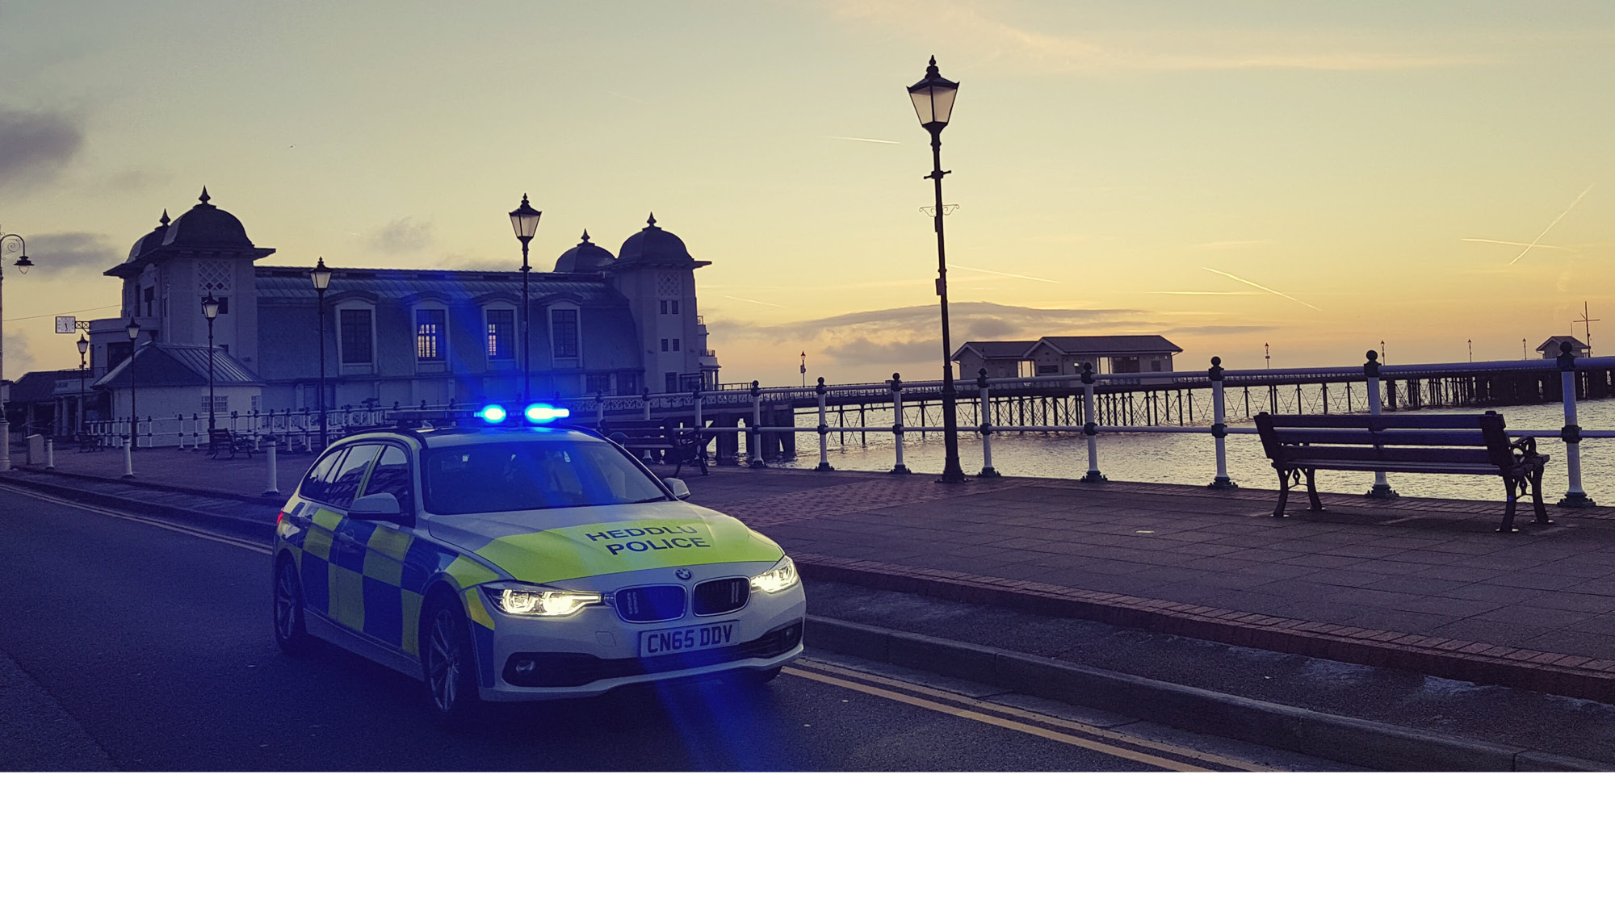
Powers to Stop Vehicles

Slide 2
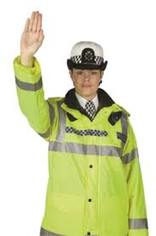
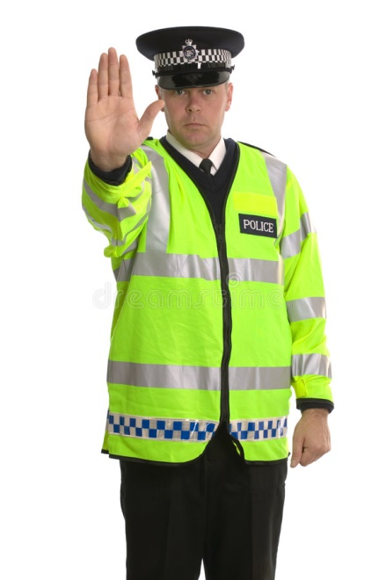
Police Powers
to
Stop a Vehicle
Notes:
Trainer to pose question to students and discuss responses
There are various instances why a police officer would want/need to stop a vehicle.
These include:
When either the vehicle ir its occupants are suspected of being involved in criminal activity
To carry out a breath test where there is reasonable suspicion that the driver has consumed alcohol or other drugs
When a fault is suspected with the vehicle

Slide 3
A person driving a mechanically propelled vehicle on a road must stop the vehicle on being required to do so by a constable in uniform or a traffic officer.
A person riding a cycle on a road must stop the cycle on being required to do so by a constable in uniform or a traffic officer.
If a person fails to comply with this section he is guilty of an offence.
Section 163 Road Traffic Act 1988
Notes:
The definitions of the terms driving, mechanically propelled vehicle and road are the same as covered in other sessions relating to road traffic matters.
Note that to stop a vehicle under Sec 163 RTA, there is a requirement for the constable to be in uniform.
A traffic officer is a designated person under the Police Reform Act 2002 and has a power to stop vehicles under Sec 163 RTA by virtue of Section 6 Traffic Management Act 2004.
The term ‘cycle’ includes pedal cycles and electrically assisted pedal cycles.
Failing to stop when required to do so is a summary offence

Slide 4
Section 163 of the Road Traffic Act 1988 allows for the stopping of vehicles, when an officer can use the powers vested in them by the following sections of the Road Traffic Act 1988 to require certain information to be divulged:
Sec 164 RTA 1988 - Power of constables to require production of driving licence and in certain cases statement of date of birth
Sec 165 RTA 1988 - Power of constables to obtain names and addresses of drivers and others, and to require production of evidence of insurance or security and test certificates.
Notes:
Section 163 of the Road Traffic Act 1988 allows for the random stopping of vehicles, when an officer can use the powers vested in them by the following sections of the Road Traffic Act 1988 to require certain information to be divulged:
164 RTA 1988 - Power of constables to require production of driving licence and in certain cases statement of date of birth
165 RTA 1988 - Power of constables to obtain names and addresses of drivers and others, and to require production of evidence of insurance or security and test certificates.

Slide 5
Section 163 of the Road Traffic Act 1988 also allows for the stopping of vehicles, when an officer can use the powers vested in them by Section 4 Police and Criminal Evidence Act 1984 in relation to finding out if the vehicle is carrying a person:
Who has committed an offence other than a road traffic offence or vehicle excise offence
Who is witness to such an offence
Who is intending to commit such an offence
Who is unlawfully at large
Notes:
Stopping of vehicles to allow officers to utilise the above powers is known as a ‘road check’
‘Road checks’ must be authorised be authorised by an officer of the rank of Superintendent (unless urgent) and relate to a specific locality and for a specified period of time.
They are usually put in place following serious incidents, e.g. abduction, robbery etc.
Whilst the grounds to stop vehicles are contained within Sec 4 Police and Criminal Evidence Act 1984, the actual power to stop the vehicle is under Sec 163 Road traffic Act 1988.

Slide 6
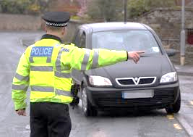
Dynamic risk assessment
Use of correct signals/procedures
Minimising risk of obstruction/danger to others
Notes:
Once the decision has been made to stop a vehicle on the road, a number of things need to be considered, all of which should be underpinned by a dynamic risk assessment.
The main factors to think about and act on are:
Using the correct arm and hand signals to stop the vehicle
Minimising the risk of the vehicle obstructing other traffic and road users; consider removal from the carriageway.
There are additional considerations where the vehicle is suspected of being involved in terrorism or believed to be carrying firearms, drugs or vulnerable people: specialist advice should be sought in these situations.

Slide 7
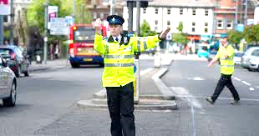
Failure to Stop
Failing to stop is an offence
Section 163(3) of the Road Traffic Act 1988
Notes:
There are occasions when drivers/riders do not stop when requested to do so.
Failing to stop is an offence under section 163(3) of the Road Traffic Act 1988.
Also to be considered are the occasions when drivers/riders fail to stop when requested and subsequently enter a house or other premises.
In these cases, constables have a power under section 17(1) (c) of the Police and Criminal Evidence Act 1984, to enter the premises to arrest the person.

Slide 8
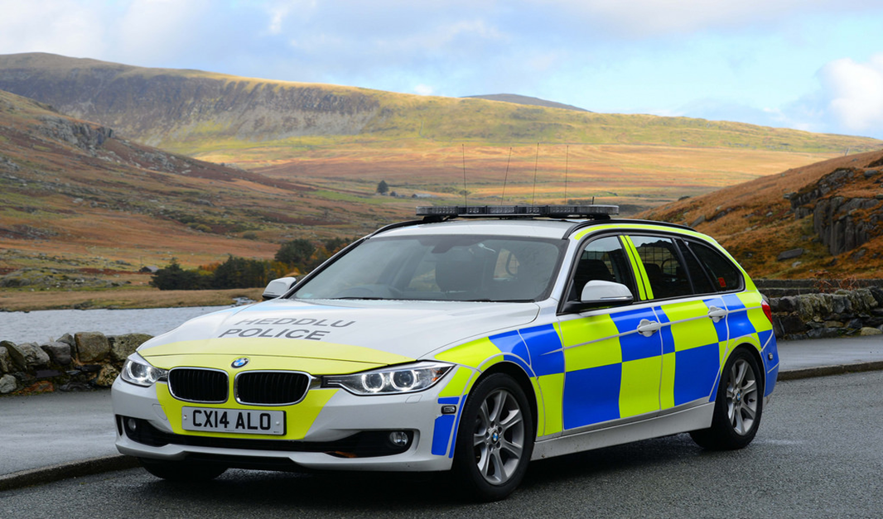

Notes:
There are occasions when drivers/riders do not stop when requested to do so.
Failing to stop is an offence under section 163(3) of the Road Traffic Act 1988.
Also to be considered are the occasions when drivers/riders fail to stop when requested and subsequently enter a house or other premises.
In these cases, constables have a power under section 17(1) (c) of the Police and Criminal Evidence Act 1984, to enter the premises to arrest the person.

