Slide 1
Advanced Greek prose
Lysias 3 – Against Simon – Overview
HPGR7004/7005

Slide 2
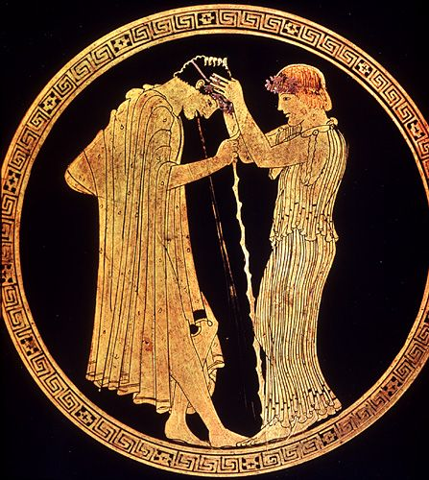
Main Themes of the Speech
Drunken violence and a love quarrel is a key aspect of this speech – which the defendant accuses Simon of engaging in
  Todd (2007) pairs this speech with 4 in terms of theme
Three main protagonists:
  Simon (represented in the speech as the villain of the piece)
  The unnamed defendant
  Theodotus – the live-in Plataean lover-boy / rent-boy
  Other named participants include: Aristokritos; Theophilos; Protarkhos; and Autokles – 4 friends of Simon; and Lysimakhos the friend of the defendant. Also Molon (shop owner) and Lampon (owner of the house outside where the last fight takes place)
Interior: after symposion, with hetaira. Attic red-figure Kylix, Brygos Painter (c. Late Archaic period)

Slide 3
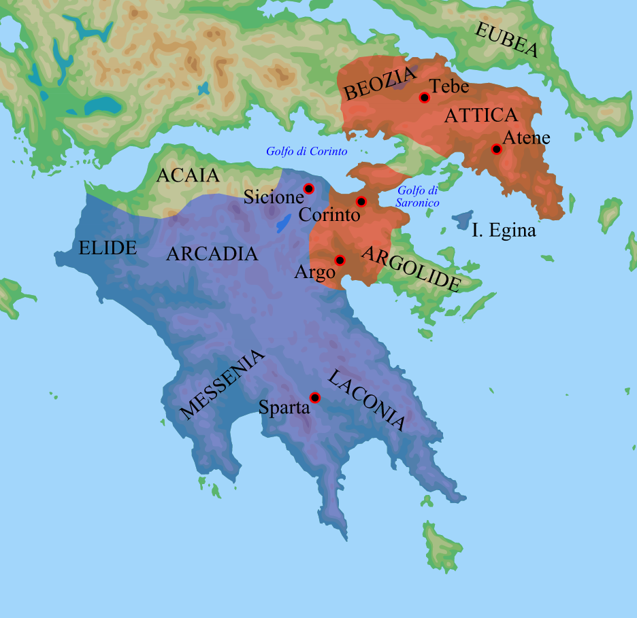
Date of the Speech
Reference to Lakhes as Taxiarch (possibly the Lakhes father of Melanopos of Demosthenes 24.127).
  He was said to be left in charge of the expeditionary force left in Corinth in summer 394.
Provides perhaps an approximate period for the speech (maybe end of 390s or in the early 380s BC).

Slide 4
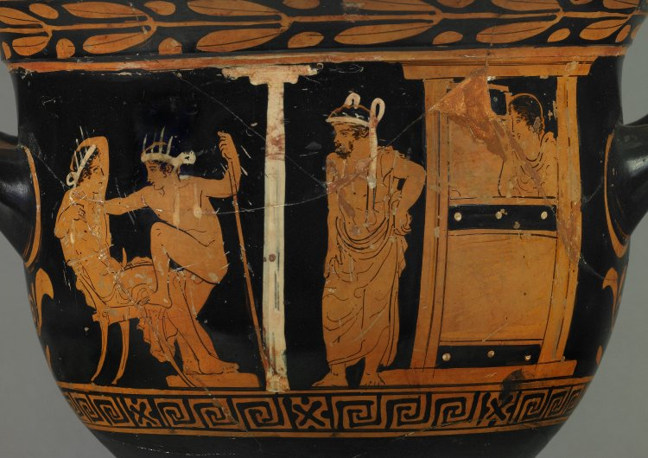
Theodotos and the defendant
Referred to as neaniskos (νεανίσκος) – young man on 3 occasions, and once as paidion (παιδίον) – child, but most commonly he is called a meirakion (μειράκιον) – male in his late teens.
Theodotos is of unclear legal status – he is a Plataian (Plataia sacked in 427 BC), could in theory have acquired citizenship (via his parents? – Thuc. 3.55.3, 63.2), but is also mentioned as potentially being subject to torture (Lys. 3.33) in order to give evidence – a slave or free metic?
Red figure Krater – Dinos Painter, c. 5th century BC
The defendant appears to be a far bit older than Theodotus (perhaps 2-3 decades) and is wealthy enough to have performed liturgies.

Slide 5
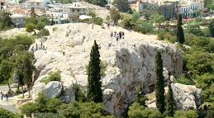
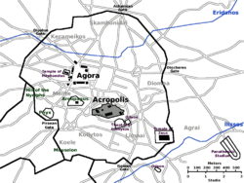
A case of “wounding with intent”
Seems to be classed as different from other cases of assault, but details are unclear.
  Cases not simply intending to wound but also of intending to kill? (Lys. 3.41).
Case heard by the Areiopagos.
Possible use of a piece of broken pottery as a weapon?

Slide 6
Oratorical Strategy
Emphasis on character, as established through the narrative.
Use of circumstantial detail to added believability/credibility to the defendants narrative.
Emphasis on acts of aggression by Simon and attempts at avoidance by the speaker.
  Injuries suffered by Simon as similar in nature to those suffered by the defendant.
Impartial bystanders as supporter of defendant and Theodotos.

