Slide 1
Principles of Health and Social Care Practice
(BMHP5016)
Week 8: Health and social care services in a diverse society

Slide 2
Recap
What did we cover in Week 7?
What did you learn?
Notes:
Peer visit: https://forms.office.com.mcas.ms/Pages/ResponsePage.aspx?id=-REPTm4EBUWcuNshUjEeIRF32vF3_iNGhBHI8gOdSeRUNjhOOTVZT0VLSUtFNEcwUFFLNFY5QTBENSQlQCN0PWcu

Slide 3
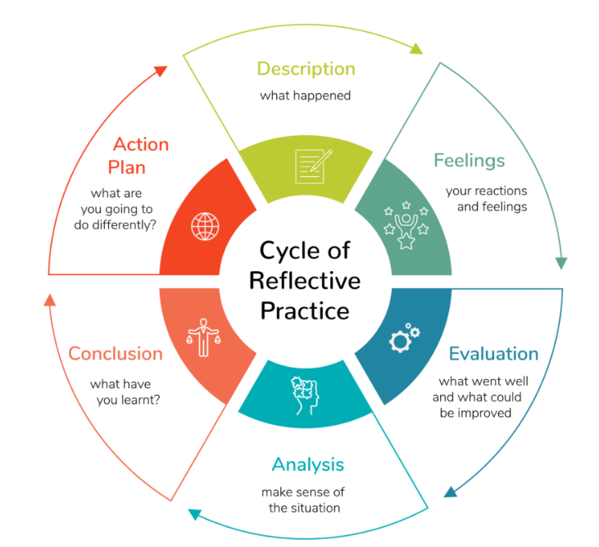
The Cycle of Reflective Practice
A six-stage model with each stage providing an opportunity to reflect on an element of a particular event, situation or project.
Gibbs, G. (1988). Learning by doing: A guide to teaching and learning methods. Further Education Unit.
Notes:
https://carveconsulting.com.au/the-positive-impacts-of-reflective-practice/

Slide 4
Why is CPD Important in Health and Social Care?
CPD contributes to providing high-quality care and services.
This is very important in the health and social care sector as the quality of care being provided directly impacts on the wellbeing of the public.
Investing in the professional development of a workforce benefits not only those utilising the service and their families but also the staff themselves and the organisation as a whole.
Source: https://www.highspeedtraining.co.uk/hub/professional-development-in-health-and-social-care/

Slide 5
CPD and duty of care
For users of health and social care services, they not only have the right to safe and effective care but it also provides reassurance and comfort to know those caring for them are taking their duty of care seriously by ensuring the environment is safe and the organisation is working within legislative boundaries.
Source: https://www.highspeedtraining.co.uk/hub/professional-development-in-health-and-social-care/

Slide 6
Aim of Lecture
(Week 8)
To develop an understanding of health and social care services in a diverse society and the impact of health inequalities on services and service users.

Slide 7
Learning objectives
(Week 8)
Discuss diversity in the UK.
Analyse health and social care services in a diverse society.
Evaluate the impact of health inequalities on services and service users.

Slide 8

Which one is more interesting?

Slide 9
Identities
Identities are made up of a wide range of different characteristics and multiple layers i.e. religion, nationality, gender, etc.
There are several different things that make us who we are.
We are born with some of these things, but others develop over time.

Slide 10

Different or the same?
It is always important to get to know people.
We can always find things we share in common.
Whilst we share many characteristics in common, we should all be proud of our own unique identities.
Our differences make us unique, special and diverse!

Slide 11

Class Discussion - What is Diversity?

Slide 12
Diverse people, diverse identities
When we talk about diversity, we do not just talk about race and ethnicity.
Diversity includes all different people, each contributing their own uniqueness, making our place more interesting to live.
So, diversity includes people of different gender, age, sexual orientation, disability, religion, beliefs and more.
It is important that everyone respects and celebrates each other’s differences so we can all get along, learn from each other and share an exciting mix of cultures and experiences.

Slide 13
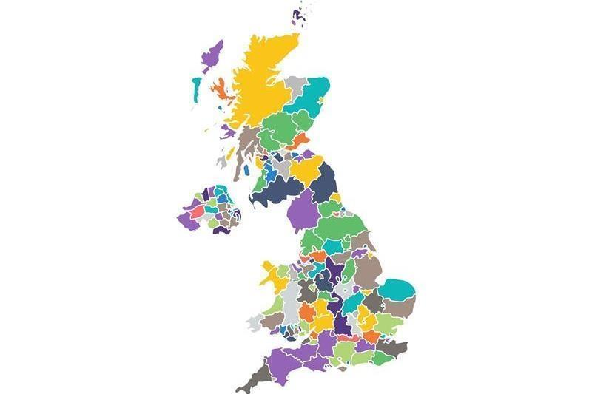
Diversity in the UK
Britain, down to its deepest roots, has always been a diverse nation.
UK’s diversity is a result of invasion, expansion, empire and Commonwealth, and being a place to study, work, and safe place for people coming from other countries.
For over 2,000 years, people have arrived in Britain, bringing with them their own cultural influence.
Source: https://www.equalityhumanrights.com/en

Slide 14
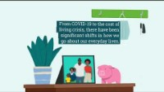
Video: What is the Equality and Human Rights Monitor?
https://www.youtube.com/watch?v=0tHv41qoHGQ

Slide 15
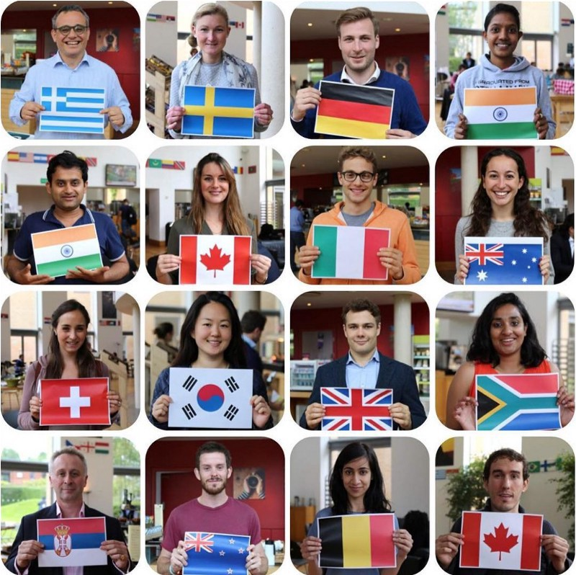
Ethnic and Cultural Diversity in the UK
Today, people continue to move all around the world.
The current population in the UK is over 67 million, including a mix of people from different ethnic and cultural backgrounds.

Slide 16



Our cultural life
Ethnic diversity has made our society rich in culture and contributed to our economic, social, and democratic development.
Everything in modern Britain – from music and sports, to food and business – has been influenced by different ethnic communities, cultures and social groups.

Slide 17

Respect our differences
It is important to celebrate and respect that we are all different.
Remember, we are all different in our own way (each one of us), and we all add something special to the diversity of our societies.
Finding out about different cultures, and discovering the different ways that people live and think, is fascinating and helps everyone to live in harmony and understand each other better.
Therefore, we should respect our differences.

Slide 18
Health and social care services in a diverse society
Equality and diversity are essential components of health and social care.
Good equality and diversity practices make sure that the services provided to people are fair and accessible to everyone.
They ensure that people are treated as equals, that people get the dignity and respect they deserve and that their differences are celebrated.

Slide 19
Group Activity
In small groups or pairs:
Search for the term “health inequalities” using your devices.
Each group should name three causes of health inequalities.
You have 10 minutes to discuss within your group.
Share your findings with the class.

Slide 20
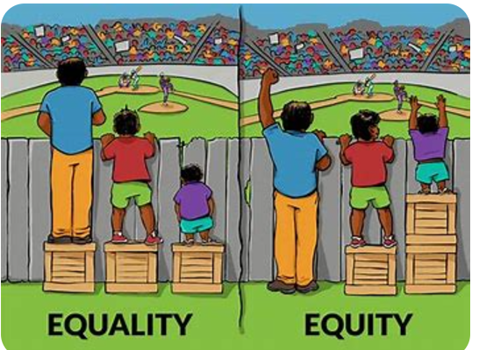
Equity vs. Equality: What’s the Difference? | Online Public Health

Slide 21
Health inequalities
Health inequalities are differences in health across the population, and between different groups in society, that are systematic, unfair and avoidable.
They are caused by the conditions in which we are born, live, work and grow. These conditions influence our opportunities for good mental and physical health.
https://www.nice.org.uk/about/what-we-do/nice-and-health-inequalities
Notes:
https://www.england.nhs.uk/about/equality/equality-hub/national-healthcare-inequalities-improvement-programme/what-are-healthcare-inequalities/
https://www.kingsfund.org.uk/insight-and-analysis/data-and-charts/health-inequalities-nutshell
BAME maternal death: https://www.youtube.com/watch?app=desktop&v=twBQtqoPKvQ&t=76s

Slide 22
Examples of Equality
Examples of Equity
A city cuts the budget for 25 community centres by reducing the operational hours for all centres by the same amount at the same times.
A community meeting, where all members of the community are invited, about a local environmental health concern is held in English though English is not the primary language for 25% of the residents.
Schools in a community have computer labs with the same number of computers and hours of operation during school hours.
The city determines which times and how many hours communities actually need to use their community centres and reduces hours for centres that aren’t used as frequently.
The community leaders hire translators to attend the meeting or offer an additional meeting held in another language.
Computer labs in lower income neighbourhoods have more computers and printers, as well as longer hours of operation, as some students don’t have access to computers or internet at home.
Notes:
Equity vs. Equality: What’s the Difference? | Online Public Health

Slide 23
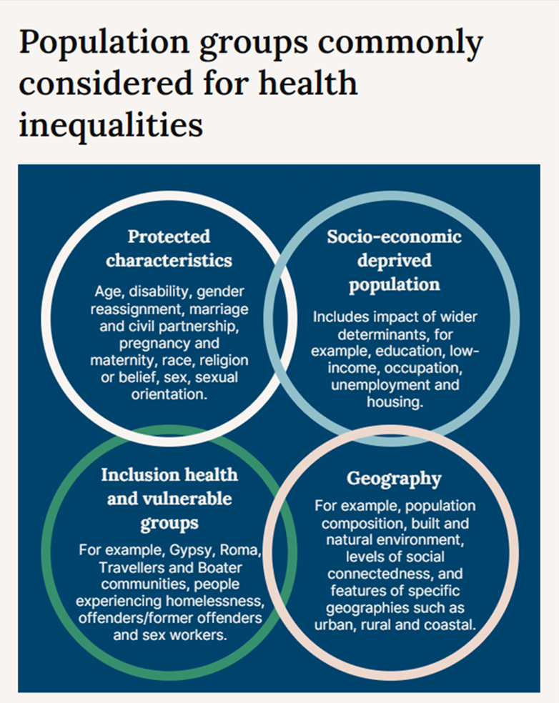
Which groups experience health inequalities?
Sources:
NICE and health inequalities | What we do | About | NICE
Place-based approaches for reducing health inequalities: main report - GOV.UK (www.gov.uk)

Slide 24
What are the effects of health inequalities?
Health inequalities can be seen and measured through differences in:
prevalence of conditions and mortality
behavioural risks to health such as smoking
the wider determinants of health such as housing and employment
access to care
the quality and experience of healthcare services

Slide 25
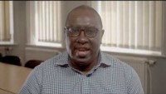
Video: The urgent action needed to tackle health inequalities
Source: https://www.youtube.com/watch?v=dfBLaZbROJob

Slide 26
Inequalities in access to and experience of health services
Access to health services refers to the availability of services that are timely, appropriate, easy to get to and use and sensitive to user choice and need.
Access to the full range of services that can have an impact on health includes access to preventive interventions and social services, as well as primary and secondary health care.
Source: https://www.kingsfund.org.uk/publications/what-are-health-inequalities#access

Slide 27
Inequitable access
Inequitable access can result in particular groups receiving less care relative to their needs, or more inappropriate or sub-optimal care, than others, which often leads to poorer experiences, outcomes and health status.
Inequitable access might mean that a group faces particular barriers to getting the services that they need.
It can mean that information is not communicated in an easily understandable or culturally sensitive way.
Source: https://www.kingsfund.org.uk/publications/what-are-health-inequalities#access

Slide 28

Video: Health Equity in England: The Marmot Review 10 Years On
Source: https://www.youtube.com/watch?v=vp9wPDrMDRU

Slide 29
Health Equity in England: The Marmot Review 10 Years On
The report highlights that:
people can expect to spend more of their lives in poor health
improvements to life expectancy have stalled, and declined for women in the most deprived 10% of areas
the health gap has grown between wealthy and deprived areas
place matters – living in a deprived area of the North East is worse for your health than living in a similarly deprived area in London, to the extent that life expectancy is nearly five years less.
Source: https://www.health.org.uk/publications/reports/the-marmot-review-10-years-on

Slide 30

Inequitable care
Different social groups might also have systematically different experiences within the services that they use, including in terms of the quality of care they receive and whether they are treated with dignity and respect.
Source: https://www.kingsfund.org.uk/publications/what-are-health-inequalities#access

Slide 31
Intersectionality
It was coined in 1989 by professor Kimberlé Crenshaw to describe how race, class, gender, and other individual characteristics “intersect” with one another and overlap.
Ref: Crenshaw, Kimberle. “Demarginalizing the Intersection of Race and Sex: A Black Feminist Critique of Antidiscrimination Doctrine, Feminist Theory and Antiracist Policies.” University of Chicago Legal Forum 1989, no. 1 (1989): 139-167.
“Now more than ever, it's important to look boldly at the reality of race and gender bias -- and understand how the two can combine to create even more harm. “

Slide 32
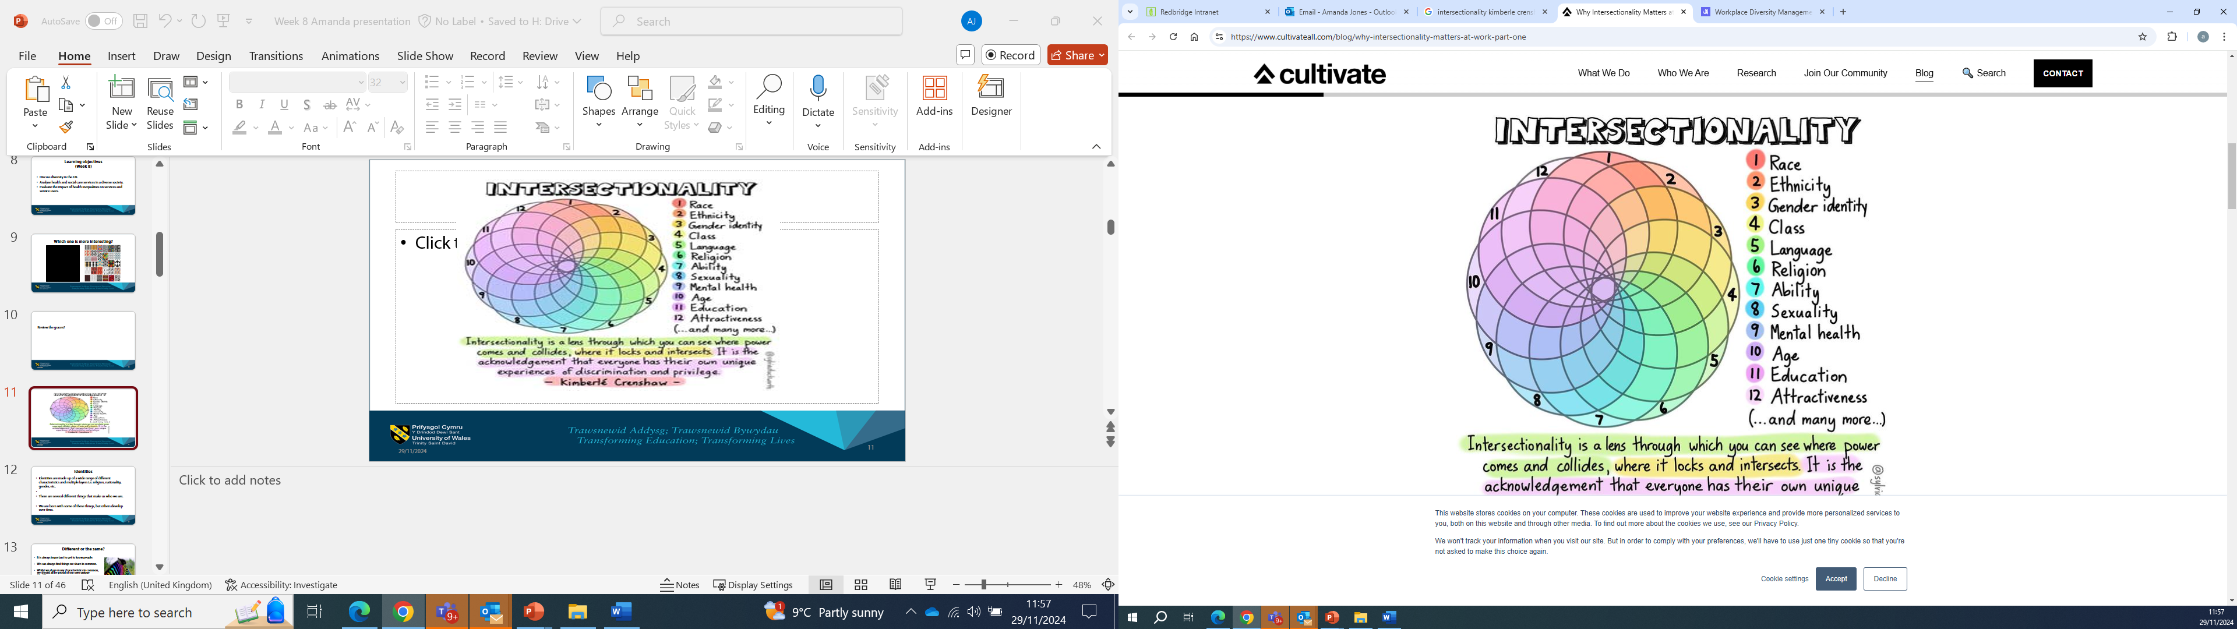

Slide 33
Inequitable care
A recent review commissioned by the NHS Race and Health Observatory, for example, found evidence of women from ethnic minority backgrounds experiencing ‘stereotyping, disrespect, discrimination and cultural insensitivity’ when using maternal and neonatal healthcare services.
Source: https://www.kingsfund.org.uk/publications/what-are-health-inequalities#access

Slide 34
Inequitable care
To take another example, in a 2018 study by Stonewall, 13 per cent of LGBT respondents reported experiencing unequal treatment from health care staff because they were LGBT, with this number rising to 32 per cent for people who are transgender and 19 per cent for LGBT people from ethnic minority backgrounds.
Source: https://www.kingsfund.org.uk/publications/what-are-health-inequalities#access

Slide 35
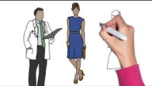
Video: Social Inequalities in Health
Source: https://youtu.be/roAQHn5rEoQ

Slide 36
NHS England: Equality, diversity and health inequalities
The NHS England Patient Equalities Programme brings together a range of work to advance patient equalities and to provide advice and support on delivery of both our key legislative commitments in relation to patient equalities and the specific commitments in the NHS Long Term Plan and NHS Mandate.
This work includes:
Equality frameworks and information standards – including the Accessible Information Standard, the Sexual Orientation Monitoring Standard and the NHS Equality Delivery System
The Learning Disability Employment Programme
The LGBT+ Health team who work to ensure that the needs of LGBT+ people are considered throughout the health system
Providing the secretariat to the independent NHS Equality and Diversity Council
(Source: NHS England » Patient equalities programme)

Slide 37
Interprofessional collaboration to improve patient outcomes
In its simplest form, interprofessional collaboration is the practice of approaching patient care from a team-based perspective.
According to the World Health Organization, by implementing interprofessional collaboration and learning to work together and respecting one another's perspectives in healthcare, multiple disciplines can work more effectively as a team to help improve patient outcomes.

Slide 38
Example: Partnership working for children
Working in partnership with other professionals is essential to meet the various health needs of children.
There might be times where healthcare/childcare/ educational services/ providers will need to work with other professionals and families to support the children in need.
In all circumstances, it is important to ensure communication is effective between the involved parties, and regular contact is made.
Holding regular meetings to discuss children’s progress allows all professionals to group together to share their experiences and expertise about the best support and advice for children.

Slide 39
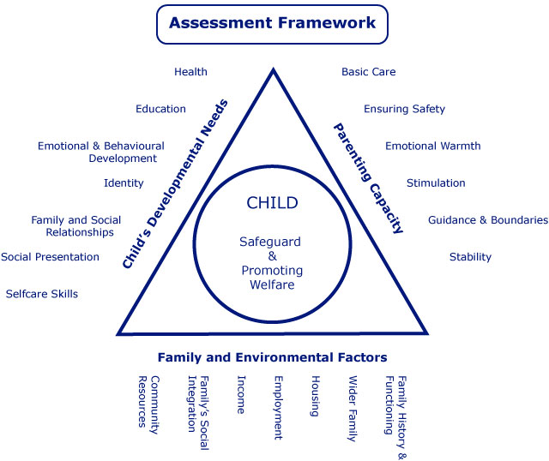
Notes:
Working together to safeguard children
A guide to inter-agency working to safeguard and promote the welfare of children
March 2015, p22
What agencies are involved?

Slide 40



QUESTION TIME

Slide 41

What did I learn?
What I have learnt today will help me in my practice because....

Slide 42
References
Equality and Human Rights Commission (2022) Equality and diversity. Available at: https://www.equalityhumanrights.com/en/equality-and-diversity (Accessed: 27 July 2022).
GOV.UK (2017) Chapter 5: inequality in health. Available at: https://www.gov.uk/government/publications/health-profile-for-england/chapter-5-inequality-in-health (Accessed: 27 July 2022).
The King’s Fund (2022) What are health inequalities? Available at: https://www.kingsfund.org.uk/publications/what-are-health-inequalities (Accessed: 27 July 2022).
NHS England » Equality, diversity and health inequalities
NHS England » The Equality and Health Inequalities Hub

