Slide 1
International Pre-Masters Course 2021/22
Academic Practice for International Postgraduate Study
WGPM6003

Slide 2
Online Etiquette
Punctuality (arrive before the tutor)
Check audio (is your mic working?)
Background (set a neutral background)
Camera On (can we see you?)
Participate (ask and answer questions)
Listen to others (we learn from one another)
Have fun! Relax and join in.

Slide 3

Maximising your time and effort
Developing reading comprehension strategies in conjunction with note-taking
Improving reading fluency and speed

Slide 4
Module Introduction –
Academic Practice for International Postgraduate Study
Aims
To recognise good academic practice and apply skills necessary for Postgraduate study in the educational context of the UK.
The focus will be on areas related to identifying and following appropriate academic practices and conventions and developing reflective writing skills

Slide 5

Module Content
TIME MANAGEMENT, MOTIVATION, UNDERSTANDING TURNITIN
Demonstrating an awareness of assessment deadlines and preparation using Turnitin
REFERENCING, PARAPHRASING , QUOTATIONS
Utilising citation and referencing appropriately
PREPARATION FOR OUTPUT, READING AND NOTE TAKING
Accessing all library provision effectively
Developing reading comprehension strategies in conjunction with note-taking
Improving reading fluency and speed
OUTPUT, ACADEMIC WRITING
Producing summaries of extended texts
Examine paragraph structure and cohesion between paragraphs
Proofreading and editing skills

Slide 6
Warm Up and Language
Watch the video, pause and repeat the exercises.
Ask the lecturer about how to pronounce words you found in your article.

Slide 7
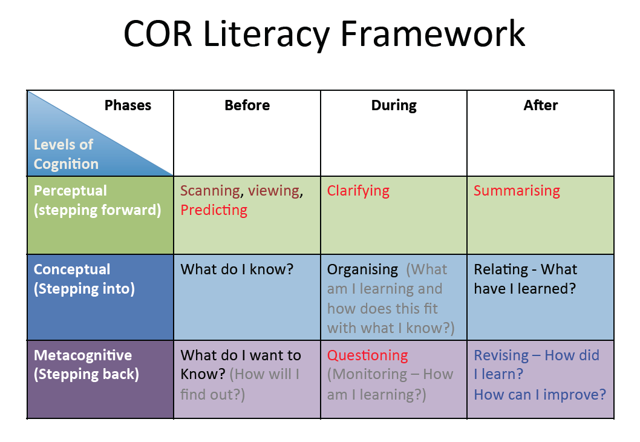
RE-CAP
(Woolley, 2013)

Slide 8
After Reading
Summarize the text in your own words (note what you learned, impressions, and reactions) in an outline, concept map, or matrix (for several texts)
Talk to someone about the author’s ideas to check your comprehension
Identify and reread difficult parts of the text
Define words on your vocabulary list (try a learner’s dictionary) and practice using them
Sample graphic organizers – Concept map · Literature review matrix
(Grabe & Stoller, 2002; The Writing Centre, 2021)

Slide 9
Express yourself:
Each student talks for 5 to 7 minutes
Get into groups of three and report to your peers what you found out.
Name and type of article
What was the article about?
What question/s did it ask?
Summarise the main points
Give your opinion about the article

Slide 10


Slide 11
You are still in your groups
Use the matrix Literature review matrix
Add the information for the three articles you have read

Slide 12

You have started your literature review!!

Slide 13
Directed study
Add more relevant publications to your literature review.

Slide 14
What is a literature review? Outline
A literature review is a survey of scholarly sources on a specific topic.
It provides an overview of current knowledge, allowing you to identify relevant theories, methods, and gaps in the existing research.
It involves collecting, evaluating and analysing publications (such as books, reports and journal articles) that relate to your research question.
(Mc Combes, 2021)

Slide 15
What is a literature review- the process
There are five main steps in the process of writing a literature review:
Search for relevant literature
Evaluate sources
Identify themes, debates and gaps
Outline the structure
Write your literature review
(Mc Combes, 2021)

Slide 16
The process-
Step 1: Search for relevant literature
Before you begin searching for literature, you need a clearly defined topic.
If you are writing the literature review section of a dissertation or research paper, you will search for literature related to your research objectives and questions.
If you are writing a literature review as a stand-alone assignment, you will have to choose a focus and develop a central question to direct your search. Unlike a dissertation research question, this question has to be answerable without collecting original data. You should be able to answer it based only on a review of existing publications.
Research question example: What is the impact of social media on body image among Generation Z?
(Mc Combes, 2021)

Slide 17
The process-
Step 1: Search for relevant literature
Make a list of keywords
Start by creating a list of keywords related to your research topic. Include each of the key concepts or variables you’re interested in, and list any synonyms and related terms. You can add to this list if you discover new keywords in the process of your literature search.
(Mc Combes, 2021)

Slide 18
Keywords form example
Social media Facebook Instagram Twitter Snapchat TikTok
Body image
Self-perception
Generation Z
Self-esteem
Mental health
Teenagers Adolescents Youth

Slide 19
The process- Step 1:
Search for relevant literature (re-cap)
Search for relevant sources usin your keywords to begin searching for sources. Some databases to search for journals and articles include:
Your university’s library catalogue
Google Scholar
JSTOR
EBSCO
Project Muse (humanities and social sciences)
Medline (life sciences and biomedicine)
EconLit (economics)
Inspec (physics, engineering and computer science)
You can use Boolean operators to help narrow down your search
What is a Boolean operator?
(Mc Combes, 2021)

Slide 20
The process- Step 1:
Search for relevant literature (re-cap)
Read the abstract to find out whether an article is relevant to your question. When you find a useful book or article, you can check the bibliography to find other relevant sources.
To identify the most important publications on your topic, take note of recurring citations. If the same authors, books or articles keep appearing in your reading, make sure to seek them out.
(Mc Combes, 2021)

Slide 21
The process-Step 2:
Evaluate and select sources (re-cap)
You’ll have to evaluate which sources are most relevant to your questions.
For each publication, ask yourself:
What question or problem is the author addressing?
What are the key concepts and how are they defined?
What are the key theories, models and methods? Does the research use established frameworks or take an innovative approach?
What are the results and conclusions of the study?
How does the publication relate to other literature in the field? Does it confirm, add to, or challenge established knowledge?
How does the publication contribute to your understanding of the topic? What are its key insights and arguments?
What are the strengths and weaknesses of the research?
(Mc Combes, 2021)

Slide 22
The process-Step 2:
Evaluate and select sources (re-cap)
Make sure the sources you use are credible, and make sure you read any landmark studies and major theories in your field of research.
You can find out how many times an article has been cited on Google Scholar – a high citation count means the article has been influential in the field, and should certainly be included in your literature review.
What is the CRAAP Test?
(Mc Combes, 2021)

Slide 23
Step 3: Identify themes, debates and gaps
To begin organising your literature review’s argument and structure, you need to understand the connections and relationships between the sources you’ve read. Based on your reading and notes, you can look for:
Trends and patterns (in theory, method or results): do certain approaches become more or less popular over time?
Themes: what questions or concepts recur across the literature?
Debates, conflicts and contradictions: where do sources disagree?
Pivotal publications: are there any influential theories or studies that changed the direction of the field?
Gaps: what is missing from the literature? Are there weaknesses that need to be addressed?
This step will help you work out the structure of your literature review and (if applicable) show how your own research will contribute to existing knowledge.
(Mc Combes, 2021)
Notes:
Engage the students in providing examples and explanations for these points.

Slide 24

Step 4 and 5: Outline your literature review’s structure, Writing your literature review and other academic writing

Slide 25
Directed study for the next 2 weeks
Practise your reading and add to the literature review matrix
Don’t forget to note down references
Make notes

Slide 26
Next week: Group tutorials
Next week
There will be s short lecture in the beginning, then
Your lecturer will put you into DIFFERENT groups of three and allocate time slots for each of the groups to spend time with the lecturer.
The rest of your time you will work in your new groups without the lecturer present.

Slide 27
References
Grabe, W., & Stoller, F. L. (2002). Teaching and researching reading. Harlow: Longman
McCombes, S. (2021). How to write a literature review. Scribbr. https://www.scribbr.co.uk/thesis-dissertation/literature-review/
The Writing Centre. (2021) Academic Reading Strategies. University of North Carolina at Chapel Hill
https://writingcenter.unc.edu/esl/resources/academic-reading-strategies/
Woolley, G. (2013) Reading Comprehension. http://reading4meaning.blogspot.com/2013/04/cor-literacy-framework-part-1.html

