Slide 1
Assesment 1 Individual presentaitin
LCHS4010
By Rukiya Pathan
2427207

Slide 2

Introduction to the Case
In my introduction today I am going to be
Talking about a case study regarding a 3year old girl who is struggling with interaction and anxiety.
I will be using Piaget's Cognitive development theory and consider the influences and biology on her behaviour.
Notes:
Amira has recently joined the nursery. She shows anxiety when separated from her carers, limited verbal communication, and struggles with group play. My role is to support her overall development.

Slide 3
Who is Piaget and what's his Theory?
The way children learn and think as they mature is explained by Piaget's theory of cognitive development. According to his theory, children's mental development occurs in four stages: sensorimotor (birth to two years), preoperational (two to seven years), concrete operational (seven to eleven years), and formal operational (twelve and higher). Children think and comprehend the world differently at each stage, progressively progressing from simple reflexes to sophisticated, abstract thought. Piaget (1952) highlighted that toddlers learn best when they actively explore their surroundings and have hands-on experiences.

Slide 4
I will be focusing on the
Preoperational Stage (2–7 years)
• Symbolic play
• Egocentrism (difficulty seeing others’ perspectives)
• Limited logical reasoning
• Rapid language development (variable)
• Relevant: explains Amira’s limited speech & play difficulties
Notes:
In the preoperational stage, children engage in symbolic play, are often egocentric, and have limited logical reasoning. Language skills develop rapidly but unevenly. This explains some of Amira’s difficulties.

Slide 5
Application to Amira
• Anxiety → difficulty separating from carers
• Limited speech → developing symbolic thought
• Group play → egocentric thinking, struggles with sharing
• Piaget explains her challenges with communication & play
Notes:
Amira’s anxiety reflects separation challenges. Her limited speech suggests she is still developing symbolic thought. Difficulty with group play links to egocentrism. Piaget’s theory helps explain these behaviours.

Slide 6

Key Concepts
Children start to represent things using words, pictures, and objects as part of symbolic thinking. For instance, pretending to wield a stick.
Egocentrism: Children frequently have trouble understanding other people's perspectives. They believe that other people see, think, and feel the same way that they do.
Animism is the belief that inanimate objects, such as toys or the sun, are sentient.
Centration is the ability to ignore other aspects of a situation while concentrating on one. For instance, believing that a taller glass can hold more liquid, even when the volume of liquid in both glasses is equal (Piaget, 1952)

Slide 7
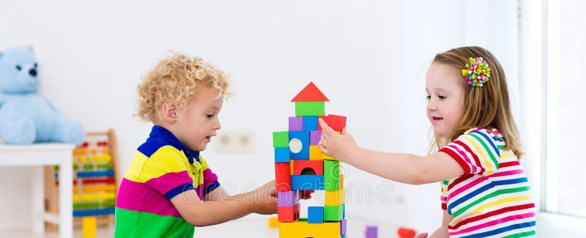
Lack of Conservation: They have not yet realized that even when appearance changes, quantity stays the same (e.g., pouring water into a new shaped glass).
Make-Belief Play: During this period, imaginative play plays a significant role in learning and growth.
In early childhood settings, this stage is crucial because it demonstrates how children are starting to acquire language, imagination, and world awareness, but they still require assistance in order to reason logically and see things from many viewpoints.

Slide 8
Current Behaviour and Development needs
Lack of Conservation Piaget's theory explains Amira's behavior and development by pointing out where she might be in the Preoperational Stage (ages 2–7) and demonstrating how her thinking and worldview are still evolving , but they do not yet realize that quantity stays the same.
Amira, who is three years old, is in the early stages of the Preoperational Stage, when children are still heavily dependent on routine, familiar people, and their immediate surroundings even as they are learning to speak, use symbols in play, build relationships, and comprehend emotions.

Slide 9
Here’s how Piaget’s theory relates to her behaviour:
Anxiety After the Caregiver Leaves
According to Piaget, young children are still very egocentric, which means they find it difficult to comprehend the viewpoints of others or to feel safe when a person they rely on departs. Piaget (1952) .
Children's comprehension of time and separation is still developing at this age, so even if they have been informed, they might not fully understand that their caregiver will return.
Insufficient Communication and Challenges in Verbal Play
Children at this stage are still learning language and symbolic thinking, according to Piaget.
Amira's limited communication may indicate that she is still learning these skills or that she needs additional assistance with language development, which can also impact her capacity for social or imaginative play.

Slide 10
How I can help Amira
I can help Amira by emphasizing her preoperational stage strengths in accordance with Piaget's theory. She can express herself, practice language, and build social skills through symbolic and imaginative play activities like role-playing, pretend tea parties, or utilizing dolls and puppets. Her cognitive growth is aided by tactile, activities like block-building or sensory play, and communication is strengthened by gestures and visual aids. With time, these techniques can help her interact with others, feel safer, and gain confidence in her ability to learn and play.

Slide 11

Help with Speech
Through speech therapy, a child improves their ability to communicate, language, and engage with others. It can boost self-esteem, reduce frustration when trying to express desires or ideas, and promote the growth of both verbal and nonverbal communication skills. Individualized strategies for assisting children with autism, language impairments, or speech challenges in interacting with their surroundings are provided via speech therapy.
.

Slide 12
Enhance Interaction
.
Parents and care givers can
help with
Pronunciation of sounds is improved by speech clarity (e.g., saying "cat" instead of "tat").
Language development: Assists in their comprehension and appropriate application of words, phrases, and grammar.
Encourages kids to communicate their needs, wants, and feelings in a clear and concise manner.
Using receptive language helps them better comprehend what other people are saying.

Slide 13
Practical Strategies (Piaget-based)
• Symbolic play (role-play, dolls) → encourage speech
• Simple, concrete activities (blocks, puzzles)
• Parallel play before cooperative play
• Visual aids/gestures to support speech
• Repetition and routine to reduce anxiety
Notes:
Strategies based on Piaget include using symbolic play to encourage communication, offering simple and concrete activities, supporting parallel play before cooperative play, and using routines to reduce anxiety.

Slide 14
Nature and Nurture
• Nature (biological): speech delay, temperament
• Nurture (environmental): home language, attachment, social opportunities
• Both shape Amira’s emotional and cognitive development
Notes:
Amira’s development is shaped by both nature and nurture. Biological factors like temperament and speech delay play a role. Environmental factors like attachment and social experiences are equally important.

Slide 15
Critical Evaluation of Piaget
Usefulness:
• Explains Amira’s stage & difficulties
• Supports play-based, child-centred learning
Limitations:
• Stages too rigid
• Underestimates social interaction (Vygotsky, 1978)
• Lacks focus on emotional needs (Bowlby, 1969)
Notes:
Piaget’s theory is useful in explaining Amira’s stage and promoting child-centred learning. However, it is limited—stages are rigid, it underestimates the role of social interaction (Vygotsky), and ignores attachment (Bowlby).

Slide 16
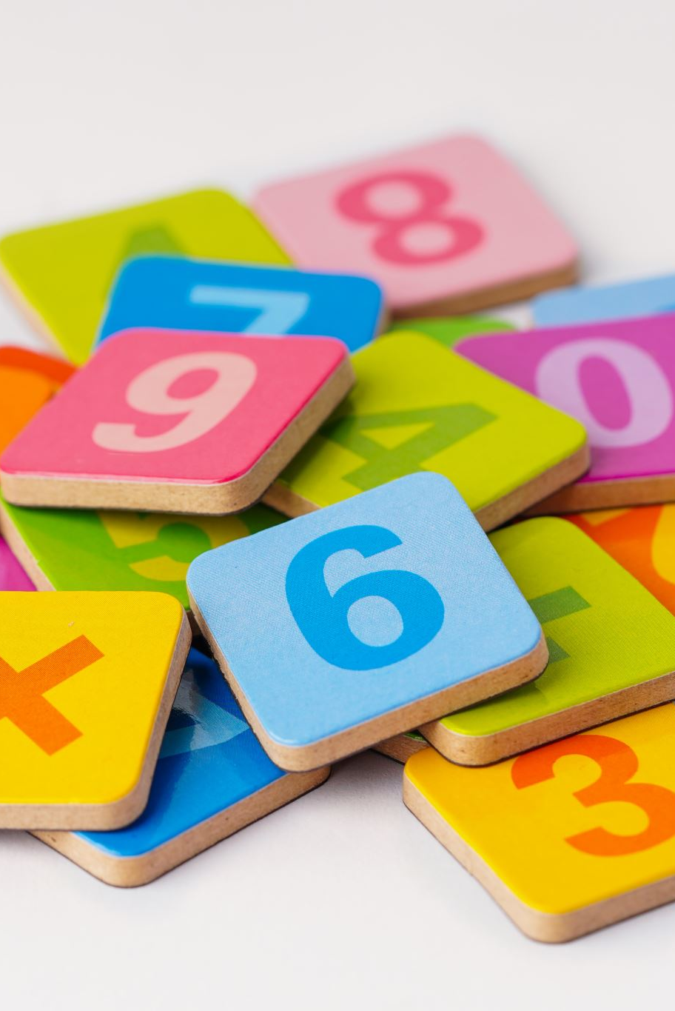
Difference between Piaget and Vygosky’s Theory
Piaget and Vygotsky disagreed on the cognitive development of children. Piaget believed that children go through universal stages of development and learn best when they explore on their own. Vygotsky, on the other hand, emphasized the importance of language, culture, and social contact in the learning process and proposed that children learn via the supervision of others. Vygotsky believed that learning occurs after development by supporting the Zone of Proximal Development, whereas Piaget believed that learning occurs after development.

Slide 17


In conclusion, Piaget's cognitive development theory offers a useful framework for analyzing Amira's current difficulties with anxiety, limited speech, and group play. Recognizing that she is at the preoperational stage allows us to recognize how her challenges with symbolic reasoning, language, and social interaction are consistent with normal developmental patterns. Symbolic play, visual supports, and regular routines can all be used to help her communicate, gain confidence, and interact in social situations.
Notes:
In conclusion, Piaget’s theory helps us understand Amira’s current development and guides strategies like symbolic play. But it should be combined with other perspectives for a holistic approach.

Slide 18
  Piaget's theory is helpful, but in order to grasp Amira's requirements more comprehensively, it's also critical to take into account alternative viewpoints, such as Bowlby's attachment theory and Vygotsky's emphasis on social learning. Ultimately, integrating these strategies will guarantee that the nursery environment efficiently supports her physical, mental, social, and emotional well-being.

Slide 19
References
Bowlby, J. (1969) Attachment and loss. Vol. 1. Attachment. New York: Basic Books.
Cole, M. and Cole, S.R. (2019) The development of children. 8th edn. New York: Worth.
Department for Education and Department of Health (2015) SEND Code of Practice. London: DfE.
Piaget, J. (1952) The origins of intelligence in children. New York: International Universities Press.
Vygotsky, L.S. (1978) Mind in society. Cambridge, MA: Harvard University Press.
Santrock, J.W. (2021) Child development. 15th edn. New York: McGraw-Hill.
Notes:
References to academic sources are included here, ensuring the presentation is evidence-based.

