Slide 1

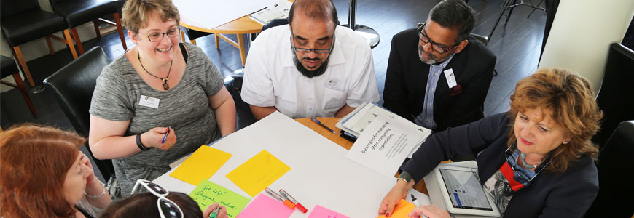
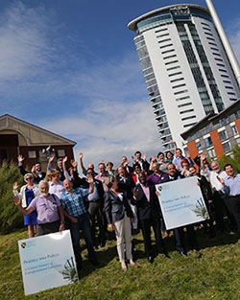
Launched in 2014, 32 country experts came to Swansea to help us to see the global perspective.

Slide 2
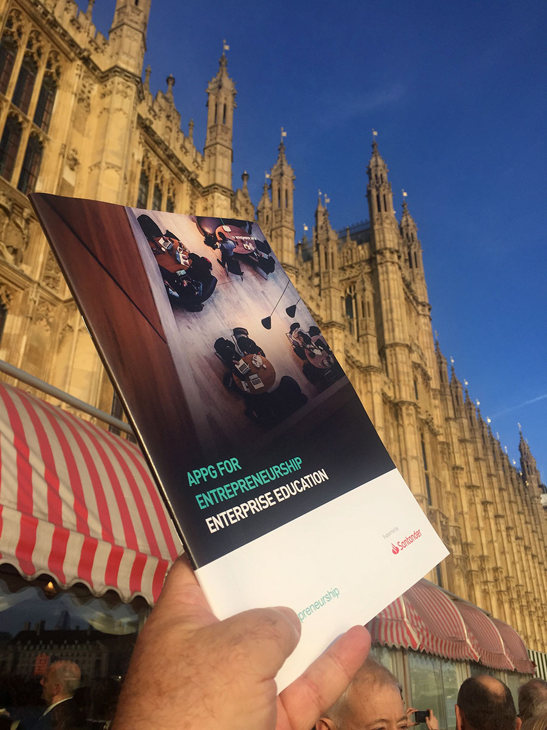
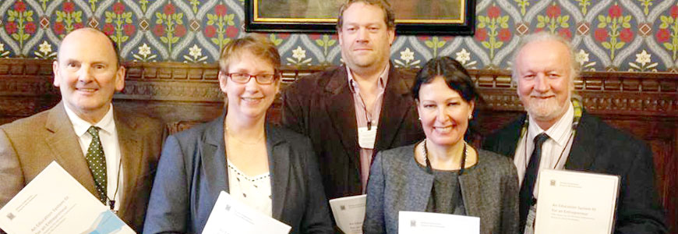
All Party Parliamentary Group for Entrepreneurship
14 November 2018
As UK experts we punch well above our weight when it comes to enterprise education

Slide 3
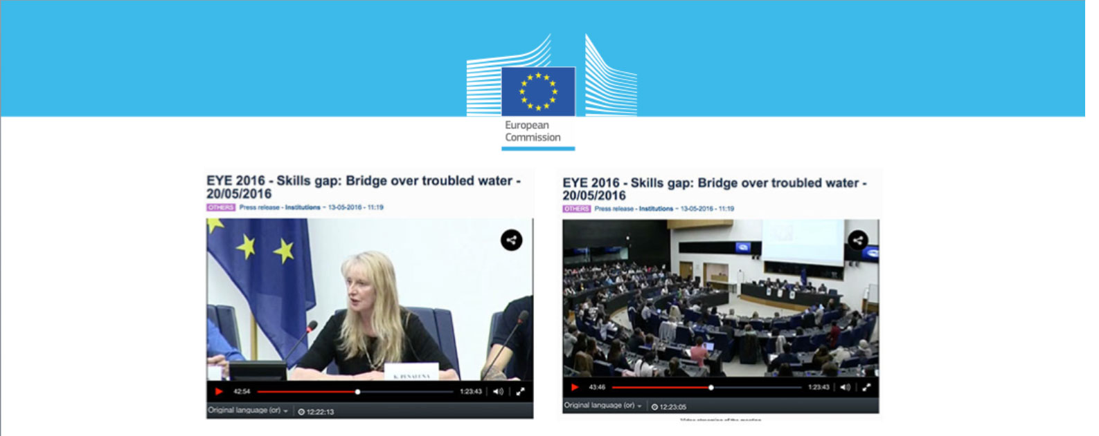
“UWTSD’s IICED is widely recognised as one of the world’s foremost institutions in creativity-based entrepreneurship education. IICED has not only been active in advising the UK government in the field of entrepreneurship education but its publications have also been leading discussions at an international level.”
Yves Punie EU Joint Research Centre, 2016

Slide 4

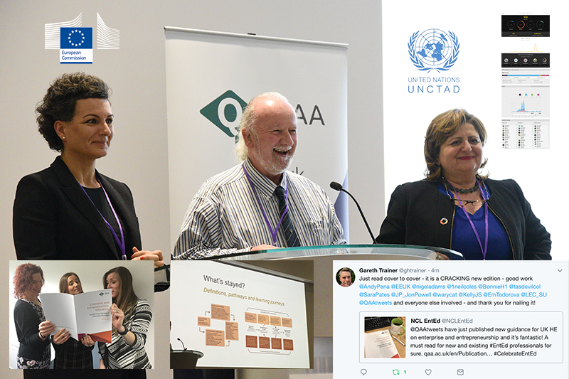
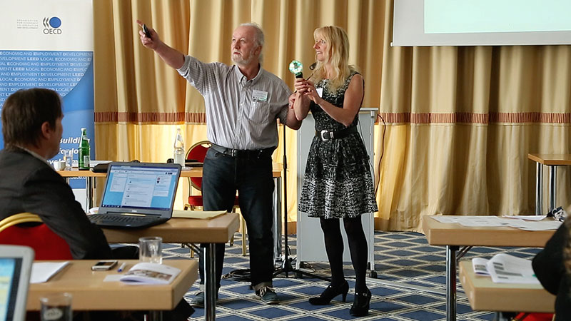
“Most experienced…the world’s first national-level guidelines on quality assurance in this field.”
Guangming Daily (STATE NEWSPAPER) – China, 16/2/16
“When it came to understanding all of the facets of entrepreneurial education, IICED lead the way.”
Joseph Tixier, OECD (2015)

Slide 5
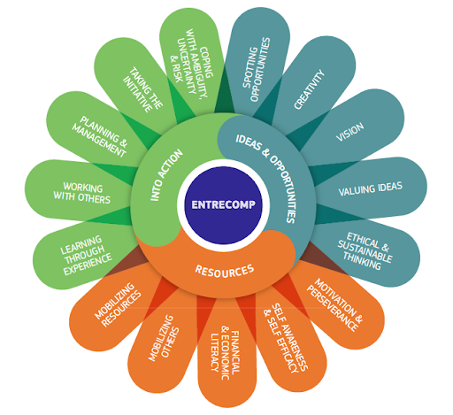
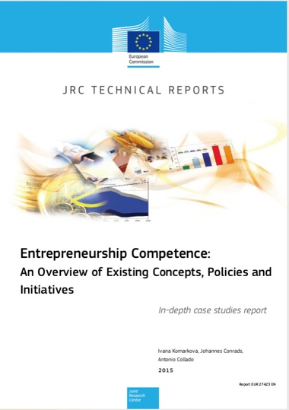
UWTSD’s IICED (Wales) and Lappeenranta University of Technology’s Centre for Training and Development were the only Two European University’s who saw the full picture.

Slide 6
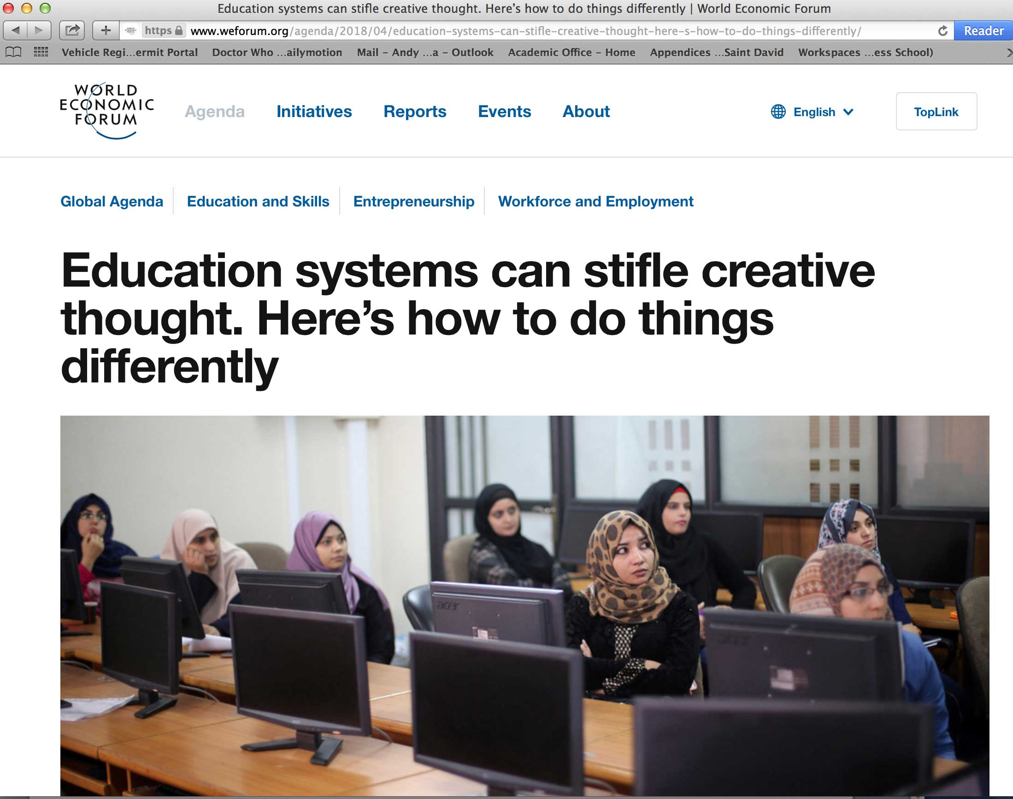

(IICED’s) “Research into creative mindset development indicates a minimum of four to six months’ continuous development is required to develop the neural capacity and enhanced plasticity required to be creative.”

Slide 7

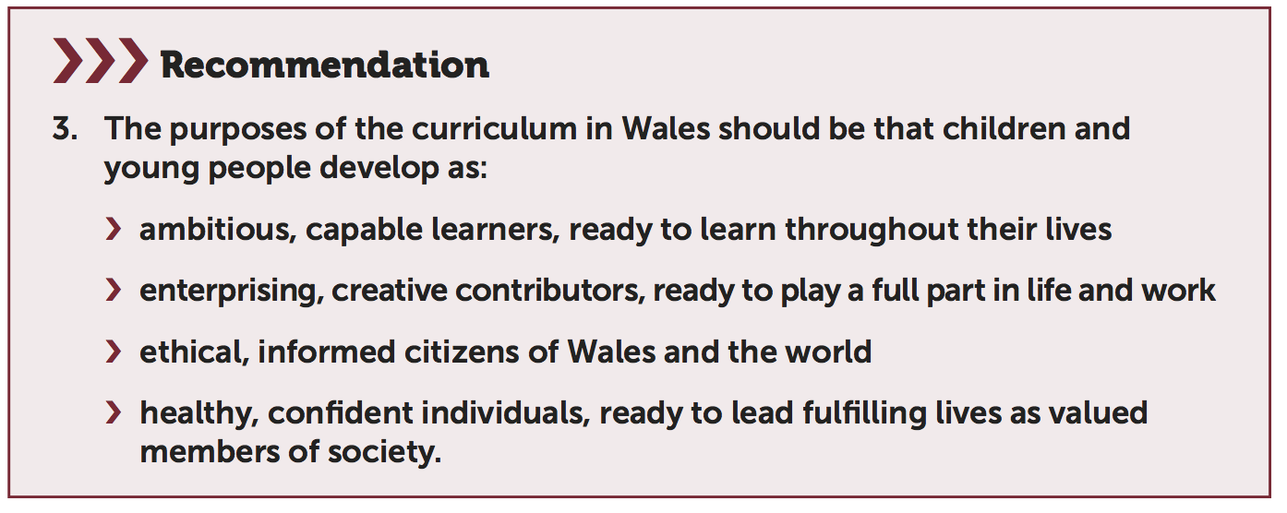
The Welsh Context – New School Curriculum
Led first discussions on ‘Wider Skills’
Undertook two ‘in progress’ reviews of AoLE
Led the development of ‘Integral Skills’
Led the development of interdisciplinary approaches between AoLEs

Slide 8

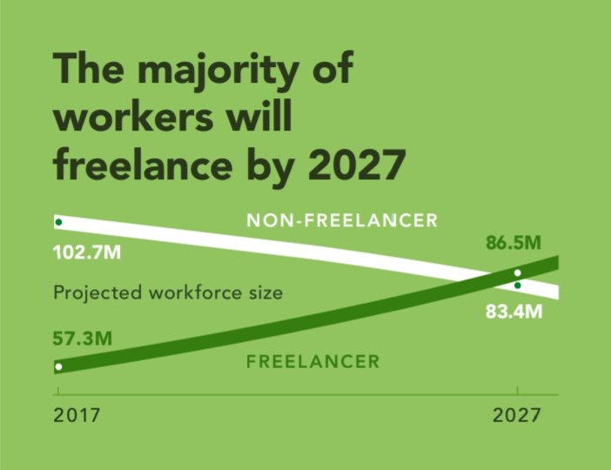

Real, relevant and robust – IICED at
Is your teaching about:
Hindsight – what has happened?
Insight – seeing multiple ways forward?
Foresight – planning for the next major changes our students will face?

Slide 9
Which of these competencies do your students need?
Which do you teach and develop?
How can you be sure, how do you assess them formatively and summatively?

