Slide 1
Developing Relationships and Workplace Achievement
BMSW5102
Lecturer: Sujeewa Herath
Student’s: Ameera Khan 1810760
Adrian Joseph 1810220
Ridwan Dahir 1714111
Anisah Khan 1808794

Slide 2
Summary
What is Human Resources
Benefits of increasing Employee Engagement
The different ways Harrods uses to engage employees in decision making
The effectiveness of a democratic leadership style at Harrods

Slide 3
What is Human Resources?
The Human Resource management is a function used by organisations like Harrods to maximise the performance of employees.
The Human Resources Management is also focused on “managing cash flow, making business transactions, communicating through all forms of media, and dealing with customers” (Haslinda, 2009, p. 181)

Slide 4
Human Resource Management at Harrods
Harrods use HRM to develop a solid understanding of their employees which facilitates innovation and flexibility as the organization negotiates factors of the external environment such as government regulation, technology, economic transition, customer perceptions, news media, and supplier relationships.
HRM at Harrods use the functional role of human capital management for the benefit of the organisation to, 'the more strategic role of developing and maintaining a dynamic, knowledgeable, and progressive career-oriented staff.' Nadler (1970)
HRM can be an enabler to any organization, but has the capacity to be of significant strategic value to Harrods that aspire to achieve the performance

Slide 5
ANALYSATION OF HARRODS EMPLOYEE ENGAGEMENT METHODS FOR PROMOTING DECISION MAKING
“Businesses benefit by involving employees in all aspects of decision making.” (MacLeoad, 2009)
Some of the main methods employed by Harrods include;
1)Internal Employee Magazine – A popular and creative magazine for employees with numerous features
2)Morning Brief – Information dispersed to all staff on the shop floor regarding that day’s performance and latest sales statistics
3)Intranet – Enables information sharing with employees. Employees are able to choose which elements to focus on as opposed to having information thrust upon them

Slide 6
Click t4)Quarterly Employee Forum - A group of volunteers made up of Harrod’s employees. This provides an opportunity for employees to present issues and contribute to company strategy
5)Other Forms of Employee voice – Bright Ideas is a scheme which encourages employees to share innovative ideas to further improve Harrods.
Of the afore mentioned methods I feel that the most impactful of these is the Quarterly Monthly Forum because it gives employees an opportunity to address any issues as well as providing an opportunity to contribute to the company strategy.
o add text

Slide 7
Conclusion
“Perception is awareness shaped by belief. Beliefs control perception. Rewrite beliefs and you rewrite perception. Rewrite perception and you rewrite genes and behavior…(Lipton, B) (2015)

Slide 8
What is Employee Engagement?
Employee Engagement can essentially be described as the effect, involvement or identification of an employee with the purposes and values of an organisation.

Slide 9
Employee engagement defined
It is often commonly interpreted as “going the extra mile” or “giving 100%”
Employee Engagement Defined
Engaged employees demonstrate their authentic selves through physical participation, cognitive awareness and emotional connections (Catherine et al., 2013).

Slide 10
Employee engagement is made of past perceptions such as job satisfaction, employee commitment and organisational citizenship behaviour (Solomon and Sandhya, 2010).
MacLeod and Clarke (2009) in a report to the UK government suggested engagement as an organisational technique intended to ensure that employees are devoted to their organisation’s goals and values.
An engaged employee also brings better output and they are negatively inclined to leave the organisation; thus, job satisfaction is related to employee engagement (Lata, 2017).

Slide 11
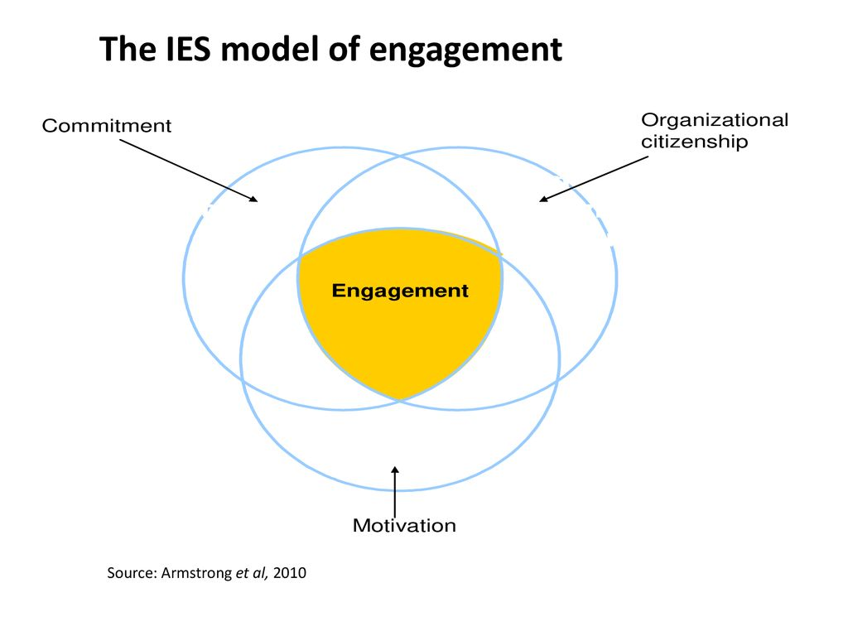

Slide 12
Benefits of Engagement
Higher Employee Satisfaction
Higher Retention and Lower Turnover
Higher Productivity
Less Absenteeism
Increased Employee Loyalty

Slide 13

Evaluate the effectiveness of employing a democratic leadership style on the success of harrods.
Democratic leadership works in favour of both employees and the company it helps the management team to spot the company’s top performers to get promoted in leadership position on the other hand it encourages employees to go above and beyond to achieve objectives and succeed.
joseppe, L.B., Ananya, K.R.: effective problem solving and online networking. Organization Science 20 (2009)

Slide 14
Reference’s
Haslinda A. (2009). Evolving terms of human resource management and development. Journal of International Social Research, 2(9), 180-186.
Nadler, L. (1970). Developing human resources. Houston, TX: Gulf Publishing Company
MacLeod, D and Clarke, N. (2009) Engaging for Success: Enhancing performance through employee engagement, London, Department for Business Innovation and Skills.
Lata, B. S. (2017) Job Satisfaction as A Predictor of Employee Engagement. Amity Global HRM Review, pp. 21-22.
Catherine, T., Amanda, S., Emma S., Kerstin, A and Rick, D. (2013) Employee engagement, organizational performance and individual well-being: exploring the evidence, developing the theory. The International Journal of Human Resource Management, 24(14), p.2659

