Slide 1
Myth and mythology: How Stories Shape the World
Professor
Ruth Parkes

Slide 2
Myths and Mythology: How Stories Shape the World
What is myth & mythology?

Slide 3
The word ‘mythology’
Mythos – originally simply: ‘something delivered by word of mouth’,
  Soon after Homer: also ‘tale, legend’.
In the last sense, a degree of untruthfulness may be implied
- mythos and logos
  Logos (‘word’) in a wider sense also means ‘tale’ and ‘story’
    Implied: a story with historical truth

Slide 4
Modern usage – several definitions!
The narrow, content-based definition: myths are stories about the relations between humans and gods (Morford & Lenardon, 2003, 3f )
The narrow, target-based definition: myths are stories that explain the origins of places, objects and customs
The broad definition: “We have chosen to define a Greek myth as a tale rooted in Greek culture that recounts a sequence of events chosen by the maker of the tale to accommodate his own medium and purpose and to achieve particular effects in his audience.” (Tyrell B. & Brown F. 1991 Athenian Myths and Institutions: Words in Action, 6)

Slide 5
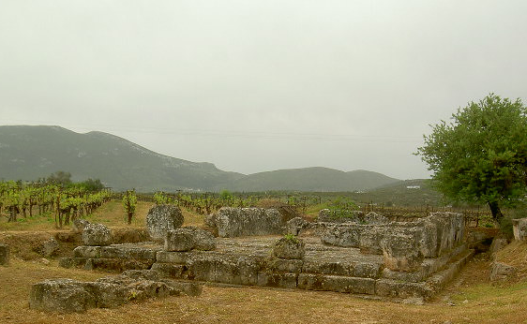
Herakles temple near Stymphalos
Myth, saga, and legend
Sometimes we also distinguish between myths, legends, and sagas
Sagas and legends also contain features found in folktale and legends without mention of gods or the supernatural
Sagas and legends are felt to have some basis in fact, some relation (however vague) to history
  Most local legends and most tales of heroes worshipped in a particular region fall in this category: Theseus for Attica, Herakles for Argos, etc.

Slide 6
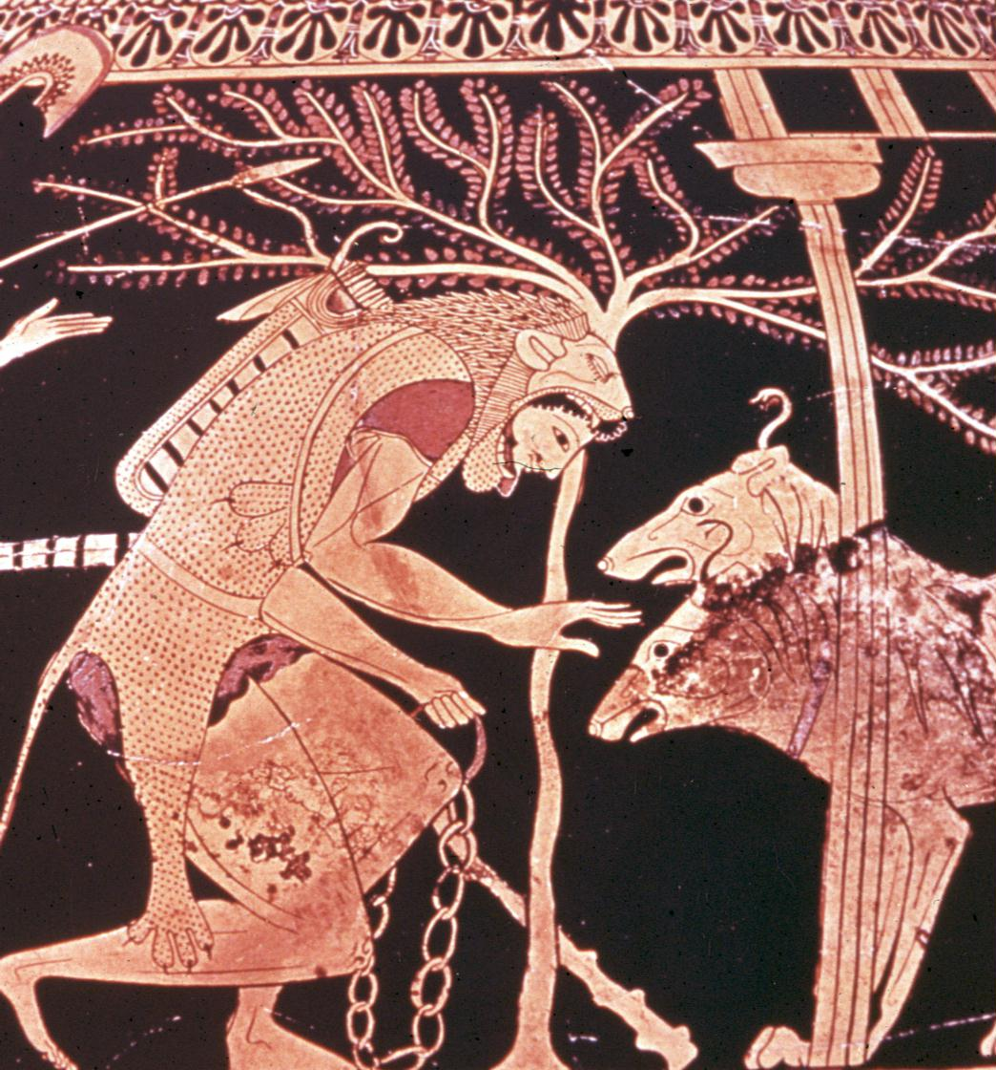
Did people believe in myths?
The truthfulness of myth questioned throughout history
The Greek geographer Hecataeus explains that Kerberos was in fact a serpent with poisonous fangs, not a three-headed hell hound
There is an ongoing scholarly discussion of to what extent the ancients believed in myths, and whether we can assess this – cf. Buxton, Imaginary Greece 1994, 145-165
Saying that a myth is not factual does not necessarily equal saying that it does not convey any truth

Slide 7
Truth in myth?
Myths fulfil important functions even for the most hardened sceptic
Myths depend on make-believe, but are also an important means to convey truths about life and society
The oppositions and problems reflected in the myths a society uses are the same ones that readers/viewers would find in their daily lives
  Choices between right and wrong, problems of power etc

