Slide 1
MSc Policing (Operational & Strategic Leadership)
Academic Argument
MSc Plisomona
( Arweiniad Weithredol & Strategol)
Dadl Academaidd

Slide 2

Lesson
Understand what is meant by argument in academic terms
Identify the elements of good academic argument and suggested structures
Provide additional resources

Slide 3

What is an ‘argument’?
What is an argument?
Disagreement or dispute
An exchange of diverging or opposite views
Derives from Latin word ‘arguer’
Notes:
Bit of a re-cap to start with to put things into context
So what do we mean by an ‘argument’ in general terms?
Open to class
Ans – a disagreement or dispute over something
An exchange of diverging or opposite views sometimes heated in nature
Therefore the idea of an argument may conjure up an image of two people yelling at each other or screaming in anger over a specific matter, however an argument is very different especially within academia.
The word argument comes from the Latin word ‘arguer’ which means to make clear

Slide 4

What is an ‘Academic argument’?
What is an academic argument?
An attempt to persuade others (of the validity of a conclusion) by offering at least one reason that supports that conclusion.
i.e. an argument begins with an issue, which is followed by a line of thinking/reasoning, leads to a conclusion
Notes:
So having identified what is an argument in general terms lets move on to asking What is an academic argument?
Open to class to respond
The overall aim of academic work is to express a point of view on a subject and support it with evidence.
So an academic argument can be defined as An attempt to persuade others (of the validity of a conclusion) by offering at least one reason that supports that conclusion.
i.e. an argument begins with an issue, which is followed by a line of thinking/reasoning, leads to a conclusion

Slide 5
Academic argument
An academic argument is
Your stance
Your claim,
Or Your take on a topic
Position
Perspective
Point of view
Notes:
An academic argument is
Your stance
Your claim,
Or Your take on a topic
This stance, claim or take on a topic/subject is your contribution to the current conversation on your topic and provides your readers with a position, perspective and /or point of view on your topic
An academic argument is also based in the research that you do with regards to your position, perspective and point of view and is often referred to as evidence based argument. This means that your argument is supported with findings from sources that you read
Differences of opinion can generate debate which furthers our knowledge. Reflect back on your degree programme, each module has encouraged you to engage in critical thinking to examine interpretations,, to defend them, to refute them or to provide your own view.

Slide 6

Academic argument is NOT..
A fight
Battle
negative confrontation
Focused on one person’s opinion
Notes:
An academic argument is NOT
A fight
A battle or a negative confrontation
Nor is it focused on just one person’s opinion
So non –academic arguments do not , in most cases include supported/evidenced facts, straight forward logic or have an end goal in mind.

Slide 7

The importance of academic argument
Arguments lie at the heart of academic writing
Established structures to assist the writer to express ideas and
Reader to follow line of argument
Argument is an important part of writing process
Notes:
Arguments and ideas lie at the heart of most academic writing.
Most academic essays ( lie your dissertation) usually follow an established organisational structure that helps the author to express their ideas in a clear way and the reader to follow the thread of their argument
Any academic writing structure – whether an essay, report, research is guided by its content and argument – so the skill of getting a clear and articulate argument across is an important part of the writing process.

Slide 8
Types of Argument structures
INDUCTIVE Reasoning
DEDUCTIVE Reasoning
INDUCTIVE – act of drawing broad conclusions from evidence gathered through specific scenarios
DEDUCTIVE – act of supporting a conclusion with evidence from specific scenarios
Notes:
There are various types of argument structures and most will fall into one of two primary categories – INDUCTIVE & DEDUCTIVE. – based on the type of reasoning they present. These are terms that you will be more familiar with when we looked at methodology
INDUCTIVE reasoning refers to the act of drawing broad conclusions from evidence gathered through specific scenarios
DEDUCTIVE refers to the act of supporting a larger conclusion with evidence from specific scenarios. Some argumetst will consist of elements of both and researchers often use DEDUCTIVE reasoning to present their findings to prove/disprove a theory with certainty.
So for an argument to be persuasive it must follow a format that a reader can follow with ease. There are number of structures to consider I’m not going to go into detail but just provide a quick overview of the structure of the 3 types

Slide 9
Argument Methods
Toulmin Method
Claim, Grounds, Bridge, Foundation, Counterclaim, rebuttal
Classical method
Introduction, background, proposition, proof, refutation, conclusion
Rogerian Method
Introduction, opposing view, statement of validity, position, context , benefits
Notes:
TOULMIN Method – is an argumentative structure first outlined by its author Stephen TOULMIN. It focuses on supporting the various key claims of an argument using factual evidence.
Its structure is within 6 stages –
CLAIM – explanation or basis of argument
GROUNDS – presentation of evidence to support the claim
BRIDGE – discussion of the evidence and how it supports the claim
FOUNDATION – presentation of additional logic or reasoning that supports the connections from the earlier stage
COUNTERCLAIM- discussion of opposing viewpoints
REBUTTAL – response to refute counterclaim through evidence
CLASSICAL method – focuses on the clear definition of an argument and presentation of evidence that leads an audience to draw conclusions seamlessly
It also has 6 stages
Introduction, Background, proposition, proof, Refutation and conclusion
ROGERIAN method – this si popular for the discussion of controversial issues and focuses on identifying a neutral perspective or compromise that opposing perspectives can agree upon.
Again a 6 step structure – Introduction, Opposing view, statement of validity, position, context and benefits

Slide 10
Simple Structure of an argument
Claim
Proof
Objections
Conclusion
Notes:
Lets look at a simple structure of an argument and the break it down
So there are 4 main steps to consider within this structure
The claim
The proof
The Objections and finally
The conclusion

Slide 11

The Claim
At the heart of all arguments – it is the main premise that you are interested in proving
Should be worth arguing over
Notes:
At the heart of all arguments is a CLAIM – it is the main premise that you are interested in proving, and offers you the opportunity to put forward your perspective on the issue.
You premise is what you are basing your argument on – so it could be an idea or theory on which a statement or question is based or something that you suppose is true and that you use that as a basis for developing an idea
Establishing your claim one of the most important parts of any academic writing, essay , dissertation or other research paper. It should therefore be concise, direct and easily understood by your audience.
Some will say that a good claim should be bold, exciting and most importantly worth arguing over.
A version of your claim will probably be included or referred to early on in your document – probably the introduction.

Slide 12

The Proof
To convince your reader you need ‘proof’
Evidence, data, sources, examples
How & Why
UWTSD Harvard
Notes:
To convince your reader of your claim you will need to provide some proof.
Your proof will be in the form of evidence, data, sources and examples all of which need to be fully referenced in the UWTSD Harvard style. Try to focus on offering facts rather than anecdotal information – hence the value of referencing your sources.
Its important to recognise that relevant evidence does not automatically prove a claim. There is usually some work to be done on your part to convince your reader that there is a connection – that is… HOW and WHY this evidence informs your thinking
This part of the argument is sometimes called a WARRANT

Slide 13

Objections
Seek out alternative points of views and potential objections
Beware of ‘echo chamber’
Deliberate engagement with objections – build into our thinking
Notes:
After offering adequate evidence to support your claim , an important part of the process is to seek out alternative points of view and potential objections
There is a tendency to be drawn to ideas that explicitly and implicitly support your own ways of thinking – sometimes called the ‘echo chamber’ which can result in narrow or flawed arguments.
Do plenty of research until you feel that you have enough data to support each of your main points. Cite sources/studies to improve your credibility BUT importantly withhold your own personal opinions and biases – let your evidence speak for itself.
By deliberately engaging with objections or alternative points of views and building them into our own thinking we can develop more balanced and rounded arguments, helps you maintain objective and adds credibility to your argument overall

Slide 14
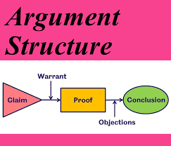
Conclusions
Present a balanced summary
Opportunity to make recommendations
Notes:
Your conclusion will draw on this process of research and thinking to present a balanced summary of the argument, using cautious language as appropriate to the strength of your findings. No harm in re-instating your argument and very briefly summarising the evidence you have already presented.
The tone and style of your writing can be more important than you think especially when you may be criticising someone elses’s perspective. Be respectful when choosing your words and phrases. Using an aggressive tone reflects worst on the writer than the target even if you are trying to rebut a bad view.
Use the conclusion to persuade your reader regarding your arguments and conclusions – you may be able to link it back to your research aim, objectives and overall question
You may even be able to use this conclusion as an opportunity to make some predictions or recommendations, suggest some practical applications or identify openings for further research

Slide 15
Evaluating the evidence of an argument
The author
Specialist knowledge
Bias and hidden agendas
Ambiguity
Inconsistency
Fact or opinion
Notes:
How do we therefore evaluate the evidence fo an argument that we have come across in our reading/our resarch to see if we agree/disagree or to establish its validity
Aauthor – who are they, google them so see are they affiliated to any UNi etc,
SPecialist knowledge – what 's in their bio's, what have they written before, are they affiliated to any organisations
Bias and hidden agenda – do they have any, sometimes it comes through in their writing, or you may find that they are affiliated to
Ambiguity – in their writing, does it pose more questions that are not addressed adequaterly or not at all
Inconsistency – do they provide an alternative view in other academic work , if so what si that based on
Fact/opinion - is it based on fact or on opinion. Don't forget fact an be evidenced, opinion cannot

Slide 16

Hints and Tips
Make sure your argument is worth arguing about
Explain HOW and WHY your evidence is sufficient valid and reliable
Engage with opposing views – consider all counter-arguments
Go beyond source material if needed
Notes:
Be bold and make sure that your argument is something worth arguing over
Watch for logical misconceptions. Just because you have some evidence it doesn’t automatically prove your argument. You need to explain HOW and WHY your evidence is sufficient, valid and reliable. I’ve put a handout onto moodle for you regarding these
For example – missing the point, making general assumptions about a whole group or range of cases based on an inadequate sample,
Engage with opposing viewpoints to ensure that you have considered all possible counter-arguments
Don’t be afraid to go beyond the source material to draw your own informed conclusions

Slide 17
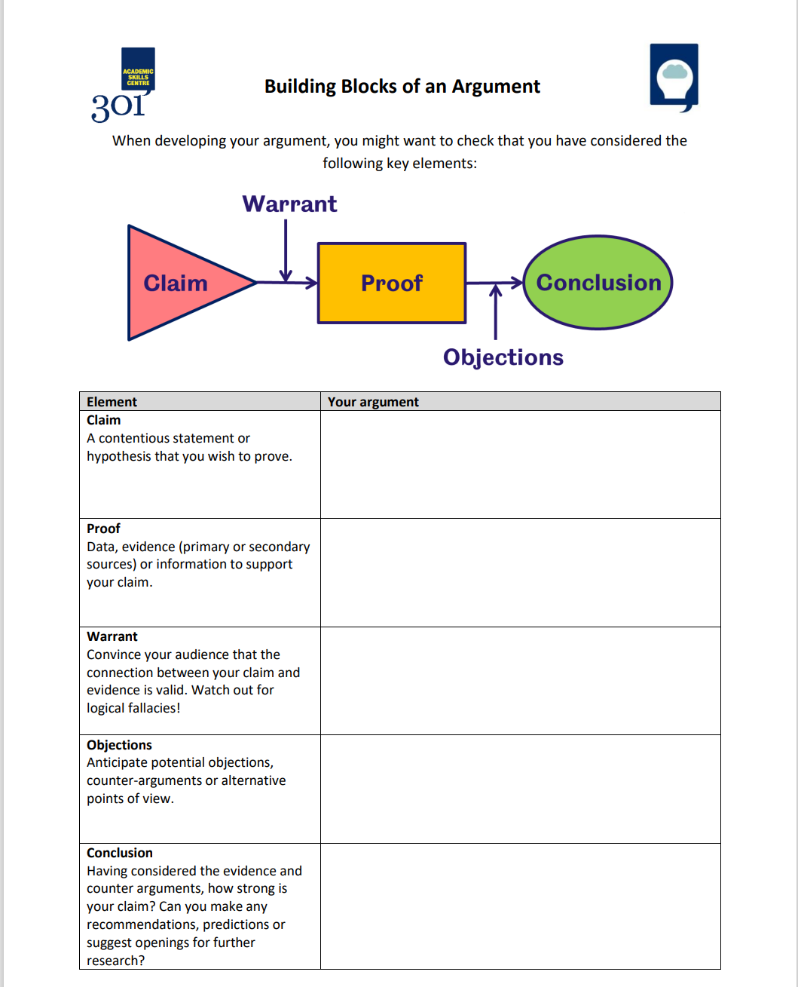
Using a template to assist in drafts
Notes:
There are a few resources available to you on the internet to help you when you are compiling your arguments in draft – this si just one which is taken from the University of Sheffield.
It guides you through the different step – claim, proof, warrant, objections and conclusion

Slide 18

References & Useful sources
Sheffield University
University of Cork
Check out Moodle
https://digitalmedia.Sheffield.ac.uk/media/making+an+Academic+Argument/1_wlhwqk8w
How to create an academic argument (youtube.com)
Structuring an argument (youtube.com)
Notes:
Source for slides – University of Sheffield
University of Cork
Useful youtube videos

Slide 19

Questions/cwestyniau

