Slide 1
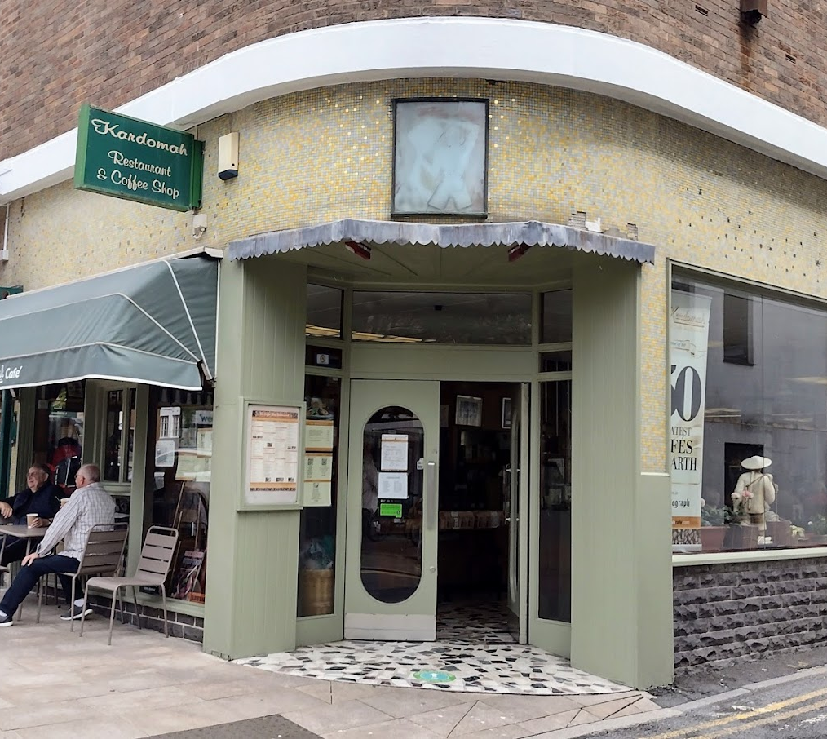
kardomah
Ayesha Amir
2306141
Placement: Developing Restaurant Management
BMGM 5004
Jemma Smith
Kardomah

Slide 2
AI
ChatGPT
I acknowledge the use of ChatGPT (www.chatgpt.com) on 8 March 2025 to check my grammar and spelling, as well as to help me understand the assessment requirements in a simplified way to guide my research.
I used the following prompt(s):
Please check my text for grammar and spelling errors.
Explain the main points of the assessment in simpler terms to aid my research.
Providing guidance and support in creating accurate references
I confirm that I have not presented any AI generated text as my own work. I confirm I have copies of my drafts, notes, and other resources I used before, and after the use of AI tools which I may be asked to provide in evidence.
Kardomah

Slide 3
dISCUSS
HISTORY
COMMUNICATE WITH TEAM MEMBERS THROUGHOUT THE ENTIRE BREAKFAST SERVICE AND HOW?
TROUBLE SHOOTING SKILLS / RESOLVING CHALLENGES THAT AFFECTED THE OPERATION.
WHAT SYSTEM WE USE POINT OF SALE SYSTEMS OR BOOKING?
WHAT SYSTEMS WE USE? STOCK ORDERING SYSTEMS, DATA FEEDBACK REPORTS, UNDERSTANDING AND KNOWLEDGE AND SKILLS. ALONG HOW TO ANAYSIS.
HOW AND ACTIONS WILL BE TOOKEN PLACE DURING THE OPERATION.
Kardomah

Slide 4
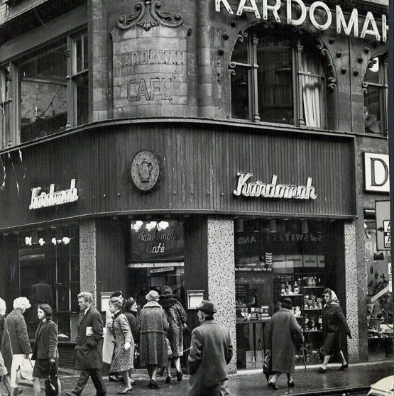
Kardomah History
Kardomah is a family-run business established in 1957 in Swansea, City Centre, making it nearly 70 years old. This independent business is managed by Marcus and Louis, who continue to uphold traditional values while maintaining a warm and friendly atmosphere. Customers are a vital part of Kardomah’s success, contributing to its long-standing presence in the community.
Although Kardomah has retained its old-fashioned charm, it has evolved slightly over the years. The café offers a range of traditional foods and coffees. In addition to their in-house service, Kardomah also operates an online coffee business and supplies coffee across Swansea under the brand name “Gower Coffee.”
Kardomah takes pride in using local suppliers for their food. They source meat from Gower Butcher, fresh vegetables and fruits from Swansea Market, and fresh salmon from Coakley Greens in Swansea Market.
(Kardomah,n.d and ).
Kardomah

Slide 5
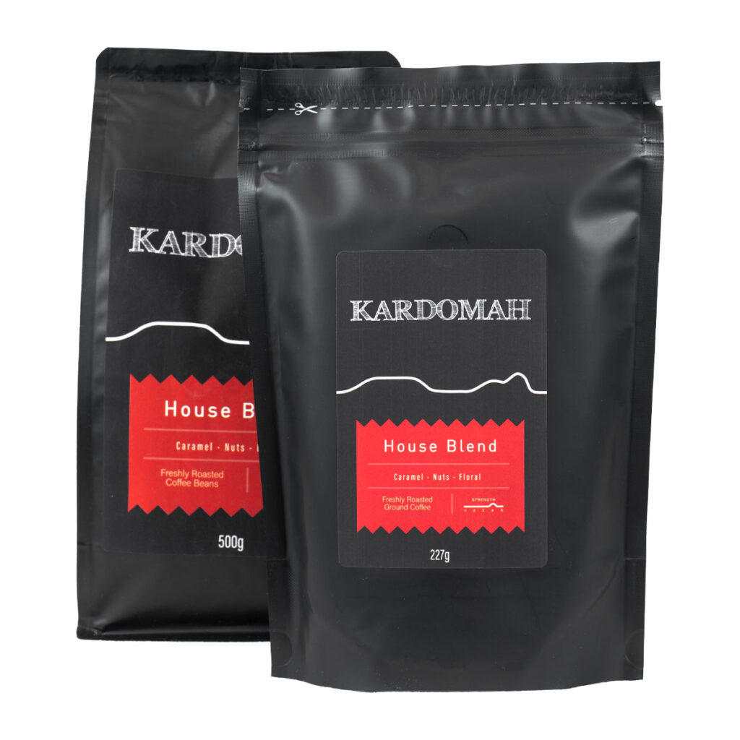
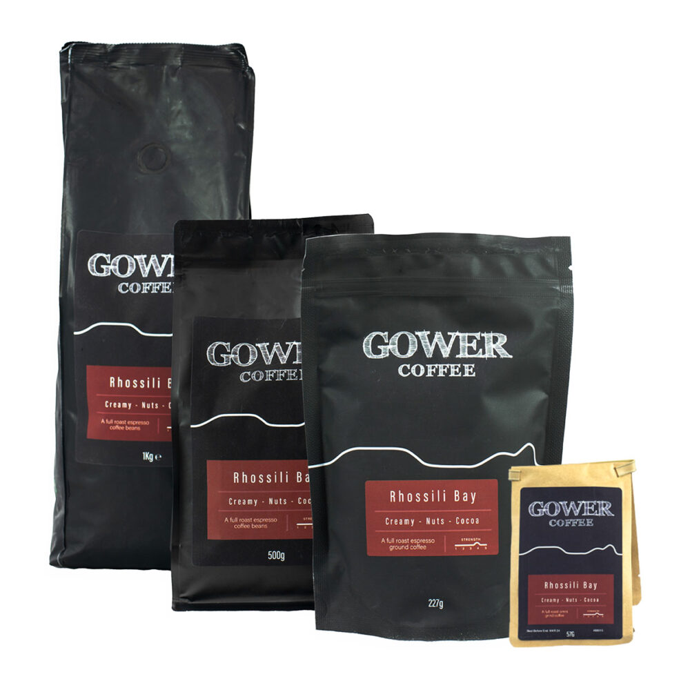
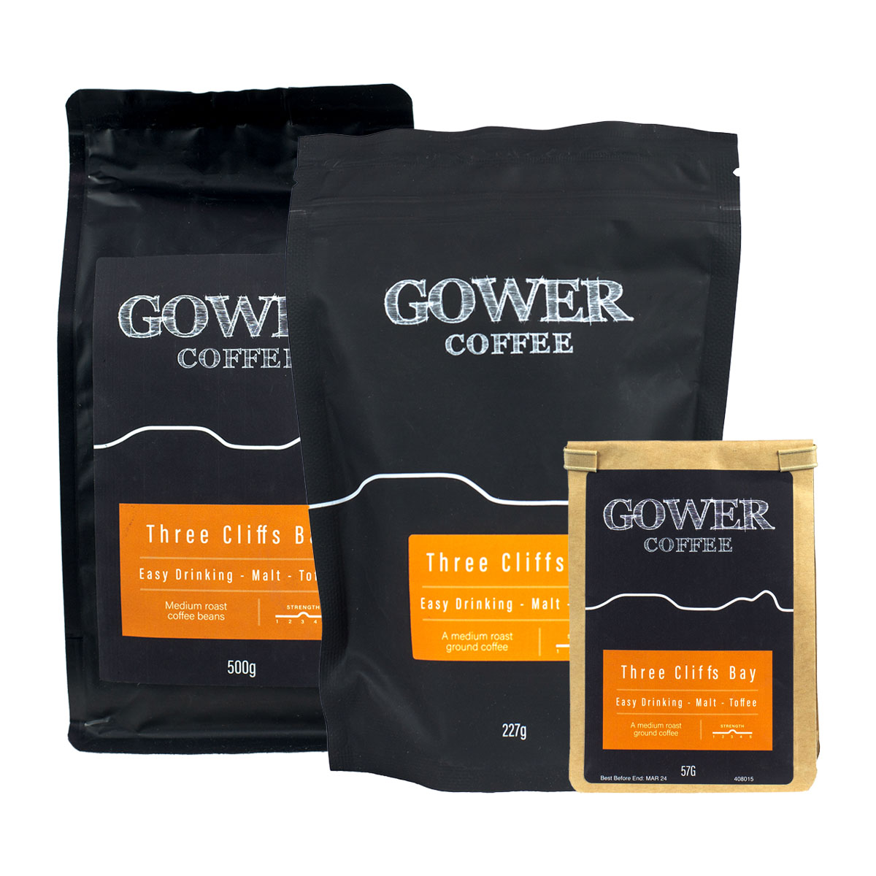

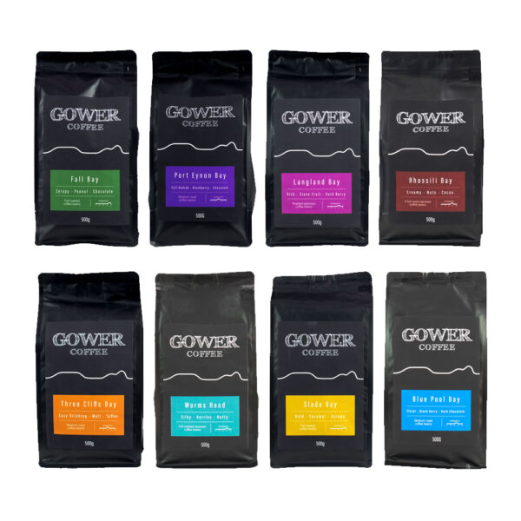
Gower Coffee
Best selling coffee is:
House Blend
Rhossili bay
Three cliffs
Kardomah

Slide 6
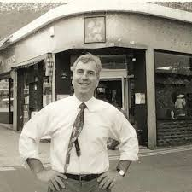
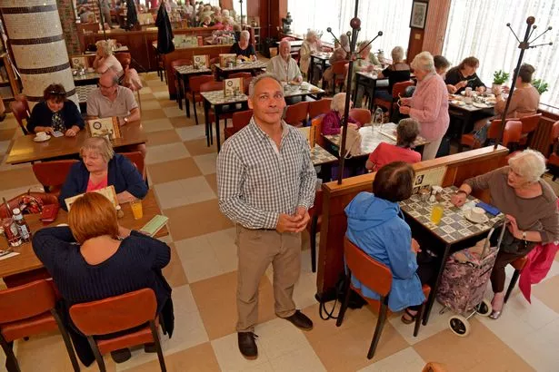
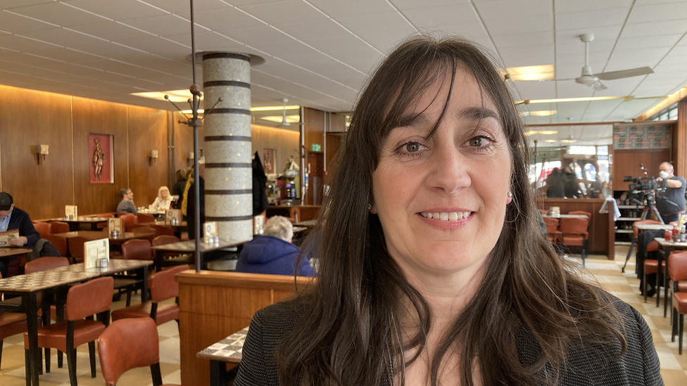
Marcus - Owner
Louis - Owner
Marcus’s Father – The real Owner
Kardomah

Slide 7
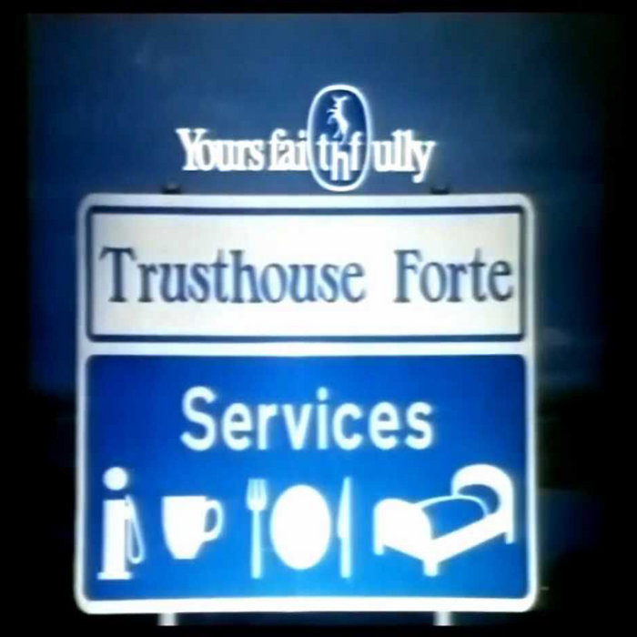

Kardomah

Slide 8
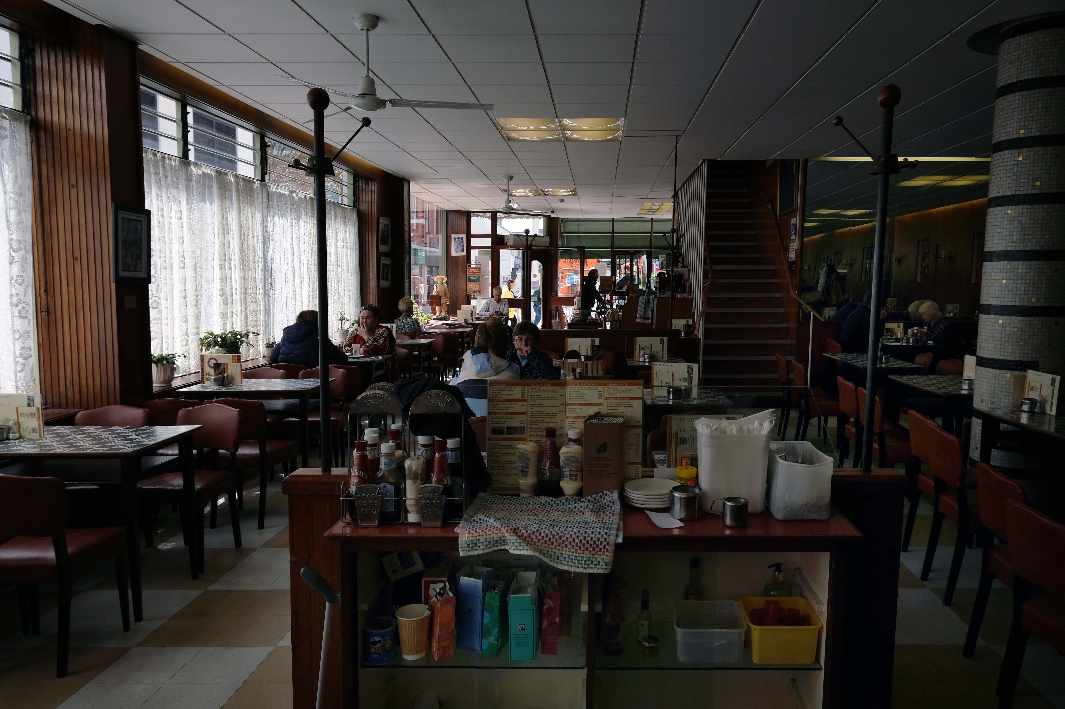

Communicate with team members throughout the entire breakfast service and how?
Take away
Pancake with cream and chocolate sauce
Chips
Employees arrive 10–20 minutes earlier to set up the tables, coffee machines, and their stations for the day, as well as to stock up on any necessary items such as cutlery or condiments. Employees ask the chef about the specials on the menu, which will be displayed at the front of house along with their prices.
Restaurant staff check if the kitchen requires any stock, note any shortages, and discuss them with the owners before placing orders.
Kitchen staff receive breakfast orders on paper checks, as shown in Figure 1, detailing all the items customers have requested from the menu. Once the food has been ordered, the staff set up the cutlery for the customers, collect the order after 10 minutes, and serve it to the tables along with condiments. Beverages are served from the front of house directly to the tables.
Each staff member is assigned to a different station, as shown in Figure 2.
The menu briefing is conducted during the first week of work to help employees familiarise themselves with the menu and confidently inform customers about its contents.
A health and safety workshop and training session are also conducted during the first week as part of the induction process.
A staff rotation system is used for effective management, ensuring that staff members take turns handling different tasks. This helps to balance workflows, ensure all staff receive their legally required breaks (Gov,n.d) and support their mental well-being while working.
Providing all employees with knowledge about allergies is essential, as it is a legal requirement in the UK to ask about allergies before serving food. Which is known as Natasha law (Gov,2019).
Training new employees to restaurant Standards.
Pancake with cream & chocolate sauce £12.00
Chips £4.50
Hot Chocolate £3.50
Latte £2.50
Total= £22.50
Kardomah stations. (figure 2)
Outcome
Better Customer experience
Efficiency service
Clearer communication
Smoother Service
Faster adaptation
Better team performers
This is how the orders of Kardomah looks. (figure 1)
Kardomah

Slide 9
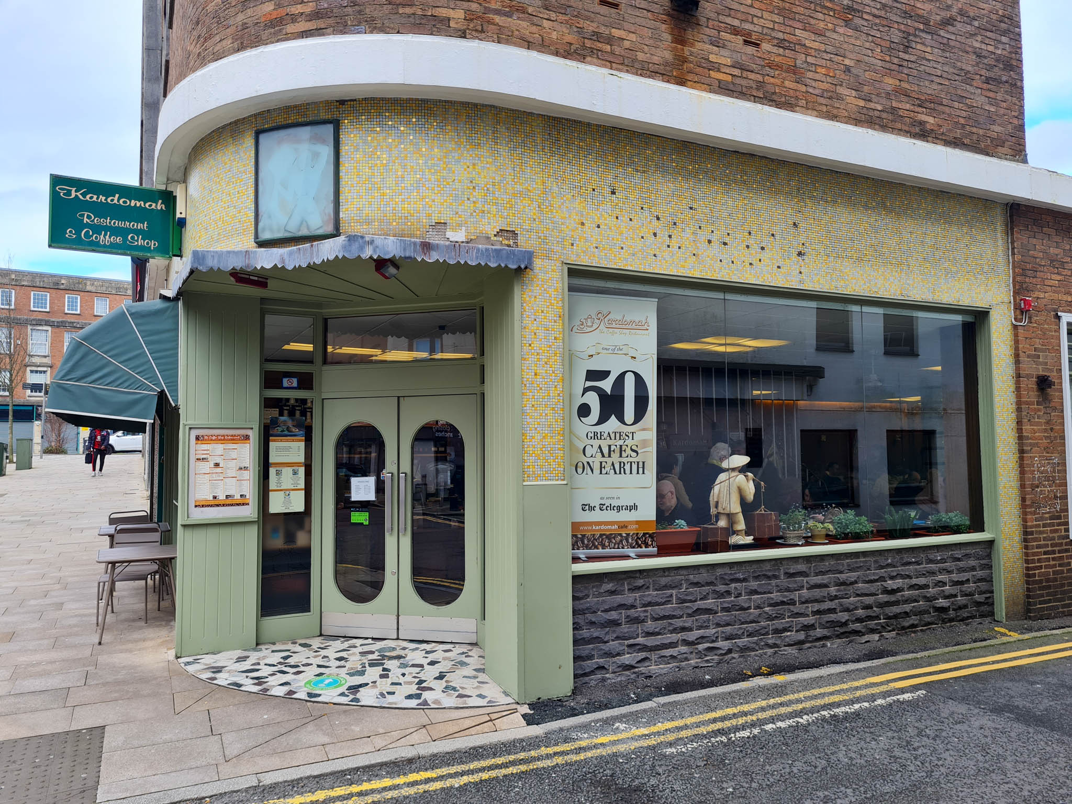
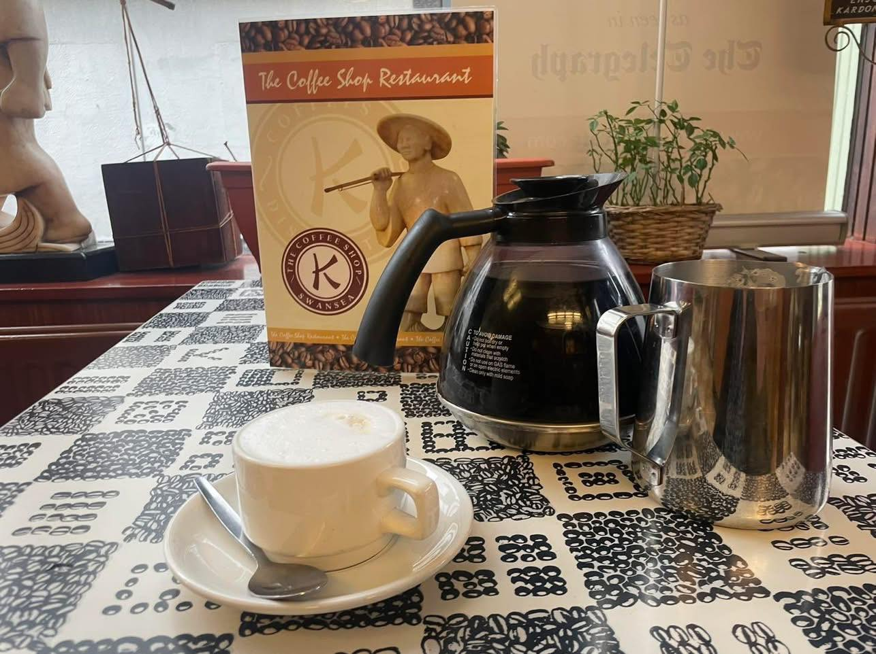
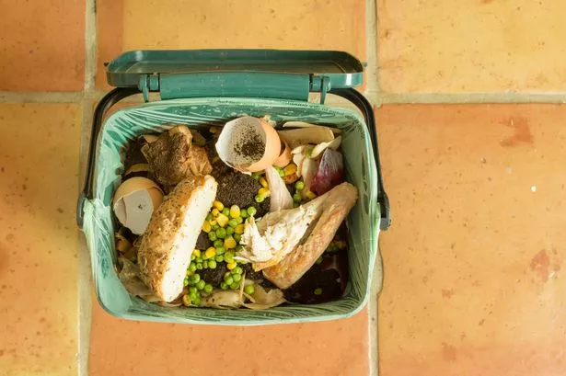
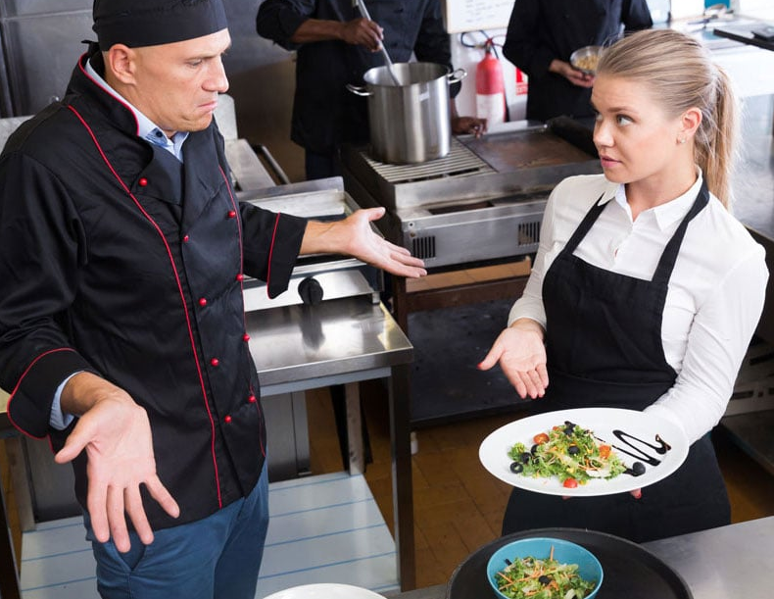
TROUBLE SHOOTING SKILLS / RESOLVING CHALLENGES THAT AFFECTED THE OPERATION
Coffee pouring
food waste
Misunderstand
Hot coffee could spill on a customer's clothes or shoes. In severe cases, it may burn the customer while being served. To prevent this, the restaurant could pour the coffee away from customers or serve pre-poured coffee from a designated station. According to legal requirements, any accidents involving injuries to employees or customers must be officially recorded (Cobain, 2024).
Once the customers finish their meal, all the leftover food goes to cleaning, where it has been noticed that a lot of waste is generated. This affects the business costs in the long term.
To solve this issue restaurants could make portion size smaller this will reduce the waste of food (Riis, J 2014).
According to new law, food waste will be reduced by 2030 about 50% food waste (Malik et al., 2024 and WRAP, n.d).
This could involve communication between the chef and front-of-house employees, who may struggle with clear verbal communication and translation. Employees would benefit from strong support from their employers. If an employee does not understand instructions, the employer could find a way to translate or assign tasks that are easier to understand.

Slide 10
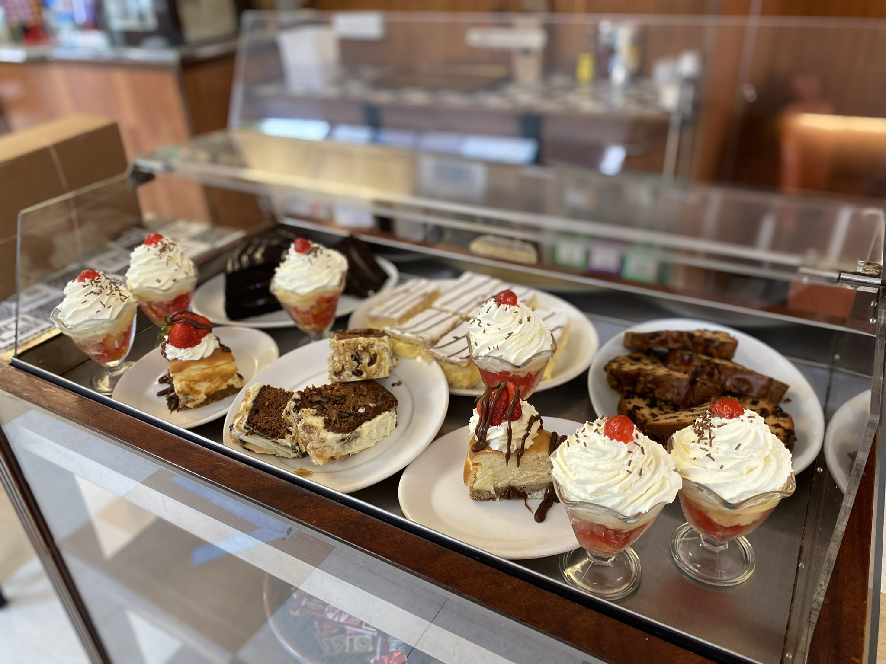
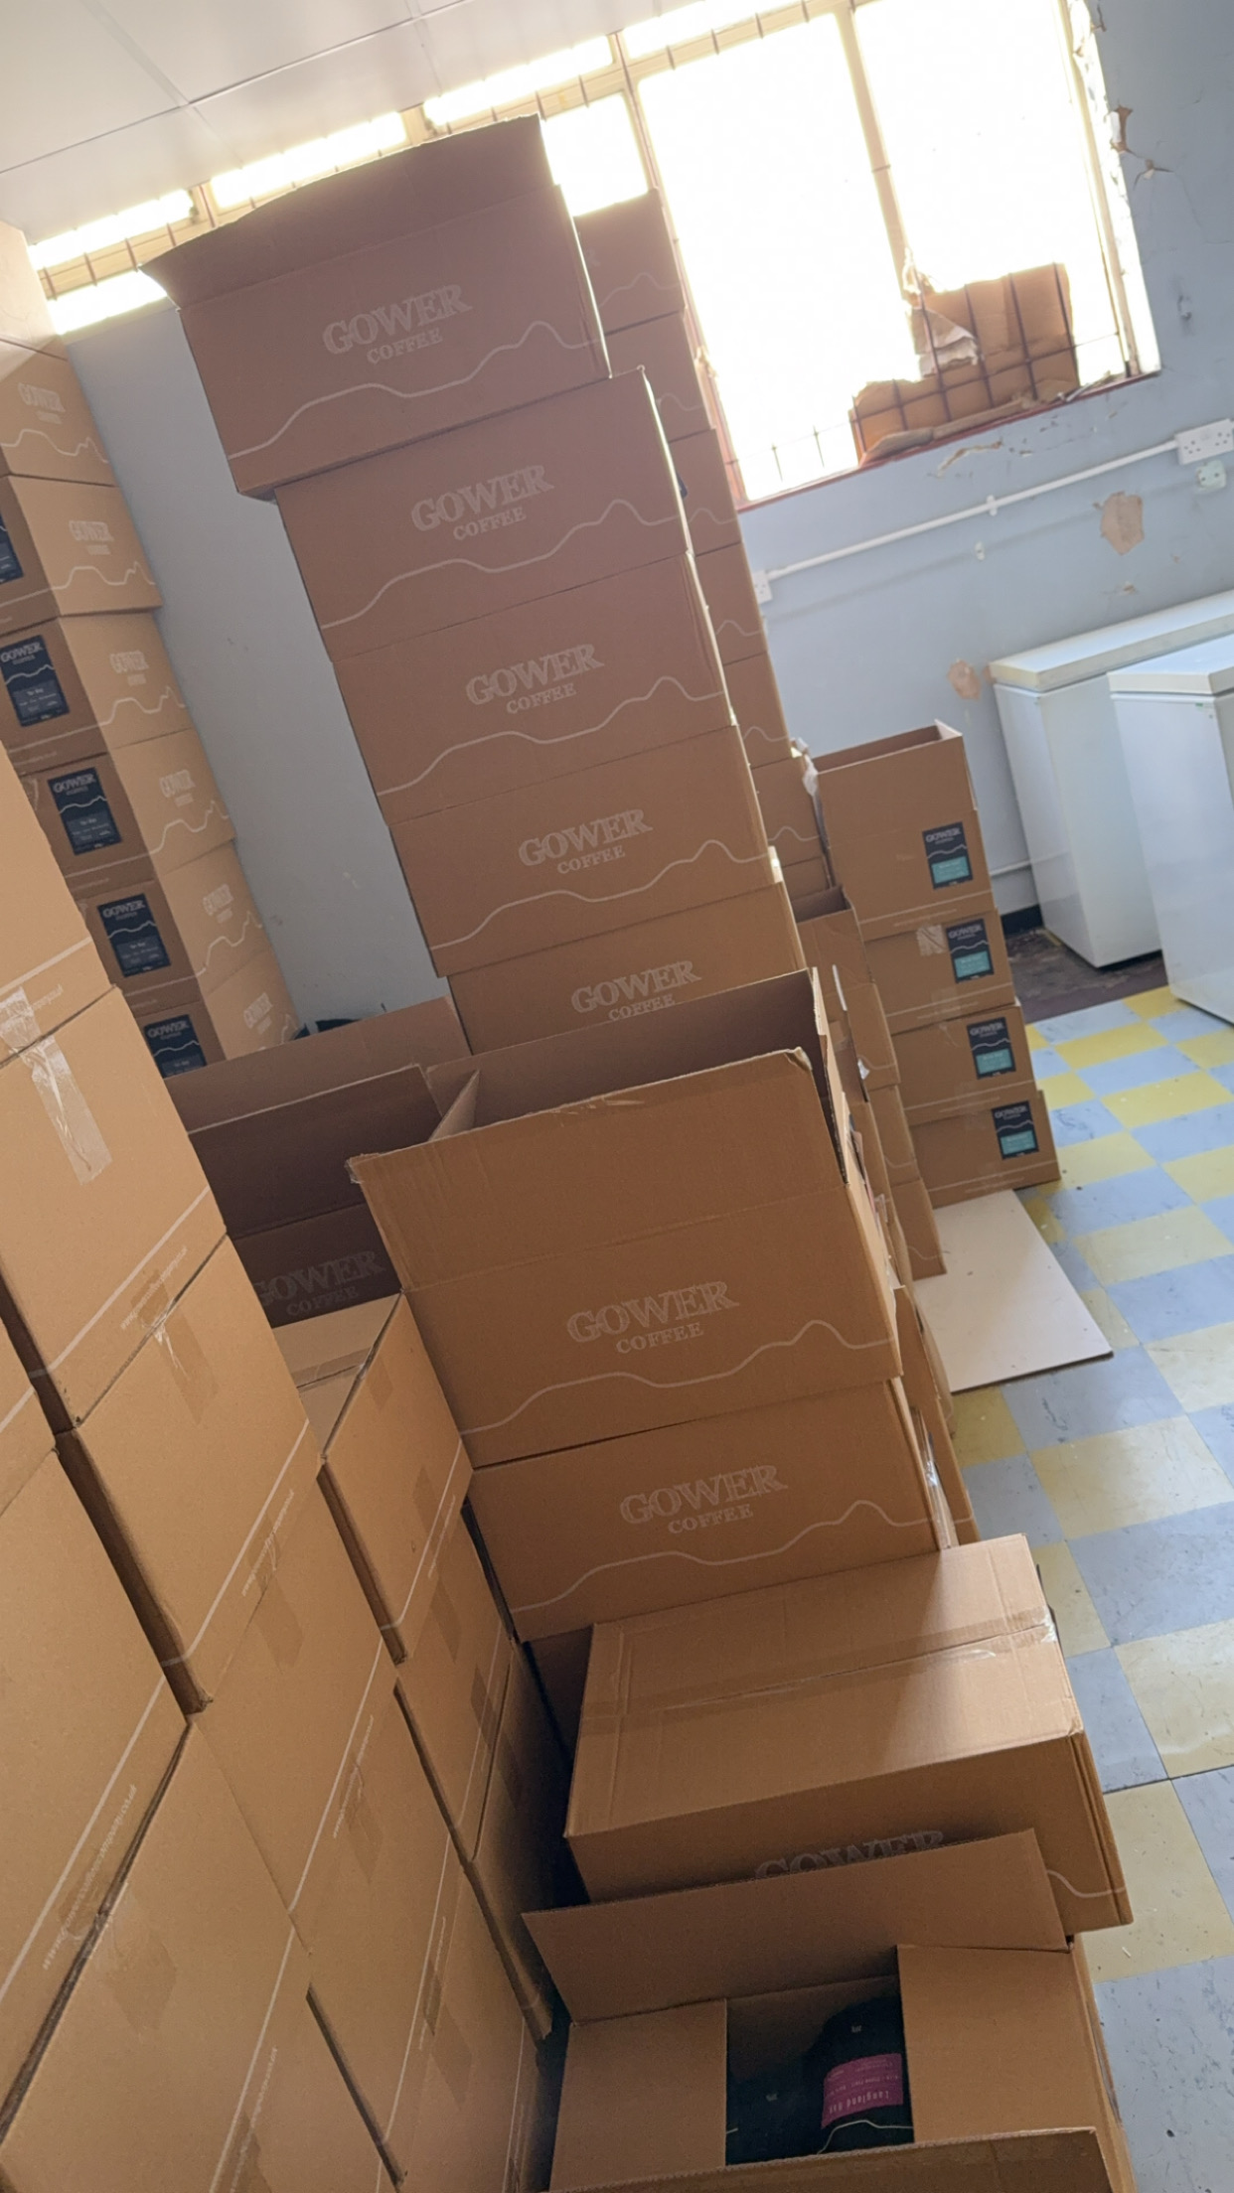
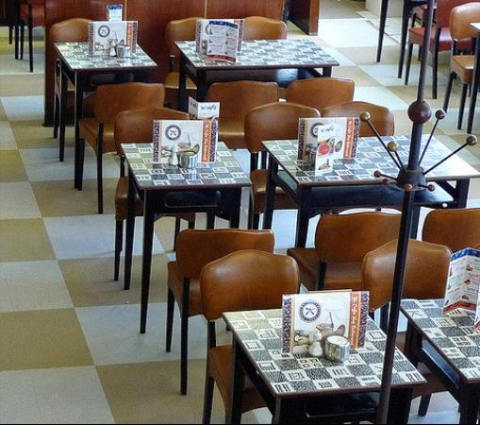

TROUBLE SHOOTING SKILLS / RESOLVING CHALLENGES THAT AFFECTED THE OPERATION
sEATING sPACE
Staff negative review
Carrying coffee Boxes on stairs
Customers might leave unhappy if there is no space for them to eat, which could negatively impact the business's image and profitability. To address this, the business could add more seating or provide customers with an estimated waiting time of 10–15 minutes. Effective communication with customers is essential, as it can significantly influence their experience and encourage them to wait, ultimately improving customer satisfaction.
Carrying multiple coffee boxes could cause you to trip on the stairs, as your focus would be on the boxes rather than the steps. It is important to follow safety regulations of Health and Safety at Work etc. Act 1974, (legislation,n.d). When carrying boxes on stairs to reduce the risk of injuries or accidents. Falling while carrying boxes could also damage the products inside.
This issue can be addressed by guiding employees on the correct way to carry boxes or by using a box lifter on the stairs. Additionally, ensuring staff safety while handling boxes is crucial. The task could be shared among two or more people to make it safer and more manageable.
Staff providing negative reviews about the workplace or their job could have a significant impact on the business, affecting both new and existing employees. If not addressed, this issue could lead to staff shortages or even business closure. To prevent this, employers should ensure that employees' needs are met by discussing any concerns with them and taking steps to improve job satisfaction

Slide 11
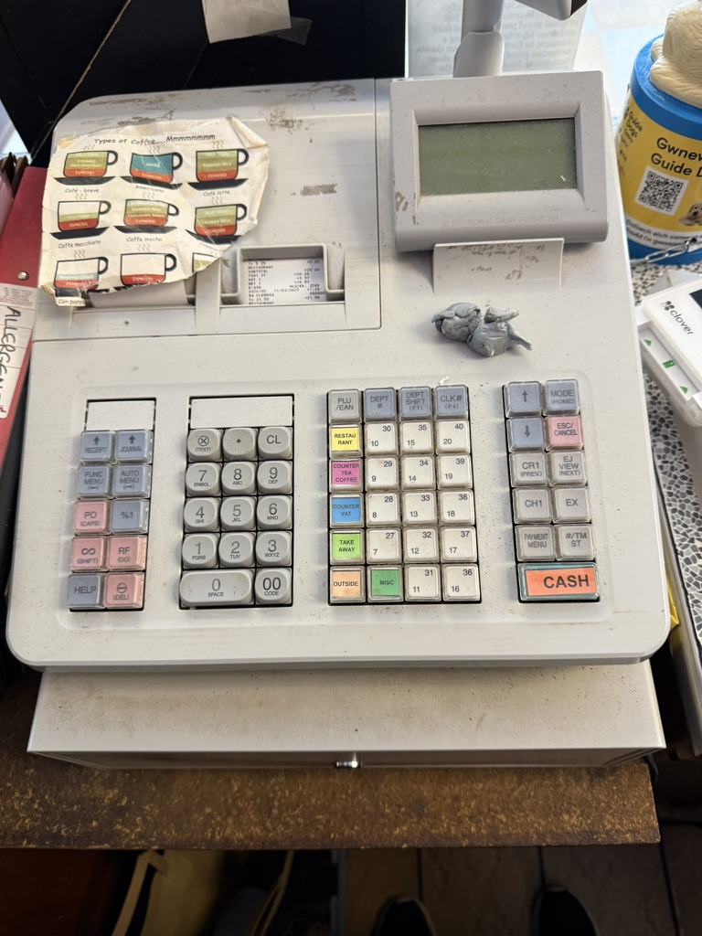
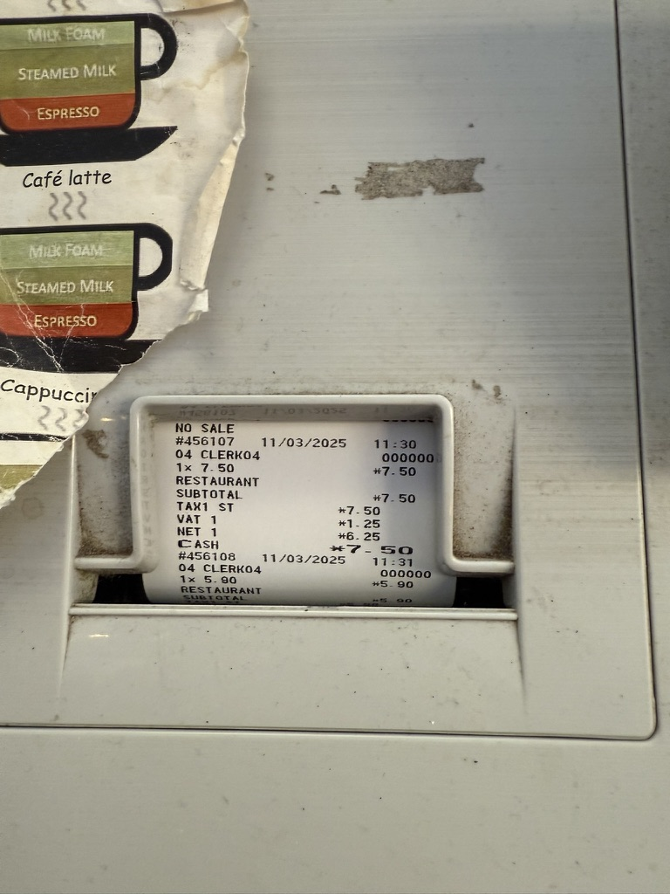
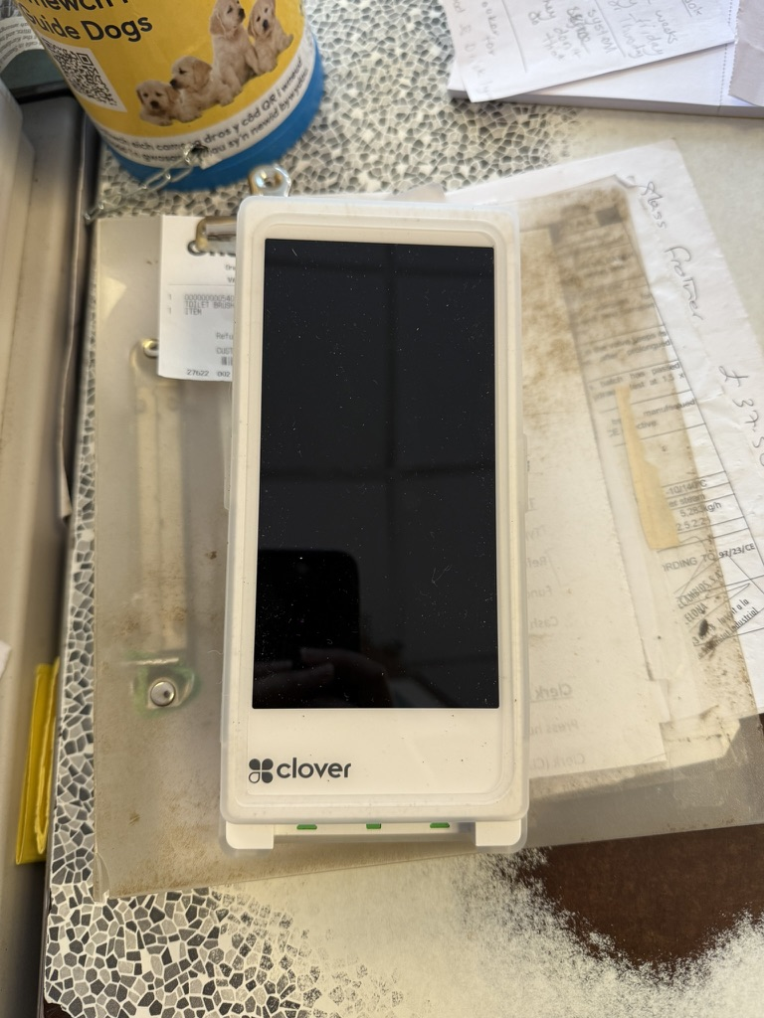
WHAT SYSTEM WE USE POINT OF SALE SYSTEMS, BOOKING or others?
The system Kardomah uses for point-of-sale (POS) is called a legacy POS system, which is an old-style system that records all transactions through the till on paper and is primarily used for cash payments.
Clover (Clover, 2025) is the cloud-based system they use to track all transactions from card machines, which can also be monitored via mobile devices. However, before switching to Clover, Kardomah used Worldpay (Worldpay, 2025), a private company that provides payment solutions to many well-known shops and restaurants.
Kardomah

Slide 12
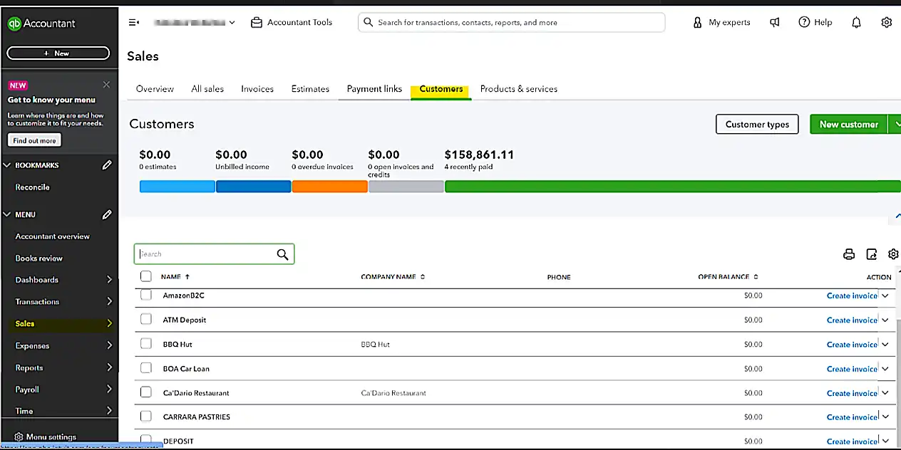
WHAT SYSTEM WE USE POINT OF SALE SYSTEMS, BOOKING or others?
Kardomah does not accept any type of bookings, as it operates as a walk-in restaurant/café. However, they do take reservations over the phone for groups of six or more customers.
Kardomah uses software called QuickBooks to manage the business, including online orders and other operations. The website is also very easy to access.
Kardomah does not use a CMS (Content Management System) for sales.
Kardomah

Slide 13



WHAT SYSTEMS WE USE? STOCK ORDERING SYSTEMS, DATA FEEDBACK REPORTS, UNDERSTANDING AND KNOWLEDGE AND SKILLS. ALONG HOW TO ANAYSIS
Kardomah keeps all reports, from till transactions to supplier statements, filed and up to date, as shown in the next few slides.
Kardomah sources its supplies from Bookers and Ke Supplies, while bakery products are supplied by The Lewis Pie Company and W M Wholesale Bakery.
Stock is typically ordered from these suppliers every one to two weeks and is delivered on Thursdays or Fridays. Additionally, coffee orders are placed monthly.
Stock levels are monitored daily and recorded in a file or book.
Any items purchased with personal money are documented, and the cost is reimbursed from the till, as shown in the next few slides.
Kardomah

Slide 14
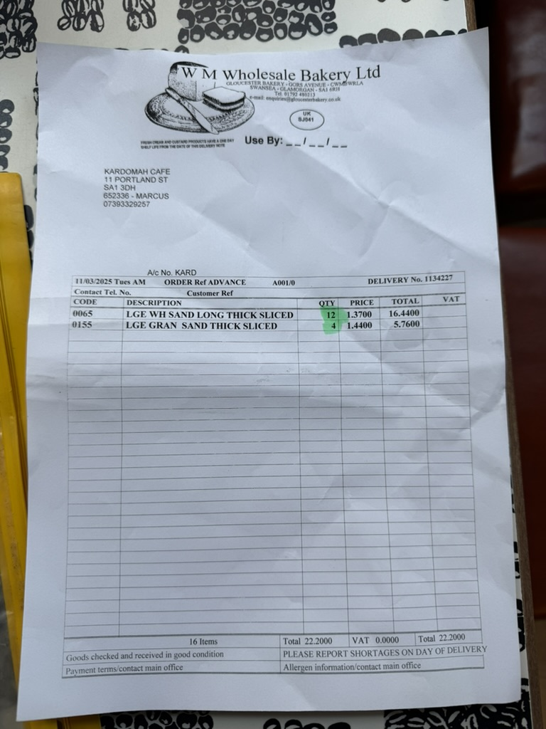
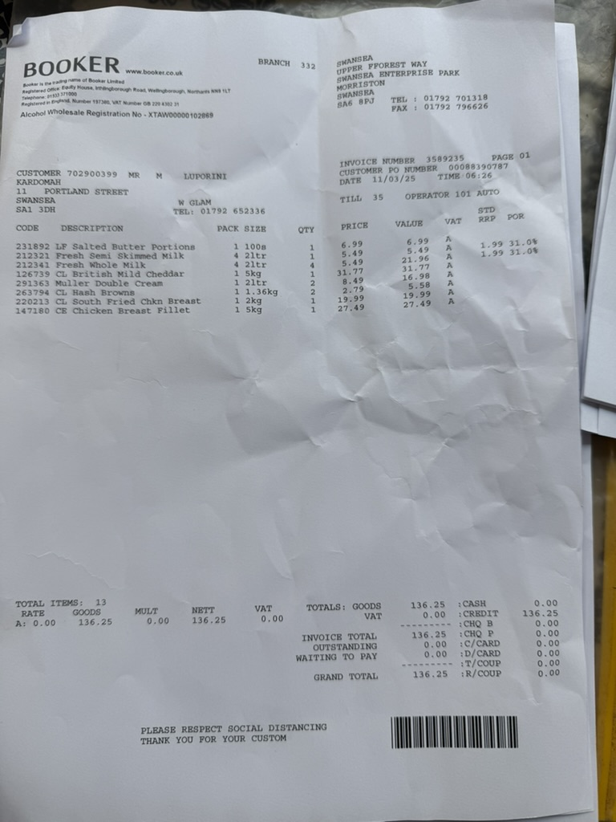
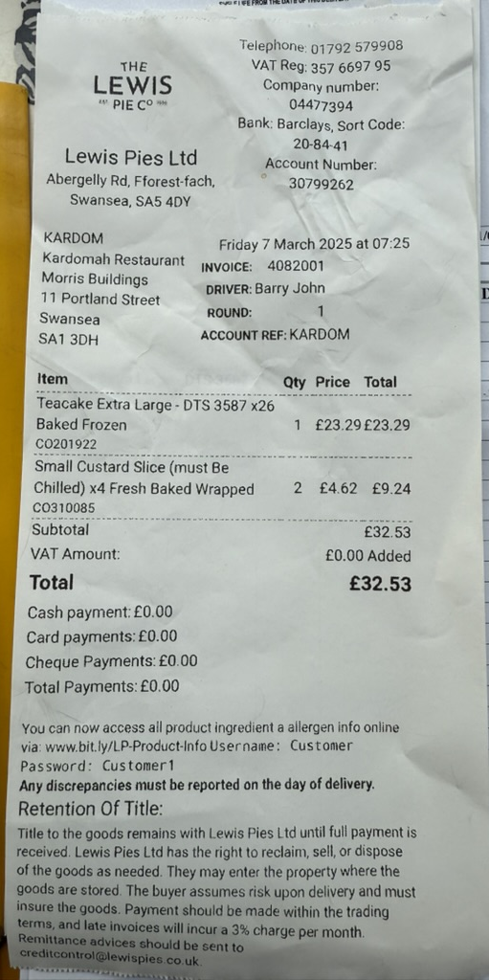
Kardomah

Slide 15
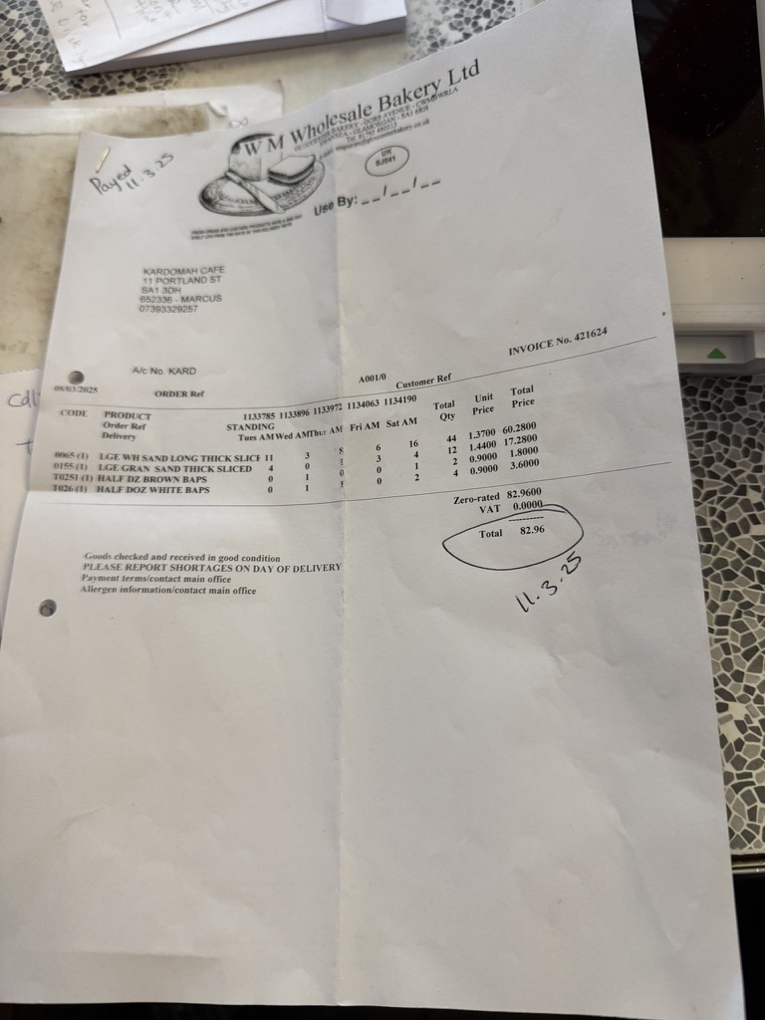
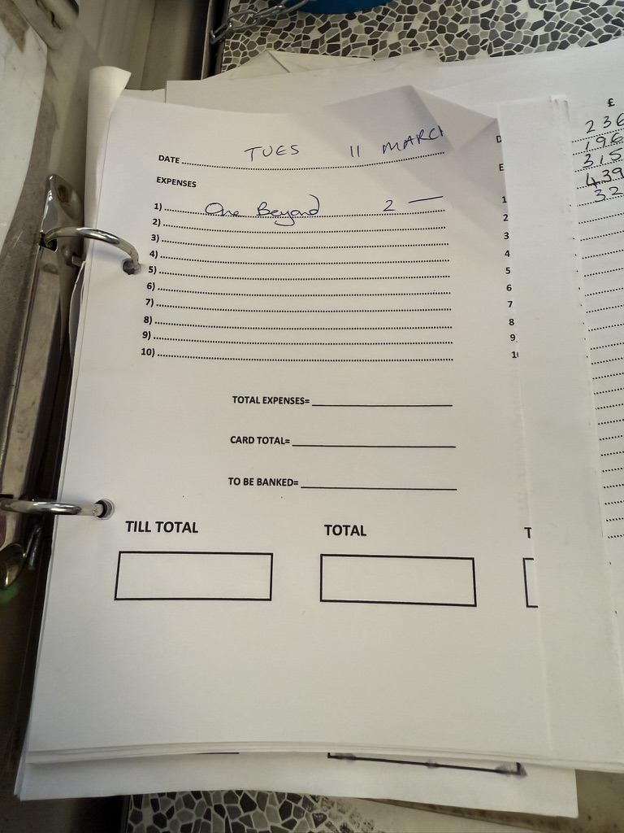
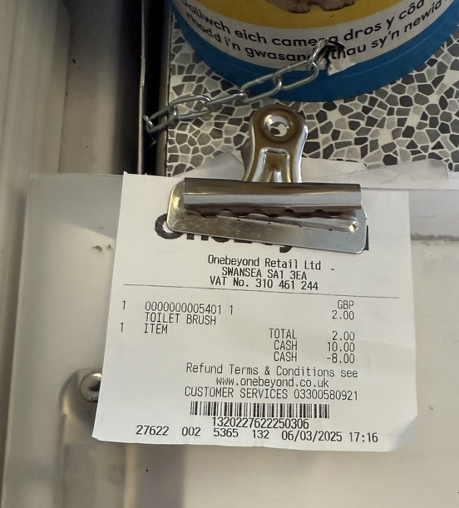
Kardomah

Slide 16
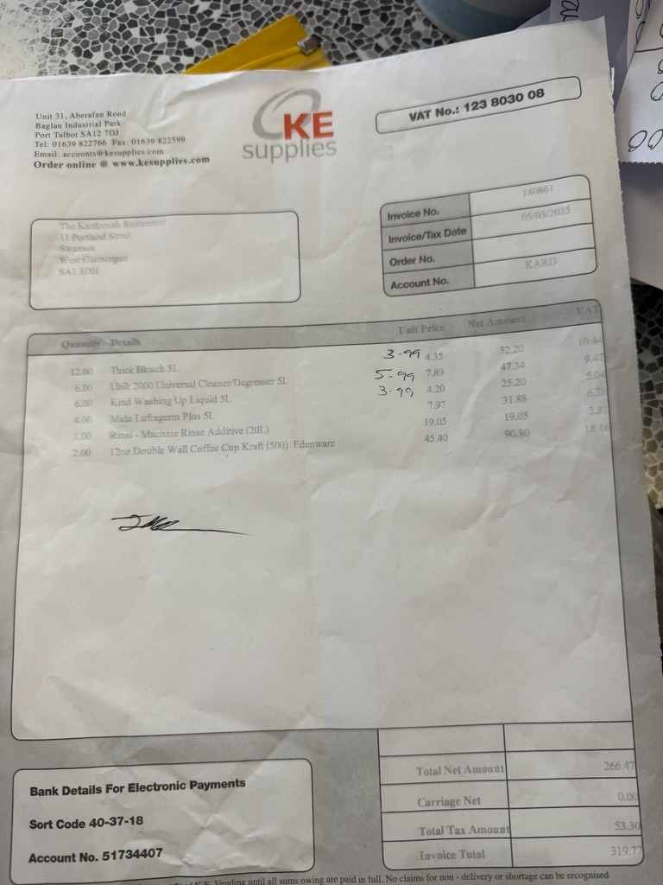
Kardomah

Slide 17

HOW AND ACTIONS WILL BE TOOKEN PLACE DURING THE OPERATION.
Overall, I believe Kardomah should comply with all the relevant laws and strive to better understand its employees. As an established restaurant, it may also benefit from updating some of its services to reduce hazards and incorporating new ideas from the younger generation for future improvements.
Kardomah

Slide 18

Thank You
Any Questions?
Than

Slide 19
References
Kardomah,(n.d) About Us. Available at: https://www.kardomahcafe.com/about-us (Accessed: 13 March 2025).
GOV.UK. (n.d.) Rest breaks at work. Available at: https://www.gov.uk/rest-breaks-work (Accessed: 13 March 2025).
GOV.UK. (2019) Natasha’s legacy becomes law. Available at: https://www.gov.uk/government/news/natashas-legacy-becomes-law (Accessed: 13 March 2025).
Cobain, L. (2024) I was burned by a hot drink, can I claim? LegalExpert. Available at: https://www.legalexpert.co.uk/how-to-claim/scalded-burn-injuries-caused-by-a-hot-drink-claims/ (Accessed: 13 March 2025).
Riis, J. (2014) ‘Opportunities and barriers for smaller portions in food service: lessons from marketing and behavioural economics’, International Journal of Obesity, 38(Suppl 1), pp. S19–S23. Available at: https://pmc.ncbi.nlm.nih.gov/articles/PMC4105577/ (Accessed: 13 March 2025).
Malik, X., Smith, L., Stewart, I. and Burnett, N. (2024) Food waste in the UK. House of Commons Library. Available at: https://researchbriefings.files.parliament.uk/documents/CBP-7552/CBP-7552.pdf (Accessed: 13 March 2025)

Slide 20
References
WRAP (n.d.) Action on food waste. Available at: https://www.wrap.ngo/taking-action/food-drink/actions/action-on-food-waste (Accessed: 13 March 2025).
Worldpay (2025) Worldpay corporate website. Available at: https://corporate.worldpay.com (Accessed: 13 March 2025).

