Slide 1
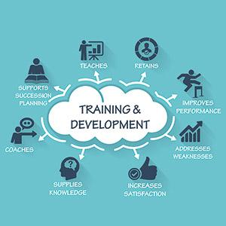
Training and Development
TESCO

Slide 2
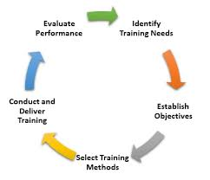
Difference between training and development (Definitions)
Training:
  Upgrades and enhances the skill set of employees.
  Activity that is designed to improvise the ability of employees or individuals that enables the organisation meets its objectives (Noe and Kodwani, 2018)
Development:
  The overall growth of individuals or employees in respect all the needed aspects.
  A systematic procedure that is handled by the management to upscale the concepts for the employees within the organisation (Salas et al., 2012)
Notes:
As per the viewpoint of Noe and Kodwani (2018), training is the process of upgrading and enhancing the capabilities, skills and knowledge of an individual as per the needs that is beneficial in both present and future conditions. On the other hand, the term development in an organisation elucidates the growth of individuals in all aspects. Identically, the article of Key Differences (2015) poised that the term training is elucidated as a learning process wherein the employees are provided with an opportunity to develop a various set of skills, knowledge and competency as per their job roles within the organisation. While on the contrary, the development is considered as an educational process that is comprised of the fact of enhancing the overall growth of the employees within an organisation. Similarly as poised by Salas et al. (2012), training is defined as learning with an earning that gives opportunities for the individuals or the employees in an organisation to upscale their skills and key capabilities that are beneficial in enhancing their job role in the workplace. On the other hand, development is a systematic procedure that is taken in the account by the management in order to enhance the conceptual and theoretical approaches of individuals or employees in an organisation.

Slide 3
Differences between training and devlopment
Training: | Development:
Short term process | Long term process
Focuses on the present situations | Focuses on the future aspects
Orientation towards the job | Orientation towards the career
Employees are motivated for the upscale from trainer | Self-motivated employees
Objective: Improvise the performances of the employees | Objective: Preparation for the future challenges
Aim: Related to the job roles | Aim: Related to the general knowledge
Scope: Limited | Scope: Comparatively wider
Notes:
The training process is comparatively shorter to the development activities within an organisation. The development activities are majorly focused on the intention of future growth, whereas the training programs have the intention to focus on the illuminating the results based on the present situations. Moreover, the training programs in an organisation are dependent on the deficiency of the skills in an employee, whereas the development is entirely dependent on the backed ambitious and personal drive of the organisation in aiming high towards the success (McDowall and Saunders, 2010).
The training programs attain various benefits in an organisation namely increase in the productivity, enhanced efficacy, increased profitability, enhanced organisation reputation, greater flexibility, enhanced multi-skilling in employees, improvised morale, decreased employee turnover, enhanced confidence and improvised the work quality. On the other hand, development activities poise various advantages namely increase in innovation, enhanced corporate image, increased capacities, improvised organisational culture, improvised morale of the organisation and optimum utilisation of human resources within the workplace (Kumar and Siddika, 2017).
In the training programs, the employees are motivated to upscale their exiting skills and capabilities within the organisation by the trainers, whereas the in the development process the employees are self-motivated that directs themselves towards the future assignments and cumulatively focus on enhancing the success of the organisation. The scope of training is limited as compared to the development as it poses a wider range. Moreover, the aim of training programs are inclined with enhancing the skill set that is related to the employee’s job roles, whereas the development is aimed at enhancing the conceptual, theoretical and general insights of all the involved employees in an organisation (Key Differences, 2015).

Slide 4
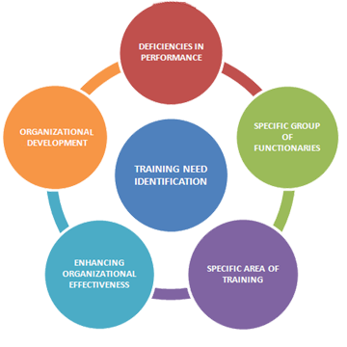
Changes in customer expectations affecting Tesco and their need to train staff
Changing expectations of the consumers’ towards “one-stop shopping” concepts
Addressing the changes in consumer’s expectations by widening the skill set of employees.
Opening new stores in new locations in order to adapt to the changes in expectations and demands made by the consumers (Allcott, 2011)
Notes:
As poised by Priporas, Stylos and Fotiadis (2017), consumers are one of the vital entities for the business prospects in the market, thus, their expectations create a larger effect and gain an ability to change the existing business strategy of the organisations. In the current market, the expectations of the consumers have combatively changed to ‘one-stop shopping’ concepts. In the case of Tesco, the organisation has a diverse range of products and services namely general and grocery stores, electrical goods, banking services, airtime, insurance services and telephone services. Thus, this approach gives an opportunity for the consumers to shop their needs and expectations at one place (The Times, n.d).
The consumers’ expectations are mainly divided under liking and disliking of services and products, healthy and secured environment and addressing the demands on time (Allcott, 2011). In the case of Tesco, addressing the constant changes in consumers’ needs and expectation affected in terms of widening the skill set of the employees in terms of being flexible and productive within the workplace. Tesco aims at expanding the organisations and employing the right employees for the right place. Thus, the opening of new stores in highly populated areas needs to focus on the consumers’ requirement; thus, having a clear understanding of the consumer profile is one of the important criteria to generate the training for the staff. Tesco also focuses on developing the competencies and technical skills within the employees that are beneficial in both in-store and non-store aspects and helps in addressing the consumer’s expectations (The Times, n.d).

Slide 5
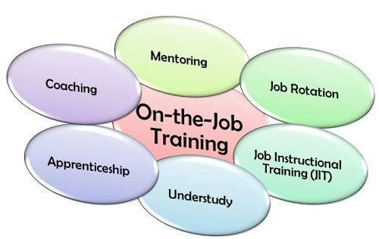
Tesco’s methods of developing their employees including the strengths and weaknesses
Training methods used by Tesco
  On-the job training: Mentoring, Coaching, Shadowing and Job rotation or secondment (Anam Amin and Lodhi, 2013)
  Off-the job training: External courses
Strengths:
  Gain skills and improvise the capabilities and productivity
  Increases the positive approach of employees at work
  Inspires to be more innovative and motivated
Weaknesses:
  Requirement of resources and funds to pull off the development programs.
Notes:
Tesco’s approach towards developing their employees is mainly comprised of being flexible, structured and inclined with the needs and expectation of the employees. This approach helps the employees to identify their strengths and weakness in the workplace and indulge in the training and development programs in order to improvise the weaknesses and enhance their strengths. Tesco uses two training methods namely on the job and off the job training methods (The Times, n.d). On the job training method is one of the most common methods used by the organisations in which a trainee is appointed for a specific job role and teach the skills, capabilities and knowledge for the necessary individuals or the employees in order to enhance their performances within the organisation. On the other hand, off the job training method attains limitations and are mostly adopted in order to enhance the development of the employees within the organisation (Anam Amin and Lodhi, 2013).
Under the on-the-job training method, Tesco uses shadowing, coaching, mentoring and secondment for the development of the employees in the organisation (The Times, n.d). Shadowing refers to qualified individuals that teach other employees with the procedure to execute the activities. Coaching refers to a designated colleague that helps the trainees with the solutions to power through the problems and inspires them constantly within the organisation. Mentoring elucidates the experienced member within the organisation that acts as an adviser for all the employees. Job rotation or secondment refers to the movement of the trainee from one job role to another in order to gain distinct experiences and capabilities within the organisation. This method helps in understanding the deficiency of the employees that need to be worked on in the organisation (Vasanthi and Basariya, 2019; The Times, n.d).
On the other hand, under the off-the-job training method, Tesco uses the help of external courses from the qualified experts of Tesco or the external professional training organisations in order to understand the strengths and weaknesses of the employees and enhance them accordingly (The Times, n.d).
Strengths and Weaknesses:
The training and development programs of Tesco helps the employees impart various skills and improvise their capabilities within the organisation. Tesco helps the employees to be more productive, positive, innovative, creative and motivated in the work environment. Thus, in order to maintain the strengths of the employees, development programs play a major role and help in bringing out the efficiency of the organisation (The Times, n.d). Moreover, in order to initiate various development programs, Tesco requires resources, investments and funds that are in turn very difficult to manage. Thus, it acts as a weakness in bringing out the development of the employees within the organisation (Awadari and Kanwal, 2019).

Slide 6
Tesco’s training program
Training Programs:
  Structured approach
  Flexible approach
  Induction training
  Informal approach of development
  360-degree appraisal
  Colour coded development rating (The Times, n.d).
Notes:
Tesco has a structured, flexile and informal approach in development programs that helps the organisation to develop the needed set of skills and capabilities in the employees within the workplace. The focus of the structured approach is to gain the business objectives, growth and profit within the competitive market. Tesco also uses the methodology of 360-degree appraisal wherein all the stakeholders are contacted with the employees in order to assess the performances and give the respective feedback. In the context of informal approach, the organisation provides as opportunity for the employees to write down three believable things that there are perfect at and three things which they lack in. Furthermore, Tesco uses the colour coded rating system namely red, blue, amber and green in order to provide the feedback for the employees. Moreover, Tesco in their development programs use the Activity Plans for the employees that helps them to evaluate the Specific, Measurable, Achievable, Realistic and Time-framed (SMART objectives) outcomes that needs to be worked on or to be improvised (The Times, n.d).

Slide 7
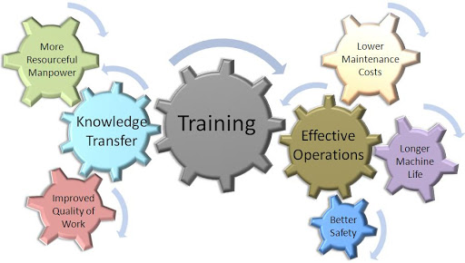
Benefits of Tesco’s training programs in terms of return on investing in training
  Enhanced quality of the products and services
  Ready to deal with all the present and upcoming situations with the help of upgraded skills, capabilities and knowledge of the employees within the organisation
  Identification of the areas that need further development
  Establishes a strong foundation for its continuous growth in the market (Helbach et al., 2020)
Notes:
The structured and flexible approaches are one of the effective methods in increasing the business prospects with the outcome of improvised quality from the organisations to the consumers (Helbach et al., 2020). Similarly, Tesco using the structured and flexible approaches helped them to enhance their business prospect in the market and deliver an improvised quality of services and products for the consumers. Moreover, the training and development programs benefitted Tesco increase the productivity, efficiency and innovative approaches within the workplace. As a return of investing, Tesco is in the position to deal with any kind of present and upcoming situations with the help of an employee’s skill set. Furthermore, use of informal development approaches, 360-degree appraisal, colour-coded feedback rating systems and Activity plans in terms of SMART objectives helped the organisation to track the development and lay the strong foundation for its continuing growth (The Times, n.d).

Slide 8
Presentation recording link
https://web.microsoftstream.com/video/e6b73e0a-e66b-40c5-ba67-64923ecb9851

Slide 9
References
Allcott, H. 2011. Consumers' perceptions and misperceptions of energy costs. American Economic Review 101(3), pp. 98-104.
Anam Amin, R.S. and Lodhi, M.R.N. 2013. The impact of employees training on the job performance in education sector of Pakistan. Middle-East Journal of scientific research 17(9), pp. 1273-1278.
Awadari, A.C. and Kanwal, S. 2019. Employee participation in organizational change: A case of Tesco PLC. International Journal of Financial, Accounting, and Management 1(2), pp. 91-99.
Helbach, M.V., van Oostendorp, S.E., Koedam, T.W.A., Knol, J.J., Stockmann, H.B.A.C., Oosterling, S.J., Vuylsteke, R.C.L.M., de Graaf, E.J.R., Doornebosch, P.G., Hompes, R. and Bonjer, H.J. 2020. Structured training pathway and proctoring; multicenter results of the implementation of transanal total mesorectal excision (TaTME) in the Netherlands. Surgical Endoscopy 34(1), pp. 192-201.
Key Differences. 2015. Differences between Training and Development. [Online]. Available at: https://keydifferences.com/difference-between-training-and-development.html [Accessed on: 20 November 2020].

Slide 10
Continued
Kumar, D. and Siddika, H. 2017. Benefits of Training and Development Program on Employees’ Performance: A Study with Special Reference to Banking Sector in Bangladesh. International Journal of Research–Granthaalayah 5(12), pp. 77-88.
McDowall, A. and Saunders, M. 2010. UK managers’ conceptions of training and development. European Journal of Industrial Training 34(7), pp. 609-630.
Noe, R.A. and Kodwani, A.D. 2018. Employee training and development, 7e. McGraw-Hill Education.
Priporas, C.V., Stylos, N. and Fotiadis, A.K. 2017. Generation Z consumers' expectations of interactions in smart retailing: A future agenda. Computers in Human Behavior 77, pp. 374-381.
Salas, E., Tannenbaum, S.I., Kraiger, K. and Smith-Jentsch, K.A. 2012. The science of training and development in organizations: What matters in practice. Psychological science in the public interest 13(2), pp. 74-101.
The Times. n.d. How training and development supports business growth. TESCO, pp. 153-156.
Vasanthi, S. and Basariya, S.R. 2019. On The Job Training Imlementation And Its Benefits. International Journal of Research and Analytical Reviews (IJRAR) 6(1), pp. 210-215.

