Slide 1
Old Age
ECED7005
Sharon Cole MA

Slide 2
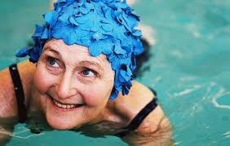
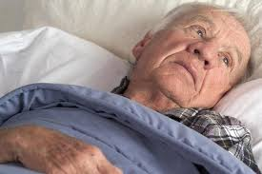
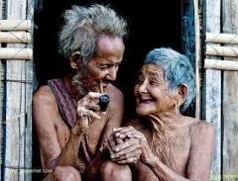
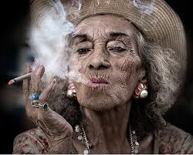
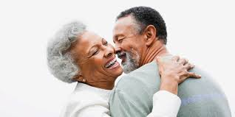
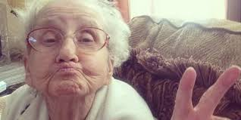
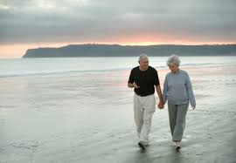
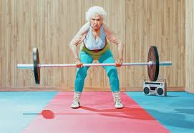
A Thought……
What do you envisage your life to be like when you are 75 years old? 85 years old? 95 years old?

Slide 3
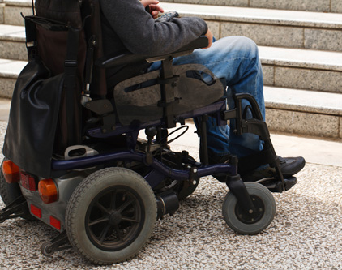
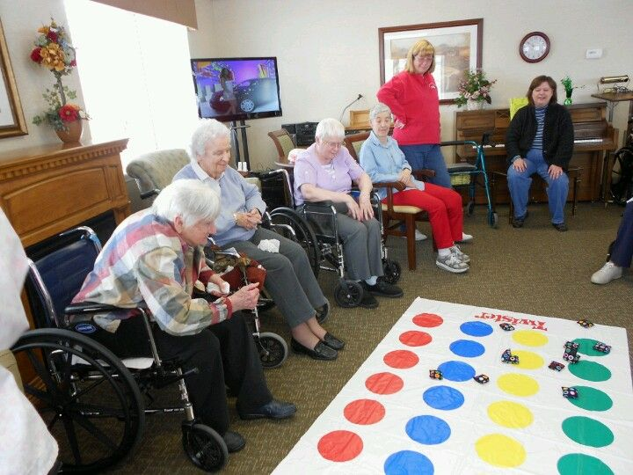
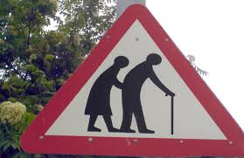
What Could be the Barriers to Your Aspirations?

Slide 4
Things to Think About . . .
An ageing population
Living at home versus residential provision
Informal versus formal care
Elderly neglect/abuse
Choices and Dignity
Financial Provision
Policies/Strategies/Frameworks
Evaluating Practice
Theories
Research
Current issues since Covid 19

Slide 5
How Would You Define Old Age?

Slide 6
How Would You Define Old Age?
Chronological age?
Biological age?
Attitudes and levels of activity?
Economic activity and retirement?
Capacity to look after yourself?

Slide 7
Defining Old Age
Social Ageing –
‘The norms, values and roles that are culturally associated with a particular chronological age’. (Giddens & Sutton, 2017)

Slide 8
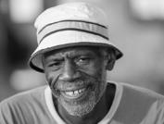
Old Age?
Definitions:
  Not universal…..
  Western cultures tend to refer to people 65years +
  Eligibility for statutory and occupational retirement pensions has become the default definition

Slide 9
Definitions of Old Age
Generally, someone over the age of 65 might be considered an older person. However, it is not easy to apply a strict definition because people can biologically age at different rates so, for example, someone aged 75 may be healthier than someone aged 60.
(NHS, 2020)

Slide 10
When Does Old Age Begin?
In terms of working patterns, age 65 years as the start of older age is out of date. There is no longer an official retirement age, State Pension age is rising, and increasing numbers of people work past the age of 65 years.
People are also living longer, healthier lives. In 2018, a man aged 65 could expect to live for another 18.6 years, while a woman could expect to live for 21 more years. So, on average, at age 65 years, women still have a quarter of their lives left to live and men just over one fifth.
(ONS, 2019)

Slide 11
Meanings of Old Age
Other socially constructed meanings of age are significant such as;
  The roles assigned to older people;
  In some cases it is the loss of roles accompanying physical decline which is significant in defining old age.
  The chronological milestones which mark life stages in the developed world,
  Old age in many developing countries is seen to begin at the point when active contribution is no longer possible.’

Slide 12
Definition of Ageing: a Global Context
‘The ageing process is a biological reality which has its own dynamic, largely beyond human control… subject to the constructions by which each society makes sense of old age.
In the developed world, chronological… age of 60 or 65, [is] roughly equivalent to retirement ages…[and] is said to be the beginning of old age. In many parts of the developing world, chronological time has little or no importance in the meaning of old age’ (WHO, 2002)

Slide 13
Can you Think of different ways that Old Age is Perceived in Other Cultures?
Discuss…

Slide 14
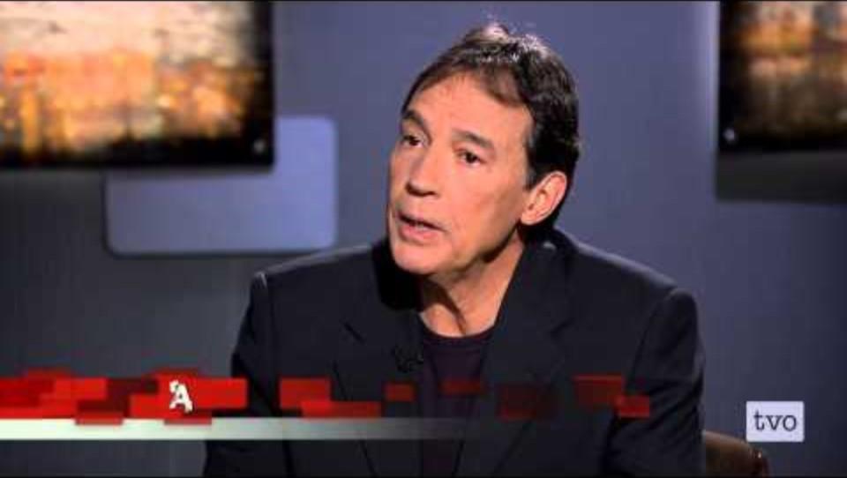
Biocognitive Science

Slide 15
So, When are you Considered Old?
The World Health Organisation believes that most developed world countries characterise old age starting at 60 years and above.
However, this definition isn’t adaptable to a place like Africa, where the more traditional definition of an elder, or elderly person, starts between 50 to 65 years of age

Slide 16
So, When are you Considered Old?
The World Economic Forum (WEF) has recently defined old age through a new measure called “prospective age” which looks at the average number of years people have left to live. So according to WEF, being old doesn’t start at age 65, rather when people have an average of 15 more years left to live
(WEF, 2015)

Slide 17
What age is considered “old” in other countries?
Most of Europe have similar views of old age to the World Health Organisation, believing old age starts at 65 years of age.
In America, one researcher found that you are considered old at 70 to 71 years of age for men and 73 to 73 for women.
Just under a decade ago in Britain, people believed old age started at 59. However, research undertaken in 2018 found that British people believed you were considered old at 70
(Aged Care Guide, 2020)

Slide 18
What age is considered “old” in other countries?
A decade ago, Turkey considered 55 the beginning of old age, because the country’s average life expectancy at the time was 72. Now, however, with an unexpected boom in people over the age of 65, you are considered old when you reach the age of 70.
In China, the retirement age is 60 for men and 50 for female workers, or for female civil servants, 55. China’s retirement age is considered one of the bigger gaps in retirement age.
Whereas, India has one of the lowest retirement ages in Asia, with 58 considered the age to retire.
(Aged Care Guide, 2020)

Slide 19
African Example
The more traditional African definitions of an elder or 'elderly' person correlate with the chronological ages of 50 to 65 years, depending on the setting, the region and the country.
Birthdates are quite often unknown because many individuals in Africa do not have an official record of their birthdate.
In addition, chronological or "official" definitions of ageing can differ widely from traditional or community understandings of when a person is older.
So we need to consider cultural factors too!
Cultural gerontology is a relatively new field in the social study of Old Age
(Hyde and Higgs, 2016)

Slide 20
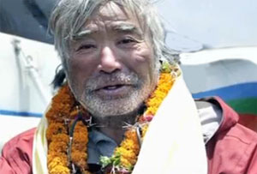
What age is considered “old” in other countries?
The oldest person to climb Mt Everest is Yuichiro Miura of Japan, who reached the summit of Mt Everest in 2013 at age 80

Slide 21
Transitions?
(Rites of Passage)
There are a range of ‘transitions’ across the life course that encompass a range of maturational tasks
These are no easier for older adults to negotiate than for adolescents entering adulthood
(Coleman and Hendry,1999)

Slide 22
Transitions
(Rites of Passage or Life Events)
For an older person what could these be?
Having grandchildren
Retirement
Loss of loved one
Decrease in abilities
Loss of health
Change in appearance
(Robertson, 2014)

Slide 23
To Illustrate…
It is suggested that the dramatic change to an individual’s self identity is no less for the pubescent child discovering pubic hair than for the older adult’s hair turning silver or disappearing altogether!
  Thus the experience of transition as well as the timing vary widely
Many people choose to retire between the age of 50/60, if they can afford to
Others, may have to work beyond the age of 65 years as the retirement age increases

Slide 24
Transition ‘Experiences’
Depend on a Number of Factors
  Social
  Economic
  Personal
What might these be?
Discuss…

Slide 25
Characteristics
of the Elderly Population

Slide 26

Activity…
Look at the document online
What did you find interesting?
What did you find surprising?
https://www.ageuk.org.uk/globalassets/age-uk/documents/reports-and-publications/later_life_uk_factsheet.pdf

Slide 27
Characteristics of the Elderly Population
Gerontology is the scientific study of ageing
Life expectancy increases as a person gets older! Average age is 65, but if you get to 80, then you are likely to live until you are 90!
The UK has an ageing population – the number of people over 90 is set to double by 2025.
There are 14,570 centenarians in the UK, a 65% increase over the last decade. Of these, an estimated 800 are aged 105 and over, double that of 2005
(AgeUK, 2018)

Slide 28
Subgroups
Gerontologists point out that there are important differences in subgroups
  60-75 years are the ‘young’ old
  75- 85 years are the ‘old’ old
  85 + years are the ‘oldest’ old

Slide 29
The Oldest Old
  This last group are more likely to suffer from significant physical and mental impairments that the other groups, thus within this sub-group are the ‘frail elderly’ who are unable to care for themselves
  Statistically this age group continues to grow – worrying demographers and economists who are concerned about the ability of the young and middle aged to support them.

Slide 30
Phil Mullan
The ‘Imaginary Time Bomb’ diffuses the myth that the aging baby-boomer population is producing a downward economic spiral.
He argues that the growing preoccupation with aging has nothing to do with demography in itself and more to do with justifying further reductions of the role of the state in the economy and curbing the welfare state. (Mullan, 2002)

Slide 31
Historical Perspectives on Ageing
We have a rosy view of how we treated our elderly in the past but is this realistic?
Between 1600 and 1800 only 3.4% were over 60
Today more than 18% are over 65!
What are the implications of this on society and the family?
Discuss…

Slide 32
Historical Perspectives on Old Age
In Medieval and Tudor times the elderly in poverty were looked after by the parish
In the early 17th Century the Poor Laws outlined the obligation of family members to care for their elderly relatives although this was rarely enforced
In the 18th and early 19th Century although there was some outdoor relief the majority of elderly people without support or/and in poverty had to enter the workhouse
These were routinely segregated

Slide 33
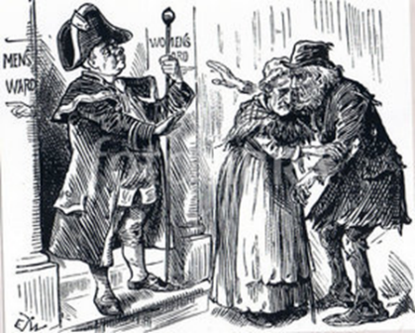
Mr Bumble refusing Darby and-Joan entry to the Workhouse Together

Slide 34
20th Century Perspectives on Ageing
Ageing approached as an individual and social problem (1940s -60s)
Ageing treated as an economic and employment issue (1970s- 80s)
Ageing constructed as a global issue and concern (1990s to present)
(Bond et al, 2007)

Slide 35
20th Century Perspectives on Ageing
Ageing approached as an individual and social problem (1940s -60s)
Ageing treated as an economic and employment issue (1970s- 80s)
Ageing constructed as a global issue and concern (1990s to present)
(Bond et al, 2007)

Slide 36
How Media and Modern Society Portray Older People
The perception in our media, whether that is film, television, books or news, seem to continue perpetuating ageist stereotypes.
One of the biggest is around computer literacy. Whilst the perception is the older you are the less familiar you'll be with modern technology, a large portion of older people are able to use computers and quite well.
(Aged Care Guide, 2020)

Slide 37
How Media and Modern Society Portray Older People
A large number of YouTube consumers are retirees with around 36 percent of users clicking on the plethora of free entertainment and informational videos.
Additionally, one of Facebook’s biggest demographics are people over the age of 50. It’s the most commonly used social media by older people
(Aged Care Guide, 2020)

Slide 38
How Media and Modern Society Portray Older People
Dementia is nothing to joke about. However, many jokes in the media we consume poke fun at older adults and their memory loss.
Along with perceptions of older people having memory loss, is the continued stereotype of older adults being mean and rude
(Aged Care Guide, 2020)

Slide 39
You’re Only as Old as you Feel
Depending on who you ask, the definition of what old is can differ depending on opinion and the age of the person being asked.
Searching for what is considered “old” can seem irrelevant when you will always receive a subjective answer.
(Aged Care Guide, 2020)

Slide 40
You’re Only as Old as you Feel
These days it seems age has become just a number, and it’s more about how you are feeling physically and mentally which determines whether you are old.
(Aged Care Guide, 2020)

Slide 41
You’re Only as Old as you Feel
If a 95 year old Finnish woman can be one of the oldest person to bungee jump, or a 80 year old can be the oldest person to reach the summit of Mount Everest even after four open-heart surgeries and suffering a shattered pelvis, who really gets to decide if you are too old to do something?
(Aged Care Guide, 2020)

Slide 42
Life Course Changes in the Elderly
What are these?
Discuss…

Slide 43
Life Course Changes in the Elderly
  Appearance
  Physical
  Biological
  Cognitive
  Social

Slide 44
Physical
Brain and the nervous system
  Slowing down
  Sleeping and eating patterns
  Motor function
Vision – field of vision deteriorates
Hearing – deteriorates, discrimination of sounds becomes more difficult
(Saxon, Etten and Perkins, 2015)

Slide 45
Physical
Brain and the nervous system
Senses - Taste, smell and touch – as one gets older the loss of these senses may impact on nutrition and safety.
Motor function – gross and fine skills - reduction in stamina, dexterity and balance
Sexual activity
(Saxon, Etten and Perkins, 2015)

Slide 46
Biological
  Although ageing is not itself a disease, it carries with it with an increased risk of many life-threatening diseases and shares several biological mechanisms that are important in the development of chronic diseases, such as heart disease, diabetes and dementia.
  Thus, if ageing can be delayed it should also be possible to also delay the development of disease, increasing longevity and minimising poor health in old age.
(British Society for Research on Ageing, 2020)

Slide 47
Biological
Disease including
Dementia
Parkinsons
Heart Disease
(Ryan and Coughlan, 2013)

Slide 48
Mental Health Problems including…
Depression
Helplessness
Suicide…
(NHS England, 2017)

Slide 49
Mental Health Problems including…
Depression
Helplessness
Suicide…
(NHS England, 2017)

Slide 50
Cognitive
Memory
  Becoming more forgetful
  Short-term memory malfunction
  Long term memory not impaired – may even improve
(Coleman and O’Hanlon, 2017)

Slide 51
Cognitive
  Positive Changes
  Wisdom – accumulative knowledge
  Creativity – particularly in areas such as music
  ‘Ordinary’ people, because they have more knowledge can become more creative
(Coleman and O’Hanlon, 2017)

Slide 52
Why do We Age?
Most likely explanations…
  Genetically programmed ‘programmed senescent theory’ suggests that age related physical declines result from species-specific genes for aging.
  Evolutionary theorists are that the decline occurs to prevent older people procreating and then being unable to raise children to maturity – thus we have a ‘built-in aging clock’ that switches on when we are past reproductive peak
  Research also suggests that body cells’ ability to repair breaks in DNA and over time this accumulates and function decreases causing aging.
  (Arking, 2006)

Slide 53
Health and Well-being
Women live longer than men, (in 2016 the figures were 82.9 years for women and 79.2 years for men)
Women are more likely to have more years in poor health than men (19 years for females, 16.1 for males)
Key factor in health tends to be SES (socio-economic status)
(GOV.UK, 2017; ONS, 2015)

Slide 54
Long-Term Limiting Illness
40% of all people aged 65+ have a limiting longstanding illness
If nothing is done about age-related disease, there will be over 6.25 million older people with a long-term limiting illness or disability by 2030: nearly 9% of the total population.
Almost two thirds (59%) of people aged 80 and over in the UK have an [age related] disability.
(AgeUK, 2018)

Slide 55
Health and Social Care

Slide 56
Health and Social Care
As we get older, general health declines, use of health services increases
12% of those over 65 receive home-care
There are more than 400,000 older people in residential care in the UK
Older people, particularly women, provide the majority of unpaid care
(AgeUK, 2018a)

Slide 57
Health and Social Care:
What Do We Need to Think About?
What do we mean by this term?
What support do we provide for the elderly?
Are there barriers in terms of age discrimination in terms of employment, lifestyle?
Is there age discrimination in terms of health provision and/or care provision?
What changes have taken place in terms of caring for the old and infirm?
If, as is widely reported, the ageing population is a financial ‘time bomb’ what may happen to services for the elderly infirm?

Slide 58
Theories of Ageing
Disengagement Theory
Activity Theory
Continuity Theory
Social Breakdown Reconstruction Theory
Modernization Theory
Gerotranscendence
Symbolic Interaction

Slide 59
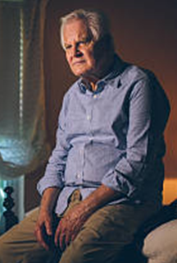
Disengagement Theory
As older adults slow down, they gradually withdraw from society.
Disengagement is a mutual activity in which the elderly not only disengages from the society, but the society disengages from the older adult.
The elderly develop greater self-preoccupation and decrease emotional ties with people and reduce interest in social activities. Such social withdrawal and increased self-absorption was thought to increase life satisfaction among them
(Larkin, 2009)

Slide 60
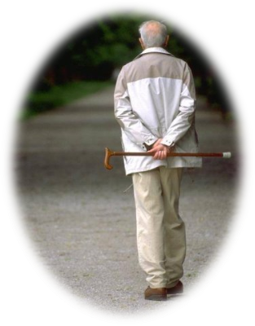
Disengagement Theory
Looks at old age as a time when both the older person and society engage in mutual separation (e.g., retirement from work)
One of the earliest attempts to explain old age in modern society
Doesn’t always refer to the outward behaviour of people – can mean an inner attitude toward life
(Larkin, 2009)

Slide 61
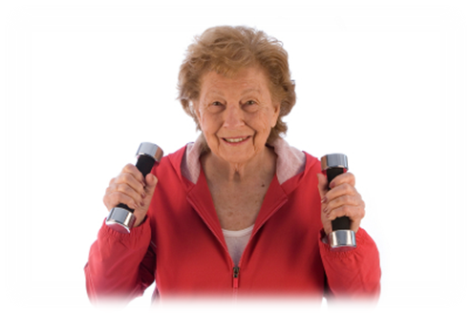
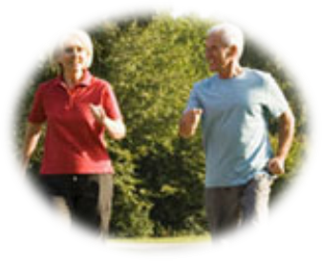
Activity Theory
Opposite view of Disengagement Theory
The more active and involved the elderly are, the more likely that they are satisfied with their lives.
It is therefore important to find substitute activities for them after their retirement.
Argues that the more active people are, the more likely they are to age successfully

Slide 62

Activity Theory
May be difficult for “old-old” people because of physical changes associated with ageing
fails to take into consideration that there may be constraints that prevent older people engaging in activities, such as a lack of social or economic resources
Formulated as a direct response to the disengagement theory

Slide 63

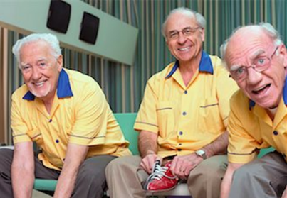
Continuity Theory
Claims that people who grow older are inclined to maintain as much as they can of the same habits, personality, and style of life they developed in earlier years
Similar to Activity Theory in believing that decreases in social interaction are better explained by poor health or disability, rather than some functional need of society to “disengage” older people from their previous roles (Wang, 2012)

Slide 64



Gerotranscendence
Gerotranscendence- Elderly become less self-centred, let go of conflict and feel more peaceful and connected to the world
There is a positive relationship between gerotranscendence and life satisfaction
Studies have also attested the fact that people who find meaning in life tend to experience better physical health
(Tornstam, 1994)

Slide 65
Policies
Human Rights Act (1998) (not ratified by the USA or the Soviet Union
The Equality Act (2010)
Social Services and Well-being (Wales) Act 2014
The Care Act (2014)
NHS policy- National and Regional

Slide 66
Barriers to Equality for Older People
What could these be?
Discuss…

Slide 67
Barriers to Equality for Older People
Ageism
Discrimination
Labelling
Societal Perception (media?)
Self Perception (self fulfilling prophecy)
Physical Health/ Cognitive Decline
Elder Abuse

Slide 68
Ageism and Older People
Ageist stereotypes in the media and advertising
Digital exclusion
Equality law and enforceability of older people’s rights
The Rights of Older People, 2025
https://committees.parliament.uk/publications/46686/documents/239426/default/

Slide 69
Something to Think About…
What is ‘Old Age’?
Is ‘old age’ as we know it a valid concept?
Is it Socially Constructed?

Slide 70
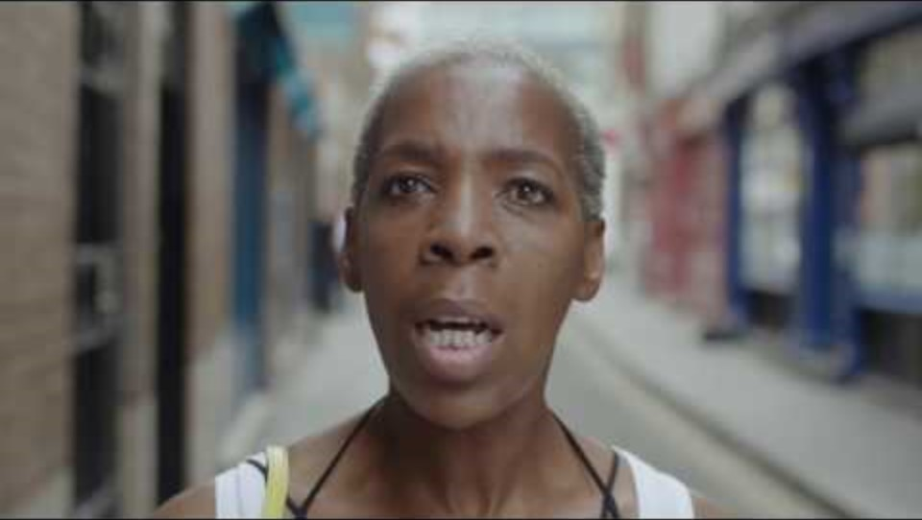

Slide 71
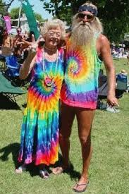
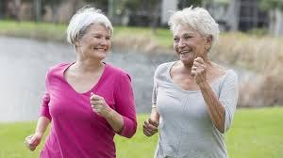
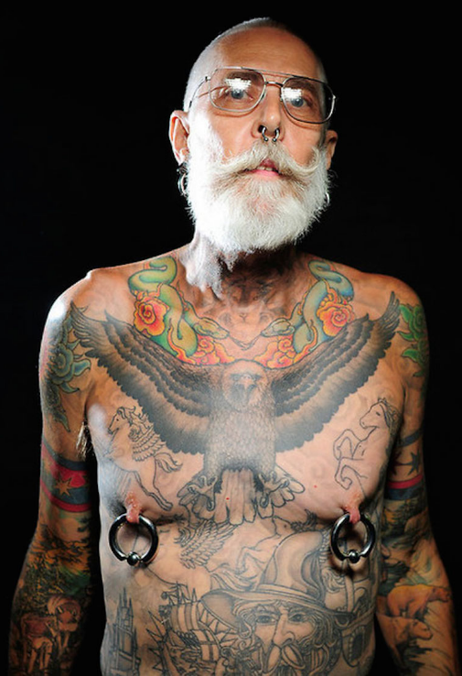
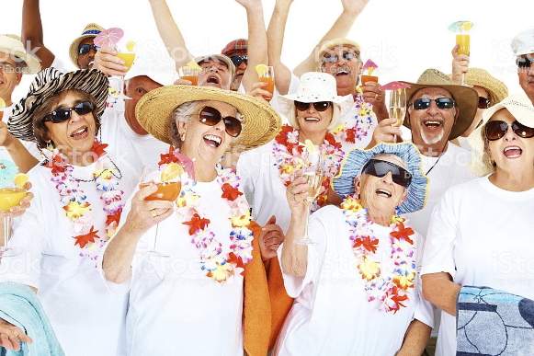
Do these people look as if they are going to die any time soon?

Slide 72
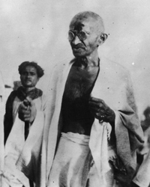
A 200 kms three week long walk at the age of 61 is not impossible for the fight for freedom.

Slide 73
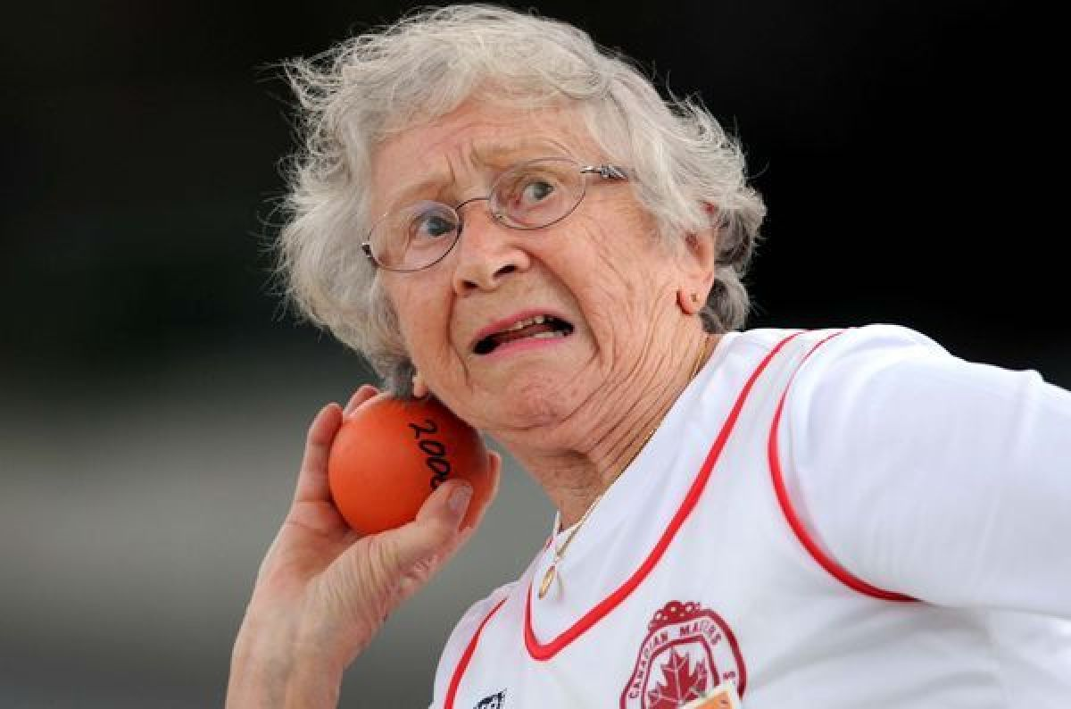
Who says I can’t play?
Olga Koto , 92
Super Athlete

Slide 74
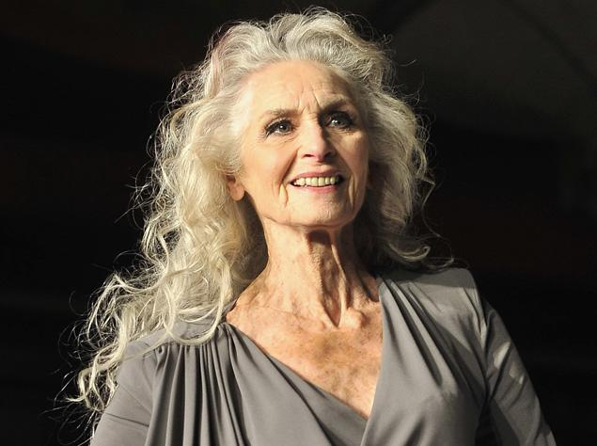
Daphne Selfe 90, Worlds Oldest Supermodel

Slide 75
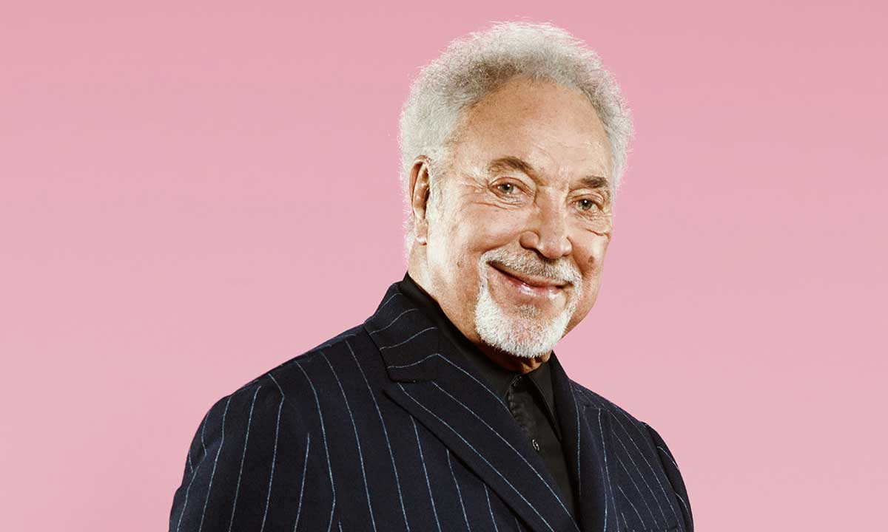
Tom Jones
King of Wales

Slide 76
References
Aged Care Guide (2020) What Age is Considered Old? Available at https://www.agedcareguide.com.au/talking-aged-care/what-age-is-considered-old (Accessed: 23 February 2021).
AgeUK. (2018) Later Life in the United Kingdom Available at: https://www.ageuk.org.uk/globalassets/age-uk/documents/reports-and-publications/later_life_uk_factsheet.pdf (Accessed: 17 March 2021).
Arking, R. (2006) Biology of Aging: Observations and Principles. 3rd edn. Oxford: OUP
Bond, J., Peace, SM., Dittmann-Kohli, F. and Westerhof, G.(eds.) (2007) Ageing in Society: European Perspectives on Gerontology London: Sage Publishing Ltd.
British Society for Research on Ageing (2020) About Ageing. Available at: https://bsra.org.uk/about-ageing/ (Accessed: 12 January 2021).
Coleman, J. and Hendry, L. (1999) The Nature of Adolescence, London: Routledge.
Coleman, P. and O’Hanlon, A. (2017) Aging and Development: Social and Emotional Perspectives 2nd edn. Oxon: Routledge.
Hyde, M., and Higgs, P. (2016). Ageing and Globalisation, Bristol: Policy Press.
Larkin, M. (2009) Vulnerable Groups in Health and Social Care. London: Sage Publications Ltd.
Maulk, K. (2010) Gerontological Nursing: Competencies for Care 2nd edn. London: Jones and Bartlett Publishers International.

Slide 77
References
Mullen, P. (2002) The Imaginary Time Bomb: Why an Ageing Population is Not a Social Problem, London: I.B.Tauris.
NHS, (2020) Improving Care for Older People. Available at: https://www.england.nhs.uk/ourwork/clinical-policy/older-people/improving-care-for-older-people/ (Accessed: 17 February 2021).
NHS England. (2017) Mental Health in Older People: A Practice Primer Available at: https://www.england.nhs.uk/wp-content/uploads/2017/09/practice-primer.pdf (Accessed: 18 December 2020).
ONS, (2019) Living Longer: Is 70 the New Age 65? Available at: https://www.ons.gov.uk/peoplepopulationandcommunity/birthsdeathsandmarriages/ageing/articles/livinglongerisage70thenewage65/2019-11-19 (Accessed: 12 March 2021).
Robertson, G. (2014) Transitions in Later Life. Available at: https://transitionsinlaterlife.files.wordpress.com/2014/09/cgf-transitions-in-later-life-guy-robertson.pdf (Accessed: 14 March 2021).
Ryan, P. and Coughlan, P.J. (eds) (2013) Ageing and Older Adult Mental Health: Issues and Implications for Practice London: Routledge.
Saxon, S.V., Etten, M.J. and Perkins, A.E. (2015) Physical Change and Aging, 6th edn: A Guide for the Helping Professions New York: Springer Publishing Company.
Tornstam, L. (1994). Gerotranscendence - a Theo­retical and Empirical Explora­tion. Westport: Green­wood
WEF (2015) What is Old Age? Available at: https://www.weforum.org/agenda/2015/04/what-is-old-age/ (Accessed: 12 March 2021).

