Slide 1
Explosive materials
Acda6020
e.kazimierska@uwtsd.ac.uk

Slide 2
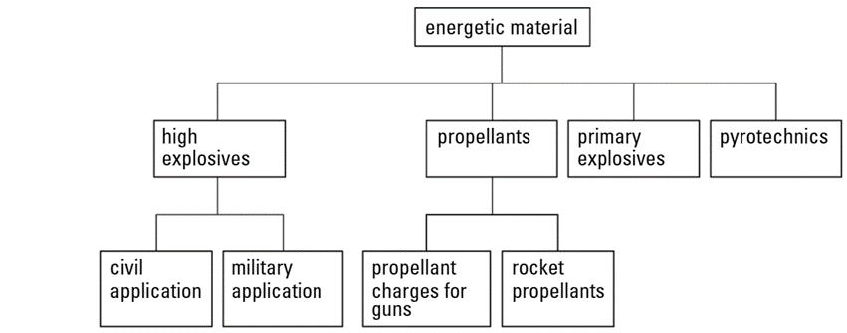
Classification of energetic materials
https://librarysearch.uwtsd.ac.uk/discovery/fulldisplay?docid=alma99100481302302421&context=L&vid=44WHELF_UWTSD:44WHELF_UWTSD_VU1&lang=en&search_scope=MyInst_and_CI&adaptor=Local%20Search%20Engine&isFrbr=true&tab=Everything&query=any,contains,akhavan

Slide 3
Students’ work
In groups of three, prepare 15 min ppt presentation about:
Primary and secondary explosives | propellants | pyrotechnics
Group 1: Pete, Jake, Ryan | Group 2: Josh Evans, Anna, Will | Group 3: Josh Ede, Sam, Stan
What are explosives in general and what are their applications in various industries. What are primary and secondary explosives specifically (PEs and SEs). Characteristics of PEs and SEs (sensitivity, stability, ease of initiation, briance, etc) Examples (describe some ) Role of PEs in initiating explosive reactions. Role of SEs in propagating explosive reactions Highlight the main differences between PEs and SEs Safety Regulatory controls Prevention of misuse Environmental impact | What are propellants? Types and applications of propellants Rockets and firearms Chemical and solid propellants. How they produce thrust Safety Regulatory controls Prevention of misuse Environmental impact | What are pyrotechnics and how do they work Types of pyrotechnic effects and applications Pyrotechnics safety Regulatory controls Prevention of misuse Environmental impact

