Slide 1
CLAH4005
The Persian Wars II

Slide 2
Empires and expansion

Slide 3
Kroisos of Lydia
Croesus was a Lydian by birth, son of Alyattes, and sovereign of all the nations west of the river Halys, which flows from the south between Syria and Paphlagonia and empties into the sea called Euxine. [2] This Croesus was the first foreigner whom we know who subjugated some Greeks and took tribute from them, and won the friendship of others: the former being the Ionians, the Aeolians, and the Dorians of Asia, and the latter the Lacedaemonians. [3] Before the reign of Croesus, all Greeks were free: for the Cimmerian host which invaded Ionia before his time did not subjugate the cities, but raided and robbed them. Herodotos 1.6

Slide 4
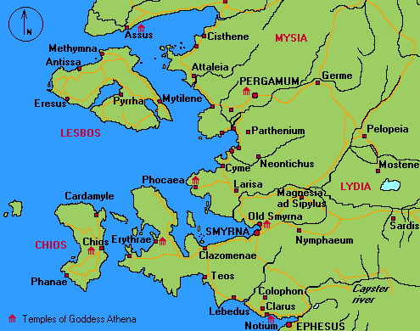
The struggle for the sea

Slide 5
The advent of Persia
Thus Astyagefrom his sovereignty s was deposed after a reign of thirty-five years: and the Medes had to bow down before the Persians because of Astyages' cruelty. They had ruled all Asia beyond the Halys for one hundred and twenty-eight years, from which must be subtracted the time when the Scythians held sway. [2] At a later time they repented of what they now did, and rebelled against Darius ; but they were defeated in battle and brought back into subjection. But now, in Astyages' time, Cyrus and the Persians rose in revolt against the Medes, and from this time ruled Asia. [3] As for Astyages, Cyrus did him no further harm, and kept him in his own house until Astyages died. This is the story of the birth and upbringing of Cyrus, and of how he became king; and afterwards, as I have already related, he subjugated Croesus in punishment for the unprovoked wrong done him; and after this victory he became sovereign of all Asia. Hdt 1.130

Slide 6
Darius’ Expansion
Darius I, king of Persia 522-486 BCE, expanded the empire greatly both towards the east and towards the west.
These are the countries which are subject unto me, and by the grace of Ahuramazda I became king of them: Persia, Elam, Babylonia, Assyria, Arabia, Egypt, the countries by the Sea, Lydia, the Greeks, Media, Armenia, Cappadocia, Parthia, Drangiana, Aria, Chorasmia, Bactria, Sogdia, Gandara, Scythia, Sattagydia, Arachosia and Maka; twenty-three lands in all.
[Behistun inscription §6]

Slide 7
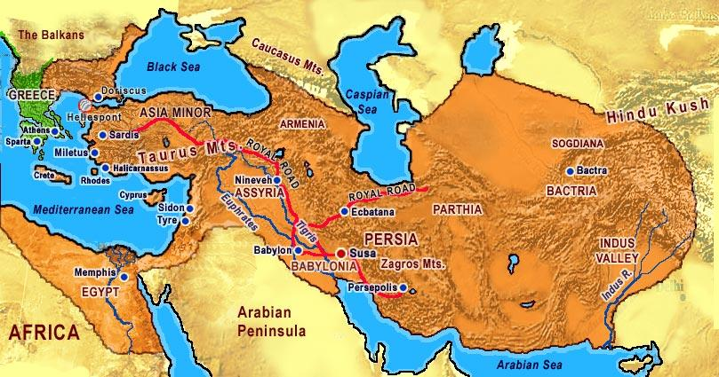
The Persian Empire

Slide 8
Oracles and War

Slide 9
Oracles in the Greek world
Oracles were extremely important as they were part of the way humans communicated with the divine.
Oracles were consulted for all important events (and indeed some not important) both by states and by individuals.
A great fear was of course that someone would manage to corrupt the oracle.
Oracles of note: Delphi, Dodona, Ammon

Slide 10
Medising Apollo
The Athenians had sent messages to Delphi asking that an oracle be given them, and when they had performed all due rites at the temple and sat down in the inner hall, the priestess, whose name was Aristonice, gave them this answer:
[2] Wretches, why do you linger here? Rather flee from your houses and city,
Flee to the ends of the earth from the circle embattled of Athens!
The head will not remain in its place, nor in the body,
Nor the feet beneath, nor the hands, nor the parts between;
But all is ruined, for fire and the headlong god of war speeding in a Syrian chariot will bring you low.
[3] Many a fortress too, not yours alone, will he shatter;
Many a shrine of the gods will he give to the flame for devouring;
Sweating for fear they stand, and quaking for dread of the enemy,
Running with gore are their roofs, foreseeing the stress of their sorrow;
Therefore I bid you depart from the sanctuary.
Have courage to lighten your evil. Herodotos 7.140

Slide 11
The second answer
When the Athenian messengers heard that, they were very greatly dismayed, and gave themselves up for lost by reason of the evil foretold. Then Timon son of Androbulus, as notable a man as any Delphian, advised them to take boughs of supplication and in the guise of suppliants, approach the oracle a second time. [2] The Athenians did exactly this; “Lord,” they said, “regard mercifully these suppliant boughs which we bring to you, and give us some better answer concerning our country. Otherwise we will not depart from your temple, but remain here until we die.” Thereupon the priestess gave them this second oracle: [3] “Vainly does Pallas strive to appease great Zeus of Olympus;
Words of entreaty are vain, and so too cunning counsels of wisdom.
Nevertheless I will speak to you again of strength adamantine.
All will be taken and lost that the sacred border of Cecrops
Holds in keeping today, and the dales divine of Cithaeron;
Yet a wood-built wall will by Zeus all-seeing be granted
To the Trito-born, a stronghold for you and your children.
” [4] “Await not the host of horse and foot coming from Asia,
Nor be still, but turn your back and withdraw from the foe.
Truly a day will come when you will meet him face to face.
Divine Salamis, you will bring death to women's sons
When the corn is scattered, or the harvest gathered in. Herodotos 7.141

Slide 12
Oracles and politics
Now there was a certain Athenian, by name and title Themistocles son of Neocles, who had lately risen to be among their chief men. He claimed that the readers of oracles had incorrectly interpreted the whole of the oracle and reasoned that if the verse really pertained to the Athenians, it would have been formulated in less mild language, calling Salamis “cruel” rather than “divine ” seeing that its inhabitants were to perish. [2] Correctly understood, the gods' oracle was spoken not of the Athenians but of their enemies, and his advice was that they should believe their ships to be the wooden wall and so make ready to fight by sea. [3] When Themistocles put forward this interpretation, the Athenians judged him to be a better counsellor than the readers of oracles, who would have had them prepare for no sea fight, and, in short, offer no resistance at all, but leave Attica and settle in some other country. Herodotos 7.143

Slide 13
Sparta: pre-planning or something else?

Slide 14
Another Spartan festival
The Spartans sent the men with Leonidas on ahead so that the rest of the allies would see them and march, instead of medizing like the others if they learned that the Spartans were delaying. At present the Carneia was in their way, but once they had completed the festival, they intended to leave a garrison at Sparta and march out in full force with all speed. [2] The rest of the allies planned to do likewise, for the Olympiad coincided with these events. They accordingly sent their advance guard, not expecting the war at Thermopylae to be decided so quickly. Hdt. 7.206

Slide 15
Spartan unwillingness or Persian planning?
To this Demaratus answered, “O king I knew from the first that the truth would be unwelcome to you. But since you compelled me to speak as truly as I could, I have told you how it stands with the Spartans. [2] You yourself best know what love I bear them: they have robbed me of my office and the privileges of my house, and made me a cityless exile; your father received me and gave me a house and the means to live on. It is not reasonable for a sensible man to reject goodwill when it appears; rather he will hold it in great affection. [3] I myself do not promise that I can fight with ten men or with two, and I would not even willingly fight with one; yet if it were necessary, or if some great contest spurred me, I would most gladly fight with one of those men who claim to be each a match for three Greeks. [4] So is it with the Lacedaemonians; fighting singly they are as brave as any man living, and together they are the best warriors on earth. They are free, yet not wholly free: law is their master, whom they fear much more than your men fear you. [5] They do whatever it bids; and its bidding is always the same, that they must never flee from the battle before any multitude of men, but must abide at their post and there conquer or die. If I seem to you to speak foolishness when I say this, then let me hereafter hold my peace; it is under constraint that I have now spoken. But may your wish be fulfilled, King.” Herodotos 7.104

Slide 16
Which Greeks?

Slide 17
Thermopylae
The Hellenes who awaited the Persians in that place were these: three hundred Spartan armed men; one thousand from Tegea and Mantinea, half from each place; one hundred and twenty from Orchomenus in Arcadia and one thousand from the rest of Arcadia; that many Arcadians, four hundred from Corinth, two hundred from Phlius, and eighty Mycenaeans. These were the Peloponnesians present; from Boeotia there were seven hundred Thespians and four hundred Thebans. 203.
In addition, the Opuntian Locrians in full force and one thousand Phocians came at the summons. The Hellenes had called upon them through messengers who told them that this was only the advance guard, that the rest of the allies were expected any day now, and that the sea was being watched, with the Athenians and Aeginetans and all those enrolled in the fleet on guard.

Slide 18
Artemision
The Greeks appointed to serve in the fleet were these: the Athenians furnished a hundred and twenty-seven ships; the Plataeans manned these ships with the Athenians, not that they had any knowledge of seamanship, but because of mere valor and zeal. The Corinthians furnished forty ships and the Megarians twenty; [2] the Chalcidians manned twenty, the Athenians furnishing the ships; the Aeginetans eighteen, the Sicyonians twelve, the Lacedaemonians ten, the Epidaurians eight, the Eretrians seven, the Troezenians five, the Styrians two, and the Ceans two, and two fifty-oared barks; the Opuntian Locrians brought seven fifty-oared barks to their aid. Herodotos 8.1

Slide 19
Salamis
The following took part in the war: from the Peloponnese, the Lacedaemonians provided sixteen ships; the Corinthians the same number as at Artemisium; the Sicyonians furnished fifteen ships, the Epidaurians ten, the Troezenians five, the Hermioneans three. …From the mainland outside the Peloponnese came the following: the Athenians provided more than all the rest, one hundred and eighty ships. …
The Megarians provided the same number as at Artemisium. The Ampraciots came to help with seven ships, and the Leucadians, who are Dorians from Corinth, with three. 46. Of the islanders, the Aeginetans provided thirty ships. …. [2] After the Aeginetans came the Chalcidians with their twenty ships from Artemisium, and the Eretrians with the same seven; these are Ionians. Next were the Ceans, Ionians from Athens, with the same ships as before. [3] The Naxians provided four ships. They had been sent by their fellow citizens to the Persians, like the rest of the islanders, but they disregarded their orders and came to the Hellenes at the urging of Democritus, an esteemed man among the townsmen and at that time captain of a trireme. The Naxians are Ionians descended from Athens. [4] The Styrians provided the same number of ships as at Artemisium, and the Cythnians one trireme and a fifty-oared boat; these are both Dryopians. The Seriphians, Siphnians, and Melians also took part, since they were the only islanders who had not given earth and water to the barbarian. …The only ones living beyond these to help Hellas in its danger were the Crotonians, with one ship Herodotos 8.45-7

Slide 20
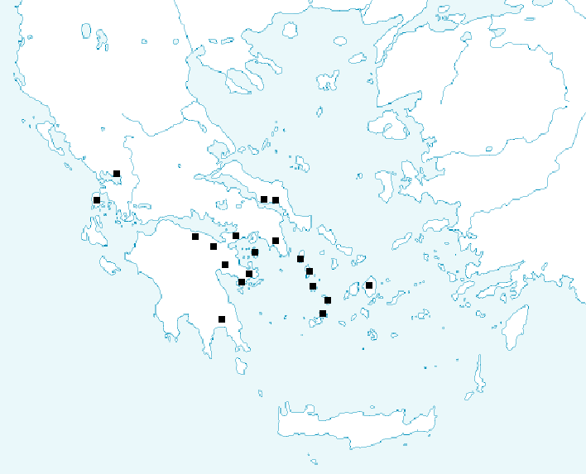
The poleis that fought – i.e. they did not medise

Slide 21
The memory of Thermopylae

Slide 22
A Last-Stand
There is an inscription written over these men, who were buried where they fell, and over those who died before the others went away, dismissed by Leonidas. It reads as follows:
Here four thousand from the Peloponnese once fought three million.
[2] That inscription is for them all, but the Spartans have their own:
Foreigner, go tell the Spartans that we lie here obedient to their commands.
[3] That one is to the Lacedaemonians, this one to the seer:
This is a monument to the renowned Megistias,
Slain by the Medes who crossed the Spercheius river.
The seer knew well his coming doom,
But endured not to abandon the leaders of Sparta.
Hdt 7.228

Slide 23
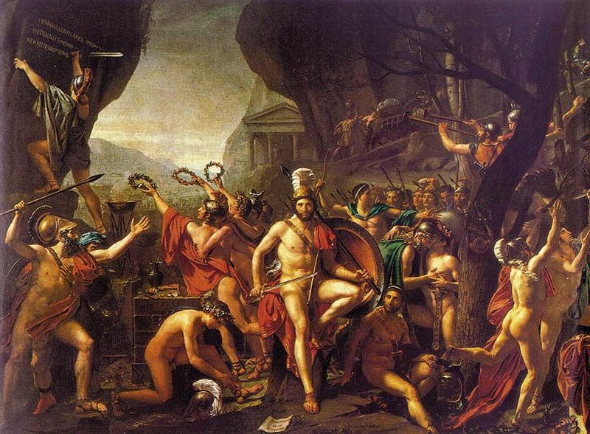
“Leonidas at Thermopylae”, David, 1814

Slide 24
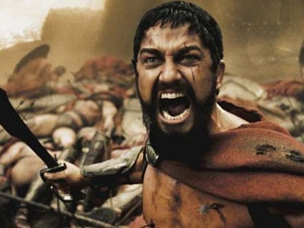

Slide 25
Follow up reading on moodle

