Slide 1
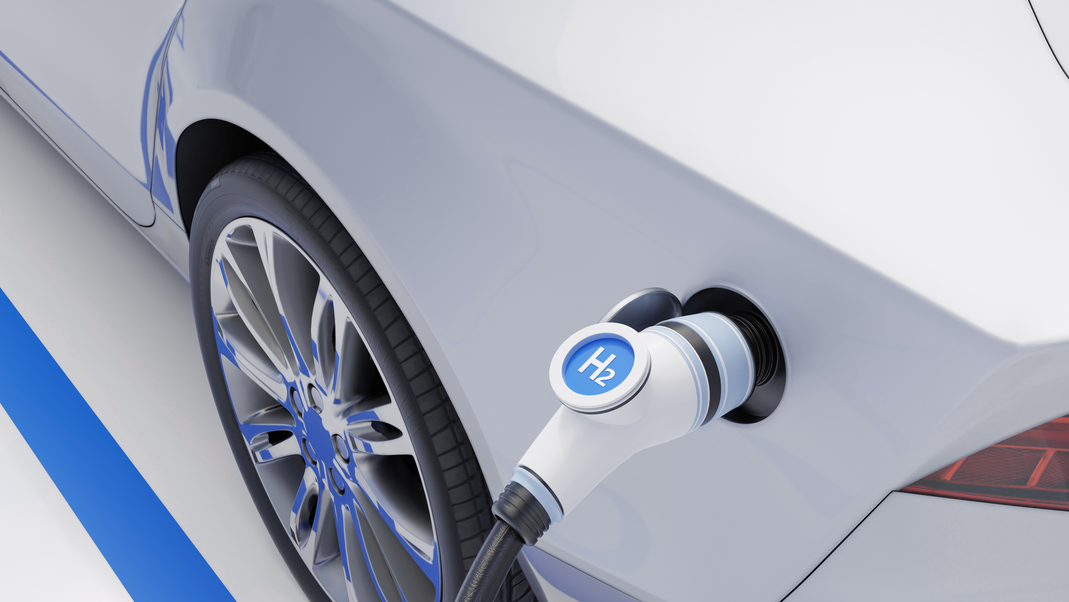
Greenwashing in the automobile industry
Problem Solving and Innovation
Vanessa Najarro 2433089

Slide 2
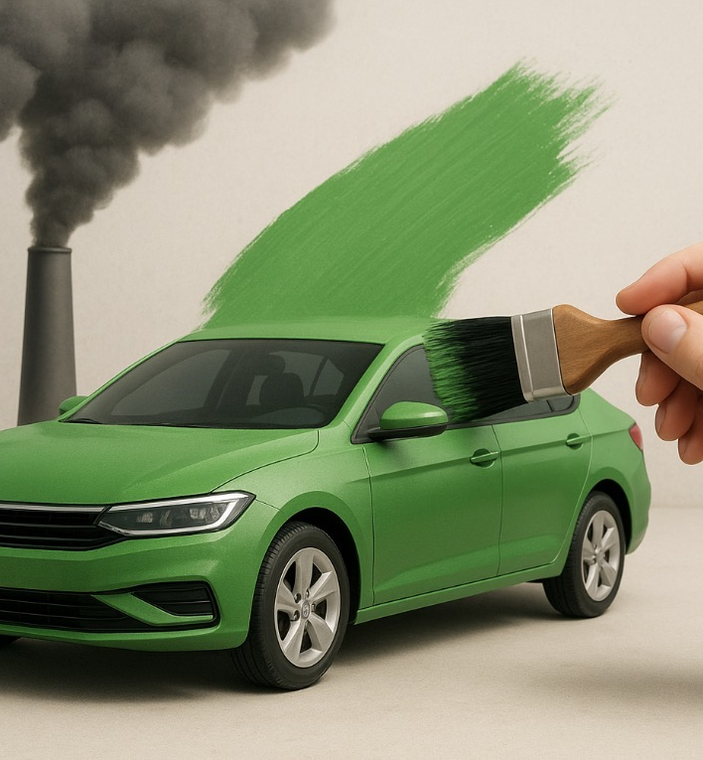
CONTENT
Introduction

Slide 3

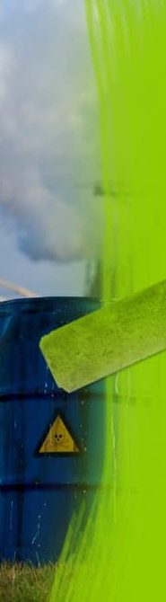
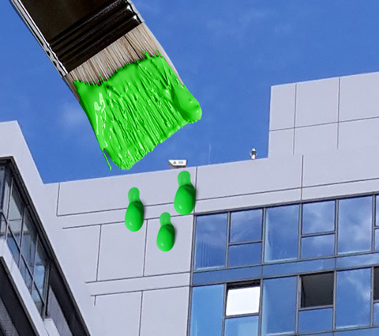
IntroduCTION
This essay analyses what greenwashing is in the
automobile industry, its impact on the current
environmental situation and how green technologies
called electric or hybrid vehicles are promoted to
contribute to environmental wellbeing, but which
ultimately end up being the biggest polluters on
the planet.
ThePhoto de PhotoAuthor se concede bajo licencia de CCYYSA.

Slide 4

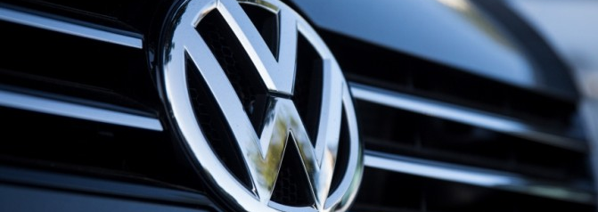
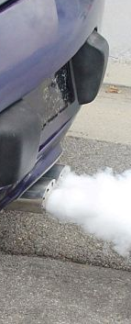
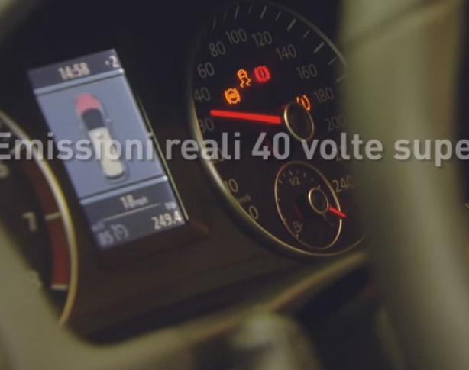
Volkswagen
This case, known as DIESELGATE, involved the company selling some 600,000 vehicles with software that altered emissions tests, showing low values in the laboratory while emitting up to 40 times more pollutants when driving.
ThePhoto de PhotoAuthor se concede bajo licencia de CCYYSA.

