Slide 1
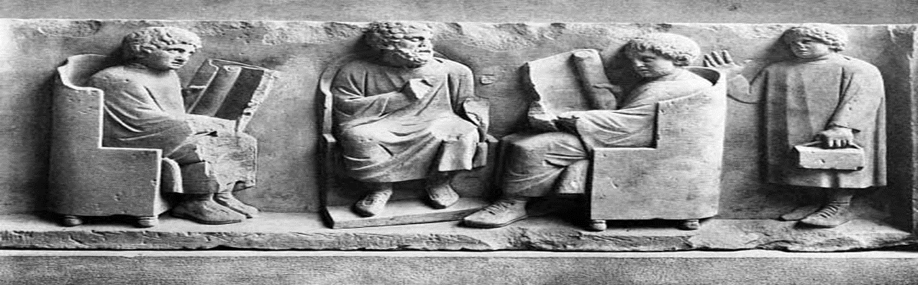
every day life in ancient Rome
Session 7 – part 1
Childhood and Education
HPAH4001

Slide 2
Development and Socialisation in the Roman World

Slide 3
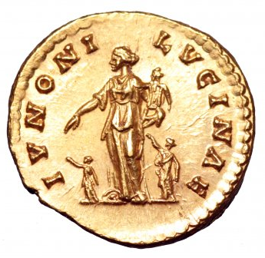
Childbirth
Giving birth potentially hazardous – loss of blood, diseases and hygiene, complications.
High birth-rate, high mortality-rate.
Payers to Diana - offerings to Juno Lucina.
Lectisternium (couch and meal) set up to Juno and Hercules, seen by those attending morning salutation.
Children not exposed were acknowledged by the father and raised (sublatus).

Slide 4
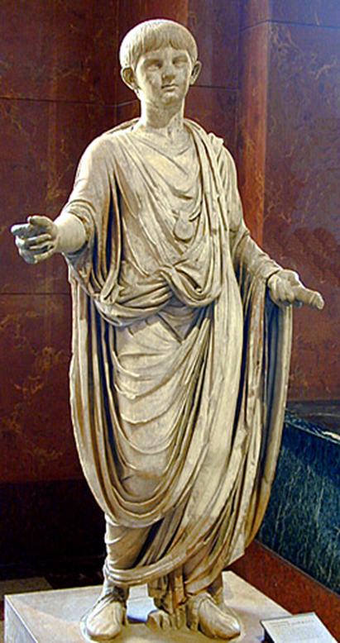
Rome - On the eight and ninth days children were purified (dies lustricus) and then named – boys usually wore a bulla (protective amulet) until reached adulthood, and a lunula for a girl until marriage.
Augustan period – lex Aelia Sentia and lex Popia Poppaea – it was necessary for Roman citizens to register a child’s birth within 30 days.
Abortion is a private affair in Roman society until reign of Septimius Severus – issue of religious pollution.
Contract for a wet-nurse – 16 month period (Egypt, 13 BC):
“Didyma agrees to nurse and suckle outside her own home… She is to receive from the said Isidora as pay for the milk and the nursing ten silver drachmas and a half-litre of oil every month.” – Selected Papyri 1, no. 16 – Loeb.

Slide 5
Early Childhood
Physiological development: swaddling seen as important for developing healthy limbs (Soranus Gyn. 2.14-15, 32-35).
Character development: balance between not crushing spirits and not overindulging children (Seneca On Anger 2.20-21).
First three years of a child’s considered to be very susceptible to influence – Soranus Gyn. 2.18).
“In the first place then, the parents are the builders-up of the children, and lay the foundation for the children; they raise them up, they carefully train them to strength, and that they may be good both for service and for view before the public.” – Plautus Mostellaria 91 ff.

Slide 6
Caregiving
“She [Timoxena] had herself, moreover, a surprising gift of mildness and good temper, and her way of responding to friendship and of bestowing favours gave us pleasure while it afforded an insight into her kindness. For she would invite the nurse to offer the breast and feed with it not only other infants, but even the inanimate objects and playthings she took pleasure in, as though serving them at her own table, dispensing in her kindness what bounty she had and sharing her greatest pleasures with whatever gave her delight.” - Plutarch Moralia 608d.
“You, Charidemus, rocked my cradle; you were the guardian and constant companion of my childhood… If I put on a Tyrian robe, or anoint my hair, you exclaim, "Your father never did such things." You count my cups of wine with contracted brow, as if they came from a cask in your own cellar. Cease this conduct: I cannot abide a Cato in a freed man.” – Martial Epigrams 11.39.

Slide 7
Play and Discipline
“[letter to Aufidius Vicotinus] He is also devoted to little birds ; he delights in chickens, young pigeons, and sparrows. I have often heard from those who were my tutors and masters that I had from my earliest infancy a passion for such things.” – Fronto Ep. Ad Amicos 1.12.
“Building doll’s houses, harnessing mice to a cart, playing odds and evens, riding a stick… that it matters not whether you play with sand like a three year old…” Horace Satires 2.3.247 ff.
“…just as nurses, after giving the children a whipping, tell them a story to comfort and please them.” – Dio Chrysostom Orations 4.74.

Slide 8
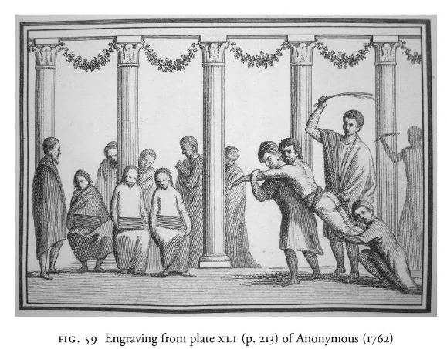
A School Whipping? – From an original Pompeian wall painting

Slide 9
Toys
How to identify “children's” toys in domestic space – dice, spinning-tops, board games, knuckle-bones.
Dolls the most well-document “toys” of antiquity.
Pipe-clay rattle, Campania, c.AD 100-200, British Museum
Terracotta, young women playing knuckle-bones, Campania, c. 330-300 BC, British Museum
Painted wooden wheeled horse, Roman Egypt, British Museum

Slide 10
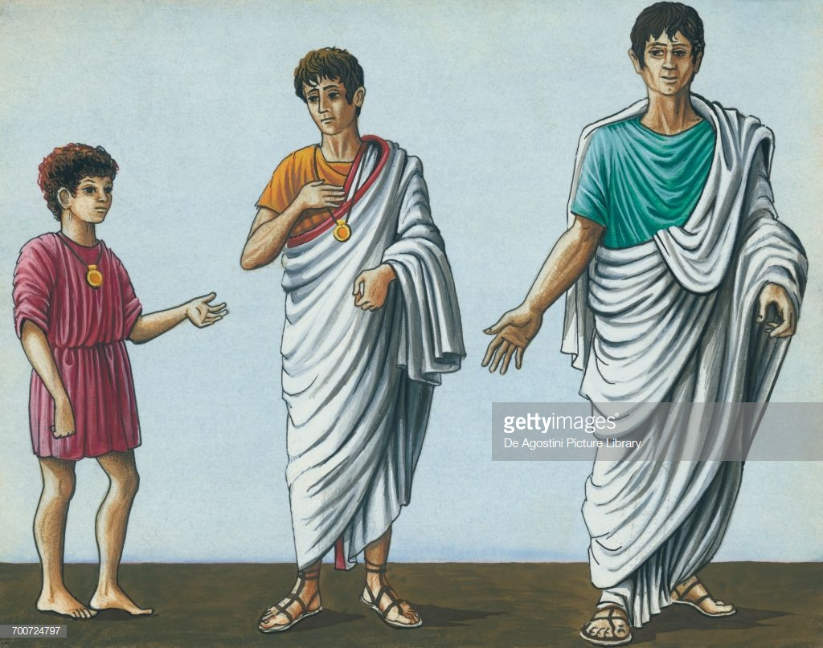
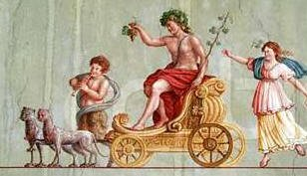
Boys’ transition to adulthood
This event marked publically by the symbolic change of dress – exchange of the toga praetexta for the toga virilis.
Upon receiving the toga virilis would be registered on the census list, and had become a iuvenis and an adult citizen.
Henceforth vote and be called up for war.
Could be done at any point in the year, though 17th of March a popular date – festival of Liber.

Slide 11
Roman Education

Slide 12
Public vs. Private Education
Tacitus Dialogue on Oratory 28-29 – complains about the lack of traditional Roman customs and how children's upbringing was being corrupted.
  Formally mother nursed child, looked after morals, she regulated young child’s study and play.
  Now “little-Greek servant girls” fills child’s mind with their stories and prejudices – people speak and act carelessly in front of the child. (Cf. Cicero Brut. 210).
“ But in our day we entrust the infant to a little Greek servant-girl who is attended by one or two, commonly the worst of all the slaves, creatures utterly unfit for any important work.”

Slide 13
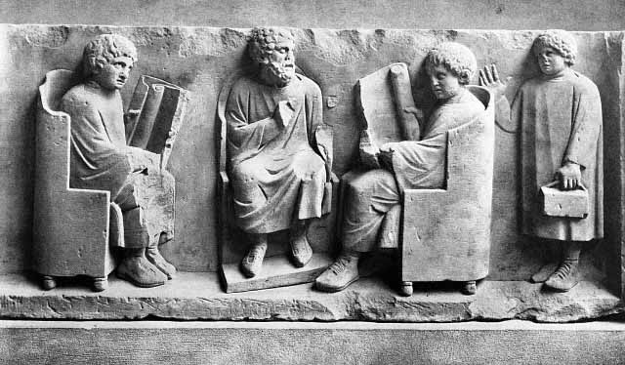
Ludi magister (first stage), grammaticus (second stage), next step to study rhetoric under a rhetor (pl. rhetores).
Quintilian Institutes of Oratory 2.1-9 – debates the merits of home vs. public school education.
  Morals can be just as easily corrupted by a bad tutor at home as by a teacher at a school.
  Fears that at public school child will not get one to one tuition, but best teachers often attract many pupils.
  “I should still prefer the broad daylight of a respectable school to the solitude and obscurity of a private education”.

Slide 14
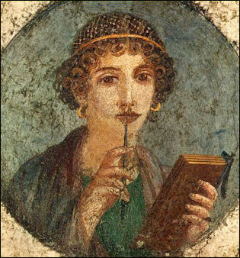
Girls in Education
“What right have you to disturb me, abominable schoolmaster, object detested by boys and girls alike? Before the crested cocks have broken silence, you begin to roar out your savage reprimands and blows.” – Martial Epigrams 9.68.1-2.
“When she begins with uncertain hand to use the pen, either let another hand put over hers to guide her baby fingers, or else have the letters marked on the tablet so that her writing may follow he outlines and keep to their limits without straying away.” – Jerome Ep. 107.4.
Papyrus letters from Egypt – Heraidous, daughter of a civil administrator “persevering with her studies”.
Depiction of Furius Phiocalus – ludi magister from Capua.
Attica (daughter of Atticus) studies under Quintus Caecilius Epirota, famous grammaticus.

Slide 15
Traditional Education
Cato the Elder refuses to have his educated slave Chilo teach his son, does so himself – Plutarch Life of Cato the Elder 20.4:
  “Cato thought it not right, as he tells us himself, that his son should be scolded by a slave… still less that he should be indebted to his slave for such a priceless thing as education. He was therefore himself not only the boys' reading-teacher, but his tutor in law, and his athletic trainer, and he taught his son not merely to hurl the javelin and fight in armour and ride the horse, but also to box, to endure heat and cold, and to swim vigorously through the swirls and vapours of the Tiber.”
  “…although he [Cato] had an accomplished slave, Chilo by name, who was a school-teacher, and taught many boys.” (20.3).

Slide 16
Young Elite Men
RHETORIC
“…we must look for a tutor in Latin rhetoric whose school shall combine a strict training along with good manners and, above all, moral standards…” - Pliny the Younger Letter to Cornelia Hispulla 3.3.
“M. Verrius Flaccus, a freedman, gained special fame from his method of teaching. For to stimulate the efforts of his pupils, he used to pit those of the same advancement against one another, not only setting the subject on which they were to write, but also offering a prize for the victor to carry off… He was therefore chosen by Augustus as the tutor of his grandsons, and he moved to the Palace with his whole school... and was paid HS 100,000 a year.” - Suetonius, On Grammarians 17.
POLITICS
Young aristocrats prepare for public life (tirocinium fori) by following a distinguished individual:
  “Now, I, upon assuming the toga virilis, had been introduced by my father to Scaevola with the understanding that… I should never leave the old man's side… my desire to gain greater profit from his legal skill, I made it a practice to commit to memory many of his learned opinions and many, too, of his brief and pointed sayings.” - Cicero Laelius on Friendship 1.
MILITARY
Young aristocrats would expect to spend a year or so in the ranks, though often under a tutor – subsequently often aimed to become a military tribune.

Slide 17
Hellenic Influence
Conquests in Greek East (esp. 2nd century BC), results in influx of slaves, many educated, who become school masters and paidagogoi.
“This Cato always gave it out as his firm opinion that all Greeks ought to be expelled from Italy, while, on the other hand, his great-grandson, Cato of Utica, upon his return from his military tribuneship, brought back with him a philosopher, and a second one when he returned from his embassy to Cyprus…” – Pliny NH 7.30.110-113.
“For as those studies which I see now occupy and interest you, you will be in no want of those ready to help both of you; so great is the crowd of such men that I see flocking here from Greece at present.” – Polybius 31.24.6-7.
“…training his sons, not only in the nature and ancestral discipline in which he himself had been trained, but also… in that of the Greeks. For not only the grammarians and philosophers and rhetoricians, but also the modellers and painters, the overseers of horses and dogs, and the teachers of the art of hunting, by whom the young men were surrounded, were Greeks…. the books of the king [Perseus]… he allowed his sons, who were devoted to learning, to pick out for themselves… – Plut. Aem. 6.8-9, 20.

Slide 18
Bibliography
Dolansky, F. 2014: ‘Education in the Roman World’, in Themes in Roman Society and Culture, Gibbs, M., Nikolic, M., Ripat, P. (eds.), Oxford University Press: 117-130.
Harlow, M. 2013: ‘Toys, Dolls, and the Material Culture of Childhood’, in The Oxford Handbook of Childhood and Education in the Classical World, Grubbs, J. D., Parkin, T. G. and Bell, R. (eds.), Oxford University Press: 322-340.
Marrou, H. I. translated by Lamb, G. 1956: A History of Education in Antiquity. London.
McWilliam, J. 2013: ‘The Socialization of Roman Children’, in The Oxford Handbook of Childhood and Education in the Classical World, Grubbs, J. D., Parkin, T. G. and Bell, R. (eds.), Oxford University Press: 264-285.

