Slide 1
No one is too small to make a difference: Working with young people to create a climate of change
The role of the youth worker in developing an understanding and commitment to sustainable development and climate change in a Youth work context.
By Sean Seymour-Davies

Slide 2
Introduction
This presentation will look at the following:
A brief background to the importance of sustainable development.
The role a youth worker can have in developing in an understanding and commitment to education for sustainable development and global youth work.
How youth work incorporates many of the principles which are implied within the notion of ESDGYW and activism.
Then different youth work approaches that can be used within practice that promote commitment to ESDGYW

Slide 3
Sustainable development
"development which meets the needs of the present without compromising the ability of future generations to meet their own needs".
(Brundtland, 1987)
Current human population : 8.2 Billion
(Worldometer, 2024)
Notes:
‘Our Common future: Report of the World Commission on Environment and Development’, International Affairs,

Slide 4
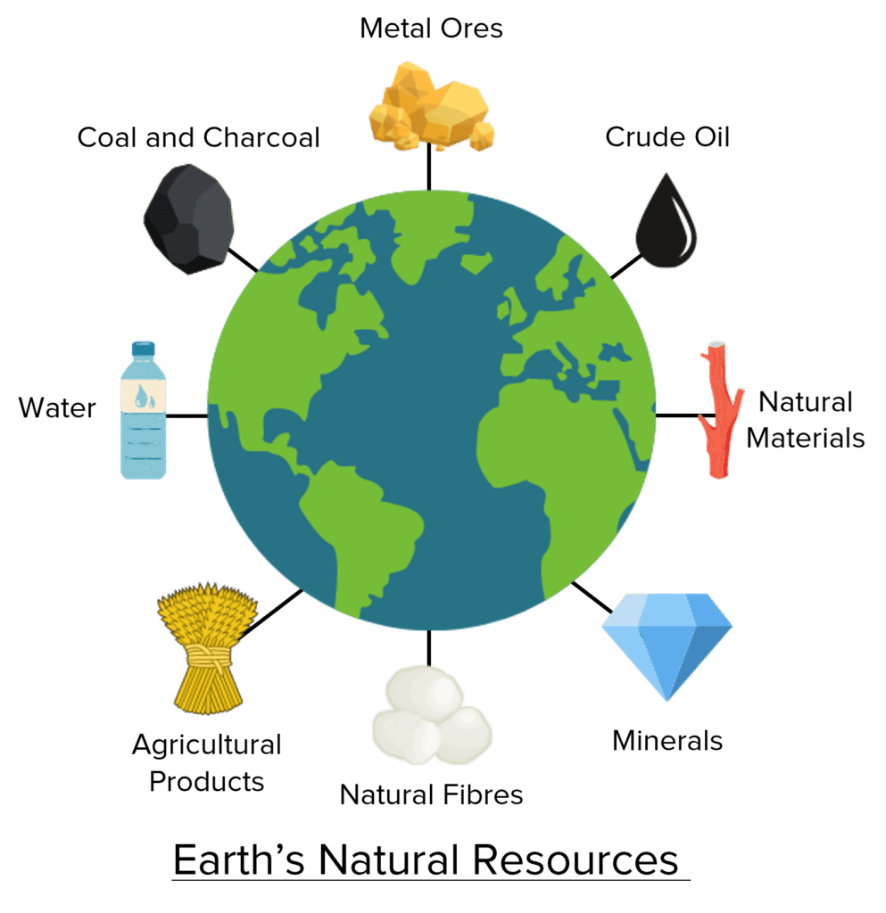
Ultimately as the human population continues to grow at a such a fast pace will continue to use and drain the world of more and more resources.
In 1992, The United Nations Conference on Environment and Development (UNCED) held a meeting of 179 heads of governments in Rio de Janeiro. It brought the world’s attention towards critical issues of resources. All the present leaders in the conference were asked to sign the declaration to undertake worldwide sustainable development. (Agenda 21 – Everything you need to know! Accessed on 15.03.25)
Notes:
In 1992, The United Nations Conference on Environment and Development (UNCED) held a meeting of 179 heads of governments in Rio de Janeiro. It brought the world’s attention towards critical issues of resources. All the present leaders in the conference were asked to sign the declaration to undertake worldwide sustainable development.
The International Commission monitors nations that have pledged to participate in Agenda 21 on Sustainable Development. The nations are also expected to promote Agenda 21 at the local and national levels in the countries. It aims to address the issues by focusing n the conservation and preservation of natural resources.

Slide 5
Timeline - Work by countries and the UN, including the UN Department of Economic and Social Affairs
Member States unanimously adopted the Millennium Declaration at the Millennium Summit in September 2000 at UN Headquarters in New York. The Summit led to the elaboration of eight Millennium Development Goals (MDGs) to reduce extreme poverty by 2015.
In June 1992, at the Earth Summit in Rio de Janeiro, Brazil, more than 178 countries adopted Agenda 21.
At the United Nations Conference on Sustainable Development (Rio+20) in Rio de Janeiro, Brazil, in June 2012, Member States adopted the outcome document "The Future We Want" Development.
The Johannesburg Declaration on Sustainable Development and the Plan of Implementation, adopted at the World Summit on Sustainable Development in South Africa in 2002.
In 2013, the General Assembly set up a 30-member Open Working Group to develop a proposal on the SDGs.
In January 2015, the General Assembly began the negotiation process on the post-2015 development agenda. The process culminated in the subsequent adoption of the 2030 Agenda for Sustainable Development, with 17 SDGs at its core, at the UN Sustainable Development Summit in September 2015.

Slide 6
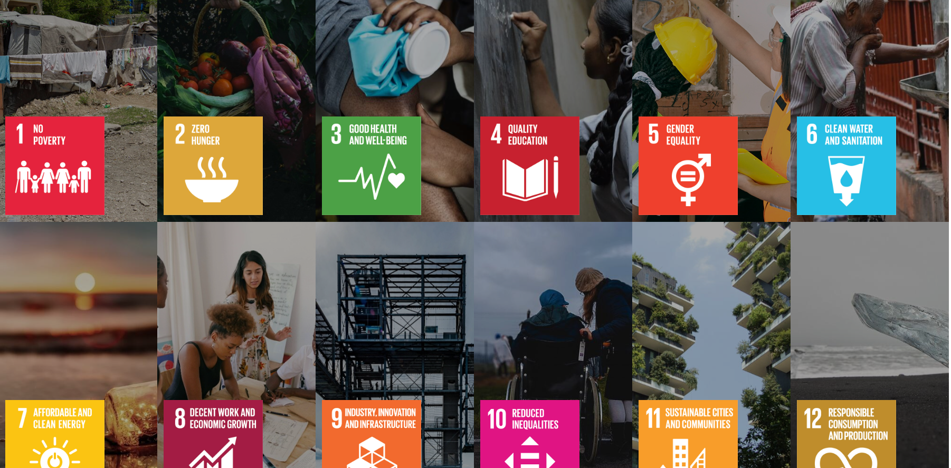
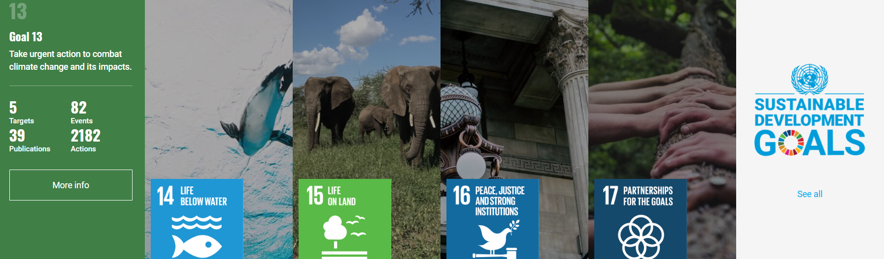
How we would like it to be going ………..
(United Nations, 2025)

Slide 7
Clarke 2012 argues that with the rise in human population, we are witnessing an unprecedented collapse in our global ecosystem with increasing disfunction in our systems of education, politics, health, finance and agriculture. With what happens next for humanity depending massively on how we can learn to live more sustainably.
How its currently going………………………………

Slide 8



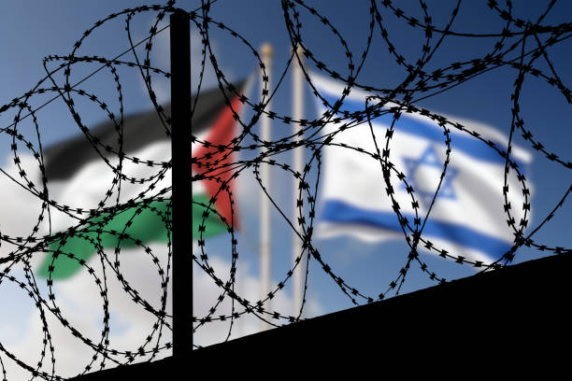
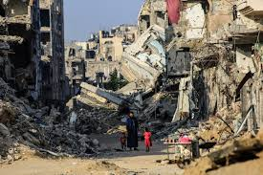
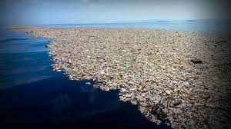
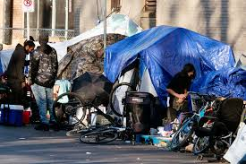

Slide 9
What can we do……………
Activism and global youth work
Walker 2017 explains that everyday environmental activism has been defined as an individual and collective efforts to change or disrupt your own or others everyday habits in which negative impacts can be made on the environment as its known, valued and imagined.
Education is crucial to promote climate action
It helps people understand and address the impacts of the climate crisis, empowering them with the knowledge, skills, values and attitudes needed to act as agents of change.
(UNESCO, 2022)
Notes:
the United Nations Educational, Scientific and Cultural Organization

Slide 10
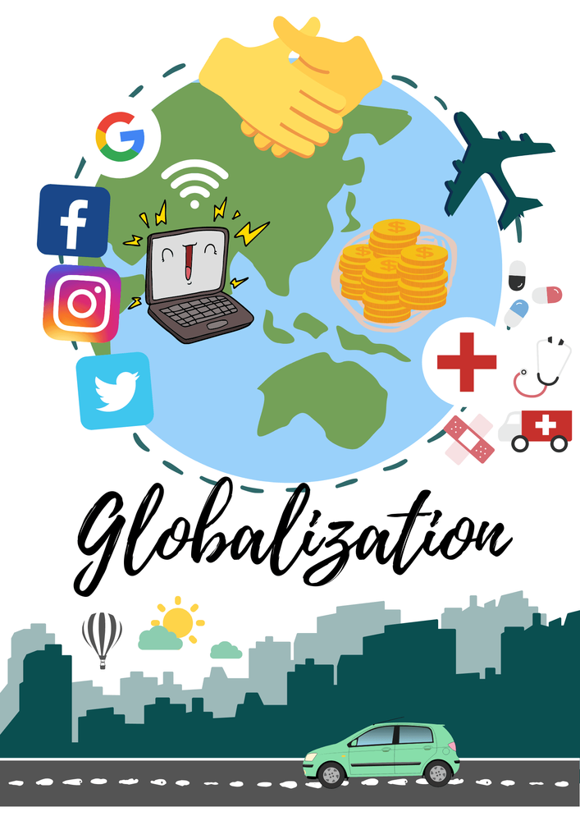
Waters 2001 describes globalisation as a social process in which constraints of geography on economy, political, social and cultural arrangements recede. People become increasingly aware that they are receding and how can they respond to this accordingly.
Notes:
How trade and technology have made the world into a more connected and interdependent place.
Young peoples experiences will differ from community to community and its important to start from a point of where they are currently at. GYW Promotes this and also encourages them to explore influences further afield from their own communities.

Slide 11
Positive impacts of Globalization
Access to new cultures.
The spread of technology and innovation.
Access to new markets (Consumables).
More opportunity to travel.
Improvement of standard of living in developing natation’s.
Access to wider variety of foods.
More education opportunities for people in developing countries.
Negative impacts of Globalization
Increased competition on consumables.
Exploitation of labour and resources.
Economic inequality.
Environmental degradation.
Threats to national sovereignty.

Slide 12
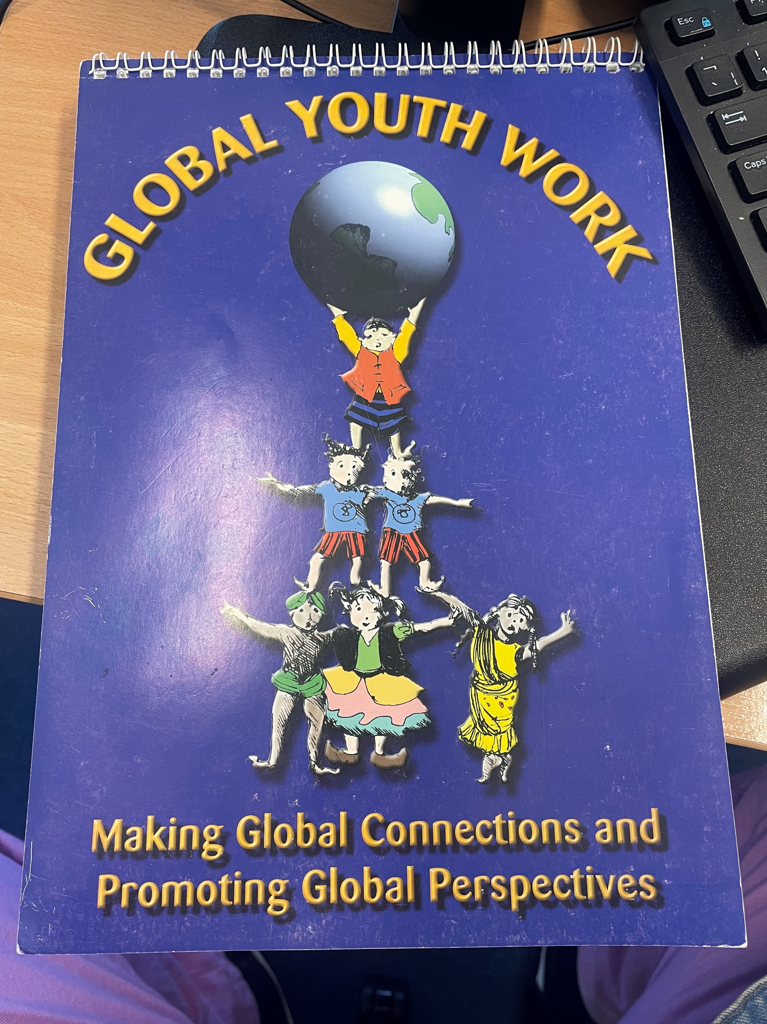
Global Youth Work is an approach to youth work that starts from young people's everyday experiences and encourages them to explore the local and global influences on their lives and those of their communities. It aims to help them understand how they fit into the world around them and how they can use their energies, talents and enthusiasm to make a difference.
(S Cooper and C Alkanaan, no date)

Slide 13
Educative
Adam 2014 argues global youth work is a considered a form of development education. However, its unique difference from just developmental education which often takes place in more formal setting such as classrooms, is that it starts out from young peoples own perspectives and experiences enabling a negotiated agenda for learning for all parties to develop.
  The Development Education Association (DEA) has been instrumental in developing global youth work, has identified the following principles as essential when delivering GYW.
  Starts from young people’s experiences, and encourages their personal, social and political development.
  Works to the principles of informal education, offering opportunities that are educative, participative, empowering and designed to promote inclusivity.
  Based on an agenda negotiated with young people.
  Engages young people in critical analysis of local and global influences in their lives and those of their communities.
(Sallah, 2010, P122)

Slide 14
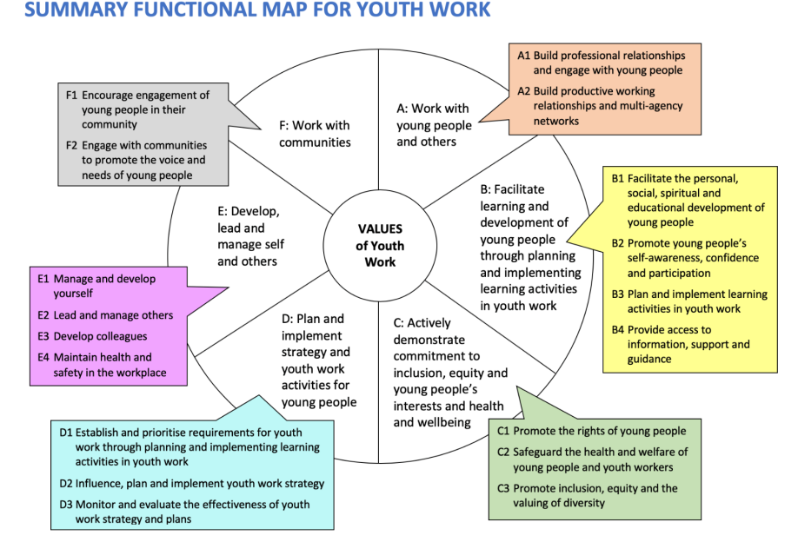
YW09 – Outlines that by delivering learning activities through youth work we can support young people with becoming active citizens. It enables us to ensure that they are informed and offered involvement within key matters within their own community as well as local, regional, national and global communities that are subject to democratic process.

Slide 15
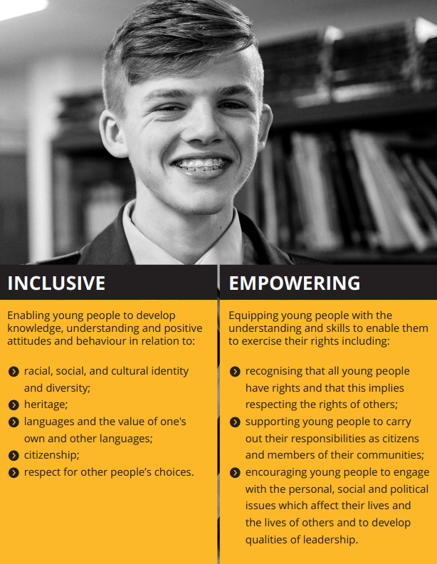
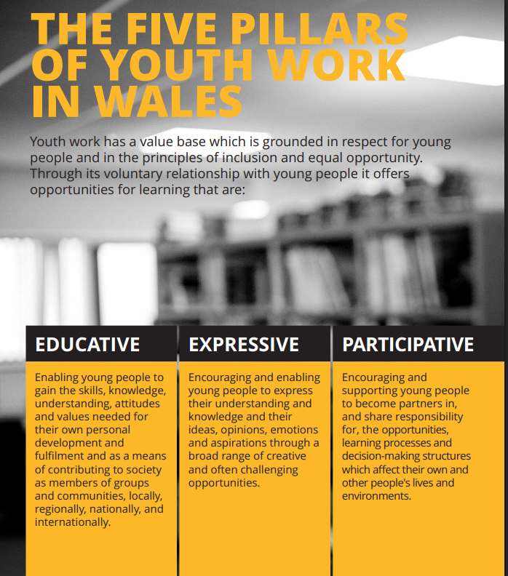
Key Area A: Work with young people and others
YW01 Initiate, build and maintain purposeful relationships with young people.
Youth Work in Wales recognizes the importance of sustainable development and equips young people with the knowledge and skills to play their part in shaping the future;
encourages young people as local, national and global citizens to exercise their responsibilities;
encourages young people to protect their own rights and those of others
(CWVYS, 2018)

Slide 16
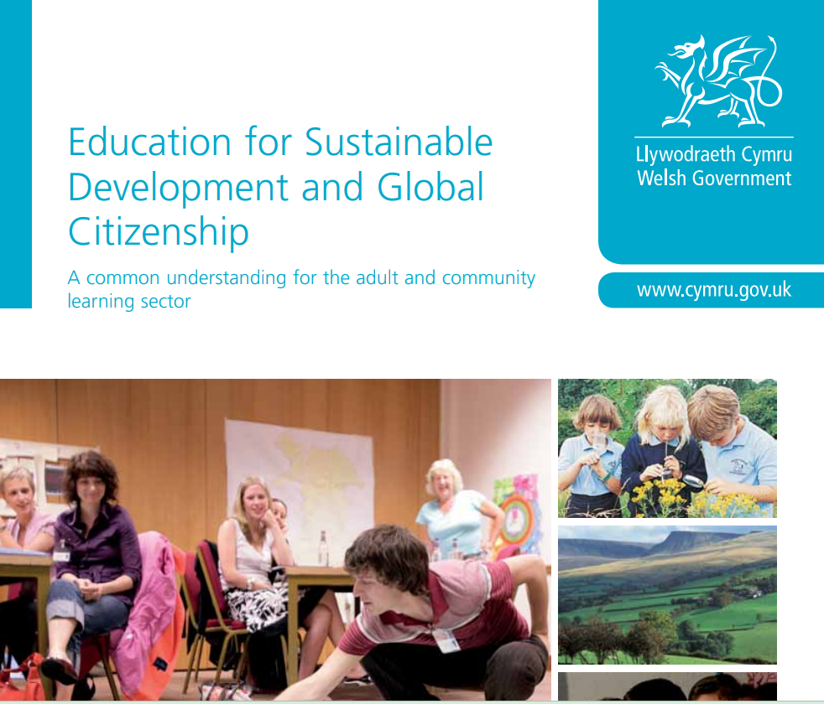

Youth Work and National policies
The overall aim of ESDGC is to equip people with knowledge and skills that can help them assist with the major challenges that world and its inhabitants face such Poverty, climate change, fuel and food shortages, international wars, biodiversity and species extinction
(Welsh Government, 2012)
Notes:
Sustainable Development and Global Citizenship is a theme that runs through many Welsh Government policies and strategies.
Future generations Wellbeing act 2015

Slide 17
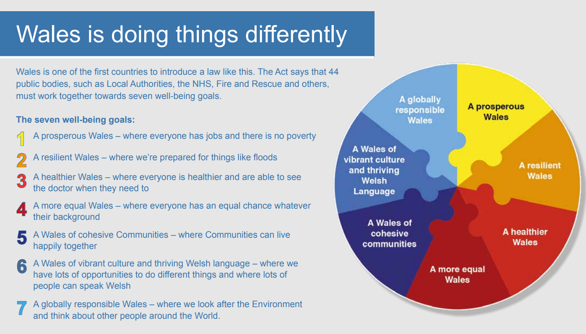
(Welsh Government, 2015)

Slide 18
Particpative
Furthing 2012 describes how participation is a process in which young people are given the opportunity to become equal partners alongside adults. Young people are able to express their views and have decision making powers about issues that can affect them. Further enabling them to become active citizens.
Youth Work in Wales: Principles and Purposes (2013, 2018, 2022) defines participative practice as
  “Encouraging and supporting young people to become partners in, and share responsibility for, the opportunities, learning processes and decision-making structures which affect their own and other people’s lives and environments.”

Slide 19
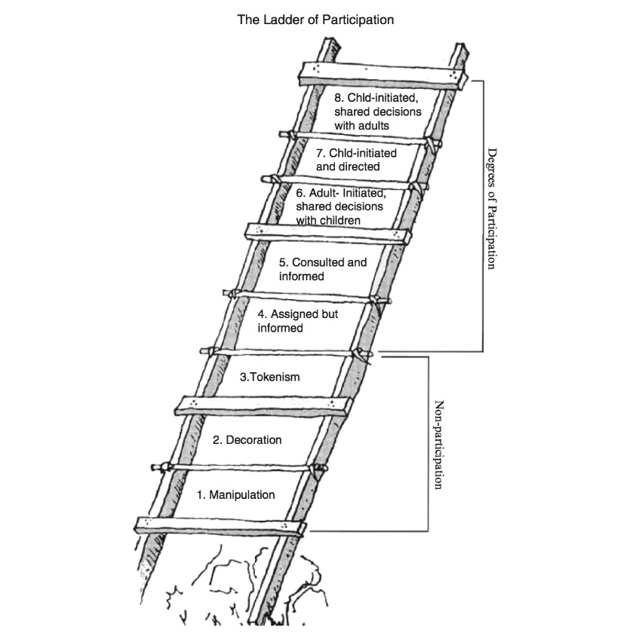
Harts Ladders illustrates the different levels of decision-making agency, control or power that can be given to young people by adults.
(https://organizingengagement.org/wp-content/uploads/2019/07/Ladder-of-Childrens-Participation-Illustration-Roger-Hart.jpg)

Slide 20
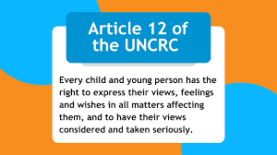
Its our role to educate, advocate and empower!
By utilising professional practice and standards we do not manipulate young people into believing our own views or agenda’s.
By promoting key childrens rights such as Article 12 of the UNCRC we encourage young people to have their say and ensure that their voices are heard.
(UNCRC 1989)

Slide 21
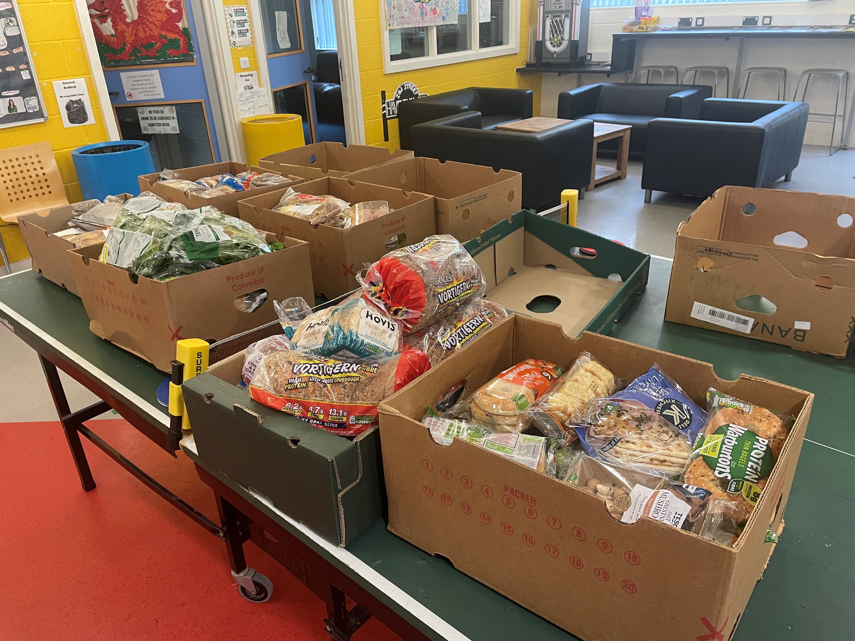
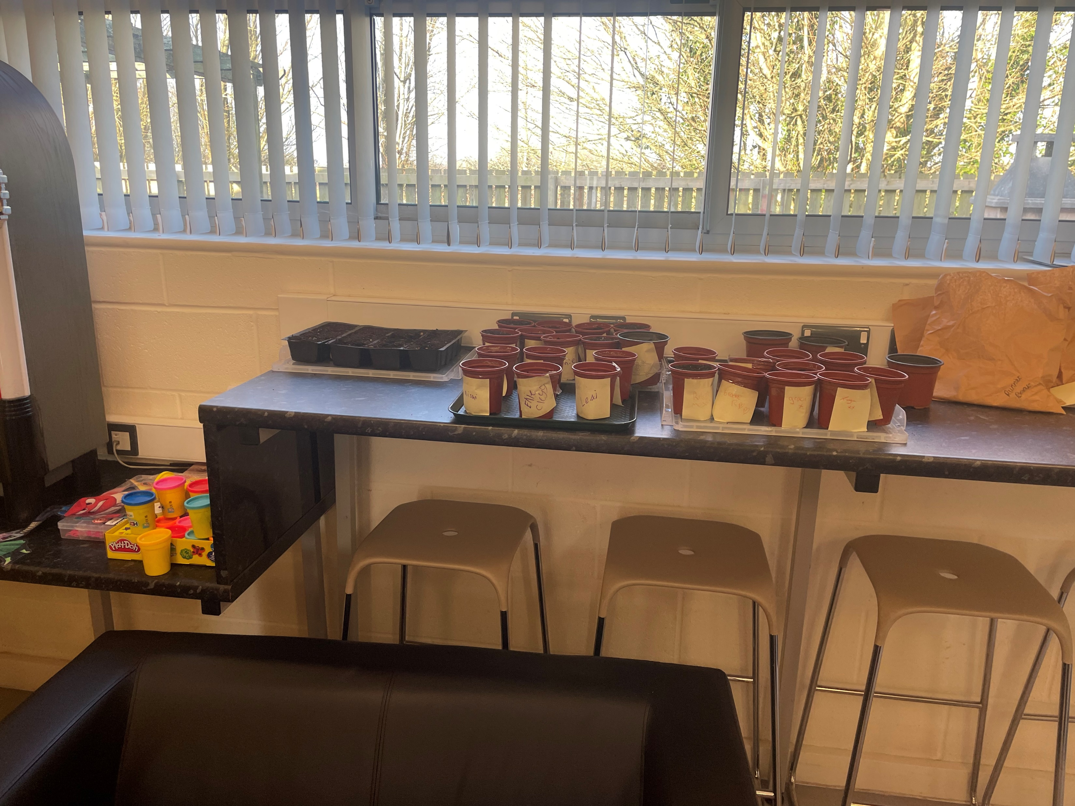
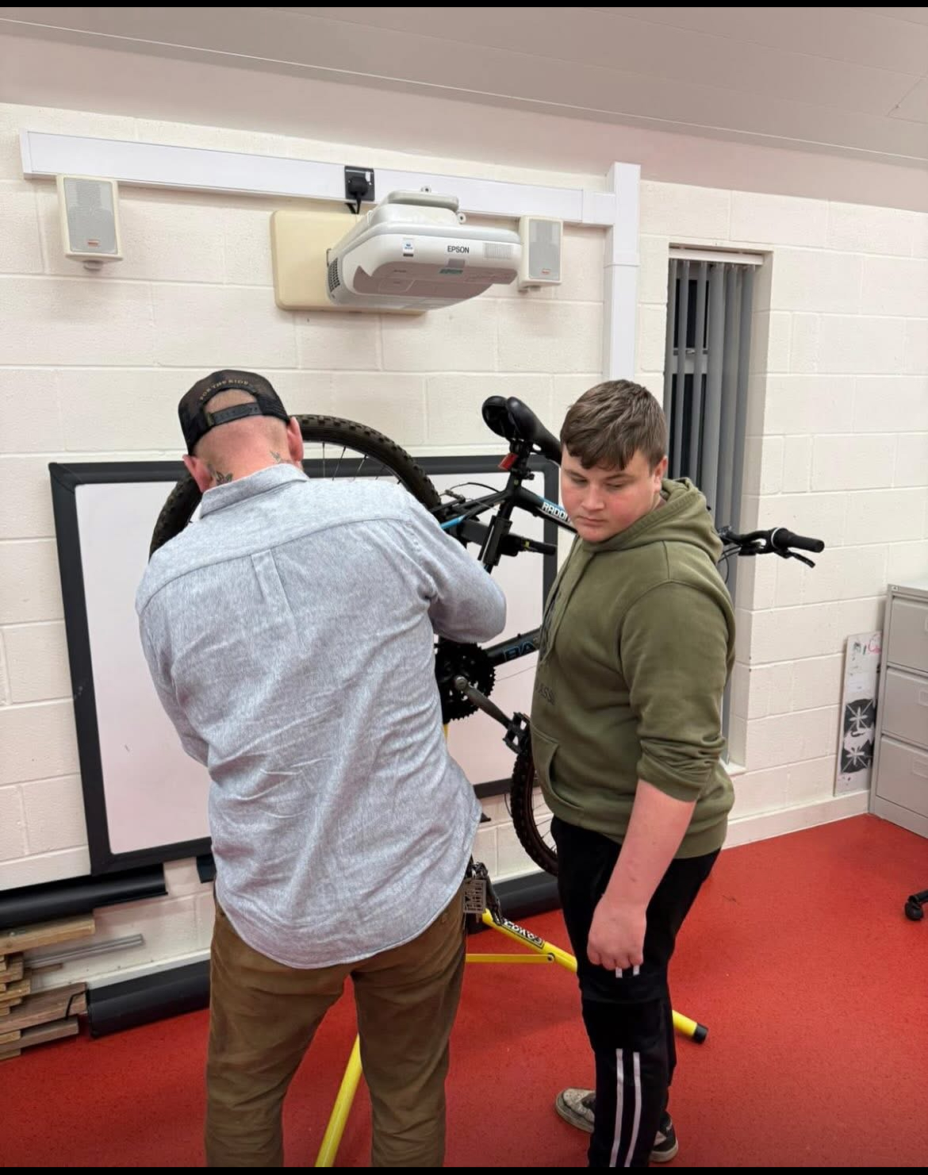
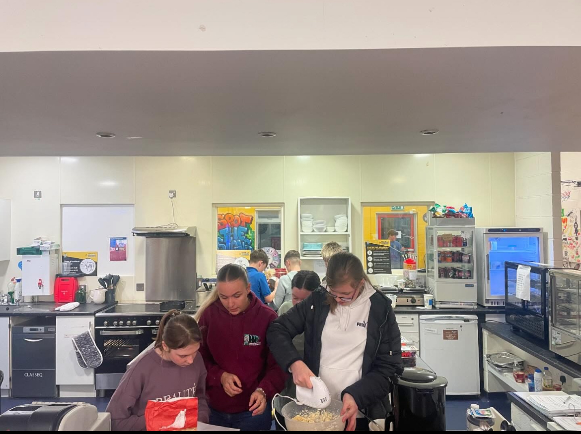
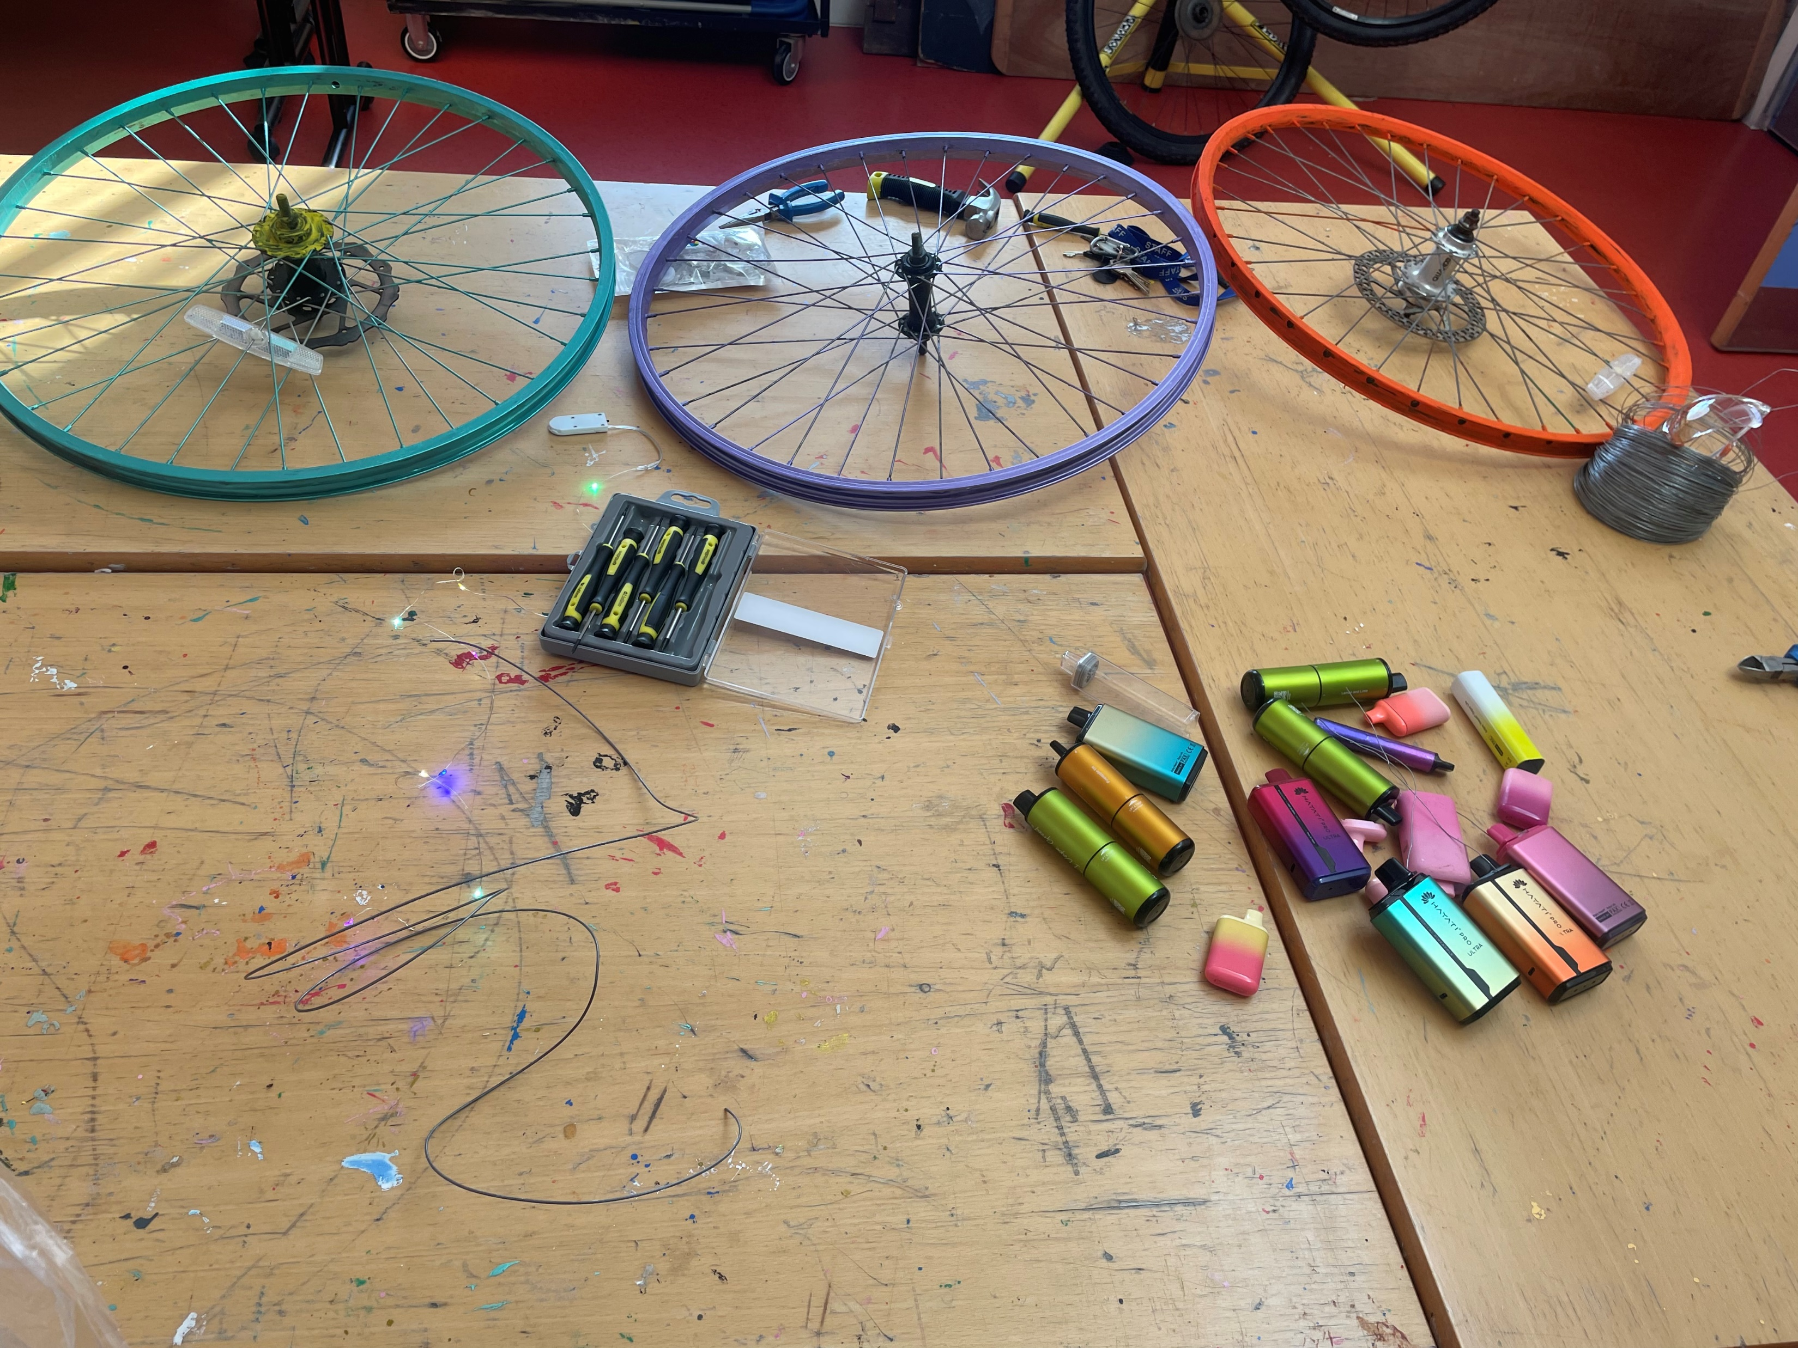
Working towards commitment in long term sustainability at Milford Youth Centre.
In Milford Youth Centre we have a few upcycling/recycling projects on the go to reduce impact on landfill.

Slide 22
To conclude …….
Following my own reflection regarding my own lifestyle and work practice, I believe there is far more that many of us can be doing to ensure there is safe and sustainable future for our younger generations. According to the latest working towards suitable development report (United Nations, 2024) only seventeen percent of SDG targets are on track to be achieved. The rest have made little progress and some have even regressed. The pandemic and other factors have led to 23 million people living in extreme poverty.
So whilst in reality we are great at putting together fancy looking polices and setting goals for sustainable development, we are still failing future generations miserably. However, Youth Work offers a vital and unique opportunity to educate and empower young people around this topic. By embedding this knowledge into them now they can take carry it forward with them into their adult lives.
Notes:
It could be perceived that cuts and current lack of resources for the Youth work sector are strategic in an attempt not to wake a sleeping giant! If young people fully knew and understood the complexity of climate change and sustainable development there could be mass panic as well all multiple campaigns/riots demanding significant change.
It is our responsibility at Youth Workers to awaken that Sleeping giant within all young people by educating and empowering them to have their voices heard.

Slide 23
Activity plan
Session Aim:
To help young learn about population growth, human movement between different countries and the impacts this can have on clean/safe water supplies.
Equipment needed:
Thin plastic full water bottles with county flag stuck on them
Drawing pins to represent humans.
Activity:
YP split into small teams with a set amount of pins, These to be stuck into the bottles, A few minutes later they remove their pins and move to another bottle, but they gain more pins and have to the stick the added pins in and keeping moving around the bottles. Keep repeating this process.
Encourage them to think of ways to stop their water bottles leaking and their water supply dropping, repeat three full circuits then get them to return to their original bottle. See who has the most water left at the end.
They are not allowed to take their bottle/country and refill it.
Evaluate:
Discuss ways we all work together to help save water waste,
Encourage young people to think of ways the visual game can be development further to demonstrate other resources that humans rely on and take for granted.

Slide 24
Thank you for time.
Any questions?

Slide 25
References
Adams, P (2014) ‘Young People and Development: The Role of Global Youth Work in Engagement and Learning’ in McCloskey, S (ed.) Development Education in Theory and Practice, Basingstoke, Hampshire: Palgrave MacMillan.
Agenda 21 – Everything you need to know! (no date) www.linkedin.com. Available at: https://www.linkedin.com/pulse/agenda-21-everything-you-need-know-tamma-carel-piema-msc-bsc-. (Accessed on 15.03.25)
Batsleer, J. and Davies, B. (Page 122), (2010) Developing global literacy and competence in youth work: What is youth work? Exeter: Learning Matters.
Brundtland, G.H. (1987) ‘Our Common future: Report of the World Commission on Environment and Development’, International Affairs, 64(1). Available at: https://doi.org/10.2307/2621529.
Clarke, P. (2012) Education for sustainability becoming naturally smart. London Routledge.
Cooper, S and Alkanaan C, (No date) “’Making Global connections and promoting global perspectives’ Global Youth Work training resource: Global Connections.
CWVYS (2018) YOUTH WORK IN WALES: PRINCIPLES AND PURPOSES. Available at: https://www.cwvys.org.uk/wp-content/uploads/2018/11/YOUTH-WORK-IN-WALES-PRINCIPLES-AND-PURPOSES.pdf.
Farthing, R. (2012) ‘Why Youth Participation? Some Justifications and Critiques of Youth Participation Using New Labour’s Youth Policies as a Case Study’, Youth and Policy, No.109 September 2012, pp. 71 – 97, available: http://www.youthandpolicy.org/, (Accessed on 09/03/25).
Heather Voisey, Andrew Walters and Chris Church O’Riordan: 10 Local Identity and Empowerment in the UK, T. (2010) Globalism, Localism and Identity. Taylor & Francis.
Ladder of Children's Participation. November 05, 2019 Organizing Engagement https://organizingengagement.org/models/ladder-of-childrens-participation/ (Accessed 15, 03, 2023)

Slide 26
Luft, J.; Ingham, H. (1955). "The Johari window, a graphic model of interpersonal awareness". Proceedings of the western training laboratory in group development.
UNESCO (2022) Climate change education, Unesco.org. Available at: https://www.unesco.org/en/node/66349.
United Nations (2024) Progress Towards the Sustainable Development Goals, United Nations. United Nations, pp. 1–26. Available at: https://unstats.un.org/sdgs/files/report/2024/SG-SDG-Progress-Report-2024-advanced-unedited-version.pdf.
United Nations (2025) The 17 Sustainable Development Goals, United Nations. Available at: https://sdgs.un.org/goals.
UNCRC (1989). The United Nations Concention on the Rights of the Child. London: UNICEF.
Walker, Catherine. 2017. “Embodying ‘The Next Generation’: Children’s Everyday Environmental Activism in India and England.” Contemporary Social Science 12 (1–2): 13–26
Waters, M (2001) Globalization. New York. Routledge.
Welsh Government (2012) Education for Sustainable Development and Global Citizenship A common understanding for the adult and community learning sector Information. Available at: https://www.gov.wales/sites/default/files/publications/2018-02/education-for-sustainable-development-and-global-citizenship-a-common-understanding-for-the-adult-and-community-learning-sector.pdf.
Welsh Government (2015) Well-being of Future Generations (Wales) Act 2015: the essentials [HTML], GOV.WALES. Available at: https://www.gov.wales/well-being-future-generations-act-essentials-html.
Worldometer (2024) World Population Clock, Worldometers. Available at: https://www.worldometers.info/world-population/. (Accessed on 14.03.25)
Youth work nos, CLD YW10. Youth Work National Occupational Standards - ETS Wales. Available at: https://etswales.org.uk/youth-work-nos (Accessed: 15 January 2025).

