Slide 1
How do students use technology to collaborate at UWTSD?
BMSW4003_BIRM
Are students confident in using technology to collaborate?
Ioana Otrocol 2125444
Livia Dragan 2130234

Slide 2
Introduction
In today's presentation we want to show you, based on our research what we think about students' confidence in using technology to collaborate.
Research Question:
Are students confident in using technology to collaborate?
1

Slide 3
Rationale
Due our research we find out that 8 out of 10 students are using technology. New subject data from UCAS shows a big shift towards technology-based degrees mirroring recent trends, with the last decade seeing impressive growth in engineering and computer science subjects, including a 400% in acceptances to artificial intelligence (AI) courses. UCAS(2021)
Often, the incorporation of online resources or peer collaboration can help students perform higher level tasks. Capacity to master more complex assignments will give students confidence in their intelligence and ingenuity. The Tech Edvocate (2021)
With social media sites galore, most students are already digital citizens. However, by incorporating technology into the classroom, students can begin to learn how to be responsible in the digital world and with their digital actions. The class becomes a microcosm of the broader digital landscape where students can practice how to communicate, search, and engage with other digital citizens. Explorance(2022)
  2

Slide 4
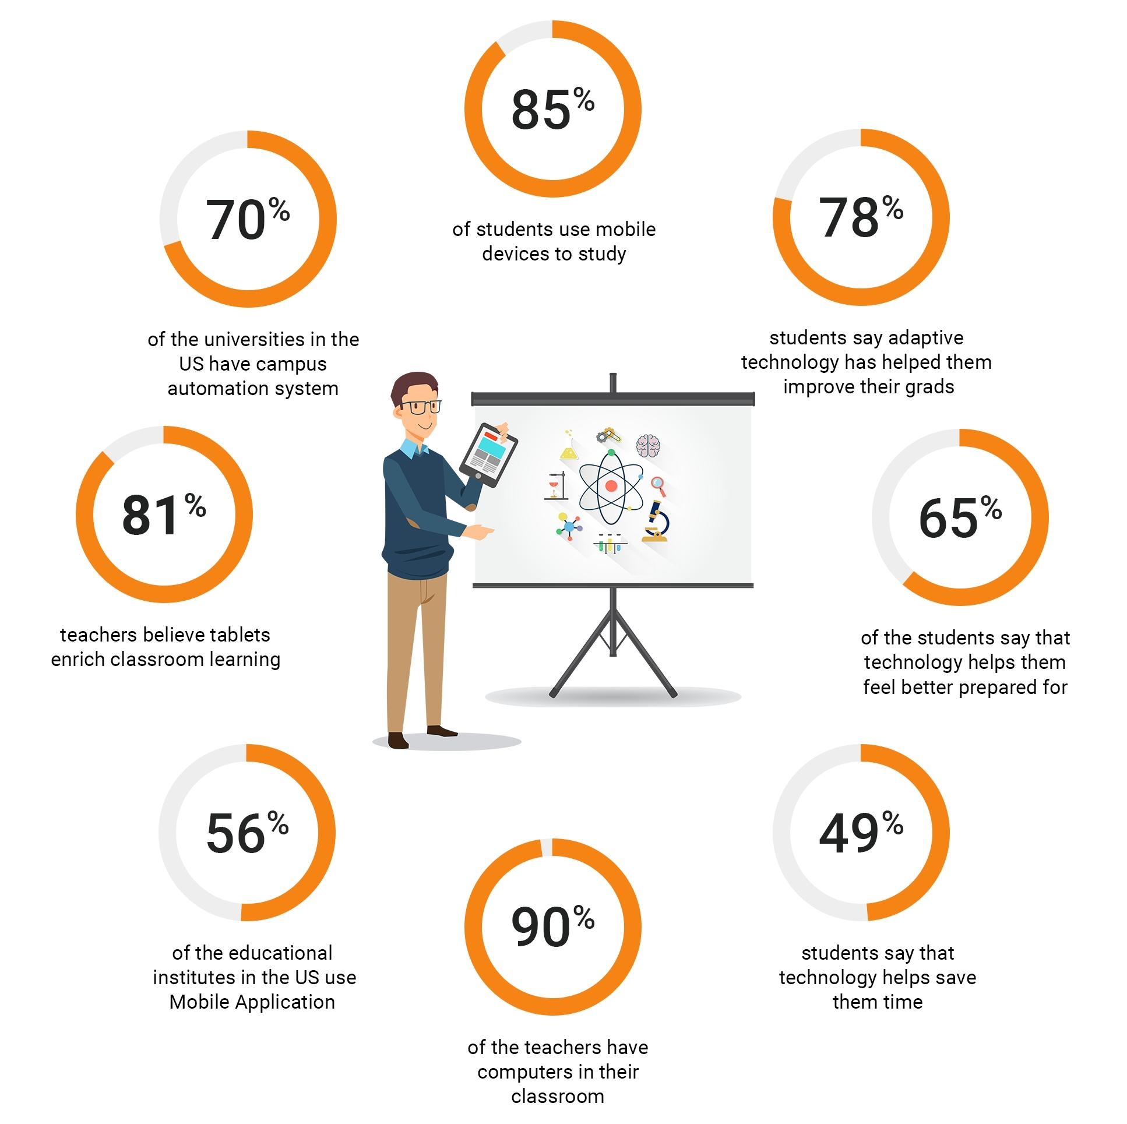
3

Slide 5
Proposed Method
Question Bank for the research question:
Are students confident in using technology to collaborate?
Closed questions. (yes or no answers)
Are you confident in using MS Teams to work with your peers?
Yes/No
Do you feel confident when using the OneDrive to collaborate with peers?
Yes/No
Have you received training on how to use the OneDrive to collaborate with others? Yes/No
Do you feel anxious if you are asked to collaborate using technology?
Yes/No
Do you feel anxious if peers want to use the OneDrive to collaborate?
Yes/No
Have you ever avoided using technology to collaborate?
Yes/No
Do you see the value of using technology to collaborate?
Yes/No
4

Slide 6
Ethical consideration
We would base our research on the following ethical principles:
Informed consent of those taking parts
Respect for others
Avoindence of harm
Privacy of those taking parts
Voluntary nature of participation and right to withdraw
Integrity ,fairness and open-mindedness
Saunders et al (2019)
5

Slide 7
Research Timeline
WEEK 1 | WEEK 2 | WEEK 3
Data collection | Analyse data | Publish the report
6

Slide 8
Hypotesis
In conclusion we think that we will find out that technology is an important part of students' lives, that have a positive impact and most of them feel very confident in using it to collaborate.
7

Slide 9
Reference List
UCAS (2021) Students turn to technology with university choices” [online] Available at :https://www.ucas.com/corporate/news-and-key-documents/news/students-turn-technology-university-choices#queryId=3e138e88ccfcfb3ef89872c1e3ccd714
The tech edvocate(2021) 9 Ways that technology student confidence in the classroom Avaible at :https://www.thetechedvocate.org/9-ways-technology-boosts-student-confidence-classroom/
Exploeance(2022) 7 Reasons why students need technology in the classroom Avaible at https://explorance.com/blog/7-reasons-students-need-technology-classroom/
Saunders,M.N.K.,Lewis,P. and Thornhill,A.(2019) Research Methods for business studens.8th edition.Harlow:Pearson
8

