Slide 1
Week 4
Project Scope Management
Managing Projects in the Organisation BMSW 5104

Slide 2
Learning Objectives:
After completion of this session you should be able to:
Understand the concept of project management scope
Understand to develop work breakdown structure (WBS)

Slide 3
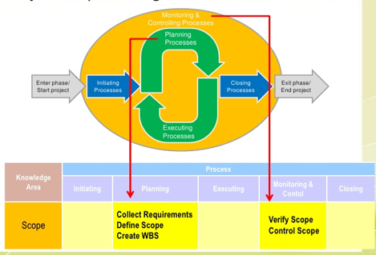
What is Project Scope Management
Scope refers to all the work involved in creating the products of the project and the processes used to create them

Slide 4
Project Scope Management Process
Process Group | Integration Management Process | Major Output
Planning | P1: Plan Scope Management | Scope Management Plan Requirement Mgt. Plan
 | P2: Collect Requirements | Req. Documentation Req. Traceability Matrix
 | P3: Define Scope | Project Scope Statement Project Docs Update
 | P4: Create WBS | Scope Baseline Project Docs Update
Monitoring and Controlling | MC1: Validate Scope | Accept Deliverables Change Requests Work Performance Info
 | MC2: Control Scope | Change Requests Project Mgt. Plan Updates Org, Process Asset Updates

Slide 5
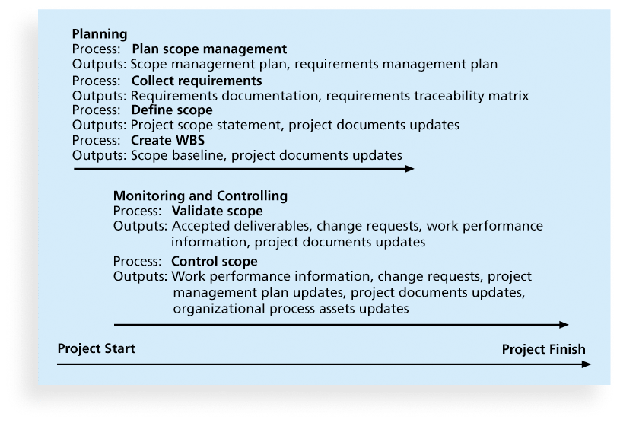
Project Scope Management Process
Planning scope
Collecting requirements
Defining scope
Creating the WBS
Validating scope
Controlling scope

Slide 6
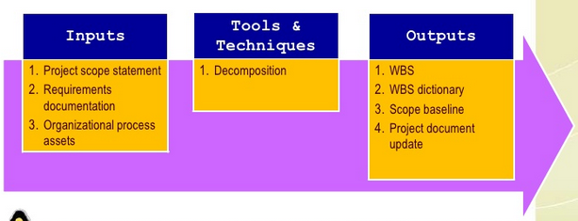
Creating the Work Breakdown Structure (WBS)
A WBS is a deliverable-oriented grouping of the work involved in a project that defines the total scope of the project

Slide 7
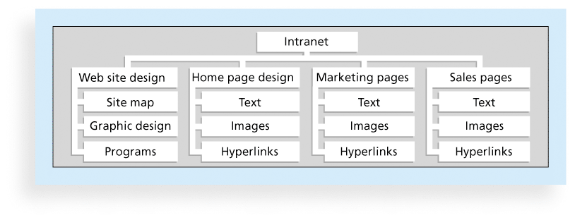
Sample Internet WBS (Organised by Product)

Slide 8
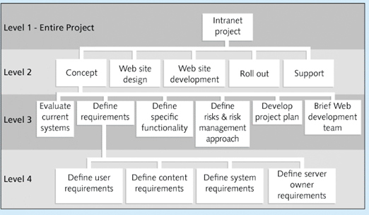
Sample Internet WBS (Organised by Phase)

Slide 9
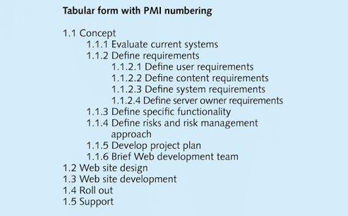
Sample Internet WBS (Organised by Phase)
Level 2
Level 3
Level 4

Slide 10
PMI Practice Standard for WBS – 100% Rule
WBS should include 100% of the work defined by the project scope and capture ALL deliverables (internal, external, interim) in terms of work to be completed

Slide 11
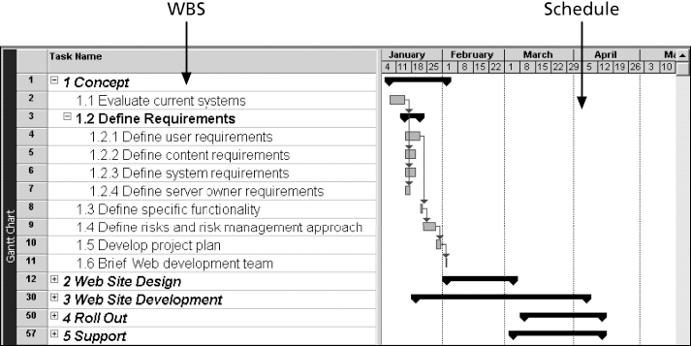
Internet WBS and Gantt Chart

Slide 12
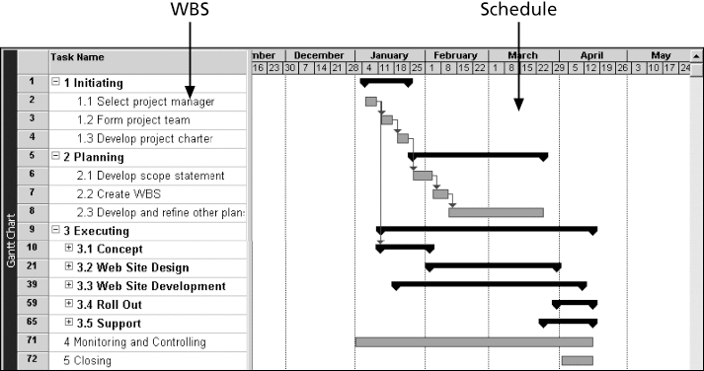
Internet Gantt Chart Organised by Project Management Process Groups

Slide 13
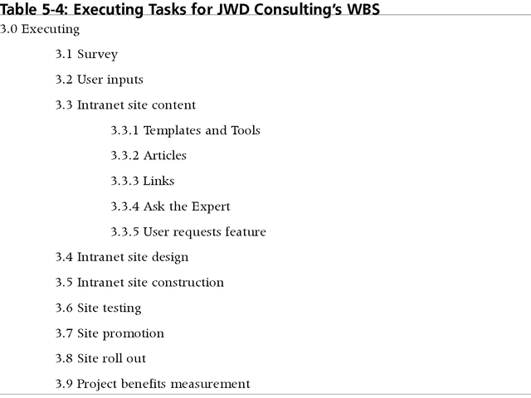
Executing Tasks – Consulting’s WBS

Slide 14
Approaches to developing a WBS
Using guidelines: Some organizations provide guidelines for preparing WBSs
  analogy approach
  top-down approach
  bottom-up approach
  Mind-mapping approach

Slide 15
Approaches to developing a WBS
Analogy Approach
This might be very helpful - If you have a similar project, you could tailor it to your project. For example, if I have an e-Commerce website and I have already worked on similar kind of project. That is simple for me to break down based on past experience.

Slide 16
Approaches to developing a WBS
Top-down Approach
Top-down approach states that you need to take the biggest task or module in the project and break them down. It requires more logic and structure and generally it is a preferred method for creating WBS.
This approach will identify the solution first and then dissect the solution into smaller steps required to implement it.

Slide 17
Approaches to developing a WBS
Bottom-up Approach:
This is very straight forward. Pick the specific task that can be easily done and complete it. Bottom up method is ideal for brainstorming a solution to a problem.

Slide 18
Approaches to developing a WBS
Mind-mapping Technique:
This is a very useful technique used by most Project Specialists and especially for the Project Managers. In this approach, we need to write the task in a non-linear, branching format and then create the WBS structure.
There are many mind-mapping tools available in the market. Just Google it!

Slide 19
Points to be noted …
Ensure that the WBS is the sum of all the work involved in your project
While the WBS list is for an individual, multiple people can work on this
The Work break down structure must be consistent in the way work is going to be performed
Project team members need to be included in the WBS so that things run smoothly
Each WBS must be documented in a WBS dictionary to ensure the accurate understanding of the scope of the project.

Slide 20
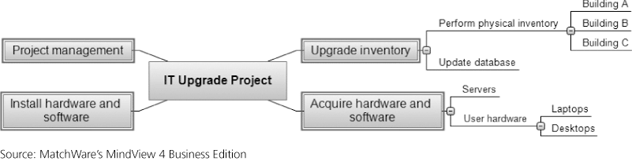
Sample – Mind-mapping approach for creating a WBS

Slide 21
Sample – Mind-mapping approach for creating a WBS
Name of the Project

Slide 22
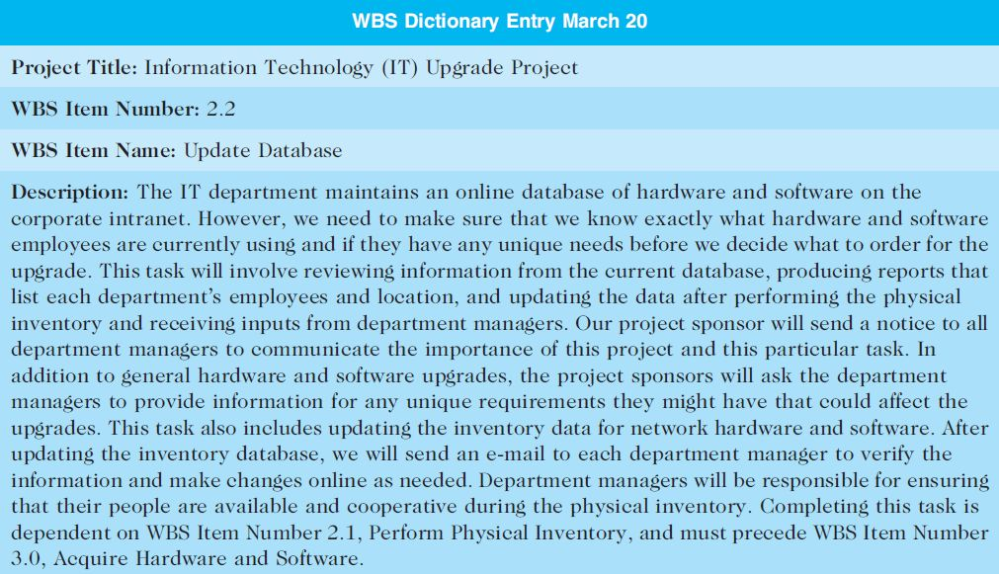
The WBS Dictionary and Scope Baseline
Many tasks are vague and must be explained more so people know what to do and can estimate how long it will take and what it will cost
WBS Dictionary

Slide 23
Advice for creating a WBS and WBS dictionary
Unit of work should appear only once in WBS.
Work content of WBS item is sum of items
Limit responsibility of a WBS item to one individual (even though many people may be working on it)
Project team member involvement in developing
Document WBS items in WBS Dictionary

Slide 24
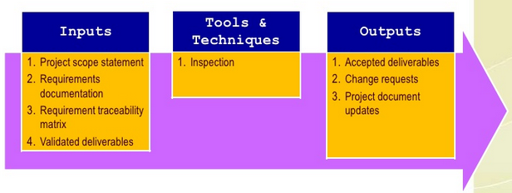
Validating Scope
Scope validation involves formal acceptance of the completed project deliverables
Acceptance is often achieved by a customer inspection and then sign-off on key deliverables

Slide 25
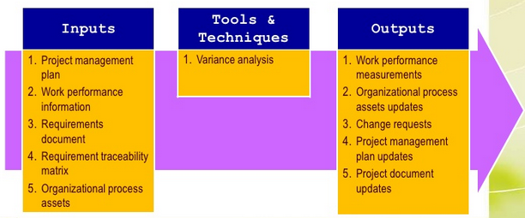
Controlling Scope
Scope control involves controlling changes to the project scope

Slide 26
Controlling Scope
Goals of scope control
influence the factors that cause scope changes
assure changes are processed according to procedures developed as part of integrated change control
manage changes when they occur
Variance is the difference between planned and actual performance

Slide 27
Avoiding Scope Creep
Scope creep may occur as a result of:
Poor change control
Lack of proper initial identification and/or documentation of the features that are required for the achievement of project objectives
Weak project manager or executive sponsor

Slide 28
Avoiding Scope Creep
To mitigate these types of issues, the proposed solutions are the following:
Define requirements as “must-haves” and “nice to haves”
Set project expectations
Agree on deliverables, and document
Document and review business requirements

Slide 29
Best practices - Avoiding Scope problems
Keep the scope realistic. Don’t make projects so large that they can’t be completed.
Involve users in project scope management.
Use off-the-shelf hardware and software whenever possible.
Follow good project management processes.

Slide 30
Improving user input
Develop a good project selection process and insist that sponsors are from the user organization
Have users on the project team in important roles
Have regular meetings with defined agendas, and have users sign off on key deliverables presented at meetings
Deliver something to users and sponsors on a regular basis
Don’t promise to deliver when you know you can’t
Co-locate users with developers

Slide 31
Next Week …
Teamwork, leadership and management for projects

Slide 32
Thank you …!

