Slide 1
Data Warehousing & Data Mining
ACCA6026
Lecture 2 – Business Intelligence Architecture
Balendran Kandasamy

Slide 2
Introduction
This is a very high level description of a BI system
Lower level descriptions will come as we start to design a data warehouse
This lecture looks at the back end; the next lecture will look at the front end
Major architectural components of small/new and large/mature BI system
Large/mature BI systems are sometimes known as Enterprise Intelligence Systems

Slide 3
Operational & Source Systems
Operational systems provide the source material for any BI system
These may also be known as source systems, transaction processing systems, enterprise resource planning (ERP) systems
There may be many systems in a company, each dealing with different types of data and, even where they use the same information, using different terms to describe the data
When business intelligence is integrated with an operational system or supports an operational task, it is referred to as operational business intelligence
Notes:
Operational systems = where the data is created
“Operational systems provide the source material for any BI system”
Operational systems are the day-to-day systems that run the business.
They record transactions and activities such as:
Sales orders
Payments
Inventory updates
Customer registrations
Employee records
These systems generate the raw data that BI later analyses.
Think of it like this:
Operational systems = data factory
BI system = data analyser

Slide 4
Tansaction Processing Systems (TPS)
Systems that handle routine, day-to-day transactions.
Example:
A supermarket checkout system
Online order processing
Enterprise resource planning systems (ERP)
Integrated systems that manage multiple business functions:
Finance
HR
Operations
Supply chain
Example: SAP, Oracle ERP, Microsoft Dynamics
ERP systems are often large integrated operational systems.

Slide 5
Multiple systems = multiple definitions of data
There may be many systems in a company…
In reality, organisations don’t usually have just one system.
They might have:
A CRM for customers
An accounting system for finance
A warehouse system for logistics
A separate HR system
Notes:
Problems arise because:
Different systems may define the same thing differently.
The same customer might be labelled differently.
“Revenue” might be calculated differently across systems.
This creates:
Data inconsistency
Integration challenges
Confusion in reporting
This is one major reason why BI and data warehousing exist — to standardise and integrate data.

Slide 6
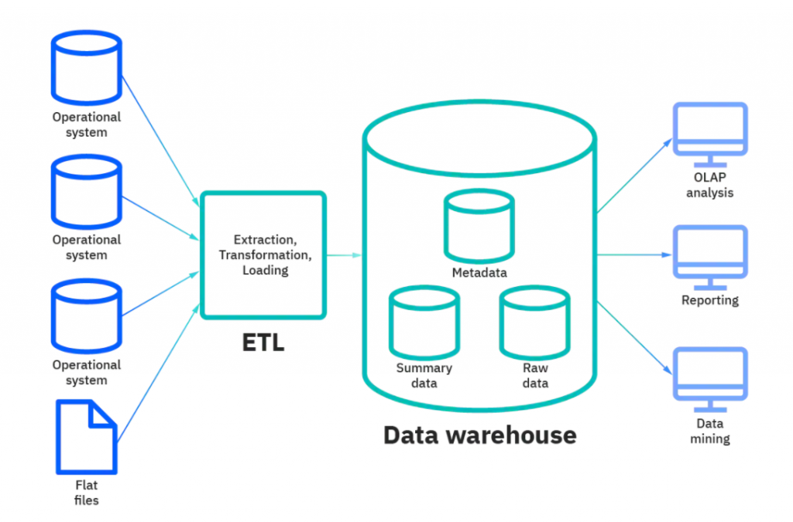
Architecture
Notes:
Operational Systems → ETL → Data Warehouse → BI Tools

Slide 7

Operational & Source Systems
Product
Product
Product
Product
Customer
Customer
Customer
Production
Orders
Orders
Shipments
Invoices
Order
Order
Order
Order
Shipping
Details
Invoice
Shipping
Details
Manufacturing
Sales
Supply Chain
Accounting

Slide 8
Operational BI System
Business Rules & Processes
Shared Reference Tables
Product
Customer
Accounts
Modules
Order Module
Accounting Module
Order
Shipping
Details
Invoice
Order
Manufacturing
Sales
Supply Chain
Accounting
Notes:
What “Operational BI” Means Here
This diagram is illustrating:
BI capabilities embedded inside operational systems.
For example:
A sales dashboard built into the order system
Real-time performance metrics in accounting
Alerts during supply chain processing

Slide 9
Operational BI v. Data Warehouse
Operational BI systems do not include data warehouses
With an operational BI system all reporting is performed from the system that controls and records day-to-day operations
This can be a problem when running reports takes up so much computer time that it slows down the operational systems
To avoid this, a data warehouse can be used
The data from many operational systems is extracted and loaded into a data warehouse using a process to either
  ETL – Extract, Transform and Load
  ELT – Extract, Load and Transform
Data warehouses also contain Online Analytical Processing (OLAP) engines to do the querying and reporting

Slide 10
ETL – Extract, Transform, Load
Process Order
Extract data from source systems
Transform it (clean, standardise, aggregate)
Load it into the data warehouse
🔎 Where transformation happens:
Outside the data warehouse (in an ETL engine).
Notes:
Why ETL Was Used Traditionally
Older systems:
Had limited storage
Had limited processing power
Required data to be cleaned before loading
So transformation happened first to:
Reduce volume
Standardise definitions
Improve performance
Historically:
The data warehouse did NOT provide the ETL engine.
ETL was handled by separate tools.
Examples of traditional ETL tools:
Informatica
IBM DataStage
Microsoft SSIS
So in classic architecture:
The ETL engine was external to the warehouse.

Slide 11
ELT – Extract, Load, Transform
Process Order
Extract data
Load raw data directly into the warehouse
Transform inside the warehouse
🔎 Where transformation happens:
Inside the data warehouse using SQL or built-in processing power.
Notes:
Why ELT Is Common Today
Modern cloud data warehouses:
Have massive storage
Have strong processing power
Can handle raw data efficiently
So we:
Load everything first
Transform later as needed

Slide 12
🏗 Why ELT Is Increasingly Popular
Because modern platforms (e.g., Snowflake, BigQuery, Redshift):
Separate storage and compute
Scale easily
Allow transformation on demand
This supports:
Data science
Machine learning
Exploratory analytics

Slide 13
Why ELT Keeps Both
In ELT:
Data is extracted
Loaded as-is (raw) into the warehouse
Then transformed into analytical structures (e.g., star schemas)
So typically you will have:
Raw layer (unchanged source data)
Transformed layer (cleaned, structured, business-ready data)
Notes:
🎯 Why This Is Useful
Keeping raw data allows:
✅ Reprocessing
If business rules change, you can rebuild transformed tables.
✅ Auditability
You can trace metrics back to original source records.
✅ Flexibility
Different teams (BI, data science) can transform data differently.
✅ Data Science
Raw granular data is useful for ML models.

Slide 14
🎯 Why This Is Useful
Keeping raw data allows:
✅ Reprocessing
If business rules change, you can rebuild transformed tables.
✅ Auditability
You can trace metrics back to original source records.
✅ Flexibility
Different teams (BI, data science) can transform data differently.
✅ Data Science
Raw granular data is useful for ML models.

Slide 15


BI with a data warehouse
IT
Department
Business
Users
ORDERS
INVOICES
Extract
Transform
Load
Query
Report
Analyse
Alert
Relational Tables
SHIPPING
WEB CLICKS
EXTERNAL DATA
OLAP
Source
Systems
BI
Tools
Data Warehouse

Slide 16
OLAP (Online Analytical Processing)
is a technology used to analyse large volumes of data quickly from multiple dimensions.
In simple terms:
OLAP allows users to explore data interactively and answer complex analytical questions.
It is designed for:
Aggregations
Trends
Comparisons
Multi-dimensional analysis

Slide 17
What Does “Multi-Dimensional” Mean?
In business analysis, data is not just one table.
Example:
Sales data can be analysed by:
Time (day, month, year)
Product
Region
Customer segment
Salesperson
Each of these is a dimension.
OLAP allows you to combine them easily:

Slide 18
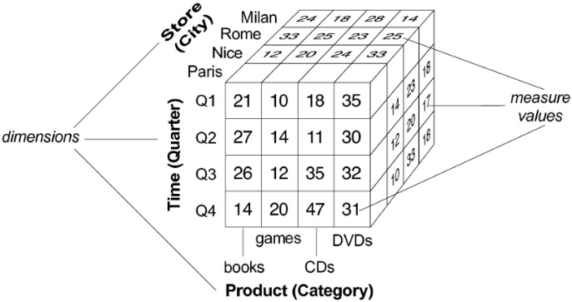

Slide 19
ETL
Data must be extracted from the source systems, transformed so that it is all in the same format, then loaded into the data warehouse
Data must be transformed because different systems may use different field names, domains or coding systems
Most transformation is custom-coded, although systems like Oracle Data Integrator and Microsoft Integration Services can automate the process to a degree
Careful thought must be given to what data is to be extracted
Extracting everything often isn’t an option due to
  Cost of storage
  Extractions must be done rapidly to keep up to date
  Too much data slows down the DW query process

Slide 20
Enterprise Information Management
The term ‘Enterprise Information Management’ (EIM) is beginning to replace the term ‘data warehouse’ in some businesses
An EIM generally includes
  The data warehouse
  ETL tools
  Data modelling tools
  Data quality tools
  Data profiling tools
  Metadata management tools
  Master data management tools
These tools may all be from the same package, such as Microsoft’s SQL Server range, or from different vendors

Slide 21
Metadata
Metadata is the data about the data
This may include:
  When the data was extracted from the source system
  Which source system the data was extracted from
  When the data was loaded into the warehouse
  Which tables/fields in a source originally held the data
  Which tables/fields in a source were used to calculate data
  What an item means in the business context
  ...
Notes:
Ask what other types of metadata might be stored

Slide 22
Master Data Management
Master Data Management (MDM) is comprised of the business applications, methods and tools that implement the policies, procedures and infrastructure to support the capture, integration and subsequent shared use of accurate, timely, consistent and complete master data
i.e. It is all of the code and descriptions for customers, products, accounts and so on
The MDM ensures, for example, that the same product ID is used throughout the system
  This is often done by including translation tables that map the manufacturing product IDs to the sales product Ids
Master data is stored in a set of tables that are available to the rest of the data warehouse

Slide 23
Data warehouses & Data marts
A data warehouse consists of data that has been extracted from the source systems, transformed so that it is all in the same format, then loaded for analysis
Data Marts are extracts from the main data warehouse tailored to the needs of individual sections of the organisation
It is possible to create data marts based directly upon an operational business intelligence system but this is generally viewed as having higher long-term costs than using a data warehouse
Data marts may be used to feed data back to the data warehouse, e.g. Updating of VAT rates
Data warehouses may be used to update source systems

Slide 24
Data warehouse with data marts
IT
Department
Business
Users
ORDERS
INVOICES
Relational Tables
SHIPPING
WEB CLICKS
EXTERNAL DATA
OLAP
Source
Systems
BI
Tools
Data Warehouse
Data Marts

Slide 25
Data warehouse tables
Most data warehouses have two types of table
Fact tables – these are relationship tables containing foreign keys to other look-up tables plus other related data for analysis
  E.g. An orders table might contain foreign key links to look-up tables for products and customers plus other fields for prices and number sold
  These facts are often called measures
  To improve performance, aggregate fact tables are sometimes used, e.g. All sales this quarter
Dimension tables – these are the look-up tables containing the information referred to by the fact tables
NB: Data warehouse databases are often not normalised

Slide 26
DW star schema
TIME
KEY | DAY | MONTH | YEAR
SHIPPING
KEY | COMPANY | STREET | TOWN
ORDERS FACT
CUSTOMER
KEY | CUSTOMER | COMPANY
PRODUCT
KEY | PRODUCT | CATEGORY

Slide 27
DW snowflake schema
Town
Year
Street
Month
Customer
Day
ORDERS FACT
Customer
Product
Company
Category

Slide 28
Summary
Operational business intelligence systems do not include data warehouses
A data warehouse consists of data that has been extracted from the source systems, transformed so that it is all in the same format, then loaded for analysis
Data marts are extracts from the main data warehouse tailored to the needs of individual sections of the organisation
Data warehouses contain fact tables and dimensions
As the data does not need to be normalised, either star schema and snowflake schema are generally used

Slide 29
Looking ahead
Next week: Business Intelligence Front End
Homework: Read the following Wikipedia entries
  Star schema
  Snowflake schema

