Slide 1
Lecture 5
Building an E-Business
E-Commerce/ Digital Presence

Slide 2
Learning Objectives
Understand the questions you must ask and answer, and the steps you should take, in developing an e-business / e-commerce / on line presence.
Explain the process that should be followed in building an e-commerce presence.
Identify and understand the major considerations involved in choosing web server and e-commerce merchant server software.
Understand the issues involved in choosing the most appropriate hardware for an e-commerce site.
Identify additional tools that can improve website performance.
Understand the important considerations involved in developing a mobile website and building mobile applications.
Notes:
Slide 2 is list of textbook LO numbers and statements

Slide 3
Imagine Your E-Commerce Presence (1 of 3)
What’s the idea? The vision includes:
  Mission statement
  Target audience
  Intended market space
  Strategic analysis
  Marketing matrix
  Development timeline
  Preliminary budget

Slide 4
Imagine Your E-Commerce Presence (2 of 3)
Where’s the money?
  Business model(s)
  Revenue model(s)
Who and where is the target audience?
  Demographics, lifestyle, consumption patterns, etc.
What is the ballpark? Characterize the marketplace
  Size, growth, demographics, structure

Slide 5
Imagine Your E-Commerce Presence (3 of 3)
Where’s the content coming from?
Know yourself—S W O T analysis
Develop an e-commerce presence map
Develop a timeline: Milestones
How much will this cost?
  Simple website: up to $5000
  Small startup: $25,000 to $50,000
  Large corporate website: $100,000+ to millions

Slide 6
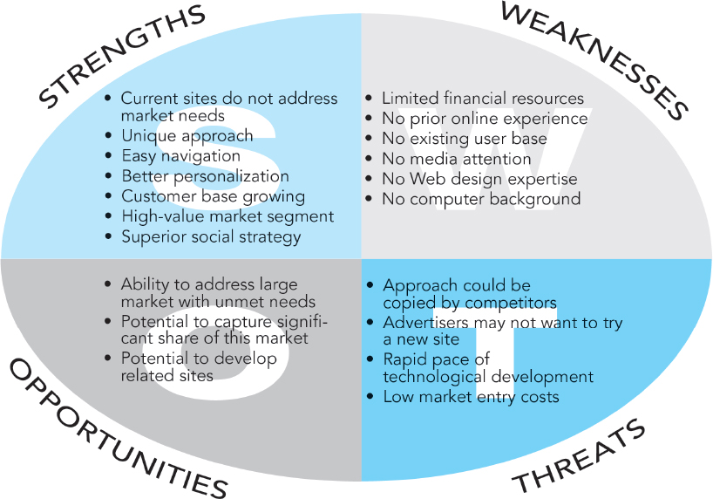
Figure 1 S W O T Analysis
Notes:
Figure 4.1, Page 197.
A SWOT analysis describes your firm’s strengths, weaknesses, opportunities, and threats.

Slide 7
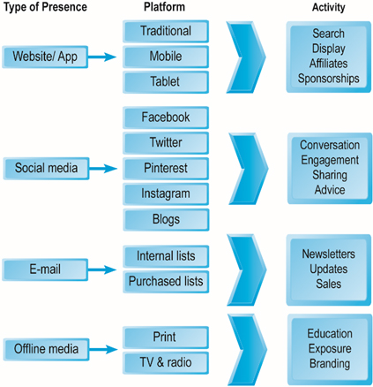
Figure 2 E-Commerce Presence Map
Notes:
Figure 4.2, Page 198.
An e-commerce presence requires firms to consider the four different kinds of presence, and the platforms and activities associated with each type of presence.

Slide 8
Insight on Technology: Will Apps Make the Web Irrelevant?
  What are the advantages and disadvantages of apps, compared with websites, for mobile users?
  What are the benefits of apps for content owners and creators?
  Will apps eventually make the Web irrelevant? Why or why not?

Slide 9
Building an E-Commerce Site: A Systematic Approach
Most important management challenges:
  Developing a clear understanding of business objectives
  Knowing how to choose the right technology to achieve those objectives
Main factors to consider
  Management
  Hardware architecture
  Software
  Design
  Telecommunications
  Human resources

Slide 10
Planning: The Systems Development Life Cycle
Methodology for understanding business objectives of a system and designing an appropriate solution
Five major steps:
  Systems analysis/planning
  Systems design
  Building the system
  Testing
  Implementation

Slide 11
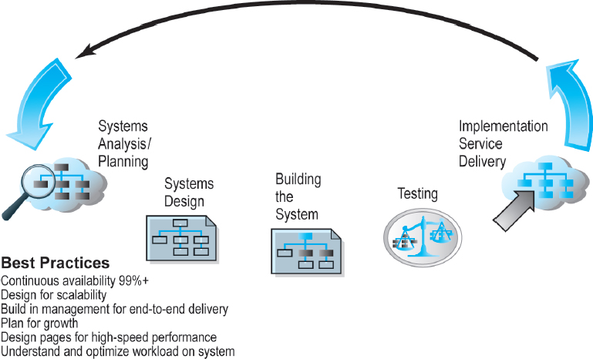
Figure 3. Website Systems Development Life Cycle
Notes:
Figure 4.5, Page 202.

Slide 12
System Analysis/Planning
Business objectives:
  List of capabilities you want your site to have
System functionalities:
  List of information system capabilities needed to achieve business objectives
Information requirements:
  Information elements that system must produce in order to achieve business objectives

Slide 13
Table 1.1 System Analysis, Business Objectives, System Functionalities, and Information Requirements for a Typical E-Commerce Site (1 of 2)
Business Objective | System Functionality | Information Requirements
Display goods | Digital Catalog | Dynamic text and graphics catalog
Provide product information | Product database | Product description, stocking numbers, inventory levels
Personalize/customize product | Customer on-site tracking | Site log for every customer visit; data mining capability to identify common customer paths and appropriate responses
Engage customers in conversations | On-site blog; user forums | Software with blogging and community forum functionality
Execute a transaction | Shopping cart/payment system | Secure credit card clearing; multiple payment options
Accumulate customer information | Customer database | Name, address, phone, and e-mail for all customers; online customer registration

Slide 14
Table 1.2 System Analysis, Business Objectives, System Functionalities, and Information Requirements for a Typical E-Commerce Site (2 of 2)
Business Objective | System Functionality | Information Requirements
Provide after-sale customer support | Sales database | Customer I D, product, date, payment, shipment date
Coordinate marketing/advertising | Ad server, e-mail server, e-mail, campaign manager, ad banner manager | Site behavior log of prospects and customers linked to e-mail and banner ad campaigns
Understand marketing effectiveness | Site tracking and reporting system | Number of unique visitors, pages visited, products purchased, identified by marketing campaign
Provide production and supplier links | Inventory management system | Product and inventory levels, supplier I D and contact, order quantity data by product

Slide 15
Systems Design: Hardware and Software Platforms
System design specification:
  Description of main components of a system and their relationship to one another
Two components of system design:
  Logical design
    Data flow diagrams, processing functions, databases
  Physical design
    Specifies actual physical, software components, models, and so on

Slide 16
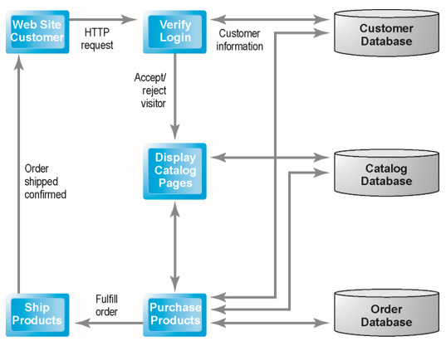
Figure 3.6(a) Logical Design for a Simple Website
(a) Simple Data Flow Diagram
This data flow diagram describes the flow of information requests and responses for a sample Web site
Notes:
Figure 4.6(a), Page 205.
This data flow diagram describes the flow of information requests and responses for a simple website.

Slide 17
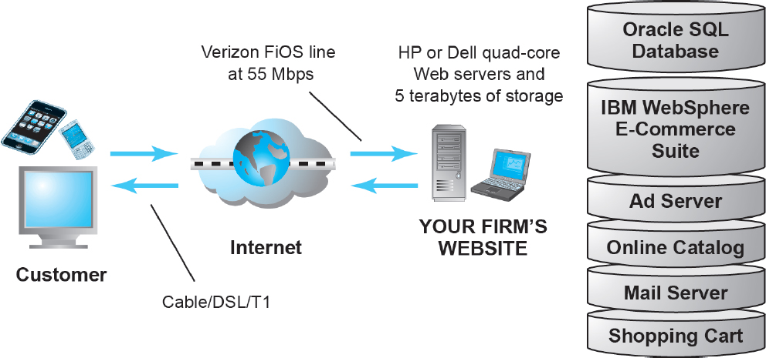
Figure 3.6(b) Physical Design for a Simple Website
Notes:
Figure 4.6(b), Page 205.
A physical design describes the hardware and software needed to realize the logical design.

Slide 18
Building the System: In-House Versus Outsourcing
Outsourcing: Hiring vendors to provide services involved in building site
Build own versus. outsourcing:
  Build your own requires team with diverse skill set; choice of software tools; both risks and possible benefits
Host own versus. outsourcing
  Hosting: Hosting company responsible for ensuring site is accessible 24/7, for monthly fee
  Co-location: Firm purchases or leases Web server (with control over its operation), but server is located at vendor’s facility

Slide 19
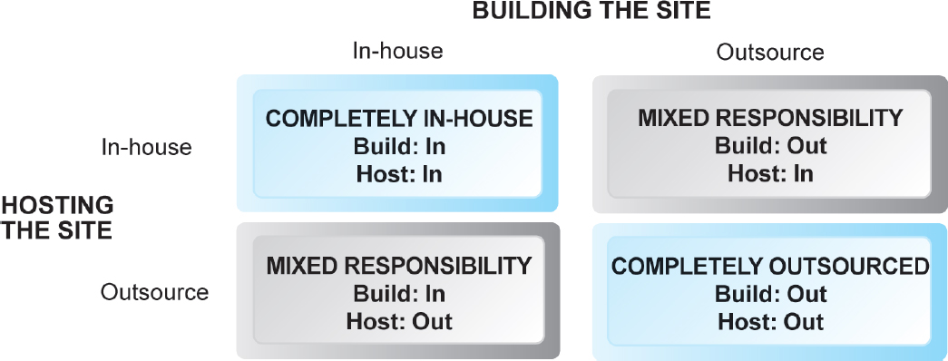
Choices in Building and Hosting
Notes:
Figure 4.7, Page 206.
You have a number of alternatives to consider when building and hosting an e-commerce site.

Slide 20
Insight on Business: Weebly Makes Creating Websites Easy
Class Discussion
  What value does Weebly offer to small businesses?
  Are there any drawbacks to using Weebly to create an e-commerce presence?
  How are service providers like Weebly changing the nature of e-commerce?

Slide 21
Testing the System
Testing
  Unit testing
  System testing
  Acceptance testing
  A/B testing (split testing)
  Multivariate testing

Slide 22
Implementation and Maintenance
Systems break down unpredictably
Maintenance is ongoing
Maintenance costs: Similar to development costs
  A $40K e-commerce site may require $40K annually to upkeep
Benchmarking

Slide 23
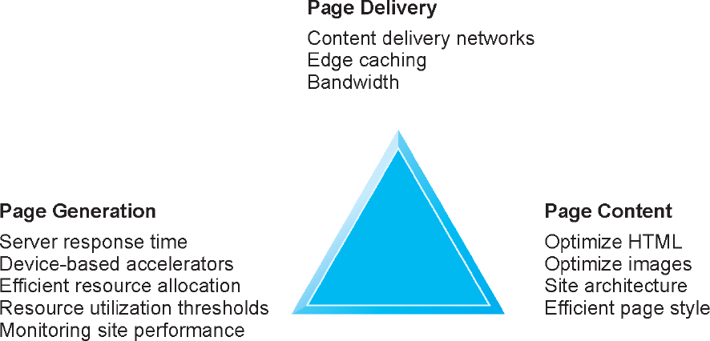
Factors in Website Optimization
Notes:
Figure 4.10, Page 213.
Website optimization requires that you consider three factors: page content, page generation, and page delivery.

Slide 24
Simple versus. Multi-Tiered Website Architecture
System architecture
  Arrangement of software, machinery, and tasks in an information system needed to achieve a specific functionality
Two-tier
  Web server and database server
Multi-tier
  Web application servers
  Backend, legacy databases

Slide 25
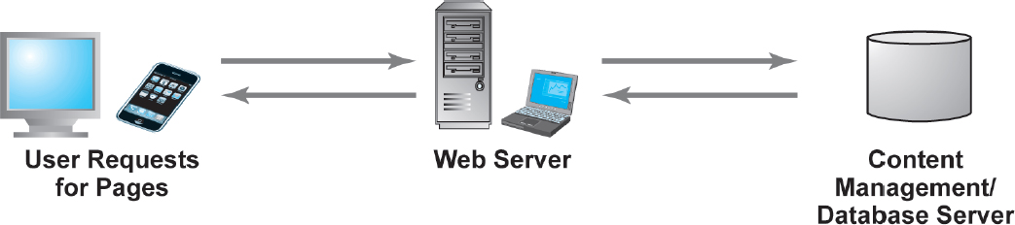
Two-Tier E-Commerce Architecture
Notes:
Figure 4.11(a), Page 215.
In a two-tier architecture, a web server responds to requests for web pages and a database server provides backend data storage.

Slide 26
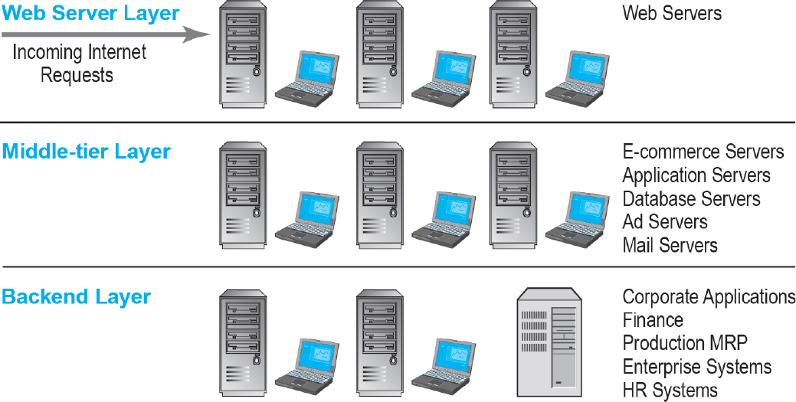
Multi-Tier E-Commerce Architecture
Notes:
Figure 4.11(b), Page 215.
In a multi-tier architecture, a web server is linked to a middle-tier layer that typically includes a series of application servers that perform specific tasks, as well as to a backend layer of existing corporate systems.

Slide 27
Web Server Software
Apache
  Leading web server software
  Works with U N I X, Linux operating systems
  Reliable, stable, part of open software community
Microsoft’s Internet Information Server (I I S)
  Second major web server software
  Windows-based
  Integrated, easy-to-use

Slide 28
Table 3.4 Basic Functionality Provided by Web Servers
Functionality | Description
Processing of H T T P requests | Receive and respond to client requests for H T M L pages
Security services (Secure Sockets Layer)/ Transport Layer Security | Verify username and password; process certificates and private/public key information required for credit card processing and other secure information
File Transfer Protocol | Permits transfer of very large files from server to server
Search engine | Indexing of site content; keyword search capability
Data capture | Log file of all visits, time, duration, and referral source
E-mail | Ability to send, receive, and store e-mail messages
Site management tools | Calculate and display key site statistics, such as unique visitors, page requests, and origin of requests; check links on pages

Slide 29
Site Management Tools
Basic tools included in all web servers
  Verify that links on pages are still valid
  Identify orphan files
Third-party software for advanced management
  Monitor customer purchases
  Marketing campaign effectiveness
  Keep track of hit counts and other statistics
  E.g. Webtrends Analytics 10

Slide 30
Dynamic Page Generation Tools
Dynamic page generation:
  Contents stored in database and fetched when needed
Common tools:
  C G I, A S P, J S P, O D B C, J D B C
Advantages
  Lowers menu costs
  Permits easy online market segmentation
  Enables cost-free price discrimination
  Enables content management system (C M S)

Slide 31
Application Servers
Web application servers:
  Provide specific business functionality required for a website
  Type of middleware
    Isolate business applications from Web servers and databases
  Single-function applications being replaced by integrated software tools that combine all functionality needed for e-commerce site

Slide 32
E-Commerce Merchant Server Software
Provides basic functionality for sales
  Online catalog
    List of products available on website
  Shopping cart
    Allows shoppers to set aside, review, edit selections, and then make purchase
  Credit card processing
    Typically works in conjunction with shopping cart
    Verifies card and puts through credit to company’s account at checkout

Slide 33
Merchant Server Software Packages (1 of 2)
Integrated environment that includes most of functionality needed
  Shopping cart
  Merchandise display
  Order management
Two main options
  E-commerce merchant service sites (e.g. Yahoo Aabaco Small Business)
  Open-source merchant server software

Slide 34
Merchant Server Software Packages (2 of 2)
Key factors in selecting a package
  Functionality
  Support for different business models, including (m-commerce)
  Business process modeling tools
  Visual site management and reporting
  Performance and scalability
  Connectivity to existing business systems
  Compliance with standards
  Global and multicultural capability
  Local sales tax and shipping rules

Slide 35
Choosing Hardware
Hardware platform:
  Underlying computing equipment needed for e-commerce functionality
Objective:
  Enough platform capacity to meet peak demand without wasting money
Important to understand the factors that affect speed, capacity, and scalability of a site

Slide 36
Right-Sizing Your Hardware Platform: the Demand Side
Customer demand:
  Most important factor affecting speed of site
Factors in overall demand:
  Number of simultaneous users in peak periods
  Nature of customer requests (user profile)
  Type of content (dynamic versus. static Web pages)
  Required security
  Number of items in inventory
  Number of page requests
  Speed of legacy applications

Slide 37
Right-Sizing Your Hardware Platform: the Supply Side
Scalability:
  Ability of site to increase in size as demand warrants
Ways to scale hardware:
  Vertically
    Increase processing power of individual components
  Horizontally
    Employ multiple computers to share workload
  Improve processing architecture
  Outsource to cloud service, C D N

Slide 38
Table 3.8 Vertical and Horizontal Scaling Techniques
Technique | Application
Use a faster computer | Deploy edge servers, presentation servers, data servers, etc.
Create a cluster of computers | Use computers in parallel to balance loads.
Use appliance servers | Use special-purpose computers optimized for their task.
Segment workload | Segment incoming work to specialized computers.
Batch requests | Combine related requests for data into groups, process as group.
Manage connections | Reduce connections between processes and computers to a minimum.
Aggregate user data | Aggregate user data from legacy applications in single data pools.
Cache | Store frequently used data in cache rather than on the disk.

Slide 39
Table 3.9 Improving the Processing Architecture of Your Site
Architecture Improvement | Description
Separate static content from dynamic content | Use specialized servers for each type of workload.
Cache static content | Increase R A M to the gigabyte range and store static content in R A M.
Cache database lookup tables | Use cache tables used to look up database records.
Consolidate business logic on dedicated servers | Put shopping cart, credit card processing, and other C P U-intensive activity on dedicated servers.
Optimize A S P code | Examine your code to ensure it is operating efficiently.
Optimize the database schema | Examine your database search times and take steps to reduce access times.

Slide 40
E-Commerce Site Tools
Website design: Basic business considerations
  Enabling customers to find and buy what they need
Tools for search engine optimization
  Search engine placement
    Metatags, titles, content
    Identify market niches
    Offer expertise
    Links
    Buy ads
    Local e-commerce

Slide 41
E-Commerce Website Features That Annoy Customers (1 of 2)
Feature
Requiring user to view ad or intro page before going to website content
Pop-up and pop-under ads and windows
Too many clicks to get to the content
Links that don’t work
Confusing navigation; no search function
Requirement to register and log in before viewing content or ordering
Slow loading pages
Content that is out of date

Slide 42
E-Commerce Website Features That Annoy Customers (2 of 2)
Inability to use browser’s Back button
No contact information available (web form only)
Unnecessary splash/flash screens, animation, etc.
Music or other audio that plays automatically
Unprofessional design elements
Text not easily legible due to size, color, format
Typographical errors
No or unclear returns policy

Slide 43
The Eight Most Important Factors in Successful E-Commerce Site Design
Factor | Description
Functionality | Pages that work, load quickly, and point the customer toward your product offerings
Informational | Links that customers can easily find to discover more about you and your products
Ease of use | Simple foolproof navigation
Redundant navigation | Alternative navigation to the same content
Ease of purchase | One or two clicks to purchase
Multi-browser functionality | Site works with the most popular browsers
Simple graphics | Avoids distracting, obnoxious graphics and sounds that the user cannot control
Legible text | Avoids backgrounds that distort text or make it illegible

Slide 44
Tools for Interactivity and Active Content
C G I (Common Gateway Interface)
A S P (Active Server Pages)/A S P.NET
Java, J S P, and JavaScript
ActiveX and V B Script
ColdFusion
P H P, Ruby on Rails, Django
Other design elements:
  Widgets, mashups

Slide 45
Personalization Tools
Personalization
  Ability to treat people based on personal qualities and prior history with site
Customization
  Ability to change the product to better fit the needs of the customer
Cookies
  Primary method to achieve personalization

Slide 46
The Information Policy Set
Privacy policy
  Set of public statements declaring how site will treat customers’ personal information that is gathered by site
Accessibility rules
  Set of design objectives that ensure disabled users can effectively access site

Slide 47
Insight on Society: Designing for Accessibility
Class discussion:
  Why might some merchants be reluctant to make their websites accessible to disabled users?
  How can websites be made more accessible?
  Should all websites be required by law to provide “equivalent alternatives” for visual and sound content?
  What additional accessibility problems do mobile devices pose?

Slide 48
Developing a Mobile Website and Building Mobile Applications
Types of m-commerce software
  Mobile website
    Responsive Web design
  Mobile Web app
  Native app
  Hybrid app
    Runs inside native container
    App distribution
    Based on H T M L5, C S S, JavaScript

Slide 49
Planning and Building a Mobile Presence
Identify business objectives, system functionality, and information requirements
Choice:
  Mobile website or mobile Web app
    Less expensive
  Native app
    Can use device hardware, available offline

Slide 50
Unique Features That Must be Taken into Account When Designing a Mobile Presence
Feature | Implications For Mobile Platform
Hardware | Mobile hardware is smaller, and there are more resource constraints in data storage and processing power.
Connectivity | The mobile platform is constrained by slower connection speeds than desktop websites.
Displays | Mobile displays are much smaller and require simplification. Some screens are not good in sunlight.
Interface | Touch-screen technology introduces new interaction routines different from the traditional mouse and keyboard. The mobile platform is not a good data entry tool but can be a good navigational tool.

Slide 51
Mobile Presence Design Considerations
Platform constraints
  Graphics, file sizes
Mobile first design
  Desktop website design after mobile design
Responsive web design (R W D)
  C S S site adjusts layout of site according to device screen resolutions
Adaptive web design (A W D)
  Server delivers different templates or versions of site optimized for device

Slide 52
Cross-Platform Mobile App Development Tools
Objective C, Java
Low cost, open-source alternatives
  Appery.io
  Codiqa
  PhoneGap
  MoSync
  Appcelerator

Slide 53
The Financial Times: A Remodel for 21st Century Publishing Profitability
Class Discussion
  What were the Financial Times’ objectives in redesigning its e-commerce presence?
  What considerations, if any, unique to the newspaper business were involved?
  What did the Financial Times do to meet the needs of mobile device users?

Slide 54
Mobile Presence: Performance and Cost Considerations
Mobile first design: Most efficient
Mobile website:
  Resizing existing website for mobile access is least expensive
Mobile web app:
  Can utilize browser A P I
Native app:
  Most expensive; requires more programming

Slide 55
Insight on Technology: Carnival Cruise Ships Go Mobile
Class Discussion
  What influenced Carnival in deciding to create a mobile app?
  Are there any disadvantages in making a mobile app a central part of the Carnival Cruise experience?
  How will the Ocean Medallion system add value to the cruising experience?

Slide 56
Careers in developing websites /E-Commerce/E-business
Position: U X Designer
Qualification/Skills
Preparing for the Interview
Possible Interview Questions

Slide 57
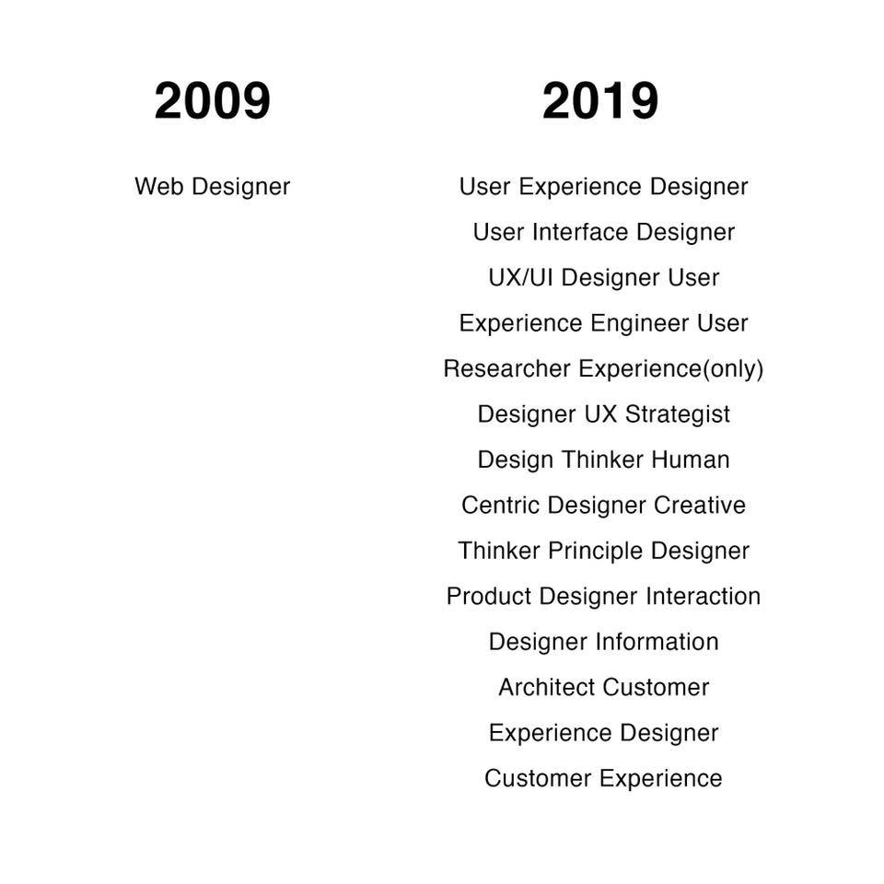
Careers in developing websites:
E-Commerce/E-business

Slide 58

E-Commerce 2018: Business. Technology. Society
Fourteenth Edition
Chapter 3
Building an E-Commerce Presence
Copyright © 2019 Pearson Education, Ltd.
Notes:
If this PowerPoint presentation contains mathematical equations, you may need to check that your computer has the following installed:
1) MathType Plugin
2) Math Player (free versions available)
3) NVDA Reader (free versions available)

