Slide 1
LCHS4007 Digital Skills & Research Methods Assessment 1
LECTURER: ANIKA TASHIN AHMED
EDWIDGE-TATY BITEMO (2511480)
NIKITA NANA ANGELINA WILSON (2506894)

Slide 2

Introduction
The aim of this presentation is to explore the use of Excel in Sunrise Residential Care Home.
It will analyse the MS Tea as a collaborative tool for staff and professionals.
The presentation will highlight challenges caused by limited digital literacy.
A digital safety checklist will be presented, followed by the conclusion
ThePhoto by PhotoAuthor is licensed under CCYYSA.

Slide 3
MS EXCEL FOR EFFICIENCY AT SUNRISE RESIDENTIAL CARE HOME
Excel tracks 200+ daily prescriptions and 25 staff rotas (benefits: saves time)(Cheng et al.,2023).
Errors in data entry risk medication mistakes (limitation: threatens patient safety).
Staff without Excel skillsstuggle to use advanced functions (limitation: threatens patient safety).
Patient ID | Patient Name | Medication | Dosage | Time(Morning) | Time(Afternoon) | Time(Evening) | Staff Initials | Notes
1 | Mary Johnson | Metformin | 500 mg | 08:00 | - | 20:00 | AJ | Check blood sugar before PM
2 | Alan Smith | Ramipril | 10 mg | 09:00 | - | - | KB | Monitor blood pressure
3 | Fatima Khan | Warfarin | 5 mg | - | 14:00 | - | LM | Record INR weekly
4 | George Patel | Warfarin | 4 mg | 08:00 | 14:01 | 20:00 | RS | PRN if pain persits
5 | Dorothy Evans | Donepezil | 10 mg | 09:00 | - | - | AJ | Dementia medication

Slide 4

MS TEAM AS A COLLABORATION TOOL
Enables video calls between staff and external doctors (Benefits: reduces delays in resident care).
Provides instant chat for urgent updates (Benefits: faster communication during emergencies) (Tamber, 2024).
Poor internet connection disrupts meetings (Limitation: delays critical discussions).
Some staff struggle with multiple channels (Limitations: lowers efficiency in teamwork).
ThePhoto by PhotoAuthor is licensed under CCYYSA.

Slide 5
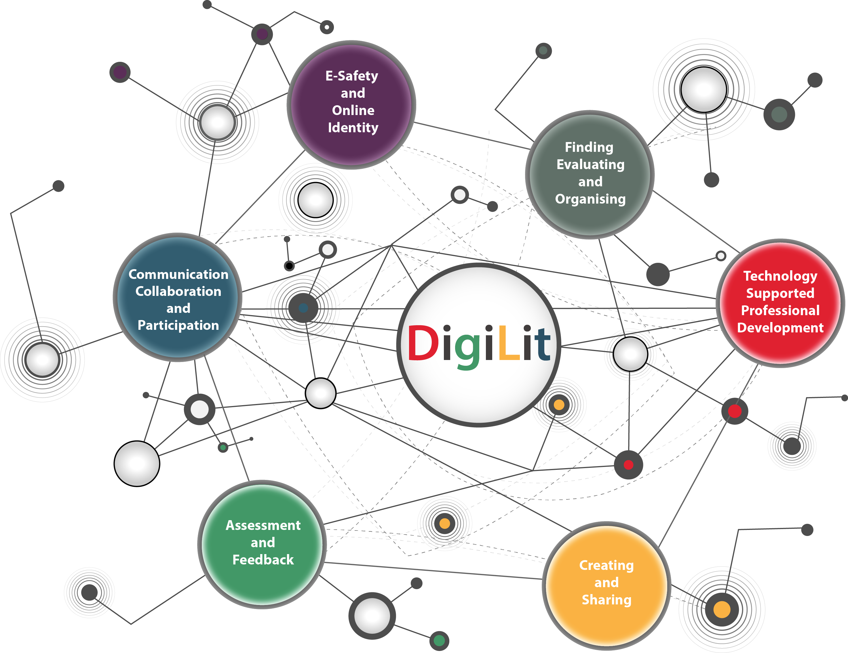
Staff struggle with Excel data entry for 200+ prescriptions (Limitation: delays and risks of medication errors).
IMPACT OF LIMITED DIGITAL SKILLS AMONG STAFF
Some miss MS Teams notifications during shift handovers (Limitation: weak communication) (Urbaniak and Wanka,2023).
Digitally skilled staff manage Excel rotas more effeciently (Benefit: balenced workload planning).
Confident Teams users improve collaboration with doctors and therapists (Benefit: faster decision making).
ThePhoto by PhotoAuthor is licensed under CCYYSA.

Slide 6
multi-factor authentication secures Excel and Teams logins (Benefit: prevents unauthorised access).
DIGITAL SAFETY CHECKLIST FOR SUNRISE RESIDENTIAL CARE HOME
Role-based access controls protect Excel care records (Benefit: ensures patient confidentiality).
Monitoring Teams chat prevents accidental sharing of resident data (Benefit: safer communication) (Carroll et al., 2022).
Extra security steps feel time consuming for some staff (Limitation: resistance or non-compliance).

Slide 7

CONCLUSION:
Excel improved scheduling, medication tracking, and daily efficiency.
The MS Teams enhanced secure collaboration and access to care plans.
Limited digital literacy created risks and communication challenges.
ThePhoto by PhotoAuthor is licensed under CCYYSA.
ThePhoto by PhotoAuthor is licensed under CCYYSA.

Slide 8
REFERENCE LIST
Carroll, F., Adejobi, J.A. and Montasari, R. (2022) 'How good are we at Detecting a Phishing Attack? Investigating the Evolving Phishing Attack Email and Why It Continues to Successfully Deceive Society', SN Computer science, 3(2). Available at: https://doi.org/10.1007/s42979-022-01069-1.
Cheng, C., Walsh, A., Jones, S., Matthews, S., Weerasooriya, D., Fernandes, R.J. and McKenzie, C.A. (2023) 'Development, implementation and evaluation of a seven-say clinical pharmacy service in a tertiary referal teaching hospital during surge-2 of a COVID-19 pandemic', international journal of clinical Pharmacy,45(2), pp.293-303. Available at: https://doi.org/10.1007/s11096-022-01475-8
Urbaniak, A. and Wanka,A. (2023) Routledge International Handbook of Participatory Approaches in Ageing Reasearch. London: Routledge. Available at: https://doi.org/10.4324/9781003254829.

