Slide 1
Certfolio
Designing and Evaluating a Verifiable Professional Identity Platform for IT Professionals
Independent Project Interim Viva · BSc Applied Computing · Marius-Catalin Bobitiu · July 2026
Notes:
Introduce the project title: Certfolio
Explain that it is your interim viva presentation
Mention that the project is about professional identity, verification, and portfolio evidence for IT professionals
Keep this slide brief and move quickly into the project context

Slide 2

Project Overview
Certfolio is a cloud-based professional identity platform for IT professionals. It brings together four main identity elements in a single structured environment:
Profile Information
Certifications
Skills
Project Evidence
Notes:
Certfolio is designed as a cloud-based professional identity platform
The main idea is to bring together profile details, certifications, skills, and project evidence
Explain that the platform is aimed at IT professionals who need to present their abilities clearly
Mention that the focus is not just on listing achievements, but giving them structure and context

Slide 3
Problem and Rationale
The Problem
IT professionals often present their identity across LinkedIn, GitHub, credential platforms, CVs, and personal websites. This creates fragmentation and makes it harder to judge trust, context, and completeness.
Why This Project
It connects to cloud computing, digital identity, employability, software development, and professional technology platforms. It also supports future career development by demonstrating research, system design, secure authentication, database design, and prototype development.
Notes:
IT professionals often use multiple platforms to show their experience
LinkedIn, GitHub, CVs, portfolio websites, and certification platforms are all separated
This makes a person’s professional identity fragmented
Employers or recruiters may have to check several places to understand someone’s skills
Certfolio tries to reduce this fragmentation by bringing key evidence into one structured place
The project also supports your own career development because it demonstrates secure authentication, database design, cloud-based development, and user-focused platform design

Slide 4

Aim and Objectives
Aim: To design, develop, and critically evaluate a prototype cloud-based professional identity platform that supports IT professionals in presenting verified certifications, self-declared skills, and portfolio evidence within a single structured environment.
Objectives
1
2
To critically analyse literature and industry practice relating to digital credentials, skills-based hiring, personal branding, and professional identity platforms.
To evaluate the limitations of existing tools such as credential networks, link-in-bio platforms, and portfolio repositories.
3
4
To design and develop a Certfolio prototype supporting authentication, profile settings, certifications, and project evidence.
To evaluate the prototype against usability, trust, clarity, and relevance criteria.
Notes:
The aim is to design, build, and evaluate a prototype of Certfolio
Objective 1 focuses on understanding the academic and industry background
Objective 2 looks at the limitations of existing platforms
Objective 3 is the practical development objective: building authentication, profile settings, certifications, and project evidence
Objective 4 focuses on evaluating whether the prototype is usable, clear, trustworthy, and relevant
Mention that the objectives combine both research and development

Slide 5
Research Completed So Far
Research areas covered:
Skills-based hiring and employability
Digital credentials and certification verification
Human Capital Theory and Signalling Theory
Digital identity and professional branding
Existing platforms such as Credly, Accredible, Linktree, Carrd, and GitHub
Key finding: Existing tools solve parts of the problem, but they do not fully combine verification, portfolio evidence, and user-controlled professional identity.
Notes:
Research has focused on employability, digital credentials, professional identity, and personal branding
Skills-based hiring is important because employers increasingly look for evidence of ability, not just qualifications
Digital credentials are useful, but they are often tied to issuer platforms
Human Capital Theory helps explain the value of education, skills, and experience
Signalling Theory helps explain how certifications and portfolio evidence communicate ability to employers
Existing platforms solve parts of the problem, but they do not fully combine verification, evidence, and personal control

Slide 6
Existing Platform Comparison
Platform Type
Examples
Strength
Limitation
Credential Networks
Credly, Accredible
Strong verification
Issuer-centred and limited personal narrative
Link-in-Bio Tools
Linktree, Carrd
Simple and flexible
No verification or professional trust structure
Technical Portfolio Platforms
GitHub
Strong evidence of technical work
Difficult for non-technical recruiters to interpret
Certfolio
—
Combines credentials, profile identity, and project evidence
Still requires prototype completion and evaluation
Notes:
Credly and Accredible are strong for verified credentials, but they are more issuer-centred
Linktree and Carrd are flexible, but they do not provide professional trust or verification
GitHub is useful for technical evidence, but it can be hard for non-technical recruiters to interpret
Certfolio is positioned between these tools
The goal is to combine professional identity, credentials, and project evidence in a clearer format
Be honest that Certfolio is still a prototype and needs completion and evaluation

Slide 7
Development Progress So Far
Completed prototype areas:
Authentication with MFA
Database Structure
Profile Settings
Certification Management
Project Evidence Management
Protected User Dashboard
At this interim stage, the focus has been on building the authenticated user-side foundation of Certfolio. The public-facing profile and recruiter view are planned for the next development phase.
Notes:
The current stage focuses on the authenticated user-side foundation
Authentication with MFA has been built to support secure access
The database structure has been created to support the main platform areas
Profile settings allow users to manage their professional information
Certification management allows credentials to be recorded in a structured way
Project evidence management allows users to connect skills to practical work
The public profile is not complete yet and is planned for the next phase

Slide 8
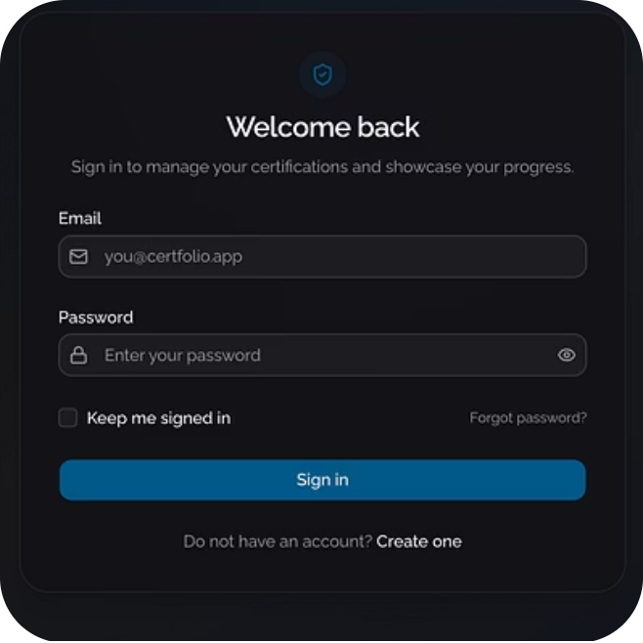
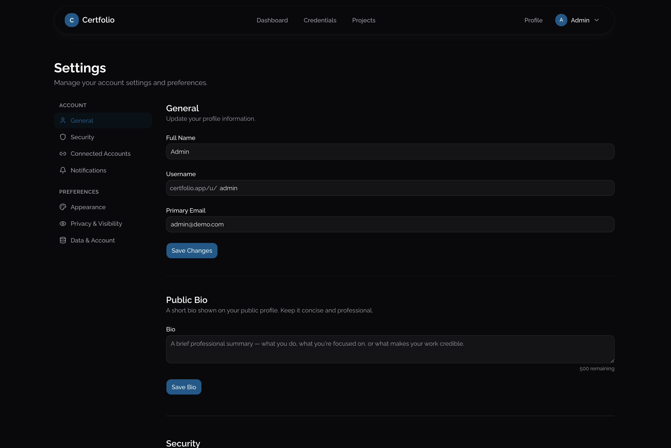
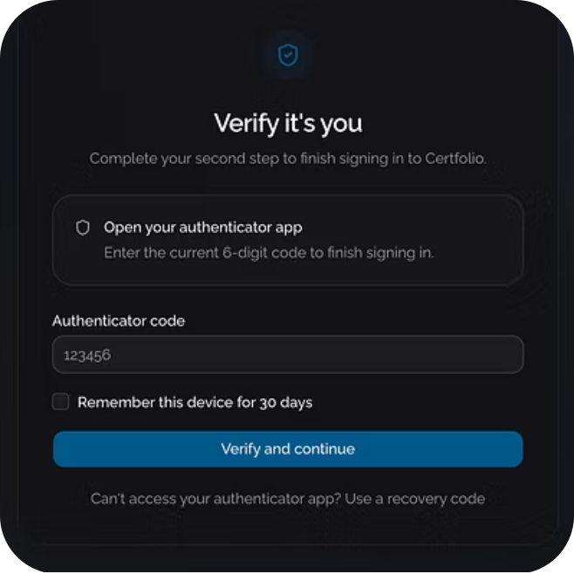
Prototype Evidence: Authentication and Profile Settings
Authentication / MFA
Profile Settings
Authentication with MFA supports secure access to the platform.
Profile settings allow users to begin structuring their professional identity.
Notes:
Use this slide to show that the project is not just theoretical
Authentication and MFA demonstrate the security side of the platform
This is important because the platform handles professional identity and user-owned information
Profile settings are the starting point for building a structured professional identity
Mention that this area helps users control how their information is presented
Explain that this forms the base for the public-facing profile later

Slide 9
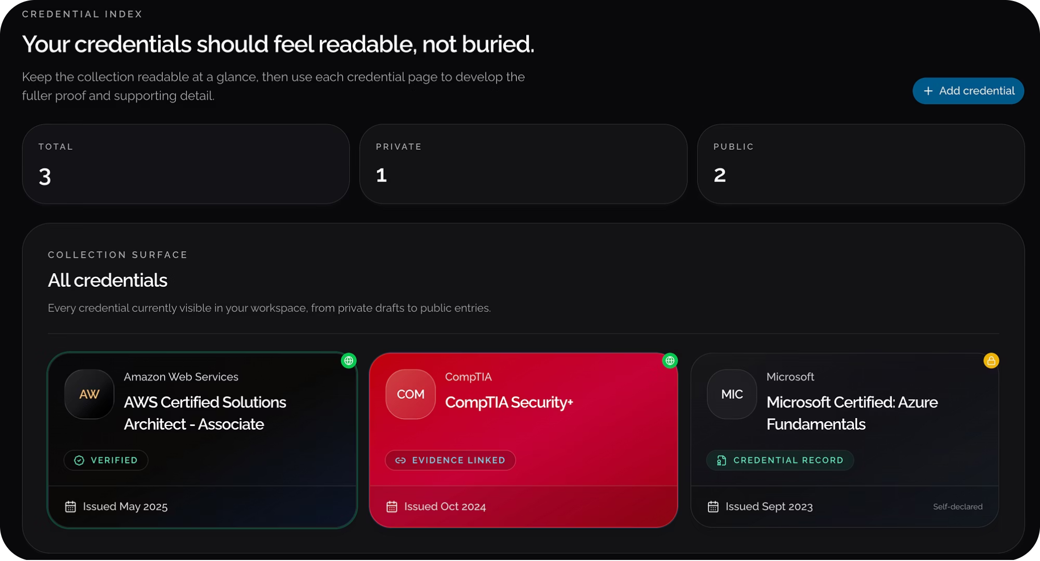
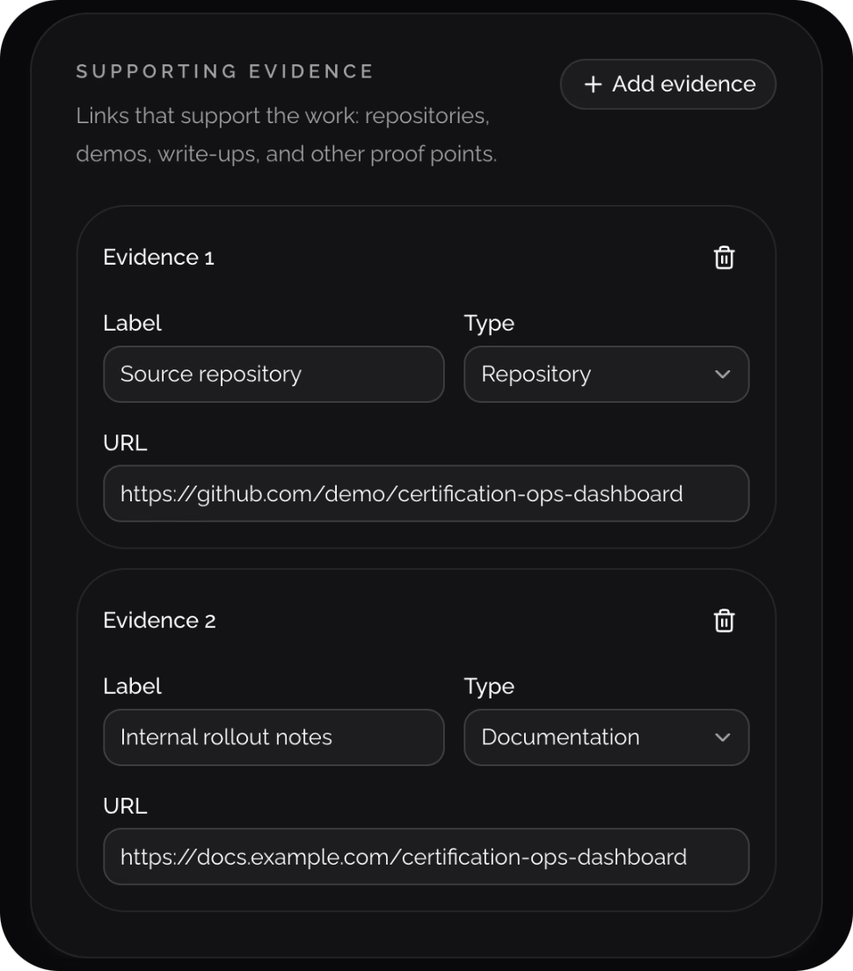
Prototype Evidence: Certifications and Project Evidence
Certification Management
Projects with Evidence
Certification management supports structured recording of professional credentials.
Project evidence allows users to connect skills with practical work, links, descriptions, and supporting material.
Notes:
Certification management supports the structured recording of professional credentials
This helps separate certifications from general profile claims
Project evidence gives users a way to support their skills with practical examples
This is important because skills alone can be vague unless supported by real work
Evidence could include project descriptions, links, supporting files, or explanations of what was built
This section supports the trust and clarity goals of the project

Slide 10
Methodology and Evaluation Plan
Methodology
Evaluation Criteria
Iterative prototyping.
The prototype will be evaluated through defined user scenarios, such as adding a certification, updating profile details, adding project evidence, and reviewing how clearly the system separates verified and self-declared information.
Methods
Secondary research
Competitor analysis
Requirements analysis
Interface and system design
Prototype development
Scenario-based evaluation
Usability
Trust
Clarity
Relevance
Notes:
The project uses iterative prototyping
This means the system is designed, built, reviewed, and refined in stages
Secondary research and competitor analysis helped define the problem
Requirements analysis and system design shaped what the prototype should include
The evaluation will use scenario-based testing
Example scenarios include adding a certification, editing profile information, adding project evidence, and checking how clearly the system separates verified and self-declared information
The main evaluation criteria are usability, trust, clarity, and relevance

Slide 11
Timeline and Remaining Work
Feb–Mar
May
July
Research, problem definition, initial planning
Requirements and system design
Public profile, UI refinement, testing, evaluation, and final report preparation
1
2
3
4
5
April
June
Literature review and competitor analysis
Authentication, database, profile, certifications, and project evidence development
Remaining Work
Build public Certfolio profile
Add visibility controls
Develop recruiter/employer view
Refine UI and user flows
Complete scenario-based evaluation
Write final report and prepare demo
Notes:
Research and problem definition started in February and March
April focused on literature review and competitor analysis
May focused on requirements and system design
June focused on development of the authenticated foundation
July will focus on public profile development, UI refinement, testing, evaluation, and final report writing
Remaining work includes building the public Certfolio profile, adding visibility controls, developing the recruiter/employer view, refining UI flows, completing evaluation, and preparing the final demo

Slide 12
Conclusion / Next Steps
Certfolio addresses the fragmentation and trust problem in IT professional identity.
The interim stage has established the platform’s authenticated foundation, including MFA, database structure, profile settings, certifications, and project evidence.
The next stage is to complete the public-facing profile, refine the interface, and evaluate whether the platform improves clarity, trust, and relevance for IT professional presentation.
Notes:
Certfolio responds to the problem of fragmented professional identity
The project has already established the authenticated foundation
Completed areas include MFA, database structure, profile settings, certifications, and project evidence
The next stage is focused on making the platform useful outside the private dashboard
The public profile and recruiter view are important because they are where the value of the platform becomes visible
The final evaluation will assess whether the platform improves clarity, trust, and relevance

Slide 13
Key References
[1] 1EdTech Consortium, "Open Badges," 1EdTech, Year.
[2] 1EdTech Consortium, "Connecting the Dots: Making Sense of Digital Credential Standards," 1EdTech, Year.
[3] M. Spence, "Job Market Signaling," The Quarterly Journal of Economics, 1973.
[4] G. S. Becker, Human Capital, University of Chicago Press, 1964.
[5] C. Gorbatov, S. N. Khapova, and E. I. Lysova, "Personal Branding: Interdisciplinary Systematic Review and Research Agenda," Frontiers in Psychology, 2018.
[6] Jobs for the Future, "Too Many Credentials, Not Enough Value. Let’s Change That," Jobs for the Future, Year.
Notes:
Mention that the project is supported by both academic and industry sources
Spence supports the idea of signalling ability through credentials and evidence
Becker supports the value of skills, education, and professional development
Personal branding literature supports the professional identity side of the project
Open Badges and digital credential sources support the technical and standards-based background
Jobs for the Future supports the wider issue that credentials can lack value or clarity without context

Slide 14

Questions?
Notes:
Thank the audience
Invite questions about the research, prototype, methodology, or next development phase
Be ready to discuss what has been completed and what still needs to be built
Also be ready to explain why the public profile is planned for the next stage rather than already completed

