Slide 1
Student Name: Seila Nemcova
Student ID: 2523161
Lecturer’s Name: Chijioke uba
Module Code: LCLM 4004
Module Name: Problem Solving and Decision-Making
Component 1: Basil’s Bakery

Slide 2
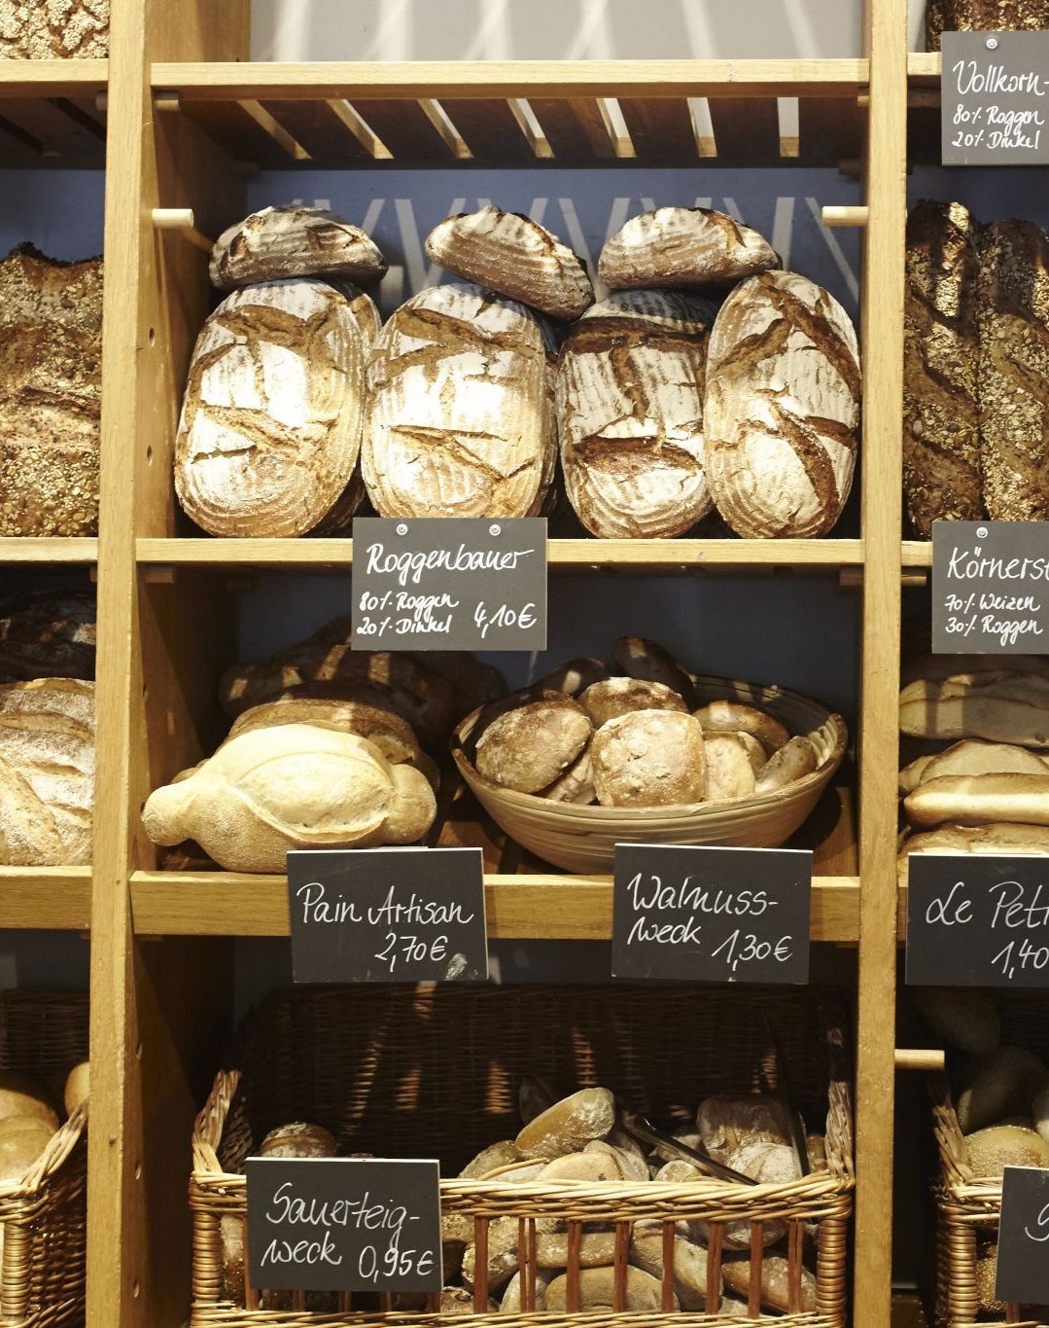
Today's discussion will be about Basil’s bakery
Good afternoon class my name is Seila.
Today, I will be talking about Basil’s Bakery, a small business that is facing serval challenges
I will use the PESTEL framework to examine the factors affecting the bakery and explain the causes and effects of these
Finally, I will summarize the main point and key findings.

Slide 3
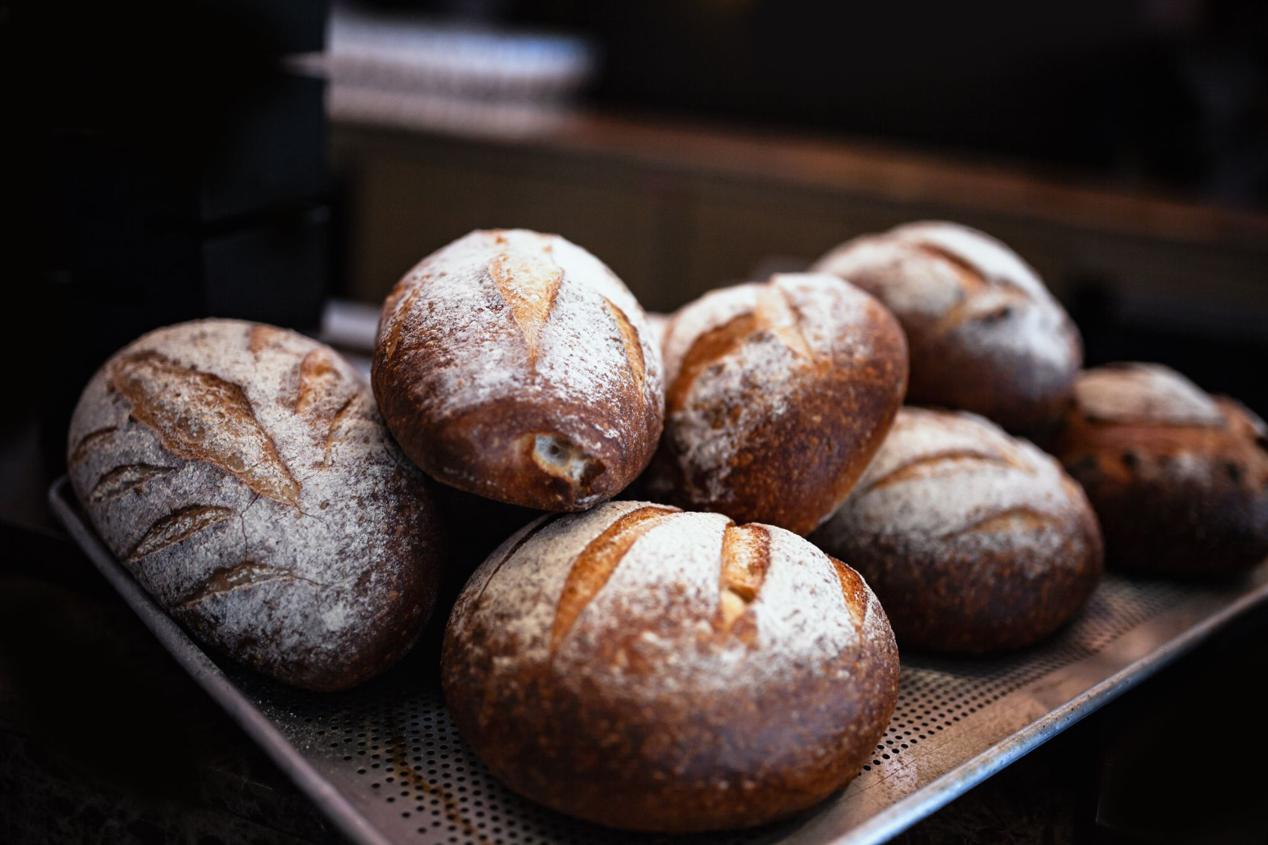
Basil’s Bakery.
Basil’s Bakery is a small business that has opened in 2015 location: Coventry.
Basil's bakery experience study growth until 2019 when sales declined significancy during the coved-19 pandemic. Although sales has was improved after restrictions were lifted, they have remained around 25% below pre -pandemic levels.
Sales at Basils bakery have fallen because less people visit the retail park ,some shops have closed down ,also more people now work from home .
Customer's have asked for pre-orders and delivery services , which basils bakery currently does not offer.
Cost like rent, bills and ingredients have gone up because of this, basils is trying to find new ways to make the bakery more successful and bring in more customers

Slide 4
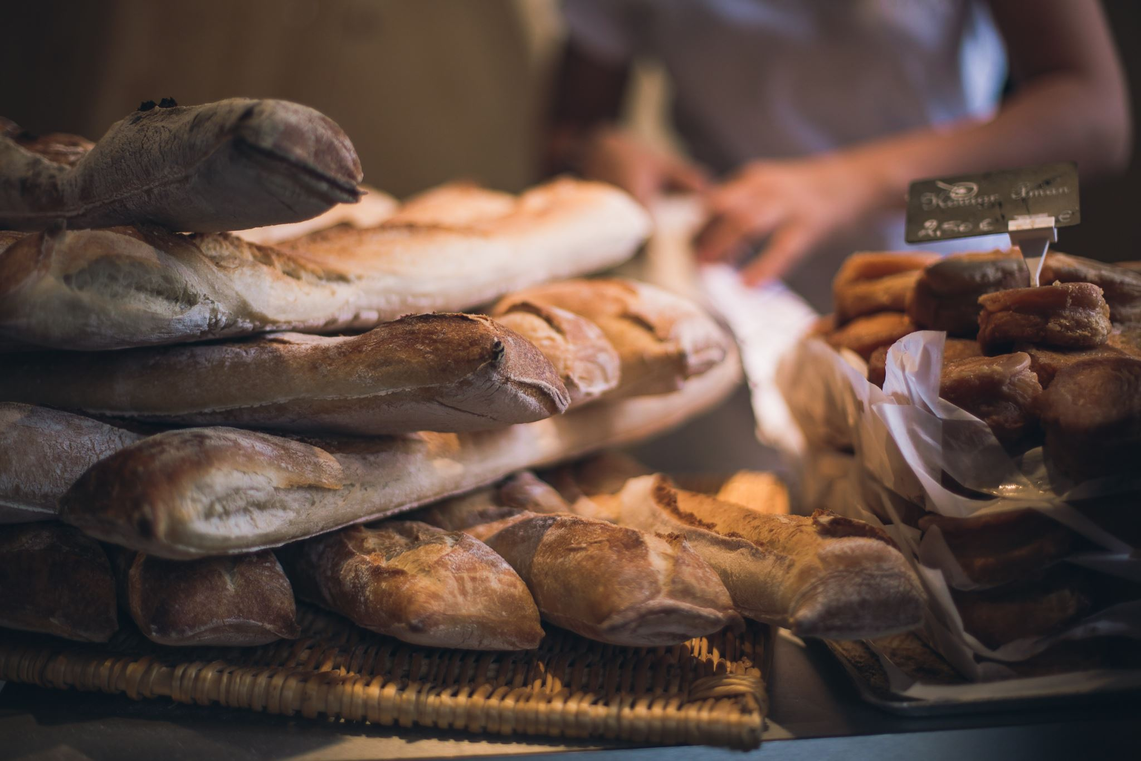
Basils bakery External and internal problem
Externals | Internal
Fewer visitors to the retail park More people working from home Shop close nearby Hight rent and utility coast | Slower customer serves Too much work for basils High ingredient cost No online orders No delivery serves
Summary :
The Bakery is also affected by fewer costumers in the area changing work patterns and increasing business experience
Summary
The bakery is also affected by limited serves rising coast and relying too heavily on basil to manage daily operation
He has more problems internal then external !

Slide 5
what is PESTEL?
Is a way to look at outside forces that affects business . Politics, economic, social, technology, environment and the laws
Like before lunching a product or entering a new market
Big benefit you get a clear picture of risk and opportunity’s
Downside it can take time and sometimes it's heard to turn those big trends into specific steps
Alanzi, S.(2018)

Slide 6
PESTEL
Political Factors | Economic Factors | Social Factors | Technological Factors | Legal Factors | Environmental Factors
Rising business rates | Higher rent, bills and ingredient costs (FSA (2024) | More home working and fewer shoppers ONS (2023). | No online ordering or delivery service GOV.UK (2012). | Food safety and employment regulations | Crop failures affecting ingredient supply
‌

Slide 7
Cause-and-Effect model
  what the Cause-and-Effect Model is
  A tool used to find the organise possible causes of problems
  Why is it used
  Helps teams discuss problems together
  Show how different different courses may be connected
  Makes problems easier to understand
  What are the benefits of this model?
  Encounter everyone's to share ideas makes complex problems simple
  Easy to use and understand
  Overall the couse and effects model is a userful tool for identifying possible causes of a problem.

Slide 8
fishbone.
Methods
Cost
People
Lack of pre-orders system
rent
Shorted of staff that make orders coming in
Ingredient
Fewer loyal costumers
Dropping in sales
Fluctuating ingredient prices
Lack of regular customer feedback
Fewer shoppers in the park
Materials
Measurement
Environment

Slide 9
Key Findings
    Key Finding 1: foot traffic has dropped significantly since 2020 due to remote work and nearby shop closures.
    Key Finding 2: rising rent and ingrediency cost squeezing the bakery profit margin
    Key Finding 3: customers want deliveries and pre-orders ,witch basil currently doesn’t offer
    Key Finding 4: the unpredictable cost of organic ingredients makes budgeting difficult

Slide 10

Reference List:
Food Standards Agency (2024). Food Standards Agency. [online] Food Standards Agency. Available at: https://www.food.gov.uk/.
GOV.UK (2012). Business rates. [online] GOV.UK. Available at: https://www.gov.uk/introduction-to-business-rates.
ONS (2023). Office for National Statistics. [online] Ons.gov.uk. Available at: https://www.ons.gov.uk/.
Alanzi, S.(2018). PESTEL analysis. Project Management, 1.

Slide 11

Thank you for listening

Slide 12

ANY QUSTIONS???

