Slide 1
Historical context and social theory of SD
Sustainable Development (ACBA7009)
Lara Hopkinson

Slide 2
Outline
How old is sustainable development?
Key definitions
A story…
Historical context of SD
Development theories

Slide 3

How old is sustainable development?

Slide 4
Some key definitions…
Development – “an evolutionary process in which the human capacity increases…” (Peet, 1999)
Sustainability – “a capacity to maintain some entity, outcome or process over time” (Basiago, 1999)
Sustainable Development – “development that can be continued ether indefinitely or for the given time period” (Dernbach, 1998)
Sustainability is a ‘state’, SD is the process to get to that state.

Slide 5
Unsustainable development?

Slide 6
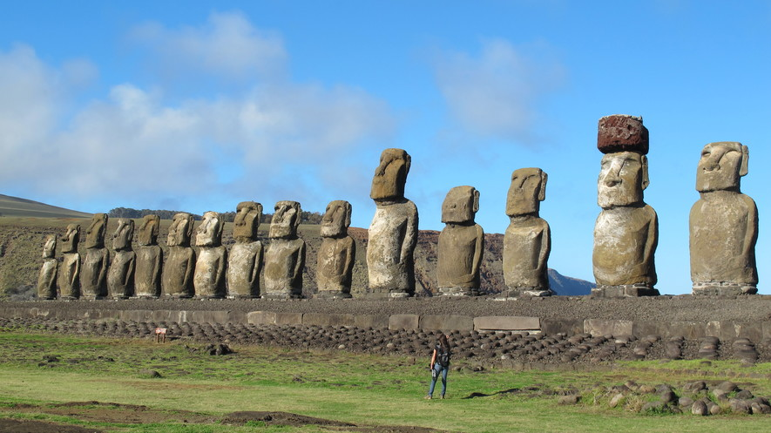
Easter Island (Rapa Nui)

Slide 7
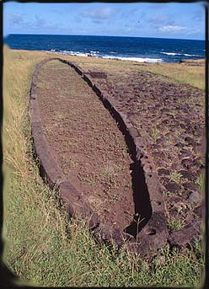
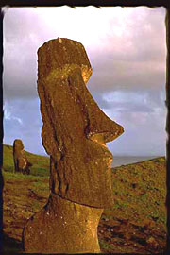
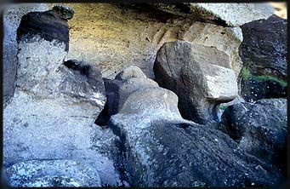
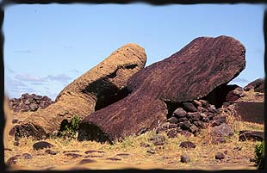
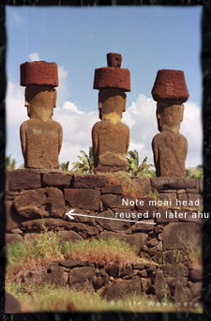
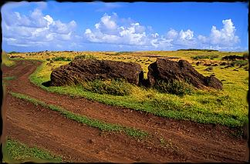
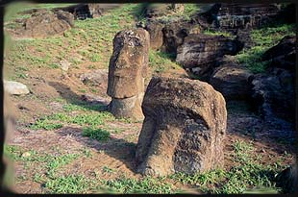

Slide 8
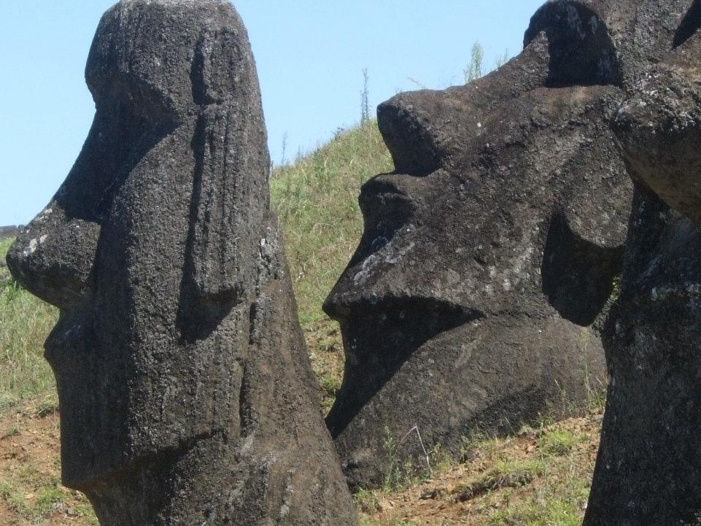

Slide 9
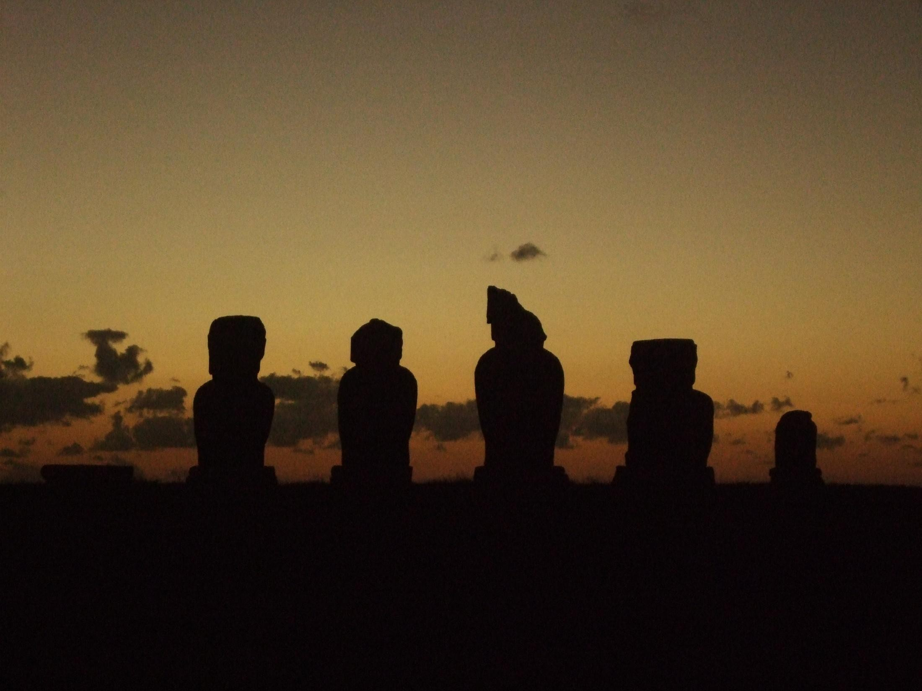
Is this our future?

Slide 10
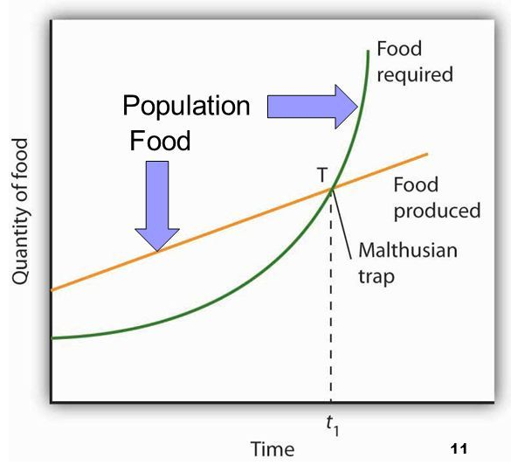
Early history of SD
Economic theory
Thomas Robert Malthus, 1789
  An essay on the principle of population

Slide 11
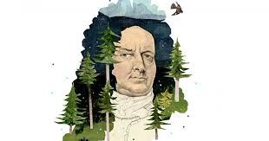
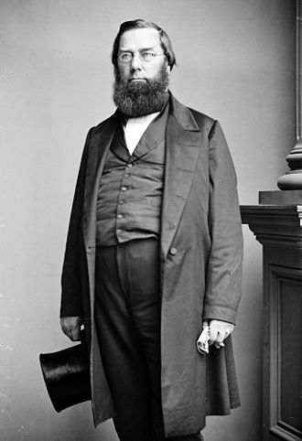
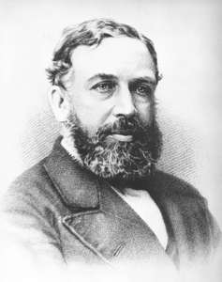
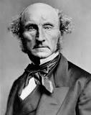
Focus on key pillars…

Slide 12
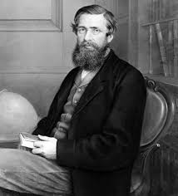
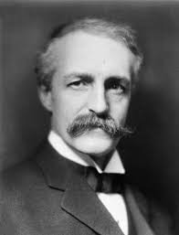
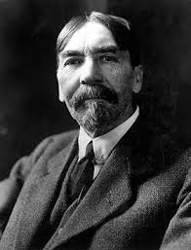
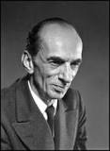
Focus on key pillars…

Slide 13
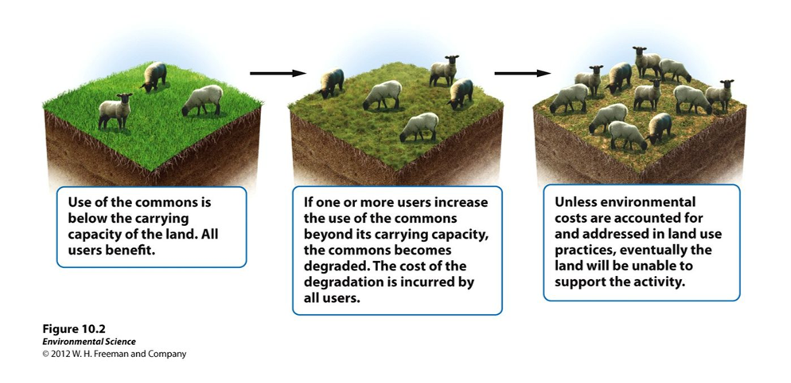
Tragedy of the Commons

Slide 14
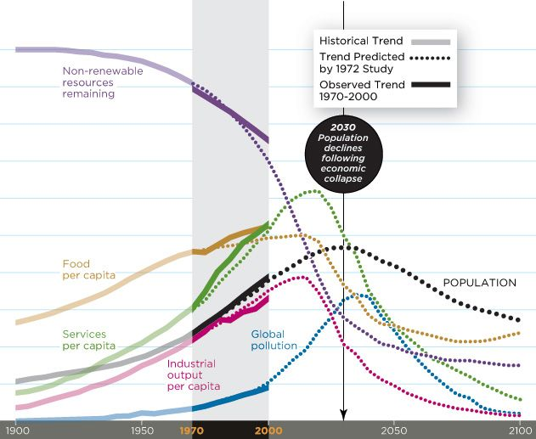
Limits to Growth

Slide 15
Why has there been no change?

Slide 16
Wanamaker, 2018

Slide 17
The SD relationship
From Khan (1995) (cited Mensah, 2019):
  “If a man in a given geographical area lacks a job (economic), he is likely to be poor & disenfranchised (social); if he is poor & disenfranchised, he has an incentive to engage in practices that harm ecology e.g. cutting down trees (environmental). As his actions are aggregated by all those in the region, deforestation will cause vital minerals to be lost from soil (environmental). If this occurs, inhabitants will be deprived of the dietary nutrients required to sustain intellectual performance needed to learn new technologies which can cause productivity to stagnate (economics); in turn poor people remain poor (social) & cycle continues”

Slide 18
Theories of development
Key issue – widening gap between developed and non-developed nations (1st & 3rd World)
Differing development theories suggested to explain these differences:
  Modernisation theory
  Dependency theory
  World Systems theory
  Globalisation theory

Slide 19
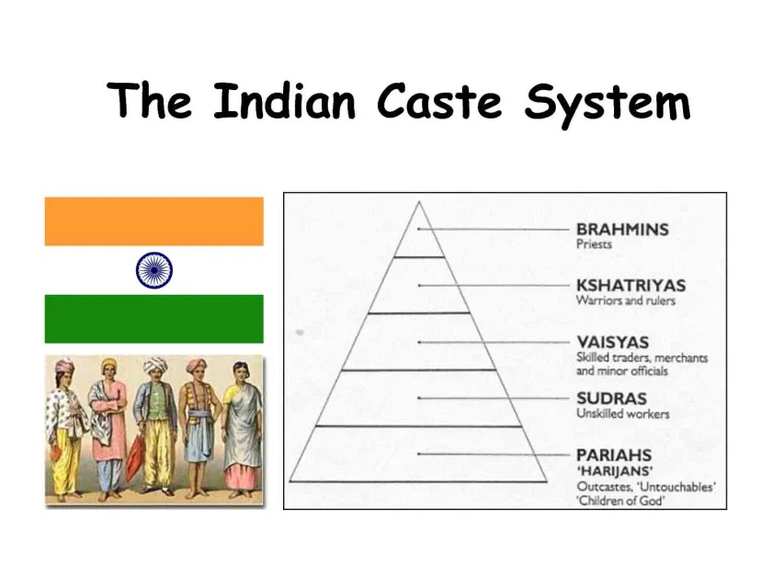
Modernisation Theory

Slide 20
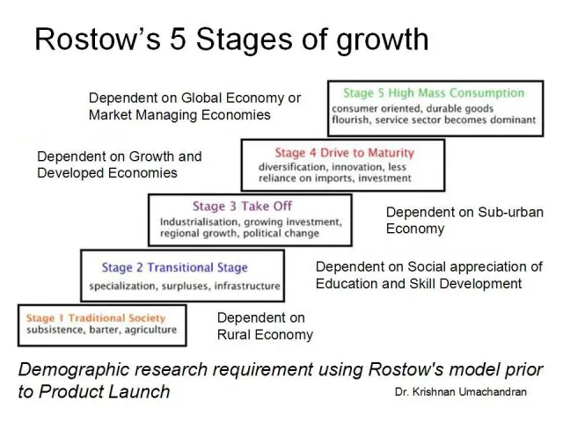
Modernisation Theory

Slide 21
An e.g. of modernisation theory
Indonesia – partly followed this in the 1960s
  Accepted loans from World Bank
  Encouraged investment from other countries
  President Surhato both praised & rubbished
  Praise “a dynamic economic success” & “the model pupil of the global economy”
  Brutal regime “one of the worst mass murders of the 20th century”

Slide 22
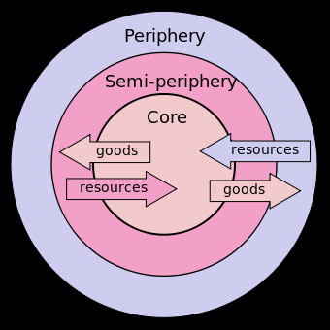
Dependency Theory

Slide 23
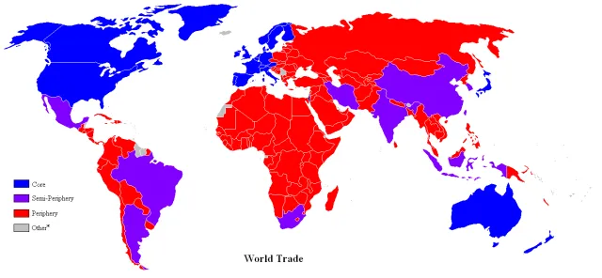
World Systems Theory

Slide 24
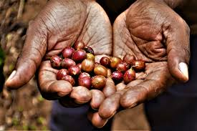
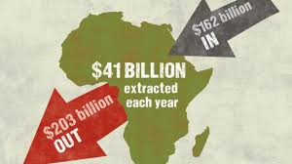

World Systems Theory - profit
Unfair trade rules
Western Corporations
Land grabs

Slide 25
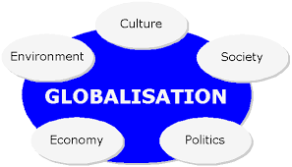
Globalisation Theory

Slide 26


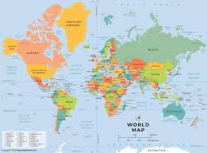

De-localisation

Slide 27
SD introduced as a solution
Optimism of the 1960s faded by the 1970s
Worldwide economic growth did not assist development of undeveloped nations
Conservation = protection of resources
Development = exploitation of resources

Slide 28

UN Conference on Human Environment
“A point has been reached in our history when we must shape our actions throughout the world with more prudent care for their environmental consequences. To defend and improve the human environment for he present and future generations has become the imperative goal for mankind”

Slide 29
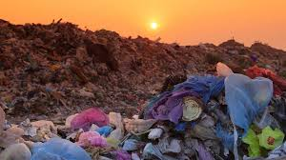
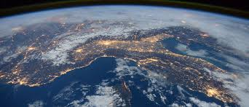

Slide 30

Brundtland Commission
Commissioned by UN
Led by Gro Harlem Brundtland
Report – Our common future
Global equity of resources for future generations
Economic development is needed
Switch to a ‘sustainable development’

Slide 31
Two central concepts
Needs
Limitations
“Sustainable development is development that meets the needs of the present without compromising the ability of future generations to meet their own needs.”

Slide 32
Some criticisms…
Does not tackle consumerism
Has no specific ‘criteria’
Will it sustain the gap between developed / non-developed nations?
Will current generations pay higher prices?
Environmental ‘quality’ within products?
Natural capital should not be replaced

Slide 33

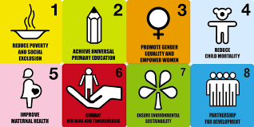

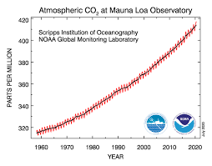
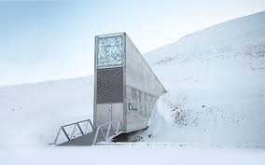
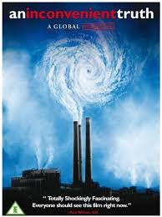
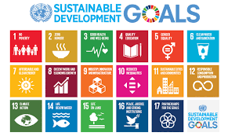

Developments since 1987…

Slide 34
Some useful videos
https://www.khanacademy.org/test-prep/mcat/society-and-culture/demographics/v/globalization-theories
https://www.youtube.com/watch?v=D5mzI9Kw4JM

Slide 35
Useful information
Mensah J (2019) Sustainable Development: Meaning, history, principles, pillars & implications for human action: Literature Review, Cogent Social Sciences, 5:1, 1653531
Smithsonian Magazine (Easter Island)
Investopedia (Malthus)
Pisani, JAD (2006) Sustainable development – historical roots of the concept, Environmental Sciences, 3(2), pp83-96
UN SDG Knowledge Platform

